Slide 1
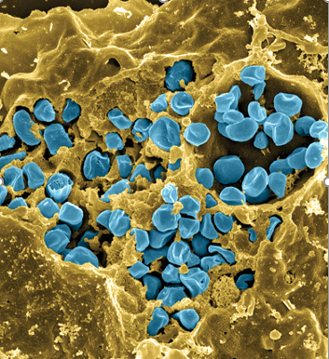
Mechanism of translation regulation in Francisella tularensis
Hannah Trautmann
K Ramsey Lab

Slide 2
Outline
Background information
  Francisella tularensis
  Translational gene regulation
  bS21
Preliminary data
  Protein vs. transcript abundance
  β-galactosidase reporter assays
Future directions

Slide 3
Francisella tularensis
Causes tularemia
Many hosts and vectors
Highly infectious/ potential bioweapon
Model: F. tularensis subsp. holarctica LVS (live vaccine strain)
Fischer, PNAS cover, 2006
Notes:
Francisella is a gram -, facultative intracellular bacteria. It is pathogenic and causes a disease called tularemia.
There are a large number of hosts and vectors and it can also be water-borne, which makes understanding its epidemiology rather complex.
It is highly infectious with as few as 10 organisms able to cause the disease, and for this reason, along with the fact that it is potentially lethal, it is considered as a potential bioweapon. This image here is colored so that the francisella are blue and are in a yellow macrophage, and you can clearly see that a ton of organisms replicate in host cells.
Luckily we don’t have to work with the pathogenic form because there is a live vaccine strain, or LVS, that we can work with in the lab. It’s non pathogenic to humans but retains it’s pathogenicity in animal models. I may be using LVS as a stand-in for wild-type throughout the presentation.

Slide 6





Acknowledgements
Dr. Kathryn Ramsey
  Sierra Schmidt
  Dan Floyd
  Aisling Macaraeg
  Oli Horyn
  Former lab members
Dr. Steven Gregory & Lab
Dr. Jodi Camberg & Lab
URI INBRE core & GSC
Notes:
Lots of people to thank, Dr. Ramsey of course and all the members of the Ramsey lab past and present. Dr. Gregory and his lab, our cryoEM collaborators, the GSC, INBRE, and all of our grants.

Slide 7

Questions?

