Slide 1
bS21-2 and the regulation of FPI genes
Ramsey Lab Meeting 2/9/21
Hannah Trautmann

Slide 2
Outline
Background information
  Heterogeneity in ribosomes
  bS21 homologs in F. tularensis
  Preliminary data: bS21-2 and the FPI genes
Recent data
  Mechanism for bS21-2 regulation: Beta-galactosidase assay design + results
  Effect on virulence: macrophage assay in isogenic strains

Slide 3
Heterogeneity in ribosomes
16S rRNA
tRNA
23S rRNA
16S rRNA
tRNA
23S rRNA
Me
1. Multiple rRNA operons
Specialized ribosomes:
heterogeneous in structure and function
2. rRNA modifications
r-protein
r-protein
Ac
3. Multiple ribosomal protein (r-protein) homologs
P
Me
4. Ribosomal protein modifications
Byrgazov et al. 2013
Notes:
First, we can have multiple rRNA operons whose products are incorporating into different ribosomes. These can be post-transcriptionally modified through acetylation or methylation. We can also have homologous ribosomal proteins that incorporate into ribosomes, and these can also be modified, post-translationally.
All these different types of ribosomes that can be made has led the field to start investigating whether these have different functions and, rather than ribosomes acting constitutively as was traditionally believed, perhaps these ribosomes can impart some level of control of gene expression. The term for this is specialized ribosomes, referring to ones that are heterogeneous in structure and in function.
Now heterogeneous ribosomes are well-studied in eukaryotes, with significantly less known about these in bacteria. I want to show you a specific example of this that has been described in bacteria.

Slide 4
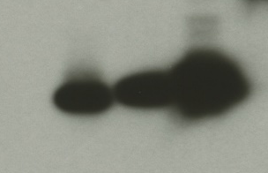
rpsU homologs in Francisella tularensis
rpsU1
cspC
bS21-3 - V
bS21-2 - V
bS21-1 - V
bS21-2-V
bS21-1-V
bS21-3-V
WT
rpsU2
yqeY
dnaG
rpoD
α-VSVG
rpsU3
Notes:
Even though francisella has a reduced genome, it encodes three copies of the rpsU genes, which encode bS21, a protein in the small ribosomal subunit. Most bacteria have 0 or 1 of this gene. We originally, hypothesized, and have since shown, that these three proteins are produced and incorporated into ribosomes. This is a western blot of purified ribosomes from our wild-type strain as well as strains ectopically expressing each of the bS21 proteins, with a VSVG tag. This, along with some mass spec data we have of purified ribosomes, indicates that multiple classes of ribosomes are possible and occurring
This protein is also interesting to us because it is located close to the mRNA exit channel in the ribosome, and early research has identified that it is involved in translation initiation, so it is in an ideal location to be regulating gene expression at the level of translation initiation.
So this heterogeneity of ribosomes may be a mechanism of regulation, but you may not know that ribosomes are heterogeneous so let me show you other ways that may occur.

Slide 5
Loss of rpsU2 results in a growth defect
Notes:
On the y-axis here we have growth as measured by optical density. Wild-type cells with empty vector pF and the drpsU2 strain.
We thought that this might be because we were disturbing nearby genes, so we wanted to test it with complementation with not only the same gene we have deleted, but the other genes as well to see if they are interchangeable.
What we found is that the overexpressing rpsU2 restores wild-type level growth, and interestingly we see functional redundancy with rpsU1 but not with rpsU3.
So this tells us that the growth defect we see due to loss of rpsU2 is specific, and appears to be complemented by rpsU1 and 2, but not 3. This got us really interested in the second homolog, so we wanted to look at whether there were changes in global protein expression in this drpsU2 strain.

Slide 6
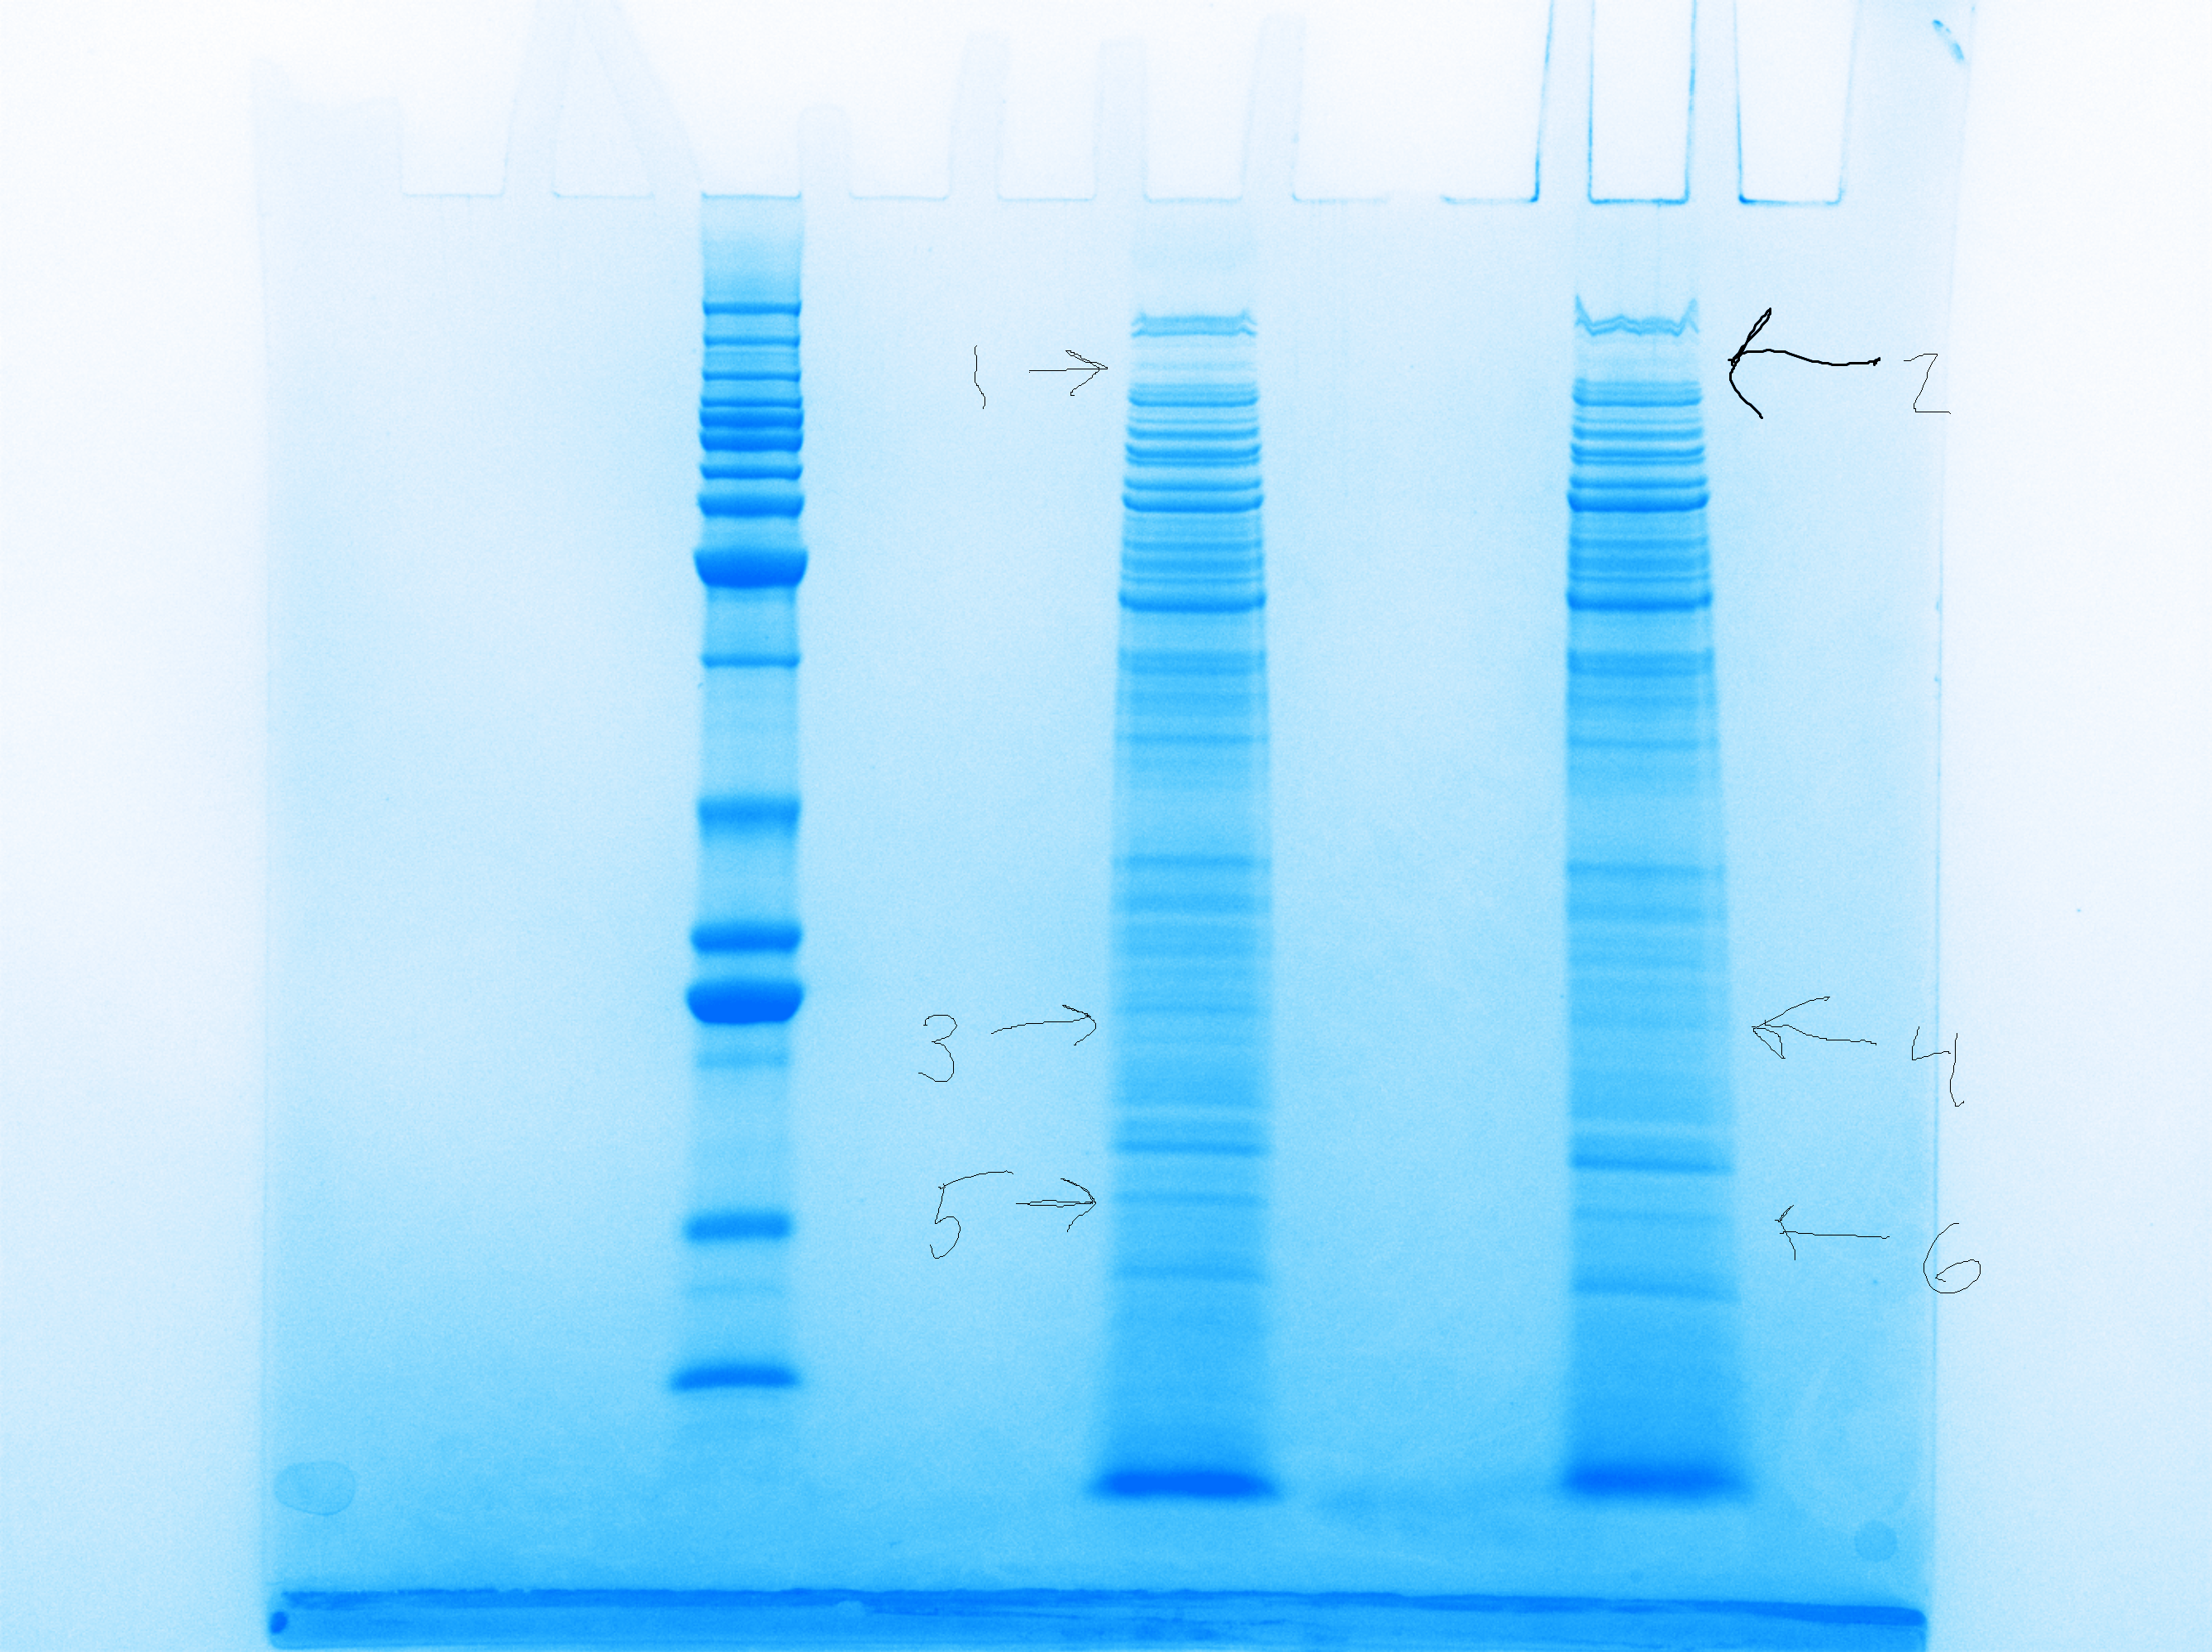
Cells lacking rpsU2 have less PdpB
LVS
∆rpsU2
LVS
~125 kDa
PdpB
Notes:
So I did a Coomassie stain of whole cell extracts of our wild-type cells and drpsU2, and we noticed honestly a lot fewer differences than we expected, but we did see a difference in a band here. We sent that out for mass spec and found, among the differences was pdpB, and that there was substantially less of this protein in drpsU2 when compared with wild-type.

Slide 7
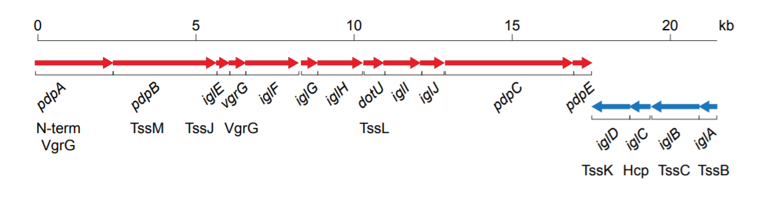
Francisella Pathogenicity Island (FPI)
Notes:
Now this was really exciting because pdpB is part of the Francisella pathogenicity island, or FPI. The FPI encodes the type vi secretion system in francisella, and is absolutely essential to virulence. I also wanted to point out here, because this will be important later on, that the FPI is comprised of two distinct operons. pdpB is on the plus strand operon here, along with pdpA, and a number of other genes, and the second operon is comprised of iglA-D.
We do know a fair amount about how the FPI genes are regulated at the level of transcription, and I don’t want to get too into the details here, but I will just introduce you to a protein called pigR which has been shown to be necessary for transcription of both operons of the FPI, so it’s a useful control we’ll be using throughout these next few experiments. There haven’t been any publications into whether the FPI is controlled at the level of translation.
Once we identified pdpB as potentially being influenced by the presence of rpsU2, we wanted to confirm these results using immunoblotting, and look to see if any of the other FPI proteins are also affected.

Slide 8
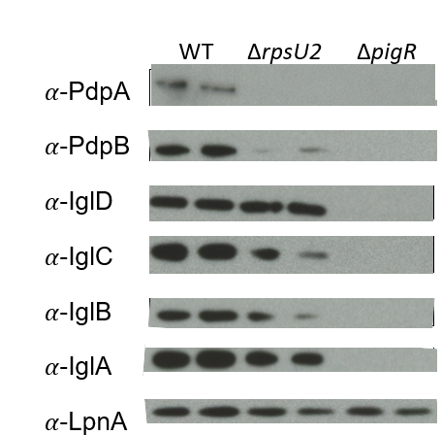
Lack of rpsU2 results in decrease in FPI proteins from one operon
FPI Operon 1
FPI Operon 2
Notes:
SLOW DOWN
Here we have the results of those western blots. We ran whole cell lysates in duplicate, our wild-type cells are represented here, and we have antibodies for a few proteins from each of the FPI operons. And then LpnA, is our loading control.
We ran a control with deltapigR, because as I mentioned the pigR protein necessary for transcription of the both operons of the FPI, and you can see clearly that without it, these proteins are not present.
When we compare the wild-type cells to drpsU2, we see a significant reduction of pdpB and a similar loss of pdpA. But, we did not observe the same level of difference in protein abundance for the igl proteins, from operon 2. I realize these results are a bit variable and we are working to replicate and quantify these differences.

Slide 9
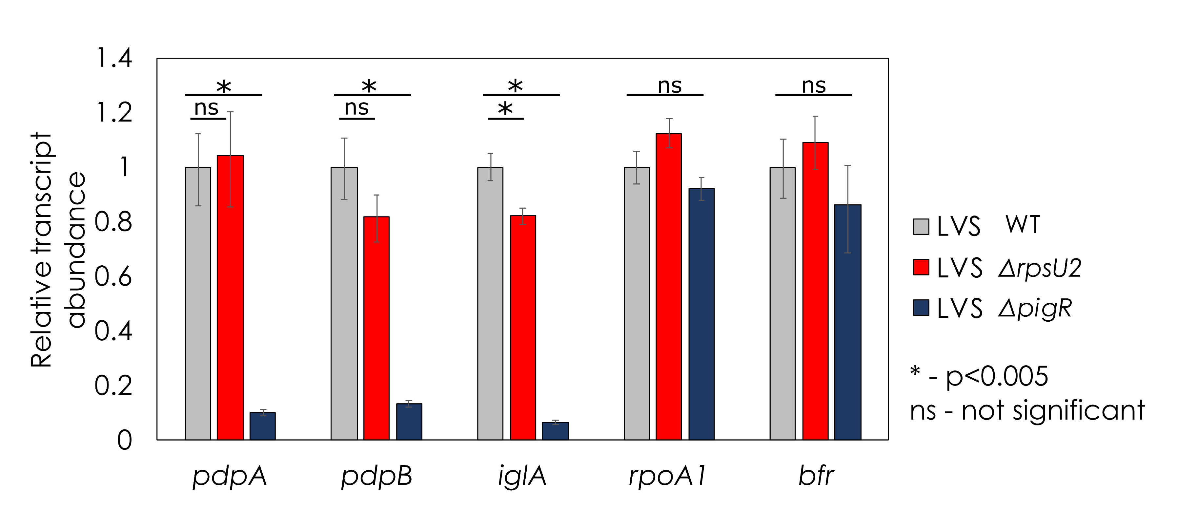
Transcript abundance is not affected by loss of rpsU2
What mechanism creates differences in protein abundance? i.e. how does bS21-2 sense which transcripts are which?
Notes:
SLOW DOWN
Alright so what you see here first are pdpA and B which were most affected by loss of rpsU2. We are using wild-type and delta pigR as our controls, because FPI proteins require PigR for expression at the level of transcription. And what we see here is that there really is NOT a significant difference in transcript abundance of these genes between wild-type and the strain lacking rpsU2.
We also looked at transcript abundance of iglA which is one of the genes on the other FPI operon and this also appears to be true.
Finally for controls we looked at two non-FPI genes, rpoA1 and bfr, and here we see pretty consistent abundance of these transcripts among the three strains.
The large difference that we are seeing in protein abundance of pdpA and pdpB is clearly not due to differences in transcription, and we want to know how this is occurring. This data opens up the possibility that regulation is occurring at the level of translation.
Given that this is a specific effect on FPI proteins, we were interested to see whether there may be an effect on intramacrophage growth.

Slide 10
Model for how bS21 might control gene expression in F. tularensis
RNAP
Your favorite gene
Notes:
As I said the bS21 proteins are important in initiation of translation. So perhaps we have RNA polymerase actively transcribing a gene. The 30S subunit that contains paralog 1 may interact with the leader sequence of this mRNA – but perhaps there isn’t strong affinity, so translation doesn’t initiate.
Then a 30S with a different bS21 comes in. There could be a stronger affinity, so the 30S interacts with the mRNA long enough for the 50S subunit to come in, translation is initiated, and we see the protein being expressed.
This is a simple model, but it shows our hypothesis: that each bS21 paralog possibly has a greater affinity for distinct mRNA species, leading to preferential translation which results in differences in protein abundance.
Now that I’ve told you why we are interested in this, I’ll show you some of our preliminary data.
We started by individually deleting each of the rpsU genes, looking at global protein abundance, and found something interesting when deleting one of the paralogs.

Slide 11
The position and role of bS21 in the ribosome
Hypothesis: bS21 is interacting (directly or indirectly) with the 5’ UTR of the mRNA molecule
PDB entry: 4V50
Notes:
bS21, which is encoded by the gene rpsU, is a component of the small ribosomal subunit. Here we have images of the 30S subunit of the E. coli ribosome. On the right we have a view of only the 16s rRNA with bS21 which is colored in red. On the left is a closer view, and to orient yourself in yellow is the p-site tRNA and an mRNA in blue, so you can imagine a longer mRNA would be exiting here, very close to the position of bS21.
Early research into the functions of ribosomal proteins identified that bS21 is involved in translation initiation, perhaps moderating the interaction between the ribosome and the mRNA molecule. However, bS21 is not found in all bacterial species and is considered non-essential.
One really interesting study shows that bS21 has been encoded by viruses – different homologs of the gene that encodes bS21 has been found on more than 1300 viral genomes. It has been show that at least one of these viral bS21 can be incorporated into the E. coli ribosome, suggesting that perhaps viruses are utilizing bS21 homologs to hijack the host ribosomes to somehow benefit them, maybe altering gene expression.
Despite the fact that bS21 is not found in all species, there have been a number of studies where null-mutants have been made in species with bS21, and these result in interesting phenotypes, including loss of motility, biofilm formation, changes in acid stress resistance, antibiotic-resistance, and loss of virulence. These last two are going to be the focus of our studies, but given its influence on specific phenotypes, bS21’s role in translation may be a regulatory role.

Slide 12



Testing the contribution of mRNA 5´UTRs
pdpA 5’UTR
lacZ
Wild-Type
pdpA 5’UTR
lacZ
ΔrpsU2
Notes:
To get at whether the 5’UTR is the component of the mRNA that is recognized, we have proposed to use B-galactosidase assays. We have built strains that have the 5’UTR of pdpA fused to the lacZ gene, and we have put these constructs both in wild-type cells and those lacking the second paralog. We have the transcripts modeled here.
What we expect to see is ribosomes that contain the second homolog, such as those in wild-type cells, colored in purple, will show a higher affinity for the 5’UTR than other ribosomes. We expect all types of ribosomes to translate lacZ into the B-galactosidase protein, which cleaves a substrate to produce a yellow color, But that we might get more translation in wild-type because of this higher affinity, leading to a greater production of yellow color.

Slide 13
Cells without rpsU2 translate the pdpA 5´UTR less efficiently
0.257
β-galactosidase activity (pdpA:bfr ratio)
0.137
p < 0.001
ΔrpsU2
Notes:
What we see here is a ratio of the B-galactosidase activity in our pdpA UTR compared to the bfr UTR in both strains. We were expecting, based on the protein abundance studies, about a 13-18 fold difference, and we see about a 2-fold difference. Which is cool, but it certainly doesn’t explain the massive difference we saw in protein abundance of pdpA.
This doesn’t mean it’s the end of this line of inquiry, though, because there is evidence that pdpA has an alternative transcription start site about 100 base pairs upstream of the one we used to build these constructs, so it may be that bS21-2 shows a greater affinity only for pdpA transcripts with the longer UTR. As next steps I am in the process of generating the strains with the longer pdpA 5’UTR.
Now as a reminder, my second specific question was about whether the ribosome was sufficient to impart the differences in abundance that we see of pdpA.

Slide 14
Possible complication – two transcription start sites
pdpA Long UTR
Ptul4
Short UTR
lacZ
Both
-35
-10
Ptul4
Short UTR
lacZ
Just TSS1
pdpA Long UTR
Ptul4
Short UTR
lacZ
Just TSS2
-35
-10
Notes:
To get at whether the 5’UTR is the component of the mRNA that is recognized, we have proposed to use B-galactosidase assays. We have built strains that have the 5’UTR of pdpA fused to the lacZ gene, and we have put these constructs both in wild-type cells and those lacking the second paralog. We have the transcripts modeled here.
What we expect to see is ribosomes that contain the second homolog, such as those in wild-type cells, colored in purple, will show a higher affinity for the 5’UTR than other ribosomes. We expect all types of ribosomes to translate lacZ into the B-galactosidase protein, which cleaves a substrate to produce a yellow color, But that we might get more translation in wild-type because of this higher affinity, leading to a greater production of yellow color.

Slide 15
B-gal results
LVS ΔrpsU2
Long UTR
LVS ΔrpsU2
Short UTR
LVS ΔrpsU2
-10 mutant
Conclusion: The short UTR seems to play a large role; the design of the long UTR may be flawed

Slide 16
Creation of isogenic strains at Tn7 site
rpsU1
P_{rpsU2}
∆rpsU1 ∆rpsU2 ∆rpsU3
rpsU2
P_{rpsU2}
rpsU3
P_{rpsU2}

Slide 17
Tn7::rpsU1 and Tn7::rpsU2 have similar growth rates

Slide 18
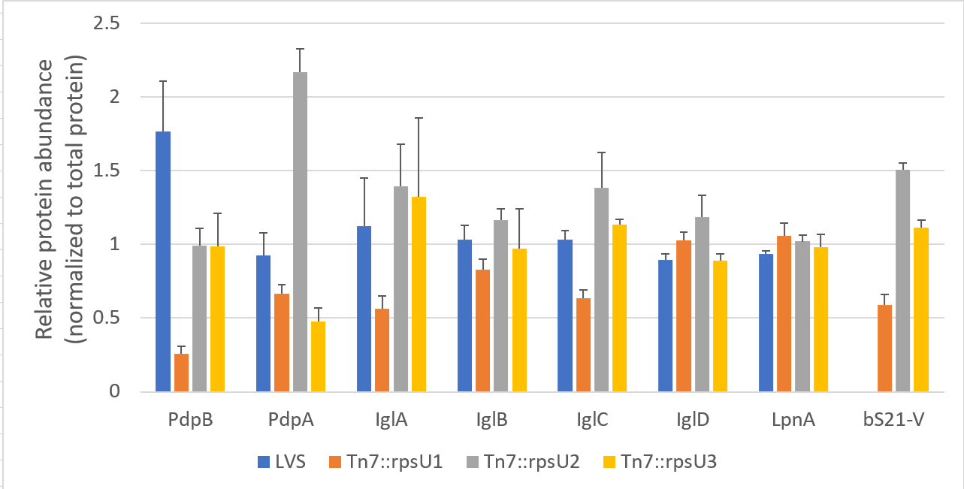
bS21 plays a regulatory role in expression of FPI proteins
Do these differences affect intramacrophage growth?

Slide 19
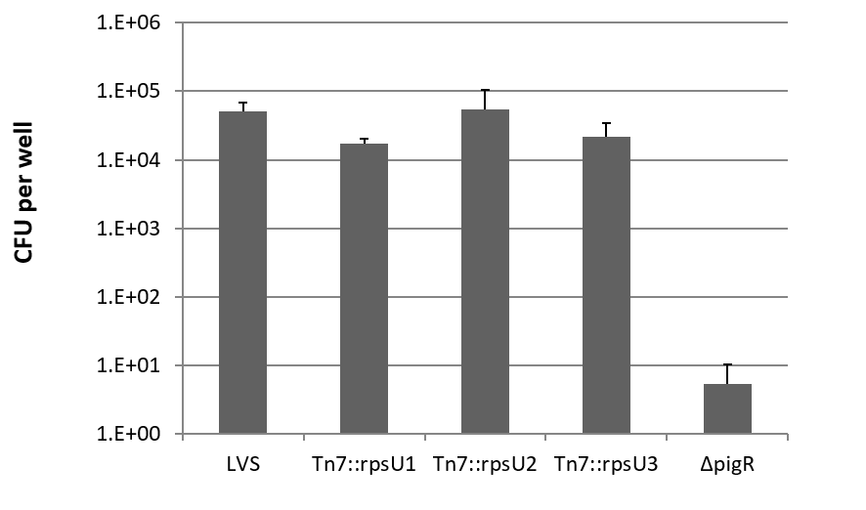
Macrophage assay results
p<0.01
p<0.05
Intramacrophage growth differs a small amount between isogenic strains

Slide 20
Next steps
Testing mutations that disrupt the structure of the pdpA UTR
In vitro assay to determine if the ribosome is sufficient to lead to differences in abundance of PdpA

Slide 21

Questions?

