Slide 1
Update on ribosome project: bS21 and FPI genes
Kramsey Lab Meeting 11/17/20
Hannah Trautmann

Slide 2
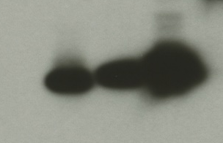
rpsU homologs in Francisella tularensis
rpsU1
cspC
bS21-3 - V
bS21-2 - V
bS21-1 - V
bS21-2-V
bS21-1-V
bS21-3-V
WT
rpsU2
yqeY
dnaG
rpoD
α-VSVG
rpsU3
Notes:
Even though francisella has a reduced genome, it encodes three copies of the rpsU genes, which encode bS21, a protein in the small ribosomal subunit. Most bacteria have 0 or 1 of this gene. We originally, hypothesized, and have since shown, that these three proteins are produced and incorporated into ribosomes. This is a western blot of purified ribosomes from our wild-type strain as well as strains ectopically expressing each of the bS21 proteins, with a VSVG tag. This, along with some mass spec data we have of purified ribosomes, indicates that multiple classes of ribosomes are possible and occurring
This protein is also interesting to us because it is located close to the mRNA exit channel in the ribosome, and early research has identified that it is involved in translation initiation, so it is in an ideal location to be regulating gene expression at the level of translation initiation.
So this heterogeneity of ribosomes may be a mechanism of regulation, but you may not know that ribosomes are heterogeneous so let me show you other ways that may occur.

Slide 3
Loss of rpsU2 results in a growth defect
Notes:
On the y-axis here we have growth as measured by optical density. Wild-type cells with empty vector pF and the drpsU2 strain.
We thought that this might be because we were disturbing nearby genes, so we wanted to test it with complementation with not only the same gene we have deleted, but the other genes as well to see if they are interchangeable.
What we found is that the overexpressing rpsU2 restores wild-type level growth, and interestingly we see functional redundancy with rpsU1 but not with rpsU3.
So this tells us that the growth defect we see due to loss of rpsU2 is specific, and appears to be complemented by rpsU1 and 2, but not 3. This got us really interested in the second homolog, so we wanted to look at whether there were changes in global protein expression in this drpsU2 strain.

Slide 4
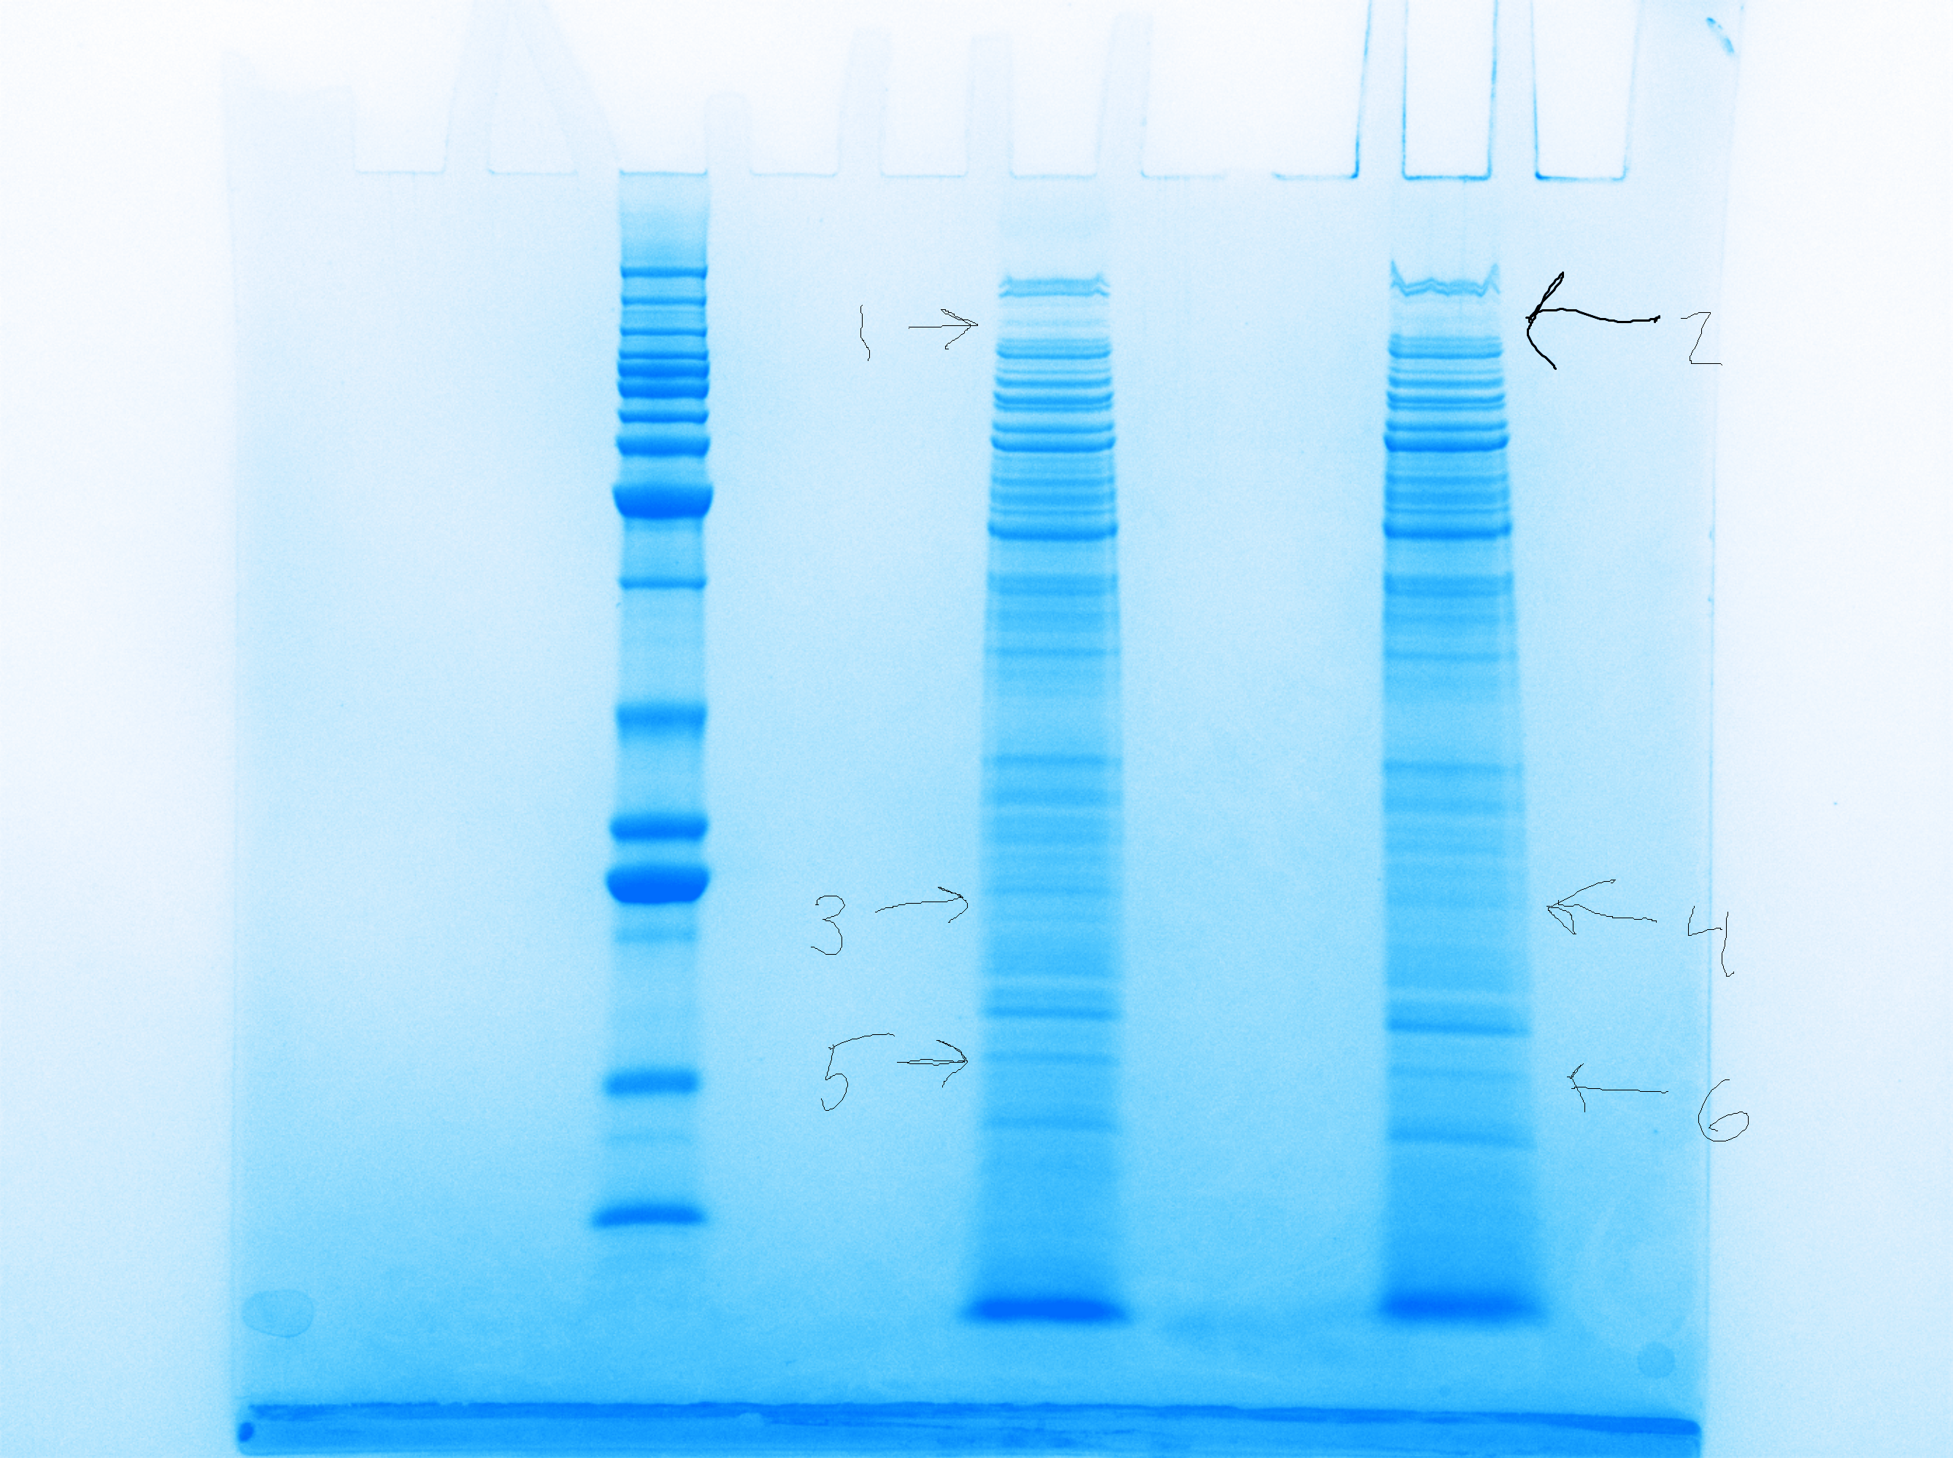
Cells lacking rpsU2 have less PdpB
LVS
∆rpsU2
LVS
~125 kDa
PdpB
Notes:
So I did a Coomassie stain of whole cell extracts of our wild-type cells and drpsU2, and we noticed honestly a lot fewer differences than we expected, but we did see a difference in a band here. We sent that out for mass spec and found, among the differences was pdpB, and that there was substantially less of this protein in drpsU2 when compared with wild-type.

Slide 5
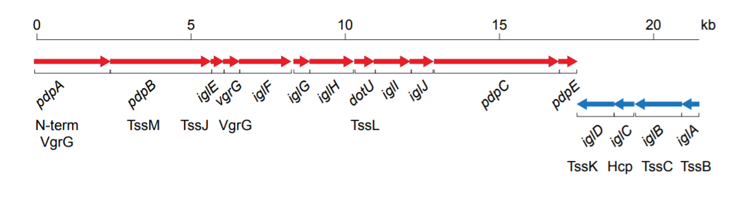
Francisella Pathogenicity Island (FPI)
Notes:
Now this was really exciting because pdpB is part of the Francisella pathogenicity island, or FPI. The FPI encodes the type vi secretion system in francisella, and is absolutely essential to virulence. I also wanted to point out here, because this will be important later on, that the FPI is comprised of two distinct operons. pdpB is on the plus strand operon here, along with pdpA, and a number of other genes, and the second operon is comprised of iglA-D.
We do know a fair amount about how the FPI genes are regulated at the level of transcription, and I don’t want to get too into the details here, but I will just introduce you to a protein called pigR which has been shown to be necessary for transcription of both operons of the FPI, so it’s a useful control we’ll be using throughout these next few experiments. There haven’t been any publications into whether the FPI is controlled at the level of translation.
Once we identified pdpB as potentially being influenced by the presence of rpsU2, we wanted to confirm these results using immunoblotting, and look to see if any of the other FPI proteins are also affected.

Slide 6
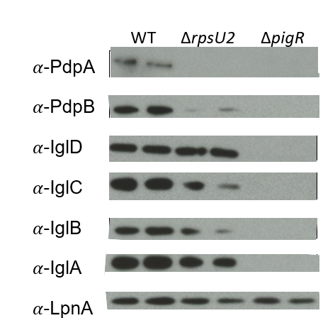
Lack of rpsU2 results in decrease in FPI proteins from one operon
FPI Operon 1
FPI Operon 2
Notes:
SLOW DOWN
Here we have the results of those western blots. We ran whole cell lysates in duplicate, our wild-type cells are represented here, and we have antibodies for a few proteins from each of the FPI operons. And then LpnA, is our loading control.
We ran a control with deltapigR, because as I mentioned the pigR protein necessary for transcription of the both operons of the FPI, and you can see clearly that without it, these proteins are not present.
When we compare the wild-type cells to drpsU2, we see a significant reduction of pdpB and a similar loss of pdpA. But, we did not observe the same level of difference in protein abundance for the igl proteins, from operon 2. I realize these results are a bit variable and we are working to replicate and quantify these differences.

Slide 7
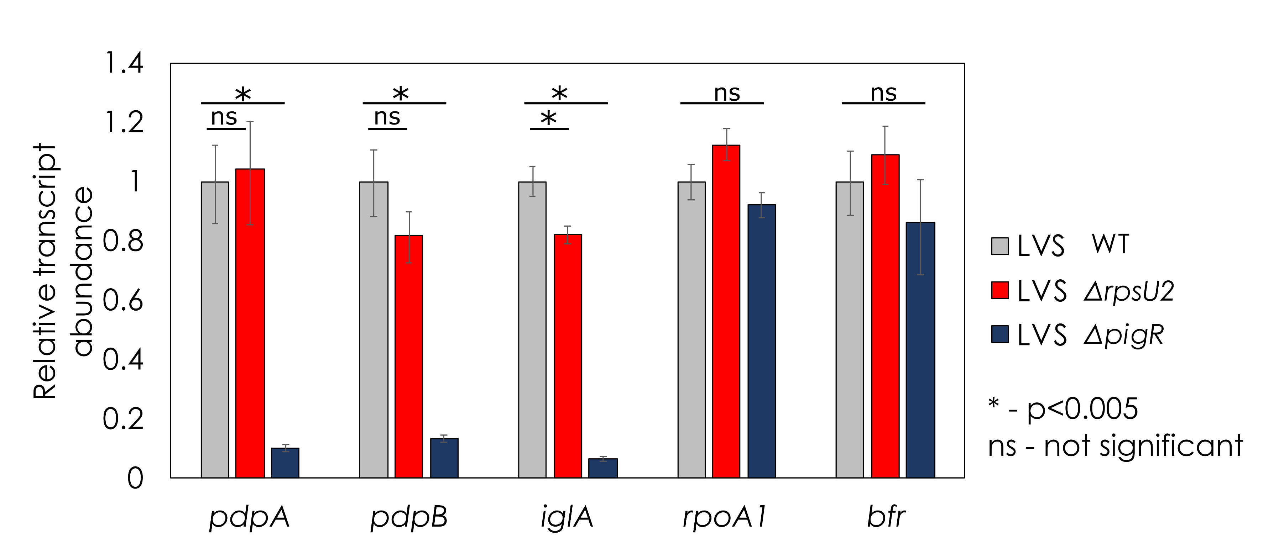
Transcript abundance is not affected by loss of rpsU2
Are differences in protein abundance due to growth defect/total ribosome number, or presence of specific bS21 proteins?
Notes:
SLOW DOWN
Alright so what you see here first are pdpA and B which were most affected by loss of rpsU2. We are using wild-type and delta pigR as our controls, because FPI proteins require PigR for expression at the level of transcription. And what we see here is that there really is NOT a significant difference in transcript abundance of these genes between wild-type and the strain lacking rpsU2.
We also looked at transcript abundance of iglA which is one of the genes on the other FPI operon and this also appears to be true.
Finally for controls we looked at two non-FPI genes, rpoA1 and bfr, and here we see pretty consistent abundance of these transcripts among the three strains.
The large difference that we are seeing in protein abundance of pdpA and pdpB is clearly not due to differences in transcription, and we want to know how this is occurring. This data opens up the possibility that regulation is occurring at the level of translation.
Given that this is a specific effect on FPI proteins, we were interested to see whether there may be an effect on intramacrophage growth.

Slide 8
Creation of isogenic strains at Tn7 site
rpsU1
P_{rpsU2}
∆rpsU1 ∆rpsU2 ∆rpsU3
rpsU2
P_{rpsU2}
rpsU3
P_{rpsU2}

Slide 9
Tn7::rpsU1 and Tn7::rpsU2 have similar growth rates

Slide 10
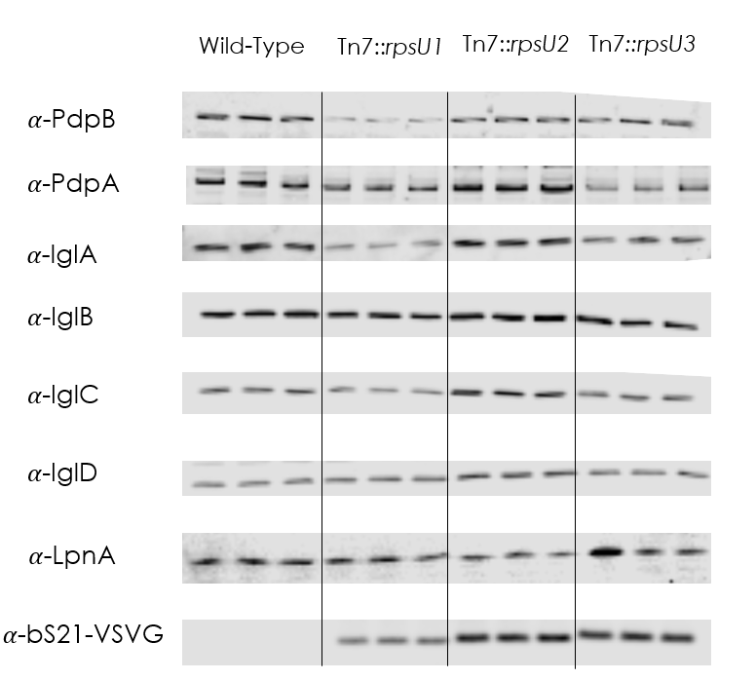
bS21 plays a regulatory role in expression of FPI proteins

Slide 11
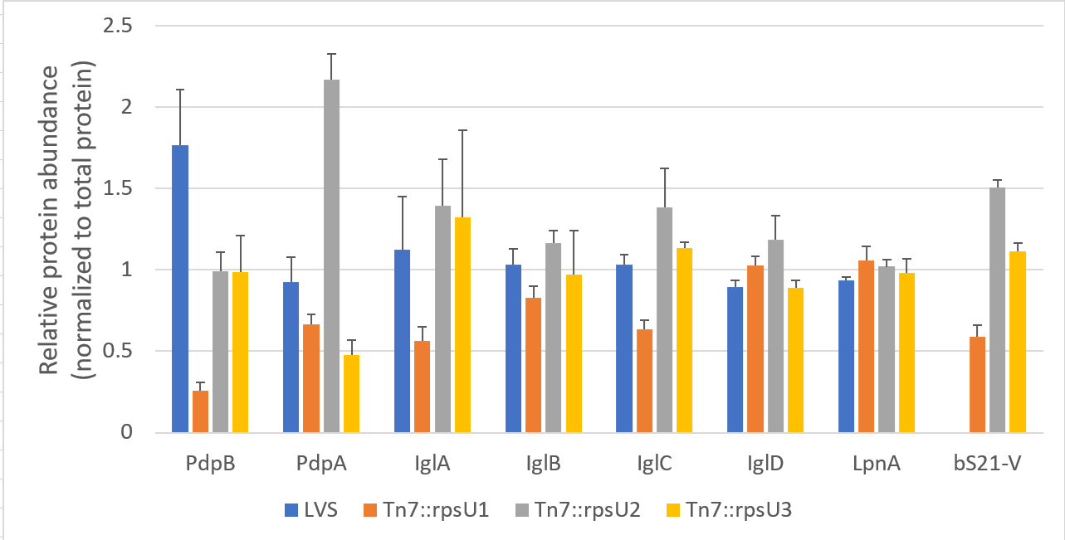
bS21 plays a regulatory role in expression of FPI proteins
Are the differences based solely on amount of ribosomes with any bS21, or are they sequence specific?

Slide 12
Next steps
Do isogenic strains have differences in bS21 presence within ribosomes?
  Westerns on purified 70S ribosomes
Is the VSV-G tag impacting the ribosome’s function?
  Watson et al., 2020
  pF-rpsU
What other proteins may be affected by loss of specific bS21s?
  Mass spec data

Slide 13
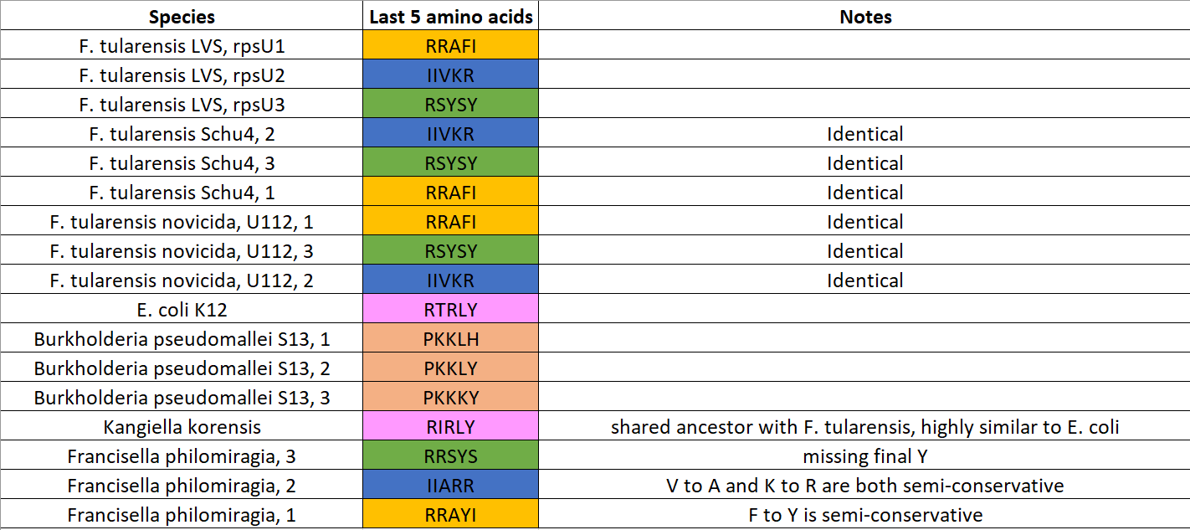
C-terminus is partially conserved in F. tularensis clades

