Slide 1
Lab Meeting
September 29, 2020
Hannah Trautmann

Slide 2
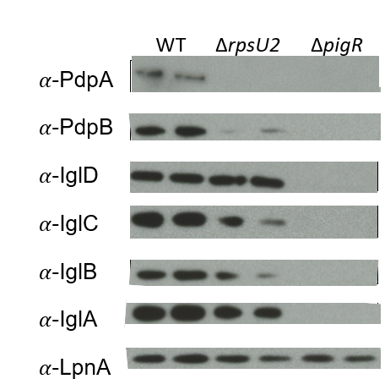
Lack of rpsU2 results in decrease in FPI proteins from one operon
FPI Operon 1
FPI Operon 2
Notes:
SLOW DOWN
Here we have the results of those western blots. We ran whole cell lysates in duplicate, our wild-type cells are represented here, and we have antibodies for a few proteins from each of the FPI operons. And then LpnA, is our loading control.
We ran a control with deltapigR, because as I mentioned the pigR protein necessary for transcription of the both operons of the FPI, and you can see clearly that without it, these proteins are not present.
When we compare the wild-type cells to drpsU2, we see a significant reduction of pdpB and a similar loss of pdpA. But, we did not observe the same level of difference in protein abundance for the igl proteins, from operon 2. I realize these results are a bit variable and we are working to replicate and quantify these differences.

Slide 3
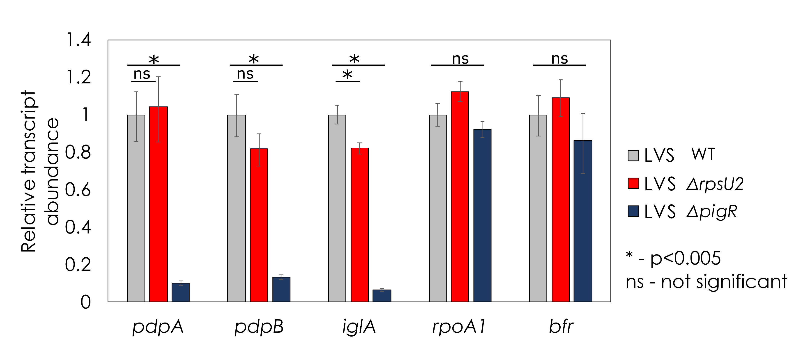
Transcript abundance is not affected by loss of rpsU2
Notes:
SLOW DOWN
Alright so what you see here first are pdpA and B which were most affected by loss of rpsU2. We are using wild-type and delta pigR as our controls, because FPI proteins require PigR for expression at the level of transcription. And what we see here is that there really is NOT a significant difference in transcript abundance of these genes between wild-type and the strain lacking rpsU2.
We also looked at transcript abundance of iglA which is one of the genes on the other FPI operon and this also appears to be true.
Finally for controls we looked at two non-FPI genes, rpoA1 and bfr, and here we see pretty consistent abundance of these transcripts among the three strains.
The large difference that we are seeing in protein abundance of pdpA and pdpB is clearly not due to differences in transcription, and we want to know how this is occurring. This data opens up the possibility that regulation is occurring at the level of translation.
Given that this is a specific effect on FPI proteins, we were interested to see whether there may be an effect on intramacrophage growth.

Slide 4
  What mechanism is used by bS21-2 to regulate abundance of PdpA in Francisella tularensis?
Notes:
Now that I’ve gone through our preliminary data, I want to get back to my first aim, which is to look at the mechanism behind these differences in protein abundance. As a reminder, our hypothesis is that ribosomes containing bS21-2 show a greater affinity for particular genes, in this case we will be focusing on pdpA, and that this leads to preferential translation and increased protein abundance compared to cells with other ribosomes.
The specific experiments that I have proposed aim to answer two sub-questions.
First, what component of the mRNA is recognized, directly or indirectly, by bS21 paralogs? We believe, based on the position of bS21 in the ribosome, may be specifically recognizing the 5’ UTR or untranslated region of mRNA.
Second, is the ribosome solely responsible for this interaction? Or are there other proteins in the cell necessary for this preferential translation to occur?

Slide 5



Testing the contribution of mRNA 5´UTRs
pdpA 5’UTR
lacZ
Wild-Type
pdpA 5’UTR
lacZ
ΔrpsU2
Notes:
To get at whether the 5’UTR is the component of the mRNA that is recognized, we have proposed to use B-galactosidase assays. We have built strains that have the 5’UTR of pdpA fused to the lacZ gene, and we have put these constructs both in wild-type cells and those lacking the second paralog. We have the transcripts modeled here.
What we expect to see is ribosomes that contain the second homolog, such as those in wild-type cells, colored in purple, will show a higher affinity for the 5’UTR than other ribosomes. We expect all types of ribosomes to translate lacZ into the B-galactosidase protein, which cleaves a substrate to produce a yellow color, But that we might get more translation in wild-type because of this higher affinity, leading to a greater production of yellow color.

Slide 6
Testing the contribution of mRNA 5´UTRs
bfr 5’UTR
lacZ
Wild-Type
bfr 5’UTR
lacZ
ΔrpsU2
Notes:
We have also constructed control strains that fuse lacZ to the UTR of a gene that is unaffected by presence of the second paralog, bfr. We will compare the ratio of the pdpA 5’ UTR to the bfr 5’UTR to compare B-galactosidase activity
So that’s basically the experimental setup, and I have gotten a little ahead of my proposal and done one of these assays already, which I’ll show to you now.

Slide 7
Cells without rpsU2 translate the pdpA 5´UTR less efficiently
0.257
β-galactosidase activity (pdpA:bfr ratio)
0.137
p < 0.001
ΔrpsU2
Notes:
What we see here is a ratio of the B-galactosidase activity in our pdpA UTR compared to the bfr UTR in both strains. We were expecting, based on the protein abundance studies, about a 13-18 fold difference, and we see about a 2-fold difference. Which is cool, but it certainly doesn’t explain the massive difference we saw in protein abundance of pdpA.
This doesn’t mean it’s the end of this line of inquiry, though, because there is evidence that pdpA has an alternative transcription start site about 100 base pairs upstream of the one we used to build these constructs, so it may be that bS21-2 shows a greater affinity only for pdpA transcripts with the longer UTR. As next steps I am in the process of generating the strains with the longer pdpA 5’UTR.
Now as a reminder, my second specific question was about whether the ribosome was sufficient to impart the differences in abundance that we see of pdpA.

Slide 8
Next steps for B-gal assays
Longer UTR for pdpA
Include 20 amino acids
tul4 control

Slide 9
  Does growth rate affect the alterations in FPI proteins that we have observed?

Slide 10
Loss of rpsU2 results in a growth defect
ΔrpsU2 pF
ΔrpsU2 pF-rpsU1
ΔrpsU2 pF-rpsU2
ΔrpsU2 pF-rpsU3
Notes:
On the y-axis here we have growth as measured by optical density. Wild-type cells with empty vector pF and the drpsU2 strain.
We thought that this might be because we were disturbing nearby genes, so we wanted to test it with complementation with not only the same gene we have deleted, but the other genes as well to see if they are interchangeable.
What we found is that the overexpressing rpsU2 restores wild-type level growth, and interestingly we see functional redundancy with rpsU1 but not with rpsU3.
So this tells us that the growth defect we see due to loss of rpsU2 is specific, and appears to be complemented by rpsU1 and 2, but not 3. This got us really interested in the second homolog, so we wanted to look at whether there were changes in global protein expression in this drpsU2 strain.

Slide 11
Creation of isogenic strains at Tn7 site
rpsU1
P_{rpsU2}
∆rpsU1 ∆rpsU2 ∆rpsU3
rpsU2
P_{rpsU2}
rpsU3
P_{rpsU2}

Slide 12
Tn7::rpsU1 and Tn7::rpsU2 have similar growth rates

Slide 13
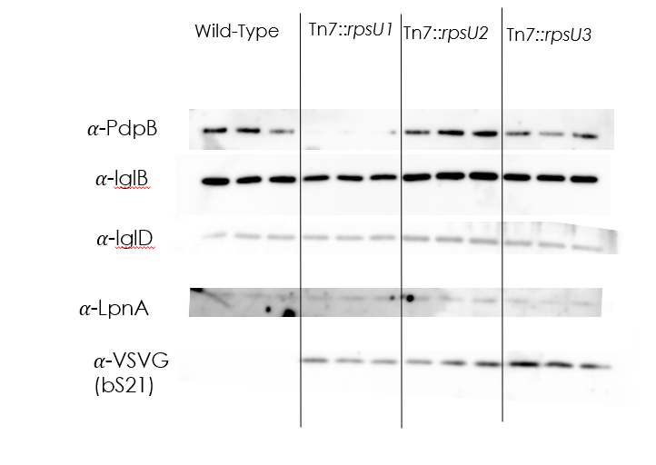
Tn7::rpsU1 and Tn7::rpsU2 have different abundances of PdpB

Slide 14
Next steps for isogenic strains
Infrared Western blots
Quantitative mass spectrometry
  Can look at other proteins as well

Slide 15
  Does rpsU2 affect virulence of Francisella?

Slide 16
Early studies indicate YES rpsU2 affects virulence
*
*
* = p<0.05
ΔrpsU2 + pF
ΔrpsU2 + pF- rpsU2
Notes:
BUT we have seen some differences upon repeating this based on how many bacteria cells we get inside the macrophage. So we are attempting to do a competition assay.

Slide 17
Competition intramacrophage growth assay
ΔrpsU2
LVS with lacZ
Macrophage
Notes:
This will help ensure that the same number of bacteria get inside the macrophage from the two different strains, allowing us to compare them more evenly.

Slide 18



Acknowledgements
Dr. Kathryn Ramsey & Lab
Dr. Steven Gregory & Lab
Dr. Jodi Camberg & Lab
INBRE Core
Janet Atoyan & GSC

Slide 19

Questions?

