Slide 1
Examining how the small ribosomal protein bS21 regulates gene expression in pathogenic bacteria
Hannah Trautmann
Qualifying Exam Oral Presentation
August 5, 2020
Notes:
Hi everyone. I’m Hannah, and I will be presenting on my research into a small ribosomal protein, bs21 and its role regulating genes

Slide 2
Outline
Introduction
  Regulation of gene expression
  Heterogeneity in ribosomes
  rpsU-encoded bS21
Overall question
  Aim 1: What mechanism is used by bS21-2 to regulate gene expression in Francisella tularensis?
  Aim 2: Does bS21 play a role in daptomycin and vancomycin resistance of Staphylococcus aureus through alterations in cell wall structure?
Notes:
First I’ll start with some background info about our current understanding of gene regulation in bacteria. I’ll introduce you to the idea that ribosomes may be heterogeneous in composition and function, and then focus in on a specific source of that heterogeneity, a ribosomal protein called bS21.
Then we will get into my specific questions about how bS21 may be involved in regulating gene expression in two bacteria: F. tularensis and S. aureus, and the implications that has on virulence and antibiotic resistance.

Slide 3
Post-transcriptional gene regulation in bacteria
RBP
RNAP
Your favorite gene
Can ribosomes provide an element of gene regulation?
Notes:
Here we have a cartoon of any bacterial gene and it’s promoter, which is transcribed by RNA polymerase, generating the growing mRNA transcript that you see here. A lot is known about how gene expression is regulated by transcription, but less well-studies is regulation occurring post-transcriptionally.
For instance, sRNAs can bind to transcripts to promote or prevent the ribosome from binding to translate. There can be RNA binding proteins that influence stability, and differences in mRNA recruitment to the ribosome.
Often people think of the ribosome as constitutively and homogenously being active, but we wonder if ribosomes can provide an element of gene regulation? Structurally, we believe it is possible because ribosomes are heterogeneous., and I’ll show you the source of that heterogeneity now.

Slide 4
Heterogeneity in ribosomes
16S rRNA
tRNA
23S rRNA
16S rRNA
tRNA
23S rRNA
Me
1. Multiple rRNA operons
Specialized ribosomes:
heterogeneous in structure and function
2. rRNA modifications
r-protein
r-protein
Ac
3. Multiple ribosomal protein (r-protein) homologs
P
Me
4. Ribosomal protein modifications
Byrgazov et al. 2013
Notes:
First, we can have multiple rRNA operons whose products are incorporating into different ribosomes. These can be post-transcriptionally modified through acetylation or methylation. We can also have homologous ribosomal proteins that incorporate into ribosomes, and these can also be modified, post-translationally.
All these different types of ribosomes that can be made has led the field to start investigating whether these have different functions and, rather than ribosomes acting constitutively as was traditionally believed, perhaps these ribosomes can impart some level of control of gene expression. The term for this is specialized ribosomes, referring to ones that are heterogeneous in structure and in function.
Now heterogeneous ribosomes are well-studied in eukaryotes, with significantly less known about these in bacteria. I want to show you a specific example of this that has been described in bacteria.

Slide 5
Heterogeneous ribosomes in Mycobacterium tuberculosis
Zur
Zn²⁺
Zn²⁺
PrimRP 18
AltRP 18
Zn²⁺
Zn²⁺
Zn²⁺
Zn²⁺
Zn²⁺
Zn²⁺
PrimRP 18
AltRP 18
Zn²⁺
Zn²⁺
Zn²⁺
Prisic et al. 2016
Notes:
In mycobacterium tuberculosis, there are two genes that encode the small ribosomal protein S18 – the primary ribosomal protein can coordinate with zinc and the alternate ribosomal protein cannot. So in high zinc conditions, zur, a transcription factor, binds to zinc to repress the alternate S18, and the primary S18 coordinates with zinc, leading to a population of ribosomes with mostly the primary S18 present. In other conditions low zinc presence, it’s been shown that this zur-zinc complex is not present so there is expression of the alternate S18, and a more evenly heterogeneous ribosome population.
The functional consequences of this are not known, but it is hypothesized that this was adapted as a way for mycobacterium to better grow in specific niches, such as in or out of host macrophage cells.
Our research is aimed at another ribosomal protein, called bS21.

Slide 6
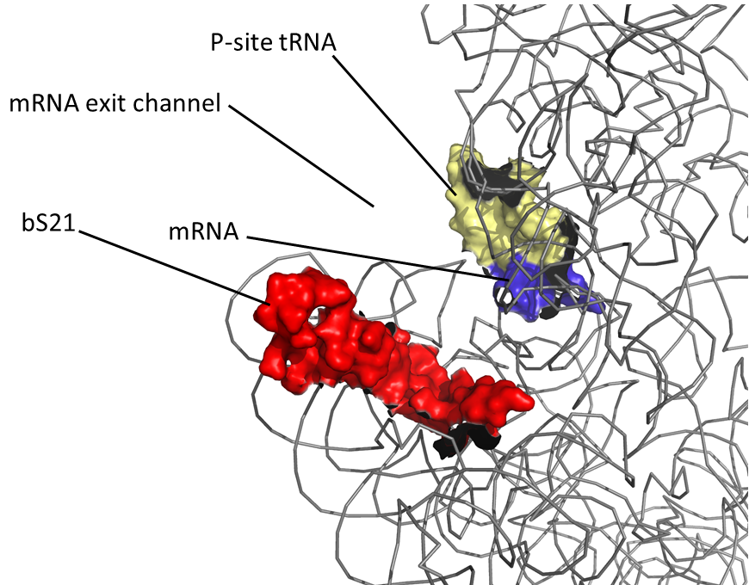
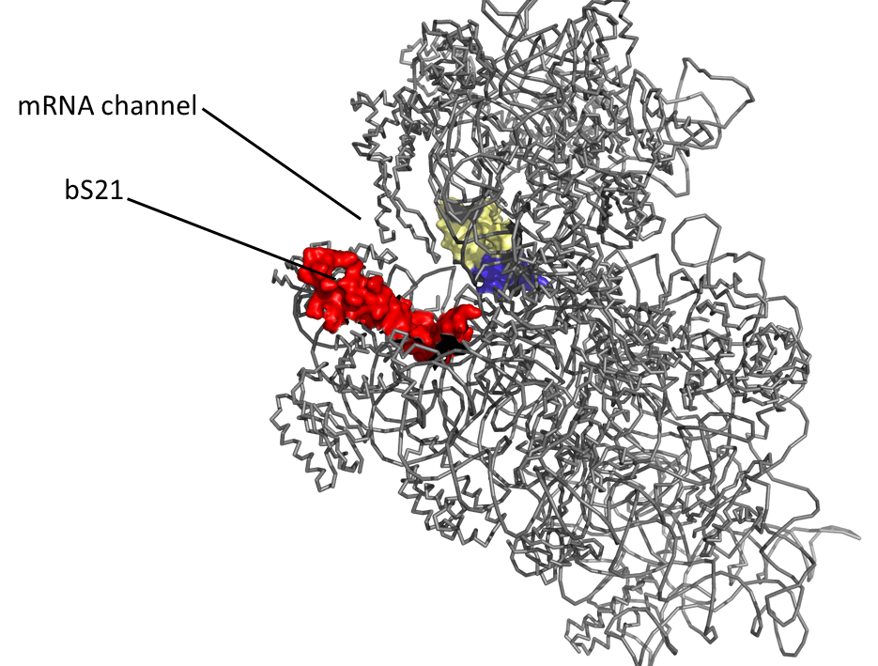
The role of bS21 in translation
Location
Function
Encoded by viruses
Implicated in distinct phenotypes
  Motility
  Biofilm formation
  Acid stress resistance
  Antibiotic resistance
  Virulence
PDB entry: 4V50
Notes:
bS21, which is encoded by the gene rpsU, is a component of the small ribosomal subunit. Here we have images of the 30S subunit of the E. coli ribosome. On the right we have a view of only the 16s rRNA with bS21 which is colored in red. On the left is a closer view, and to orient yourself in yellow is the p-site tRNA and an mRNA in blue, so you can imagine a longer mRNA would be exiting here, very close to the position of bS21.
Early research into the functions of ribosomal proteins identified that bS21 is involved in translation initiation, perhaps moderating the interaction between the ribosome and the mRNA molecule. However, bS21 is not found in all bacterial species and is considered non-essential.
One really interesting study shows that bS21 has been encoded by viruses – different homologs of the gene that encodes bS21 has been found on more than 1300 viral genomes. It has been show that at least one of these viral bS21 can be incorporated into the E. coli ribosome, suggesting that perhaps viruses are utilizing bS21 homologs to hijack the host ribosomes to somehow benefit them, maybe altering gene expression.
Despite the fact that bS21 is not found in all species, there have been a number of studies where null-mutants have been made in species with bS21, and these result in interesting phenotypes, including loss of motility, biofilm formation, changes in acid stress resistance, antibiotic-resistance, and loss of virulence. These last two are going to be the focus of our studies, but given its influence on specific phenotypes, bS21’s role in translation may be a regulatory role.

Slide 7
Overall question: How does bS21 contribute to control of gene expression?
  Aim 1: What mechanism is used by bS21-2 to regulate abundance of PdpA in Francisella tularensis?
  Aim 2: Does bS21 play a role in daptomycin and vancomycin resistance of Staphylococcus aureus through alterations in cell wall structure?
Notes:
My overarching question is if, and how, bS21 contributes to control of gene expression in two pathogenic bacteria.
First I’ll be looking at F. tularensis, which I’ll introduce you to shortly, where we have 3 paralogs of bS21 and we have seen effects of loss of one of these paralogs on abundance of specific proteins, including one called PdpA, so we would like to look into the mechanism by which this regulation occurs.
The second aim will look at staph aureus, where bS21 has been implicated in resistance to antibiotics.
We’ll start with aim 1 with some background information on Francisella.

Slide 8
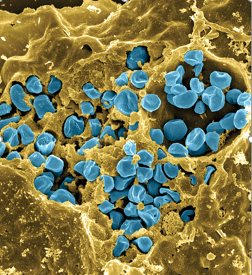
Francisella tularensis
Causes tularemia – ulceroglandular, respiratory
Many hosts and vectors
Highly infectious/ potential bioweapon
Model: F. tularensis subsp. holarctica LVS (live vaccine strain)
Fischer, PNAS cover, 2006
Notes:
Francisella is a gram -, facultative intracellular bacteria. It is pathogenic and causes a disease called tularemia, which can take a number of forms based on the route of infection. If infection is via the skin like through a mosquito or tick bite, it produces the ulceroglandular form of the disease, or if infection is by breathing in the bacteria, it causes the respiratory form, which can be fatal.
There are a large number of hosts and vectors including ticks, mosquitos, flies, rabbits, and a number of rodents. It can also be water-borne, which makes understanding its epidemiology rather complex.
It is highly infectious with as few as 10 organisms able to cause the disease, and for this reason, along with the fact that it is potentially lethal, it is considered as a potential bioweapon. This image here is colored so that the francisella are blue and are in a yellow macrophage, and you can clearly see that a ton of organisms replicate.
Luckily we don’t have to work with the pathogenic form because there is a live vaccine strain that we can work with in the lab. It’s non pathogenic to humans but retains it’s pathogenicity in animal models, so we can continue to use it in infection assays.

Slide 9
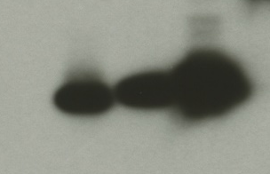
F. tularensis has heterogeneous populations of ribosomes
rpsU1
cspC
bS21-1 - V
bS21-2 - V
bS21-3 - V
bS21-2-V
bS21-1-V
bS21-3-V
WT
rpsU2
yqeY
dnaG
rpoD
α-VSVG
rpsU3
Notes:
Even though francisella has a very small genome, it encodes three copies of the rpsU genes, which encode bS21. This is especially noteworthy because most bacteria have 0 or 1 of this gene.
We originally hypothesized, and have since shown, that these three proteins are produced and incorporated into ribosomes. I purified ribosomes from wild-type cells as well as cells ectopically expressing each of the bS21 proteins with a VSVG tag. We then ran these on a gel and immunoblotted. This, along with some mass spec data we have of purified ribosomes, indicates that F. tularensis can incorporate each paralog into ribosomes, so Francisella is producing heterogeneous ribosomes.
Now that we have seen that structurally heterogeneous ribosomes exist, the question is why Francisella may have these and if they affect translation? We have developed a model for our hypothesis about this, which I will show you now.

Slide 10
Model for how bS21 might control gene expression in F. tularensis
RNAP
Your favorite gene
Hypothesis: Each bS21 paralog has a greater affinity for distinct mRNA species, leading to preferential translation which results in differences in protein abundance
Notes:
As I said the bS21 proteins are important in initiation of translation. So perhaps we have RNA polymerase actively transcribing a gene. The 30S subunit that contains paralog 1 may interact with the leader sequence of this mRNA – but perhaps there isn’t strong affinity, so translation doesn’t initiate.
Then a 30S with a different bS21 comes in. There could be a stronger affinity, so the 30S interacts with the mRNA long enough for the 50S subunit to come in, translation is initiated, and we see the protein being expressed.
This is a simple model, but it shows our hypothesis: that each bS21 paralog possibly has a greater affinity for distinct mRNA species, leading to preferential translation which results in differences in protein abundance.
Now that I’ve told you why we are interested in this, I’ll show you some of our preliminary data.
We started by individually deleting each of the rpsU genes, looking at global protein abundance, and found something interesting when deleting one of the paralogs.

Slide 11
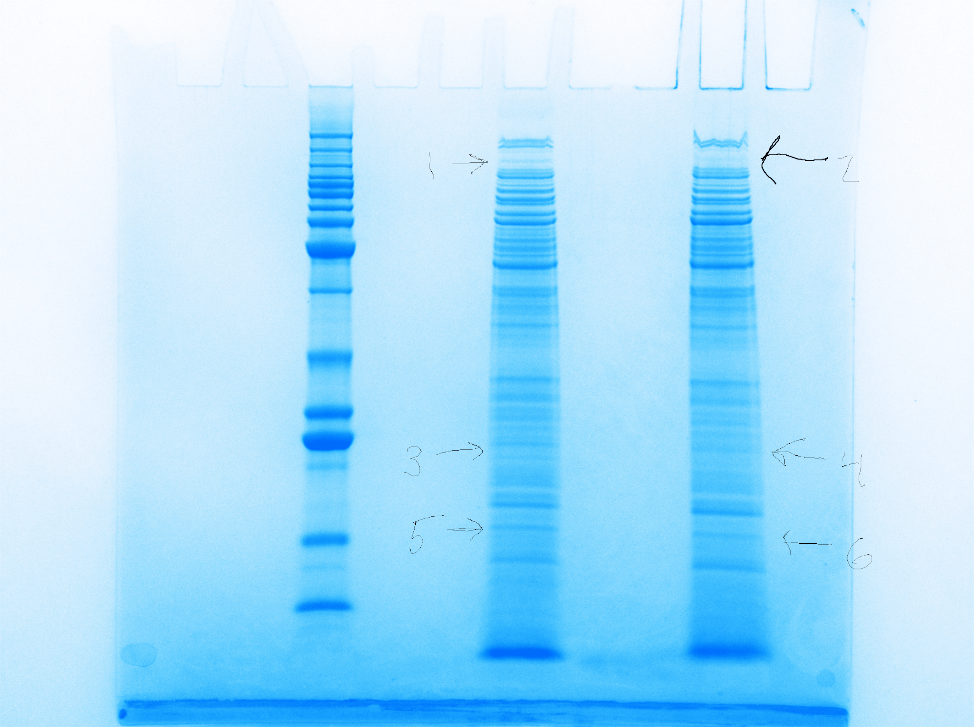
Cells lacking rpsU2 have less PdpB
LVS
∆rpsU2
LVS
~125 kDa
PdpB
Normalized Spectral Count LVS | Normalized Spectral Count ΔrpsU2
103 | 69
Notes:
Here you have a Coomassie stain of whole cell extracts of our wild-type cells and drpsU2, and we don’t see large differences, but we did see a difference in a band here. We sent that out for mass spec and found, among the differences was pdpB, and that there was substantially less of this protein in drpsU2 when compared with wild-type.

Slide 12
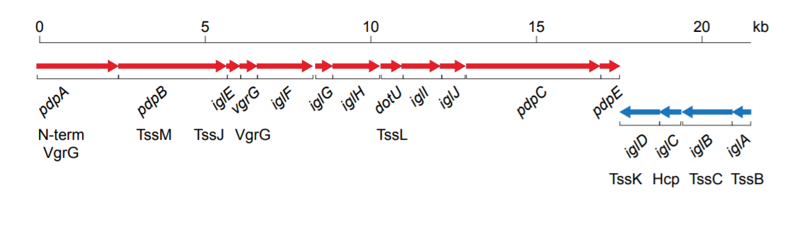
Francisella Pathogenicity Island (FPI)
Regulated at level of transcription, by PigR and other components
Notes:
Now this was really exciting because pdpB is encoded by the Francisella pathogenicity island, or FPI. The FPI encodes the type vi secretion system in francisella, and is absolutely essential to virulence. I also wanted to point out here, because this will be important later on, that the FPI is comprised of two distinct operons. pdpB is on the plus strand operon here, along with pdpA, and a number of other genes, and the second operon is comprised of iglA-D.
We do know a fair amount about how the FPI genes are regulated at the level of transcription, and I don’t want to get too into the details here, but I will just introduce you to a protein called pigR which has been shown to be necessary for transcription of both operons of the FPI, so it’s a useful control we’ll be using throughout these next few experiments. There haven’t been any publications into whether the FPI is controlled at the level of translation.
Once we identified pdpB as potentially being influenced by the presence of rpsU2, we wanted to confirm these results using immunoblotting, and look to see if any of the other FPI proteins are also affected.

Slide 13
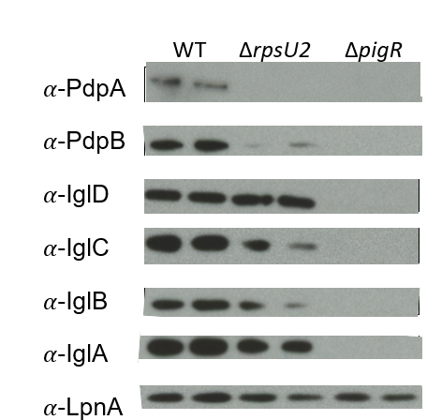
Lack of rpsU2 results in decrease in FPI proteins from one operon
FPI Operon 1
FPI Operon 2
Notes:
SLOW DOWN
Here we have the results of those western blots. We ran whole cell lysates in duplicate, our wild-type cells are represented here, and we have antibodies for a few proteins from each of the FPI operons. And then LpnA, is our loading control.
We ran a control with deltapigR, because as I mentioned the pigR protein necessary for transcription of the both operons of the FPI, and you can see clearly that without it, these proteins are not present.
When we compare the wild-type cells to drpsU2, we see a significant reduction of pdpB and a similar loss of pdpA. But, we did not observe the same level of difference in protein abundance for the igl proteins, from operon 2. I realize these results are a bit variable and we are working to replicate and quantify these differences.

Slide 14
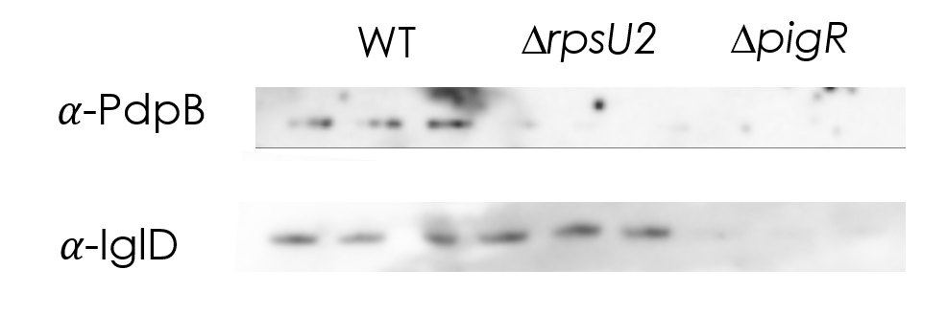
Lack of rpsU2 results in decrease in FPI proteins from one operon
Total Protein Loaded
Notes:
This is just one replicate that we have done, in this case we used total protein loaded as a control, and we are able to quantify the difference in pdpB abundance between drpsU2 and WT in this and other replicates, to be about 13-18 fold reduction.
Now this is all very interesting, but we don’t know if this affect on pdpB and pdpA is happening at the level of transcription or translation, so we isolated RNA, generated cDNA, and determined abundance of these different transcripts using qRT-PCR.

Slide 15
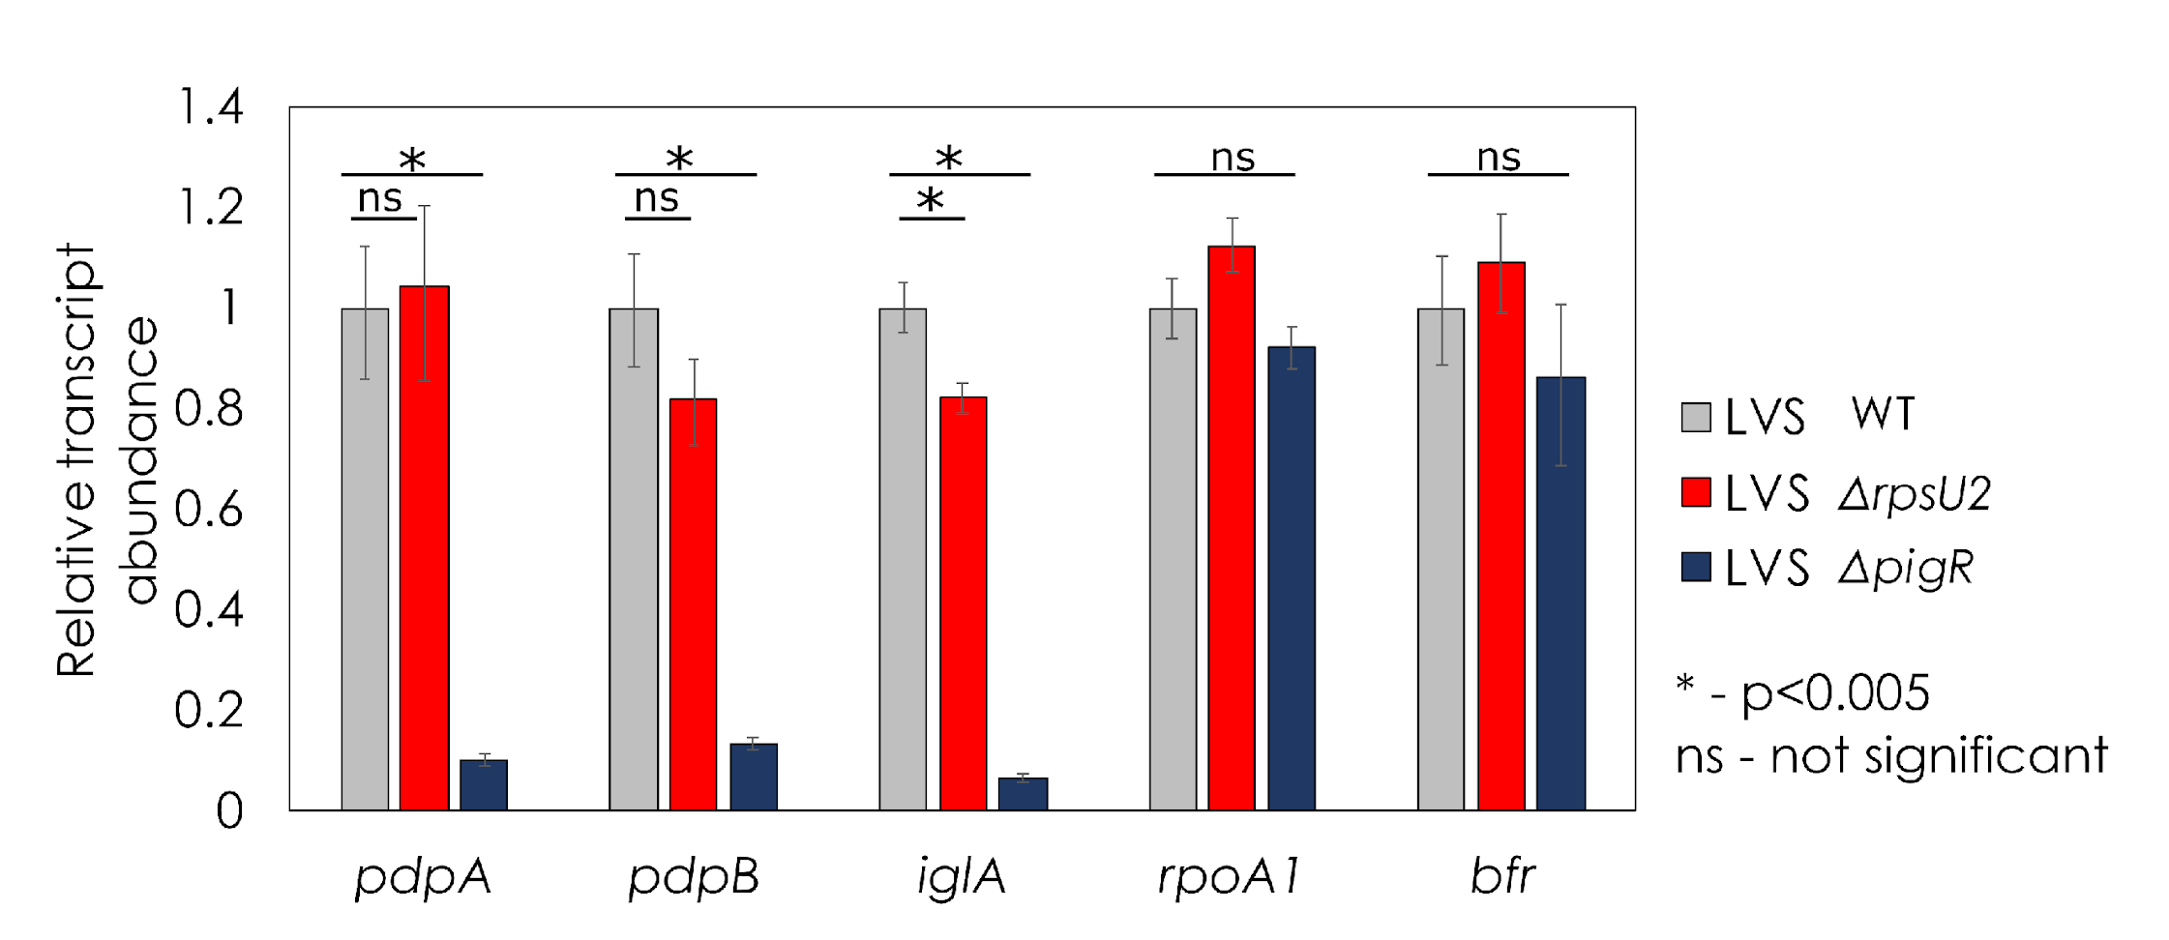
Transcript abundance is not affected by loss of rpsU2
Notes:
SLOW DOWN
Alright so what you see here first are pdpA and B which were most affected by loss of rpsU2. We are using wild-type and delta pigR as our controls, because FPI proteins require PigR for expression at the level of transcription. And what we see here is that there really is NOT a significant difference in transcript abundance of these genes between wild-type and the strain lacking rpsU2.
We also looked at transcript abundance of iglA which is one of the genes on the other FPI operon and this also appears to be true.
Finally for controls we looked at two non-FPI genes, rpoA1 and bfr, and here we see pretty consistent abundance of these transcripts among the three strains.
The large difference that we are seeing in protein abundance of pdpA and pdpB is clearly not due to differences in transcription, and we want to know how this is occurring. This data opens up the possibility that regulation is occurring at the level of translation.
Given that this is a specific effect on FPI proteins, we were interested to see whether there may be an effect on intramacrophage growth.

Slide 16
Loss of rpsU2 causes an intramacrophage growth defect
*
*
* = p<0.05
ΔrpsU2 + pF
ΔrpsU2 + pF- rpsU2
Notes:
So I conducted a macrophage assay. We have total bacterial cells recovered after 24 hours in macrophage on the y axis. When looking first at our wild-type compared to drpsU2 with empty vectors, you see a significant loss in growth. We also complemented rpsU2 on an ectopic expression plasmid and found recovery of intramacrophage growth, suggesting that cells lacking bS21-2 have a defect in T6SS function.
All of my preliminary data suggests that bS21-2 may be playing a role regulating expression of specific proteins involved in virulence, and we hope to learn more about how this may be occurring in experiments proposed in my first aim.

Slide 17
  Aim 1: What mechanism is used by bS21-2 to regulate abundance of PdpA in Francisella tularensis?
Hypothesis: Ribosomes containing bS21-2 have a greater affinity for the pdpA transcript, leading to preferential translation and increased protein abundance
What component of mRNA is recognized?
Is the ribosome solely responsible for this interaction?
Notes:
Now that I’ve gone through our preliminary data, I want to get back to my first aim, which is to look at the mechanism behind these differences in protein abundance. As a reminder, our hypothesis is that ribosomes containing bS21-2 show a greater affinity for particular genes, in this case we will be focusing on pdpA, and that this leads to preferential translation and increased protein abundance compared to cells with other ribosomes.
The specific experiments that I have proposed aim to answer two sub-questions.
First, what component of the mRNA is recognized, directly or indirectly, by bS21 paralogs? We believe, based on the position of bS21 in the ribosome, may be specifically recognizing the 5’ UTR or untranslated region of mRNA.
Second, is the ribosome solely responsible for this interaction? Or are there other proteins in the cell necessary for this preferential translation to occur?

Slide 18



Testing the contribution of mRNA 5´UTRs
pdpA 5’UTR
lacZ
Wild-Type
pdpA 5’UTR
lacZ
ΔrpsU2
Notes:
To get at whether the 5’UTR is the component of the mRNA that is recognized, we have proposed to use B-galactosidase assays. We have built strains that have the 5’UTR of pdpA fused to the lacZ gene, and we have put these constructs both in wild-type cells and those lacking the second paralog. We have the transcripts modeled here.
What we expect to see is ribosomes that contain the second homolog, such as those in wild-type cells, colored in purple, will show a higher affinity for the 5’UTR than other ribosomes. We expect all types of ribosomes to translate lacZ into the B-galactosidase protein, which cleaves a substrate to produce a yellow color, But that we might get more translation in wild-type because of this higher affinity, leading to a greater production of yellow color.

Slide 19
Testing the contribution of mRNA 5´UTRs
bfr 5’UTR
lacZ
Wild-Type
bfr 5’UTR
lacZ
ΔrpsU2
Notes:
We have also constructed control strains that fuse lacZ to the UTR of a gene that is unaffected by presence of the second paralog, bfr. We will compare the ratio of the pdpA 5’ UTR to the bfr 5’UTR to compare B-galactosidase activity
So that’s basically the experimental setup, and I have gotten a little ahead of my proposal and done one of these assays already, which I’ll show to you now.

Slide 20
Cells without rpsU2 translate the pdpA 5´UTR less efficiently
0.257
β-galactosidase activity (pdpA:bfr ratio)
0.137
p < 0.001
ΔrpsU2
Notes:
What we see here is a ratio of the B-galactosidase activity in our pdpA UTR compared to the bfr UTR in both strains. We were expecting, based on the protein abundance studies, about a 13-18 fold difference, and we see about a 2-fold difference. Which is cool, but it certainly doesn’t explain the massive difference we saw in protein abundance of pdpA.
This doesn’t mean it’s the end of this line of inquiry, though, because there is evidence that pdpA has an alternative transcription start site about 100 base pairs upstream of the one we used to build these constructs, so it may be that bS21-2 shows a greater affinity only for pdpA transcripts with the longer UTR. As next steps I am in the process of generating the strains with the longer pdpA 5’UTR.
Now as a reminder, my second specific question was about whether the ribosome was sufficient to impart the differences in abundance that we see of pdpA.

Slide 21

Are ribosomes with bS21-2 sufficient to regulate translation of pdpA?
Hypothesis:
2
pdpA
1
pdpA
3
pdpA
Notes:
To study this, we are going to do an in-vitro assay, with a kit that has all the transcription-translation machinery, and add in a pdpA transcript, as well as purified ribosomes that only have one of each of the paralogs. We can perform the reactions and then immunoblot the samples to see abundance of pdpA. We expect to find that when only bS21-2 is present, there is more pdpA produced than with ribosomes containing only the other two paralogs.
This would tell us that there aren’t other proteins involved in the specific interaction between bS21 and mRNA, it is just the ribosome responsible for the changes we see.

Slide 22
Aim 1 Summary
Is bS21 recognizing (directly or indirectly) the 5´ UTR on mRNA molecules?
Is the ribosome sufficient to lead to differences in protein abundance of PdpA and PdpB?
This would be the first study highlighting that alterations in ribosomal r-protein content affect gene expression in bacteria!
Future directions
  Are there ribosome inhibitors specific to ribosomes containing one paralog?
  How is this functioning at the atomic level?
  What conditions lead to increased expression of each paralog?
Notes:
Alright so in summary, we expect to find whether or not bS21 is recognizing the 5’ UTR of mRNA molecules, and whether the ribosome, and co-purified proteins, are sufficient to explain these differences. This would not only elucidate the role of bS21 in translation, but it would also be the first study in bacteria highlighting that alterations in r-proteins affect gene expression.
This research could lead in some exciting directions. For instance, we may be able to start screening ribosome-inhibitors to see if there is any specificity for ribosomes containing a specific paralog.
We are also working with collaborators to develop a structure to see how this is working at an atomic level. And finally, if F. tularensis perhaps developed these paralogs this as an evolutionary advantage to adapt better to its wide range of environments, what conditions lead to expression of each paralog?

Slide 23
Aim 1 Alternate Approaches
If the 5´UTR does not confer regulation by bS21-2:
  Proteomics approach
If the data suggests another protein is involved:
  Biochemical approach
  Genetic approach
Notes:
I also realize that all of our experiments might not show us what we are hoping to find, so if we don’t see the changes we expect in the proposed experiments, we have some alternate plans to better study our hypothesis.
First, if we don’t find the 5’ UTR is sufficient to create the difference we are seeing, it may be the bS21-2 is affecting translation of another protein, such as a protease, that modifies pdpA post-translationally. We can try to find what that protein may be using a proteomics approach with mass spec.
If we find that the ribosome alone isn’t sufficient to exhibit the differences we see in pdpA abundance in our in vitro assay, it is very likely that another protein is interacting with bS21 to moderate the recognition of mRNA. We could do an IP using VSV-G beads to pull down other proteins associating with the protein, or we could do transposon mutagenesis to find what other proteins are necessary for expression of pdpA. **how will we screen for this again? Is it with lacZ somehow**
Hopefully, between all the proposed and backup experiments, we should be able to learn a great deal about the mechanism of gene regulation via bS21 in francisella.

Slide 24
  Aim 2: Does bS21 play a role in daptomycin and vancomycin resistance of Staphylococcus aureus through alterations in cell wall structure?
Notes:
That brings us to my second aim, which is to determine whether bS21 plays a role in antibiotic resistance in Staphylococcus aureus through alterations in cell wall structure

Slide 25
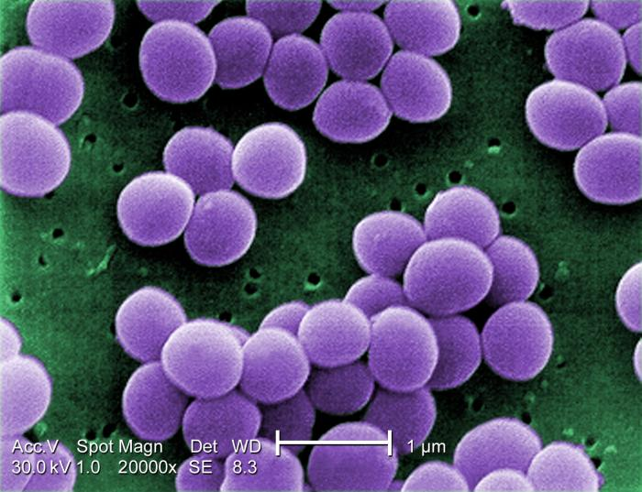
Staphylococcus aureus
Gram-positive, facultative human pathogen
High rates of infection globally
  Intensity varies
Highly adaptive resistance to antibiotics
  Penicillin
  Methicillin
  Vancomycin
  Daptomycin
CDC PHIL, Matthew J. Arduino, 2001
Notes:
-G+, facultative human pathogen. Normally lives on skin and mucosal membranes of healthy humans.
-Extremely common, estimate that 30% of population carries staph on their skin asymptomatically. When it infects, can be very mild skin boils or life-threatening bacteremia.
-one reason it is so dangerous is because of antibiotic resistance making it difficult or impossible to treat. These are just some of the antibiotics used to treat staph infections, but some staph strains have acquired resistance to every single one. For years methicillin was the main antibiotic being used, but Methicillin-resistant staph aureus, or MRSA, is now extremely common, leading vancomycin and daptomycin to become more widely used. These are the two I’m going to be focusing on for my second aim, because it turns out that clinically, mutations in rpsU are associated with resistance to vancomycin and daptomycin

Slide 26
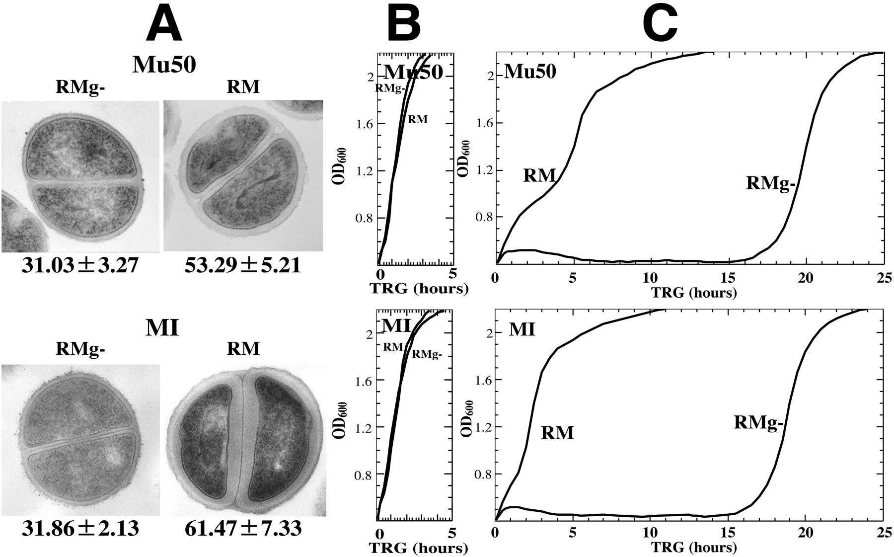
Inactivation of rpsU in S. aureus is linked to antibiotic resistance
Clinical isolates
  Frameshift insertion from 4th amino acid on; van-R (Basco 2019)
  Stop codon at 31st amino acid; van-R (Matsuo et al. 2013)
  Frameshift deletion at 53rd amino acid; van-R (Cameron et al. 2012)
  Promoter region of rpsU; dap-R (Friedman et al. 2006)
In vitro experiments
  Transposon insertion in start codon; van-R and dap-R (Blake and O'Neill 2012)
Cui et al. 2006
Notes:
There have been numerous studies on clinical strains of staph with resistance to vancomycin or daptomycin, that show mutations in rpsU, the ONLY rpsU in s. aureus, with mutations occurring in different parts of the gene as well as in the promoter region. These loss of function mutants implicate loss of rpsU in antibiotic resistance.
These clinical isolates often have numerous mutations so it’s hard to single out rpsU as being causative of the antibiotic resistance that is observed.
Fortunately, there has also been a transposon mutagenesis of staph that implicates rpsU ALONE as the transposon inserts at only one place in the genome. This study showed that knocking out rpsU was sufficient to cause both vancomycin and daptomycin resistance.
The question remains, HOW is loss of bS21 causing antibiotic resistance? Research has shown that many cells exhibiting antibiotic resistance have thickened cell walls, an example of which you can see here in vancomycin resistant bacteria. It is believed that this thickening titrates down the effective antibiotics. Even in diverse genetic backgrounds, this same mechanism results in antibiotic resistance.
This information has led us to develop a model for what may be happening with bS21 in S. aureus.

Slide 27

Model for how bS21 might control gene expression in S. aureus
RNAP
Cell wall regulator
Hypothesis: bS21 regulates expression of proteins involved in cell wall structure, thereby affecting antibiotic resistance
Notes:
SLOW DOWN
Much like the model I showed you for francisella, here we have RNA polymerase actively transcribing a gene, specifically a cell wall negative regulator. The 30S subunit that contains bS21 may interact with this mRNA, there is a strong affinity, a protein is made and we have a normal cell wall produced, which is represented by this cartoon. Antibiotics can enter this cell and eventually the cell dies.
You can imagine that there are also 30S subunits that altogether lack bS21. There may be a weaker affinity between these ribosomes and the mRNA, so translation is not initiated the protein is not produced, and this results in a thicker cell wall. In this case, antibiotics are unable to penetrate and enter the cell.
This is our hypothesis – that bS21 regulates expression of proteins involved in cell wall structure, and this in turn has an affect on antibiotic resistance.

Slide 28
  Aim 2: Does bS21 play a role in daptomycin and vancomycin resistance of Staphylococcus aureus through alterations in cell wall structure?
Do we see alterations in antibiotic resistance in ΔrpsU cells?
Are there effects on cell wall thickness when bS21 is not present?
Notes:
Now that brings us to the specific questions we have for aim 2.
First, we plan to delete rpsU from staph and determine whether we can replicate the results of the transposon mutagenesis study, which showed that without a functional bS21 staph shows resistance to both vancomycin and daptomycin.
Next, we want to assess whether cells lacking bS21 have any alterations in the cell wall thickness. As a reminder, our hypothesis is that cells without bs21 will have thicker cell walls.

Slide 29
Population analysis of S. aureus antibiotic-resistance
Starting CFU
Hypothesis:
Wild-type
Antibiotic Concentration
(Vancomycin or daptomycin)
ΔrpsU
MIC
Notes:
In order to determine whether we see alterations in antibiotic resistance when bS21 is lost, we will setup a very simple population analysis experiment. We will make plates that have different antibiotic concentrations, and then plate cells at different concentrations to determine that minimum concentration of antibiotic that is necessary to prevent growth, or the MIC. Using a range of starting CFU’s will allow us to better quantify if there are heterogeneous populations that have increased MICs which are only evident at higher concentrations of cells.
We plan to do this with both antibiotics – daptomycin and vancomycin- with two strains, our wild-type cells and cells lacking rpsU. Based on the results of previous studies, particularly the transposon-mutagenesis study, we expect that the drpsU strain will have a higher MIC for both antibiotics when compared to wild-type.

Slide 30

Analysis of cell wall size
Hypothesis:
Wild-type
ΔrpsU
Notes:
For our second specific question, we want to see whether cell wall size is affected by loss of rpsU. To do this experiment, we will again take our wild-type and drpsU cells, which I have as purple cartoons here, and we will fix and stain the cells, represented here on a slide, then we can analyze using transmission electron microscopy. We should be able to measure the cell walls in each of these strains. We expect to find that cells with rpsU, our wild-type strain, will have thinner cell walls than cells lacking rpsU.

Slide 31
Aim 2 Summary
Can we reproduce antibiotic resistance in ΔrpsU cells?
Is bS21 implicated in differences in cell wall size?
Regulation of gene expression at the level of translation may be involved in antibiotic resistance!
Future directions
  What specific proteins related to cell envelope structure change abundance?
  Is this the case in other organisms that are vancomycin resistant?
Notes:
In summary, we hope to reproduce previous research that shows cells lacking functional bS21 have increased resistance to vancomycin and daptomycin, and we hope to look at whether there are also changes in cell wall size.
This would be really exciting because it would draw a connection between the ribosome, and perhaps gene regulation through translation, to antibiotic resistance.
If the results of these experiments support our model, it could lead in some exciting directions. We would definitely want to look at what specific proteins involved in cell envelope structure are being affected by bS21, directly and indirectly, through a proteomics approach.
We would also want to see if this is true in other organisms that are antibiotic resistant, especially vanc-resistant bugs like enterococcus.

Slide 32
Aim 2 Alternate Approaches
If the cell wall is not affected by loss of rpsU:
  Proteomics approach
  Genetic approach
Notes:
Of course it is possible that these experiments will not support our model. If that’s the case, we might want to take a step back from the cell-wall line of inquiry and attempt to figure out what proteins are differentially expressed when rpsU is lost, through a mass spec experiment similar to what we did with Francisella.
We could also take a genetic approaching by using RNA-seq. If bS21 is affecting translation of a transcription factor, we might see significant changes at the level of transcription, indicating an indirect relationship between bS21 and those genes.

Slide 33
Overall Summary
  Aim 1: What mechanism is used by bS21-2 to regulate gene expression in Francisella tularensis?
    5´UTR assays
    In vitro translation assays
  Aim 2: Does bS21 play a role in daptomycin and vancomycin resistance of Staphylococcus aureus through alterations in cell wall structure?
    Population analysis of antibiotic-resistance
    Analysis of cell wall size
Notes:
Just to wrap up, the focus of my dissertation research will be on the role that the small ribosomal protein bS21 plays in two pathogenic bacteria. In francisella tularensis, we will look specifically at the second bS21 paralog to try to isolate the mechanism that this r-protein uses to regulate gene expression through B-galactosidase assays and in-vitro translation assays. Here were are focusing on how ribosomal protein heterogeneity influences gene expression and potentially virulence.
In Staphylococcus aureus, we will look at the relationship between bS21 and antibiotic resistance andcell wall size, using population analysis experiments and transmission electron microscopy. This will help us understand how loss of function of r-proteins, and therefore alterations in ribosome composition, influence gene expression and antibiotic resistance.

Slide 34




Acknowledgements
Dr. Kathryn Ramsey
  Jamie Wandzilak
  Tala Allababidi
  Dan Ruggiero
  Maria Santiago
  Other lab members
Dr. Jodi Camberg & Lab
Dr. Maria Schumacher & Lab
URI GSC
URI INBRE core
Committee members:
  Dr. Steven Gregory
  Dr. Steven Irvine
Notes:
Lots of people to thank, Dr. Ramsey of course and all the members of the Ramsey lab, especially Tala, Dan, and Maria who have helped me thus far with my ribosome project. Then Dr. Gregory and Dr. Camberg and their labs for lending us equipment and supplies, our collaborator at Duke Dr. Schumaker, and of course Janet, and grants we’ve received for this project from the RI foundation and INBRE.

Slide 35
Questions?
Notes:
What couples transcription and translation? NusG
-important that at exit channel because initiation occurs at exit channel when 16s rRNA recognizes shine delgarno on mRNA
-bS21 interacts with bs18, uS11, and 16s rRNA
-In bacillus subtilis, this results in defects in motility and biofilm formation, and in listeria monocytogenes, null mutants have increased acid stress resistance and changes in transcription of stress resistance genes.
-Percent identities:
1 and 3 – 72%
1 and 2 57%
1 and ecoli – 52%
2 and 3 – 50%
2 and e coli – 60%
-E.Coli bS21 is in same operon rpoC and primase, so most similar to #2. Others are more similar to #3, like listeria and bacillus
- paralogs = gene duplication, orthologs = from different species. Likely rpsU are paralogs because we built a tree and they all clustered very close together and were only surrounded by other francisella proteins
-yqeY = hypothetical protein, uncharacterized
GT in Vivo Generation Time in Vitro
LVS + pF 156.3858 131.5391
∆rpsU2 + pF 233.5667 169.1624
∆rpsU2 + pF-rpsU2 119.5633 147.0962
*Faster in Vivo for WT and complement, slower in vivo for drpsU2*
Complement is fasted in vivo, drpsU2 is slowest

Slide 36
Conditions rpsU1 is Expressed

Slide 37
Amino acid alignment of bS21 (rpsU-encoded) homologs with S. aureus
bS21-1 MLSIRVDEHKPFDISLRNFKRACEKAGIKQELRDRQHYVKPTEKRKIAKRQAVKRARISQ 60
bS21-3 MPRIIVDPKKPFDISLRNFKRACEKAGIKQELRDRQHYVKPTQKRKIAKKAAISKAKKEA 60
S.aureus MSKTVVRKNESLEDALRRFKRSVSKSGTIQEVRKREFYEKPSVKRKKKSEAARKRKFK-- 58
bS21-2 MPSVRIKEREPFDVALRRFKRSCEKAGIVSELRRREYFEKPTWARKRKKTAAVKRAHKSN 60
E.coli MPVIKVRENEPFDVALRRFKRSCEKAGVLAEVRRREFYEKPTTERKRAKASAVKRHAKKL 60
* : .: :: :**.***: .*:* *:* *:.: **: ** . * .:
bS21-1 -----RRAFI- 65
bS21-3 -----RRSYSY 66
S.aureus ----------- 58
bS21-2 IIVKR------ 65
E.coli ARENARRTRLY 71
* = identical amino acid
: = very similar amino acid
. = somewhat similar amino acid
Notes:
Percent identities:

Slide 38
Percent identity matrix of bS21 (rpsU-encoded) homologs with S. aureus
 | bS21-1 | bS21-3 | S. aureus | bS21-2 | E. coli
bS21-1 | 100.00 | 72.31 | 37.93 | 56.67 | 52.31
bS21-3 |  | 100.00 | 37.93 | 50.00 | 50.00
S. aureus |  |  | 100.00 | 46.55 | 53.45
bS21-2 |  |  |  | 100.00 | 60.00
E. coli |  |  |  |  | 100.00
Notes:
Percent identities:

Slide 39
Francisella Pathogenicity Island (FPI)

Slide 40
Loss of rpsU2 leads to alterations in MIC for some ribosome-targeting antibiotics
 | WT | ∆rpsU1 ∆rpsU3 | ∆rpsU1 ∆rpsU2 | ∆rpsU2 ∆rpsU3
Kanamycin | 6.3 | 6.3 | 6.25 | 6.25
Hygromycin | 84.4 | 84.4 | 42.19 | 42.19
Tetracycline | 4.0 | 4.0 | 2.0 | 2.0
Streptomycin | 6.3 | 6.3 | 6.3 | 6.3
All values in μg/mL

Slide 41
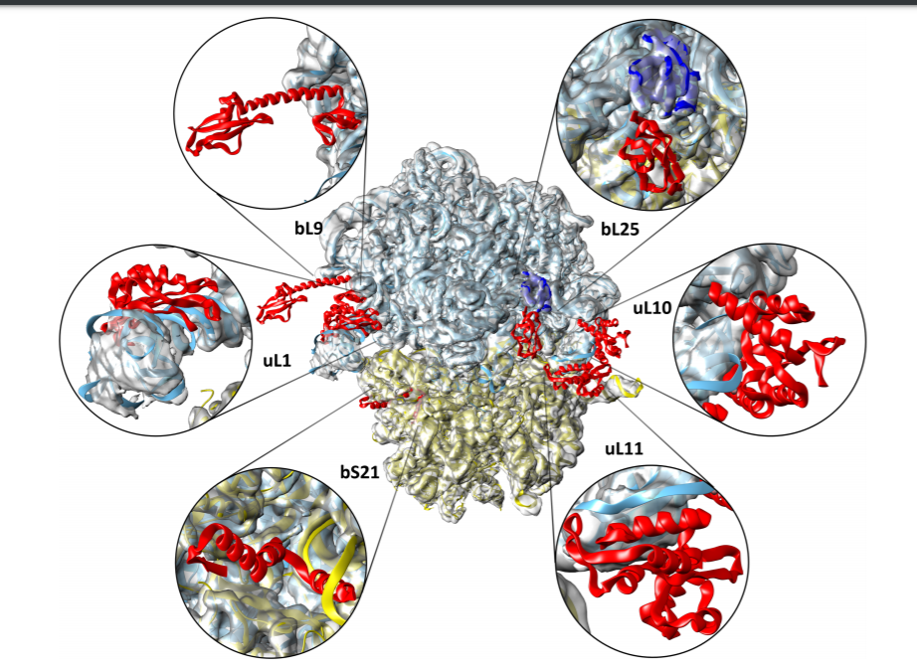
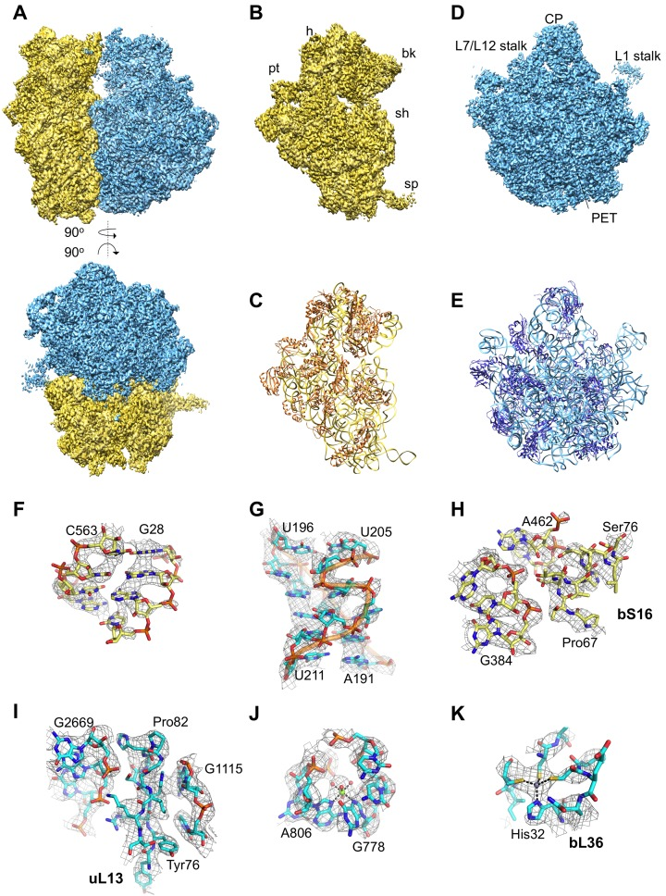
S. aureus ribosome
3.8 Å resolution, Khusanoiv et al. 2016, PDB ID: 5LI0
Notes:
bS21 was purified but was too mobile so electron density at that location was weak – decided to exclude it.
Was modeled in a hibernating ribosome they published a year later

Slide 42
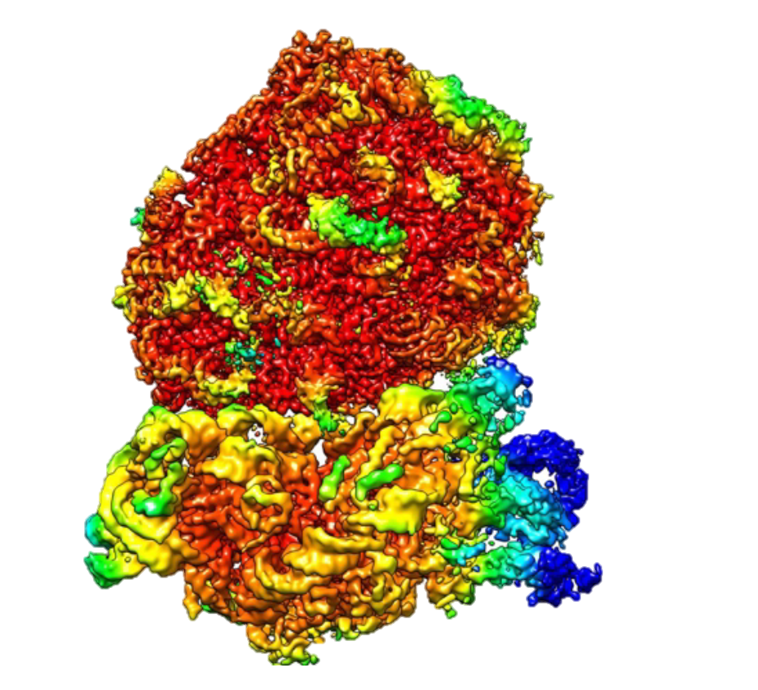


F. tularensis ribosome

Slide 43
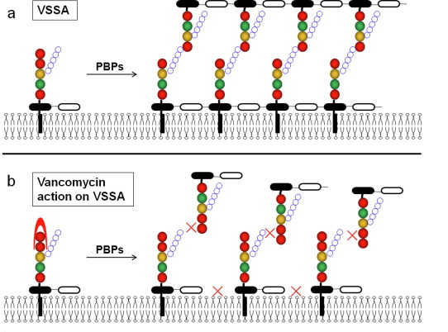
Vancomycin mechanism of action

Slide 44
pdpA alternate transcription start site
Potential promoter, -35 and -10 elements
Potential alternate transcription start site
Documented promoter, -10 and -35 elements
Tested transcription start site
pdpA start codon
TCTTTTTTATACTTCCCATATATCCAACAGCAAAATCAATACTAAAATAACCAT A TCAATACACTTTTTATAACTTTATCGTCAGACCAATTAGCTGTAAACATATAGTCAATAGATAAGTGCTTATGTAAAATGACTTTAGTTATGTTCTAATTAAGTAGACA ATG

Slide 45
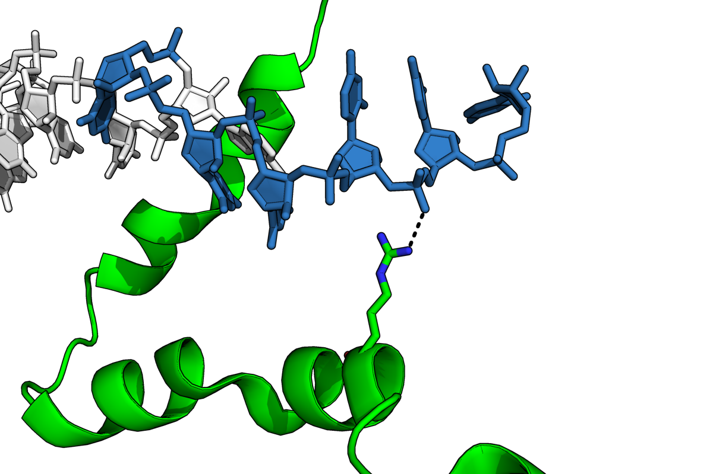
Possible interaction between bS21 and ASD
C1535
C1538
16S rRNA
C1539
3’
U1540
ASD sequence (1535-1540)
5’-CCUCCU-3’
bS21
PFDVALRRFKRSCEKAG
U1536
U1537
R17
bS21
pdb entry 6o7k.cif
Kaledhonkar et al. (2019) Nature 570:400
Image courtesy of Dr. Gregory

Slide 46
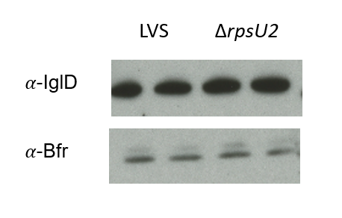
Bfr abundance is unaffected by loss of rpsU2

Slide 47
Antibiotic resistance is associated with increases in cell wall thickness
No antibiotics
Vancomycin
Cui et al. 2006
Notes:
This data is from a study from 2006, in which the researchers used vancomycin-intermediate S. aureus and grew it in two different media, with and without certain cell-wall monomers, generating a thinner cell wall which you see here and one with thickened cell walls, labeled RM.
When the cells are grown in normal culture, we see no difference in their growth rates.
However, when the cells are grown in the presence of vancomycin, we see that the cells with the thicker cell wall grow better than those with the thinner cell wall.
This indicates that there is a correlation between cell wall thickness and antibiotic resistance, specifically vancomycin resistance. However, we are interested in the ribosome. So you might be wondering how does all this talk about antibiotics and staph aureus have to do with our ribosomal protein?
**is this seen in naturally occurring antibiotic resistant strains? Or just this artificially produced one?**

Slide 48
Partial phylogenetic tree of rpsU genes
Burkholderia pseudomallei S13 bS21-1
Burkholderia pseudomallei S13 bS21-3
Burkholderia pseudomallei S13 bS21-2
F. tularensis subsp. holarctica LVS bS21-1
F. tularensis subsp. tularensis Schu4 bS21-1
F. tularensis subsp. novicida U112 bS21-1
F. tularensis subsp. holarctica LVS bS21-3
F. tularensis subsp. tularensis Schu4 bS21-3
F. tularensis subsp. novicida U112 bS21-3
F. tularensis subsp. holarctica LVS bS21-2
F. tularensis subsp. tularensis Schu4 bS21-2
F. tularensis subsp. novicida U112 bS21-2
Escherichia coli K12 bS21
Notes:
S. Aureus bS21 is VERY far away from this, definitely farther away than E. coli.

