Slide 1
Role of a small ribosomal protein, bS21, encoded by rpsU, in regulating virulence genes in Francisella tularensis
Hannah Trautmann
K Ramsey Lab
CMB Seminar
April 3, 2020
Notes:
Hi everyone. I’m Hannah, and I will be presenting on my research into a small ribosomal protein, bs21 and its role regulating virulence genes.

Slide 2
Outline
Background information
  Francisella tularensis
  Regulation of gene expression
  rpsU homologs
  Specialized ribosomes
Preliminary data
  Effects of rpsU2 on virulence genes
  Effects of rpsU2 on intramacrophage growth
Future directions
Notes:
First I’ll start with some background info about the bacteria I’m studying, Francisella tularensis, and the ways that it regulates genes. I’ll then introduce you to the gene of interest, rpsu, and the possibility of specialized ribosomes.
Next I’ll go through some of our preliminary data on effects that one of these genes has on virulence genes and intramagrophage growth
Leave you with future directions

Slide 3
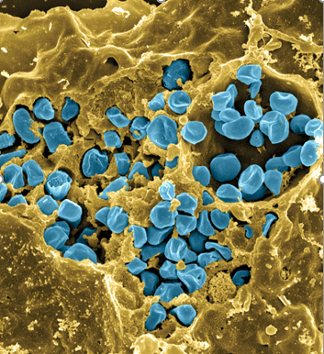
Francisella tularensis
Causes tularemia – ulceroglandular, respiratory
Many hosts and vectors
Highly infectious/ potential bioweapon
Model: F. tularensis subsp. holarctica LVS (live vaccine strain)
Notes:
Francisella is a gram -, facultative intracellular bacteria. It is pathogenic and causes a disease called tularemia, which can take a number of forms based on the route of infection. If infection is via the skin like through a mosquito or tick bite, it produces the ulceroglandular form of the disease, or if infection is by breathing in the bacteria, it causes the respiratory form, which can be fatal.
There are a large number of hosts and vectors including ticks, mosquitos, horse flies, rabbits, and a number of rodents. It can also be water-borne, which makes understanding its epidemiology rather complex.
It is highly infectious with as few as 10 organisms able to cause the disease, and for this reason, along with the fact that it is potentially lethal, that it is considered as a potential bioweapon. This image here is colored so that the francisella are blue and are in a yellow macrophage, and you can clearly see that a ton of organisms replicate in a single host cell.
Luckily we don’t have to work with the pathogenic form because there is a live vaccine strain that we can work with in the lab. It’s non pathogenic to humans but retains it’s pathogenicity in animal models, so we can continue to use it in infection assays.

Slide 4
Gene regulation in F. tularensis
RNAP
Only 2 sigma factors
Relatively few transcription factors
T.F.
σ
How does it adapt so well to its many environments?
Notes:
First I wanted to go through some of the typical ways that we are used to seeing gene regulation in bacteria, which occurs at the level of transcription. In blue we have RNA polymerase at the promoter region of a gene. Generally we will have different sigma factors that help recognition of a promoter of certain genes, and we can have a variety of transcription factors that can influence gene expression in different ways
In Francisella, though, there are only 2 sigma factors, and relatively few transcription factors. But as I just told you, it lives in a wide variety of hosts and environments, so that leads us to question:
How can francisella adapt to its many environments? What other ways might it be regulating gene expression?
70 and 32
Less than 25 – poor annotation

Slide 5
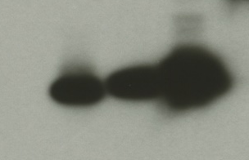
rpsU homologs in Francisella tularensis
rpsU1
cspC
bS21-3 - V
bS21-2 - V
bS21-1 - V
bS21-2-V
bS21-1-V
bS21-3-V
WT
rpsU2
yqeY
dnaG
rpoD
α-VSVG
rpsU3
Notes:
Even though francisella has a reduced genome, it encodes three copies of the rpsU genes, which encode bS21, a protein in the small ribosomal subunit. Most bacteria have 0 or 1 of this gene. We originally, hypothesized, and have since shown, that these three proteins are produced and incorporated into ribosomes. This is a western blot of purified ribosomes from our wild-type strain as well as strains ectopically expressing each of the bS21 proteins, with a VSVG tag. This, along with some mass spec data we have of purified ribosomes, indicates that multiple classes of ribosomes are possible and occurring
This protein is also interesting to us because it is located close to the mRNA exit channel in the ribosome, and early research has identified that it is involved in translation initiation, so it is in an ideal location to be regulating gene expression at the level of translation initiation.
So this heterogeneity of ribosomes may be a mechanism of regulation, but you may not know that ribosomes are heterogeneous so let me show you other ways that may occur.

Slide 6
Heterogeneity in ribosomes
16S rRNA
tRNA
23S rRNA
16S rRNA
tRNA
23S rRNA
Me
1. Multiple rRNA operons
2. rRNA modifications
r-protein
r-protein
Ac
3. Multiple ribosomal protein (r-protein) homologs
P
Me
4. Ribosomal protein modifications
Byrgazov et al. 2013
Notes:
Now all of these sources of heterogeneity have been observed in other bacteria.
First, we can have multiple rRNA operons whose products are incorporating into different ribosomes. These can be post-transcriptionally modified through acetylation or methylation. We can also have homologous ribosomal proteins that incorporate into ribosomes, and these can also be modified, post-translationally.
All these different types of ribosomes that can be made has led the field to start investigating whether these have different functions and, rather than ribosomes acting constitutively as was traditionally believed, perhaps these ribosomes can impart some level of control of gene expression.
Now I want to show you how this might function in Francisella.

Slide 7
Model for how rpsU-encoded bS21 might control gene expression
RNAP
Your favorite gene
Hypothesis: Each bS21 paralog preferentially translates distinct mRNA species, and this leads to differences in protein abundance
Notes:
SLOW DOWN
As I said the bS21 proteins, encoded by rpsU, are important in initiation of translation. So perhaps we have RNA polymerase actively transcribing a gene. The 30S subunit that contains homolog 1 may interact with the leader sequence of this mRNA – but perhaps there isn’t strong affinity, so the 30S subunit falls off.
Then a 30S with a different bS21 comes in. There’s a stronger affinity, so the 30S interacts with the mRNA long enough for the 50S subunit to come in, translation is initiated, and we see the protein being expressed.
This is a simple model, but it shows our hypothesis: that each bS21 paralog preferentially translates distinct mRNA species, and this leads to differences in protein abundance.
We wanted to test this hypothesis so we started by individually deleting each of the rpsU genes, and we found some differences in growth with cells that lacked rpsU2.

Slide 8
Loss of rpsU2 results in a growth defect
ΔrpsU2 pF
ΔrpsU2 pF-rpsU1
ΔrpsU2 pF-rpsU2
ΔrpsU2 pF-rpsU3
Notes:
On the y-axis here we have growth as measured by optical density. Wild-type cells with empty vector pF and the drpsU2 strain.
We thought that this might be because we were disturbing nearby genes, so we wanted to test it with complementation with not only the same gene we have deleted, but the other genes as well to see if they are interchangeable.
What we found is that the overexpressing rpsU2 restores wild-type level growth, and interestingly we see functional redundancy with rpsU1 but not with rpsU3.
So this tells us that the growth defect we see due to loss of rpsU2 is specific, and appears to be complemented by rpsU1 and 2, but not 3. This got us really interested in the second homolog, so we wanted to look at whether there were changes in global protein expression in this drpsU2 strain.

Slide 9
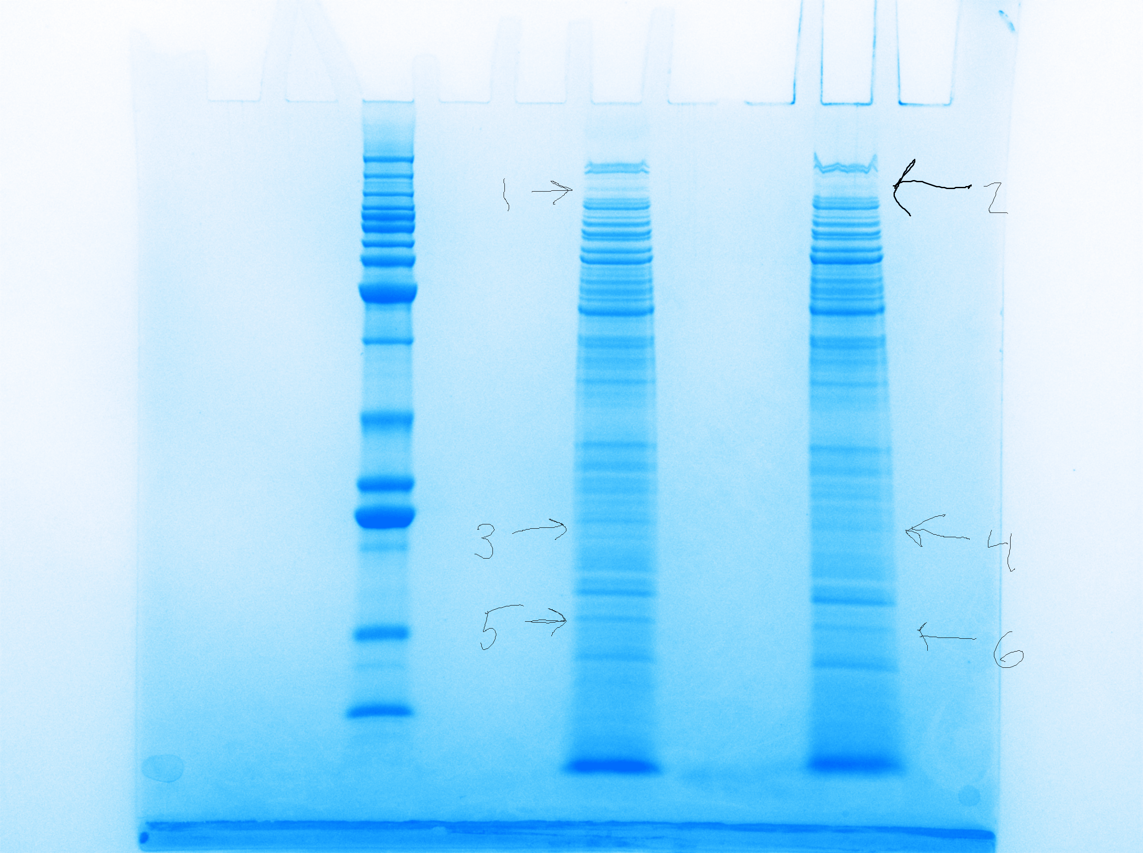
Cells lacking rpsU2 have less PdpB
LVS
∆rpsU2
LVS
~125 kDa
PdpB
Notes:
So I did a Coomassie stain of whole cell extracts of our wild-type cells and drpsU2, and we noticed honestly a lot fewer differences than we expected, but we did see a difference in a band here. We sent that out for mass spec and found, among the differences was pdpB, and that there was substantially less of this protein in drpsU2 when compared with wild-type.

Slide 10
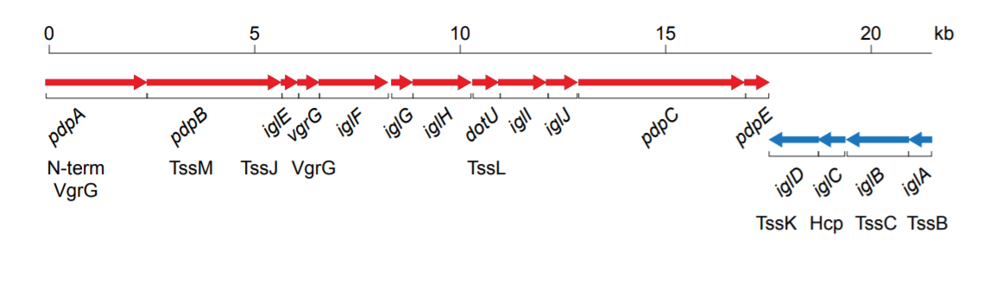
Francisella Pathogenicity Island (FPI)
Regulated at level of transcription, by PigR and other components
Notes:
Now this was really exciting because pdpB is part of the Francisella pathogenicity island, or FPI. The FPI encodes the type vi secretion system in francisella, and is absolutely essential to virulence. I also wanted to point out here, because this will be important later on, that the FPI is comprised of two distinct operons. pdpB is on the plus strand operon here, along with pdpA, and a number of other genes, and the second operon is comprised of iglA-D.
We do know a fair amount about how the FPI genes are regulated at the level of transcription, and I don’t want to get too into the details here, but I will just introduce you to a protein called pigR which has been shown to be necessary for transcription of both operons of the FPI, so it’s a useful control we’ll be using throughout these next few experiments. There haven’t been any publications into whether the FPI is controlled at the level of translation.
Once we identified pdpB as potentially being influenced by the presence of rpsU2, we wanted to confirm these results using immunoblotting, and look to see if any of the other FPI proteins are also affected.

Slide 11
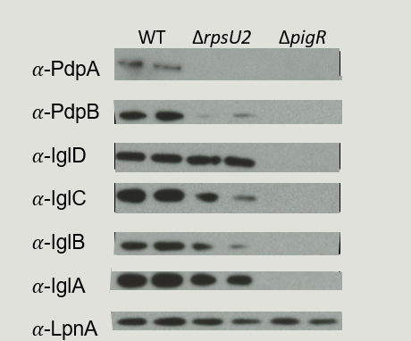
Lack of rpsU2 results in decrease in FPI proteins from one operon
FPI Operon 1
FPI Operon 2
Notes:
SLOW DOWN
Here we have the results of those western blots. We ran whole cell lysates in duplicate, our wild-type cells are represented here, and we have antibodies for a few proteins from each of the FPI opersons. And then LpnA, is our loading control.
When we compare the wild-type cells to drpsU2, we see a significant reduction, 18-fold reduction, of pdpB and a similar loss of pdpA. But, we did not observe the same level of difference in protein abundance for the igl proteins, from operon 2. I realize these results are a bit inconsistent and they will be repeated we just haven’t gotten to it because of the covid19 fiasco.
Then finally we ran a control with deltapigR, because as I mentioned the pigR protein necessary for transcription of the both operons of the FPI, and you can see clearly that without it, these proteins are not present.
In summary, the new information is this middle column here, where we found that just one FPI operon appears to be affected by presence of rpsU2.
Because we had seen earlier those interesting complementation results with the growth curve, we wanted to see if pdpB abundance could be complemented by ectopically expressing rpsU, so we did another Western. I just want to point out here that iglD was very consistent, so on the next blots we started using that as our loading control.

Slide 12
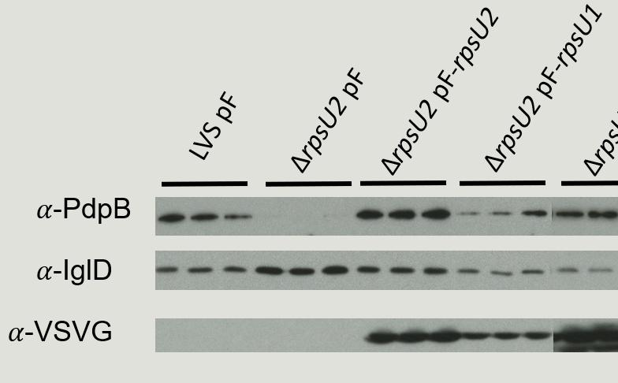
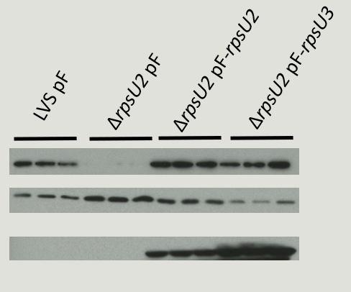
PdpB abundance can be recovered with complementation of rpsU2
-V
-V
-V
-V
Notes:
SLOW DOWN
Here we have our blots, like I said iglD is our loading control, we are looking only at pdpB abundance and then we also assessed the amount of the rpsU-encoded protein that is produced by using VSVG-tagged genes and probing for that.
We ran our samples in triplicate this time and we see the same results comparing our wild-type strains to drpsU2, where there’s a major loss of pdpB amounts. When we complement with the second homolog, we see restoration of pdpB beyond wild-type levels.
We were also testing specificity so when we complement with the first homolog, we see pdpB, but at lower levels than we see with the second, and we see this correlates with the amount of the ribosomal protein produced.
Complementing with the third homolog, which came from a different blot where the first three samples are the same, we see about wild-type levels, but this doesn’t correlate to the amount of bS21. Sorry for the ugly blot here – such a strong signal.
So all of this tell sus that rpsU2 can complement in the drpsU2 strain, and so can rpsU1, but it appears that rpsU3 doesn’t quite work the same way because more of the ribosomal protein does not correlate with more pdpB.
Now this is all very interesting, but we still don’t know if this affect on pdpB and pdpA is happening at the level of transcription or translation, so we isolated RNA, generated cDNA, and determined abundance of these different transcripts using qRT-PCR.
Diff abundances? Same promoter but diff RBS and stability

Slide 13
Transcript abundance is not affected by loss of rpsU2
WT
ΔrpsU2
ΔpigR
Notes:
SLOW DOWN
Alright so what you see here first are pdpA and B which were most affected by loss of rpsU2. We are using wild-type and delta pigR as our controls, because FPI proteins require PigR for expression at the level of transcription. And what we see here is that there really is NOT a significant difference in transcript abundance of these genes between wild-type and the strain lacking rpsU2.
We also looked at transcript abundance of iglA which is one of the genes on the other FPI operon that doesn’t appear to be affected significantly at the level of protein expression, and we see very similar results here.
Finally for controls we looked at two non-FPI genes, rpoA1 and bfr, and here we see pretty consistent abundance of these transcripts among the three strains.
If regulation were occurring at the level of transcription, we would see something like what we see with delta pigR where clearly BOTH FPI operons are affected at the level of transcript abundance, but what we see is indicating that our ribosomal protein is operating differently. So this is really exciting, and it opens up the possibility that regulation is occurring at the level of translation.
I’m also in the processing of doing this with our complementation strains as well, but I didn’t quite finish before this covid19 thing, so that data is forthcoming, but so far it looks consistent with this data.
So this all tells us that perhaps the protein encoded by rpsU2 is regulating gene expression of SOME FPI proteins at the level of translation. But what affect does that have on the virulence of the bacteria, since we know these are virulence genes?

Slide 14
Loss of rpsU2 leads to intramacrophage growth defects
ΔrpsU2 + pF
ΔrpsU2 + pF- rpsU2
Notes:
To test that I did an intramacrophage growth assay, where I grow up my different bacterial strains in mouse macrophages then see how much they were able to replicate after 24 hours. On the y-axis we have normalized bacterial growth comparing 24 hours to 2 hours. Here we have our wild-type strain, where we get good replication.
In the strain that lacks rpsU2 we see about a 1-log defect in growth, so indeed there is some affect on francisella’s virulence. Then we tried complementing with our ectopically expressed rpsU2, and we find that we can complement this defect.
All of this fits with the model that the protein encoded by rpsU2 effects pdpA and pdpB, and this may be causing a defect in type vi secretion leading to a loss in virulence.
GT in Vivo Generation Time in Vitro
LVS + pF 156.3858 131.5391
∆rpsU2 + pF 233.5667 169.1624
∆rpsU2 + pF-rpsU2 119.5633 147.0962
*Faster in Vivo for WT and complement, slower in vivo for drpsU2*
Complement is fastest in vivo, drpsU2 is slowest

Slide 15

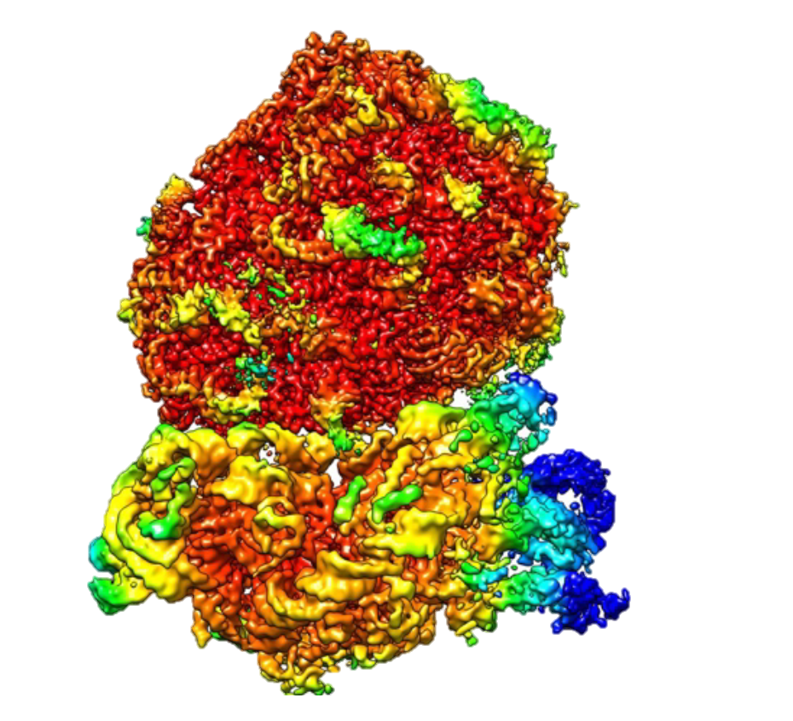

Future Directions
Identify molecular mechanism causing this affect on protein abundance
In vitro transcription/translation kit
Competition macrophage assay
Ribosome structure
What role does rpsU play in other species?
  Staphylococcus aureus shows reduction in vancomycin and daptomycin sensitivity
lacZ
pdpA 5’UTR
Notes:
So there’s a lot of work to do. One of the major questions we have is HOW the rpsU2-encoded protein is able to control protein abundance, and we hypothesize that it is via translation. Based on it’s location in the ribosome, we suspect that it may be interacting with the 5’ untranslated region, or UTR, of these mRNA. So to test this theory I’ve generated strains that fuse the 5’ UTR of pdpA to lacZ, because that’s a gene we know is affected and has a well-defined UTR. We are lucky to have a single target to analyze the mechanism, so we can produce this mRNA and assess protein abundance in drpsU2 and wild-type with B-gal assays.
We are also going to look at this using an in-vitro transcription/translation kit, which has all of the components you need except the ribosomes. So I’ll put in some of the ribosomes I’ve isolated that have only 1 of the homologs, and then compare how much pdpA is translated, and this will tell us whether the ribosome containing different homologs is sufficient to demonstrate these differences.
We’ve also been seeing a lot of variability in our macrophage assays, which I didn’t show here, but we are going to work on setting up a competition assay where we put both wild-type and drpsU2 cells into the same well.
Also, we have a collaborator, Maria Schumacher, at Duke who has been generating a structure of the francisella ribosome for us. This is what she has so far, this is the 30S and 50S here, with the colors representing resolution in angstroms. I’ve been purifying ribosomes that are homogenous in which homolog they have, and hopefully we will be able to see if there are any structural differences in the ribosome as a whole when we switch out for a different homolog.
And then sort of further down the line, we want to look at rpsU in different species. So there’ve been a few studies that flagged rpsU in Staph aureus as potentially being important for both vancomycin and daptomycin resistance, which are not ribosome-targeting antibiotics, so we want to look into that.

Slide 16




Acknowledgements
Dr. Kathryn Ramsey
  Jamie Wandzilak
  Tala Allababidi
  Dan Ruggiero
  Maria Santiago
  Other lab members
Dr. Steven Gregory & Lab
Dr. Jodi Camberg & Lab
Dr. Maria Schumacher & Lab
Janet Atoyan & GSC
Notes:
Lots of people to thank, Dr. Ramsey of course and all the members of the Ramsey lab, especially Tala, Dan, and Maria who have helped me with the ribosome project. Then Dr. Gregory and Dr. Camberg and their labs for lending us equipment and supplies, our collaborator at Duke Dr. Schumaker, and of course Janet, and grants we’ve received for this project from the RI foundation and INBRE.

Slide 17

Got any questions?
Notes:
What couples transcription and translation? NusG
-important that at exit channel because initiation occurs at exit channel when 16s rRNA recognizes shine delgarno on mRNA
-bS21 interacts with bs18, uS11, and 16s rRNA
-In bacillus subtilis, this results in defects in motility and biofilm formation, and in listeria monocytogenes, null mutants have increased acid stress resistance and changes in transcription of stress resistance genes.
-Percent identities:
1 and 3 – 72%
1 and 2 57%
1 and ecoli – 52%
2 and 3 – 50%
2 and e coli – 60%
-E.Coli bS21 is in same operon rpoC and primase, so most similar to #2. Others are more similar to #3, like listeria and bacillus
- paralogs = gene duplication, orthologs = from different species. Likely rpsU are paralogs because we built a tree and they all clustered very close together and were only surrounded by other francisella proteins
-yqeY = hypothetical protein, uncharacterized
GT in Vivo Generation Time in Vitro
LVS + pF 156.3858 131.5391
∆rpsU2 + pF 233.5667 169.1624
∆rpsU2 + pF-rpsU2 119.5633 147.0962
*Faster in Vivo for WT and complement, slower in vivo for drpsU2*
Complement is fasted in vivo, drpsU2 is slowest

Slide 18
Conditions rpsU1 is Expressed

Slide 19
Amino acid alignment of bS21 (rpsU-encoded) homologs
bS21-1 MLSIRVDEHKPFDISLRNFKRACEKAGIKQELRDRQHYVKPTEKRKIAKRQAVKRARISQ-----RRAFI-
bS21-2 MPSVRIKEREPFDVALRRFKRSCEKAGIVSELRRREYFEKPTWARKRKKTAAVKRAHKSNIIVKR------
bS21-3 MPRIIVDPKKPFDISLRNFKRACEKAGIKQELRDRQHYVKPTQKRKIAKKAAISKAKKEA-----RRSYSY
E.coli MPVIKVRENEPFDVALRRFKRSCEKAGVLAEVRRREFYEKPTTERKRAKASAVKRHAKKLARENARRTRLY
Identical amino acids
Similar properties
Notes:
Percent identities:
1 and 3 – 72%
1 and 2 57%
1 and ecoli – 52%
2 and 3 – 50%
2 and e coli – 60%

Slide 20
Francisella Pathogenicity Island (FPI)

Slide 21
Complementation of only rpsU2 restores growth in macrophage
ΔrpsU2 + pF
ΔrpsU2 + pF- rpsU1
ΔrpsU2 + pF- rpsU2
Notes:
Generation Times In Vitro In Vivo
LVS + pF 132 137.1485
∆rpsU2 + pF 169 161.1571
∆rpsU2 + pF-rpsU1 148 166.6685
∆rpsU2 + pF-rpsU2 147 146.9349
*slowest in viv is for the pF-rpsU1, next slowest is drpsU2, but does not correlate with in vitro growth times*

Slide 22
Loss of rpsU2 leads to alterations in MIC for some ribosome-targeting antibiotics
 | WT | ∆rpsU1 ∆rpsU3 | ∆rpsU1 ∆rpsU2 | ∆rpsU2 ∆rpsU3
Kanamycin | 6.3 | 6.3 | 6.25 | 6.25
Hygromycin | 84.4 | 84.4 | 42.19 | 42.19
Tetracycline | 4.0 | 4.0 | 2.0 | 2.0
Streptomycin | 6.3 | 6.3 | 6.3 | 6.3
All values in μg/mL

Slide 23
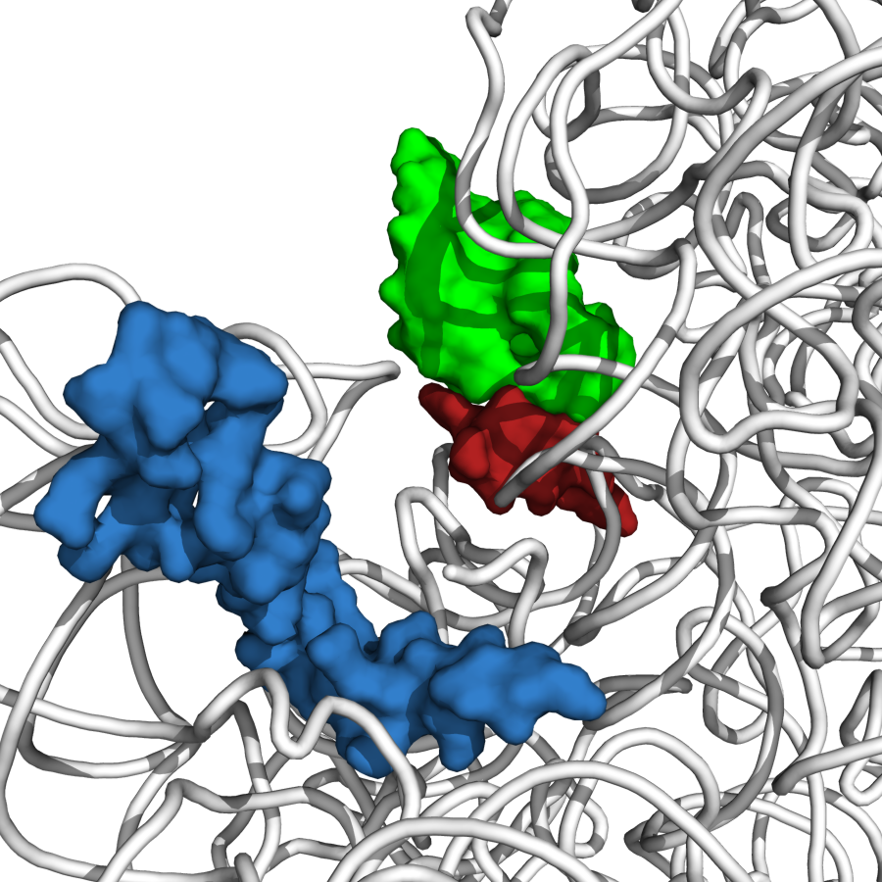
Ribosomal protein bS21
P-site tRNA ASL
bS21
mRNA
Steven Gregory, PDB Entry 4V50

