Slide 1
Lab Meeting
December 02, 2019
Hannah Trautmann

Slide 2
Outline
Background refresher
Phylogenetic tree
Macrophage infection assays
Type VI secretion assays
CryoEM

Slide 3
Bacterial ribosomes
RNAP

Slide 4
bS21 homologs in Francisella tularensis
rpsU1
cspC
rpsU2
yqeY
dnaG
rpoD
rpsU3

Slide 5
Amino acid alignment of bS21 homologs
bS21-1 MLSIRVDEHKPFDISLRNFKRACEKAGIKQELRDRQHYVKPTEKRKIAKRQAVKRARISQ-----RRAFI-
bS21-2 MPSVRIKEREPFDVALRRFKRSCEKAGIVSELRRREYFEKPTWARKRKKTAAVKRAHKSNIIVKR------
bS21-3 MPRIIVDPKKPFDISLRNFKRACEKAGIKQELRDRQHYVKPTQKRKIAKKAAISKAKKEA-----RRSYSY
E.coli MPVIKVRENEPFDVALRRFKRSCEKAGVLAEVRRREFYEKPTTERKRAKASAVKRHAKKLARENARRTRLY
Identical amino acids
Similar properties
Percent Identity | bS21-1 | bS21-2 | bS21-3 | bS21-4
bS21-1 | 100
bS21-2 | 56.67 | 100
bS21-3 | 72.31 | 50 | 100
E. coli bS21 | 52.31 | 60 | 50 | 100

Slide 6
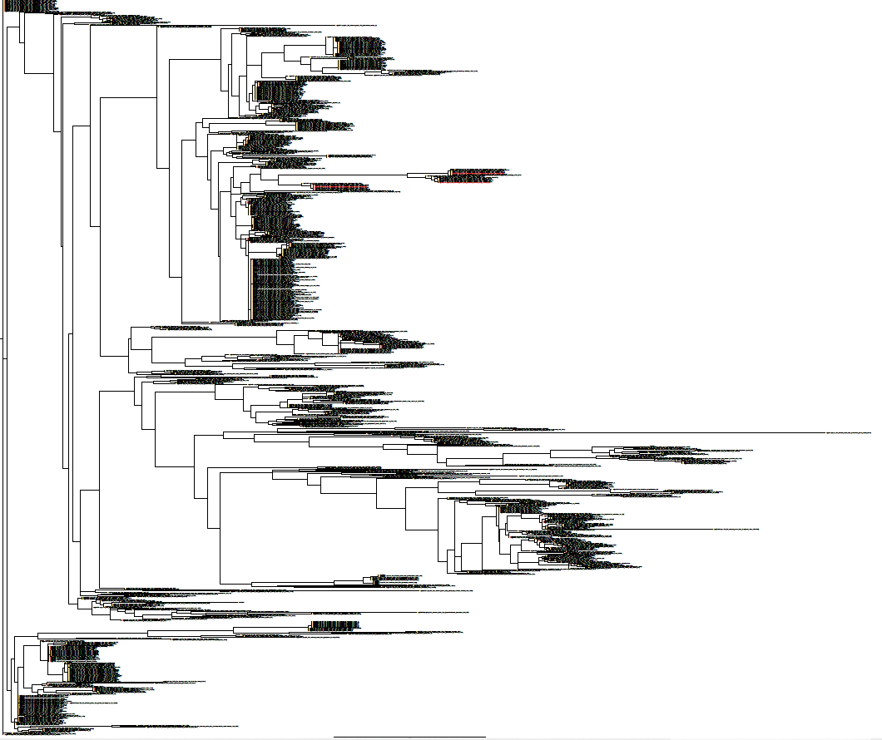
Phylogenetic tree
LVS
E. coli

Slide 7
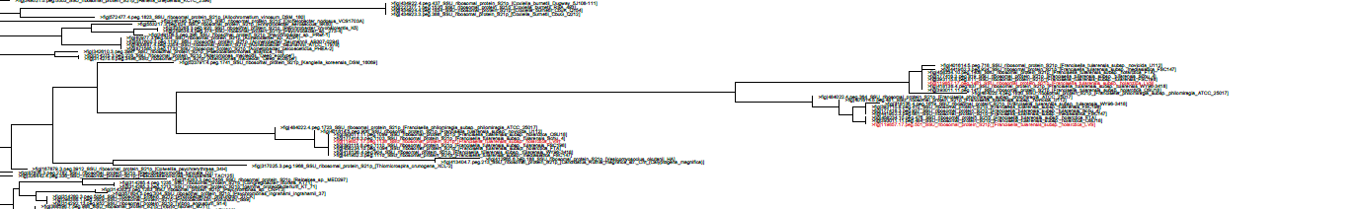
Phylogenetic tree

Slide 8
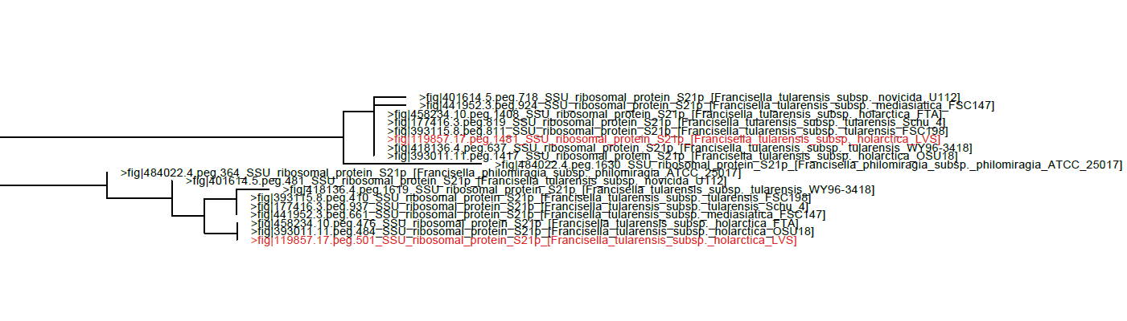
Phylogenetic tree
Conclusion: paralogs?

Slide 9
Intramacrophage growth defects associated with loss of rpsU2
*
*
*
*

Slide 10
Effects of ΔrpsU2 on Type VI Secretion
sBHIc
sBHIc + 5% KCl
pellet
supernatant
pellet
supernatant
ΔrpsU2
ΔrpsU2
ΔrpsU2
ΔrpsU2
LVS
LVS
LVS
LVS
ΔpigR
ΔpigR
ΔpigR
ΔpigR
anti-sigma70
anti-IglC

Slide 11
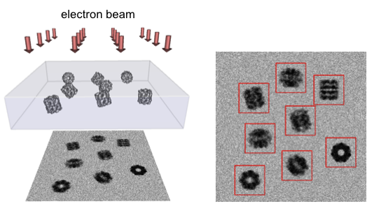
ΔrpsU1/ ΔrpsU3 cryoEM progress

Slide 12
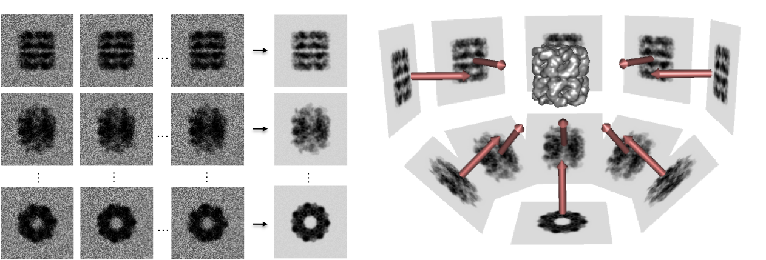
ΔrpsU1/ ΔrpsU3 cryoEM progress

Slide 13
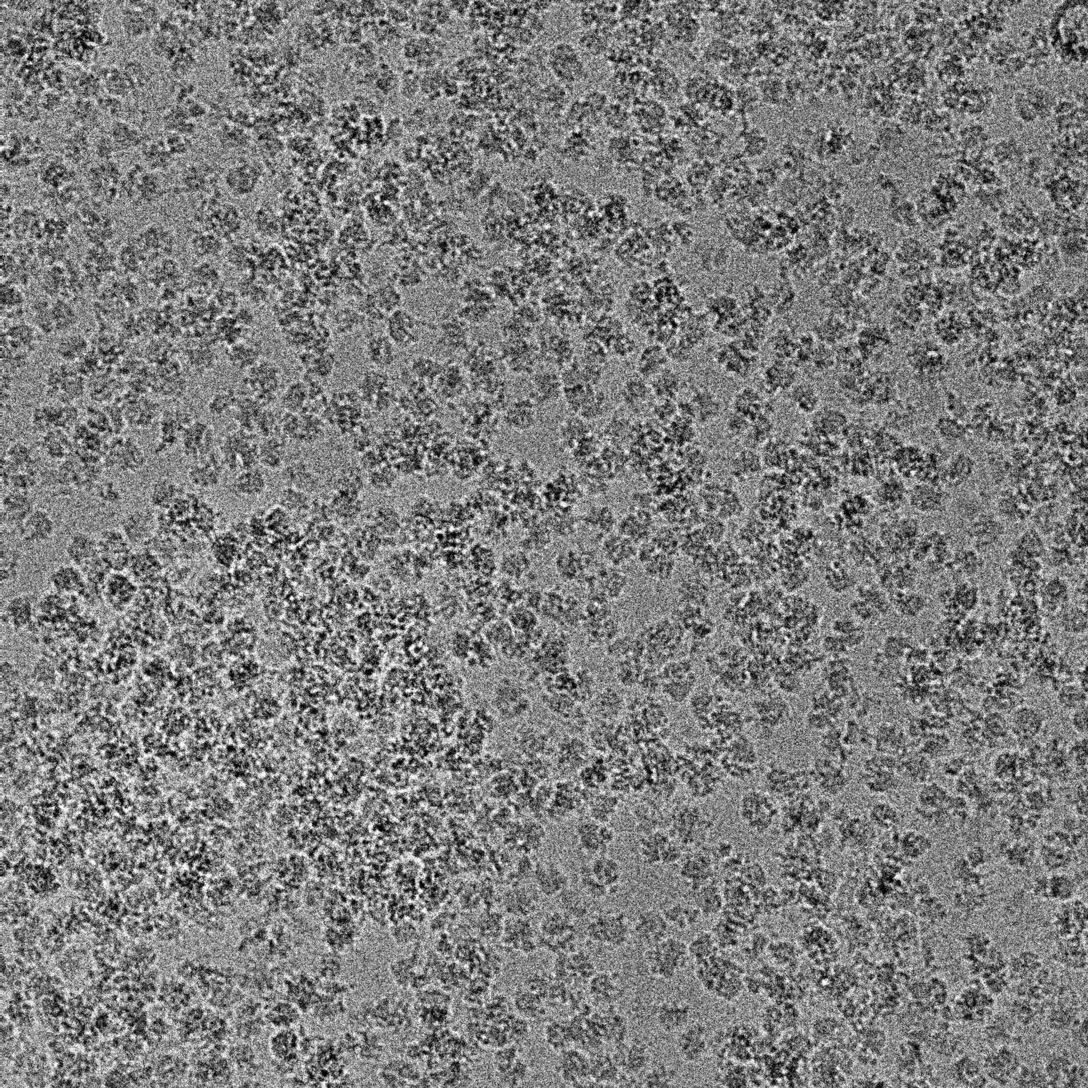
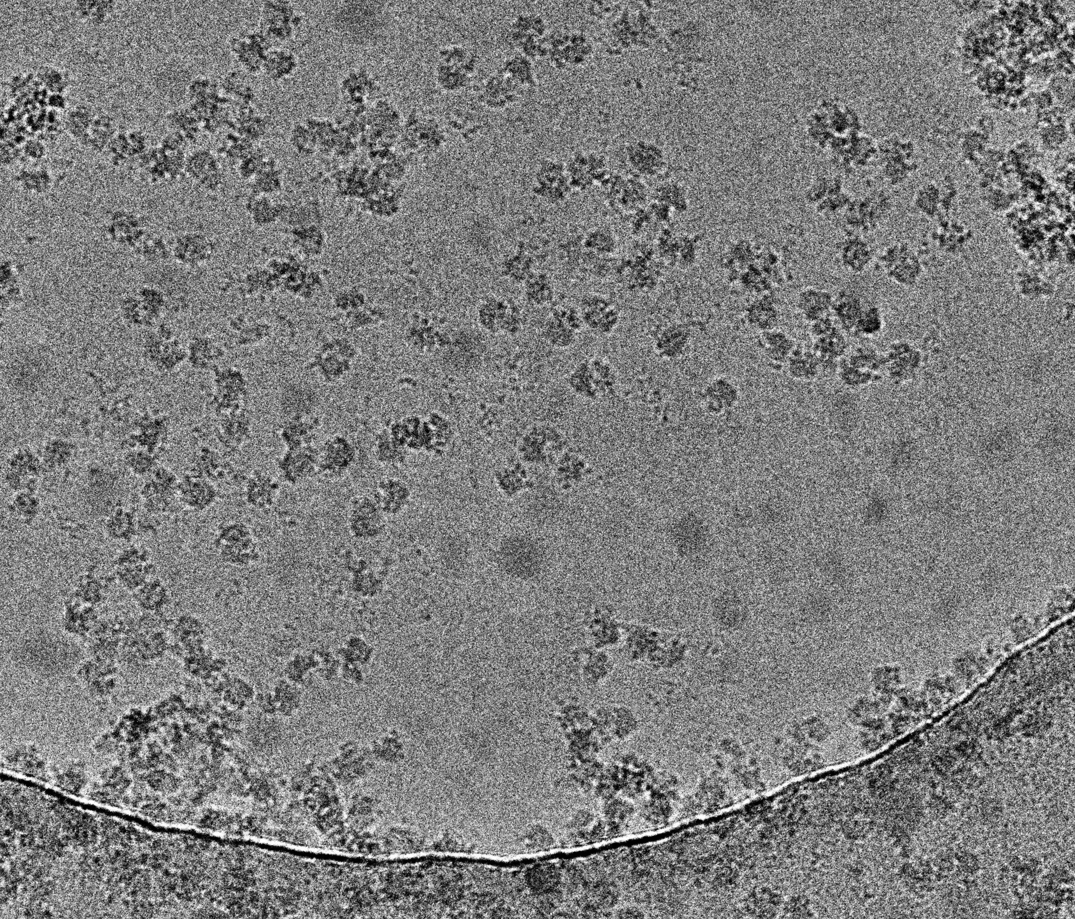
ΔrpsU1/ ΔrpsU3 cryoEM progress

Slide 14
Next steps
Macrophage assays
  Double deletions
Type VI secretion assays
  Repeat and verify!
CryoEM
  Isolate ribosomes from other double deletion strains

Slide 15
Questions?

