Slide 1
Investigation of heterogeneous ribosomes in Francisella tularensis
Hannah Trautmann
Lab Meeting
September 24, 2019

Slide 2

Gene regulation in bacteria
P
Me
DNA
RNA
protein
translation
transcription
Promoters
Small RNAs
Transcription Factors
RNA binding proteins
Ac
Corepressors
Coactivators

Slide 3
Bacterial ribosomes
RNAP

Slide 4
Heterogeneity in ribosomes
16S rRNA
tRNA
23S rRNA
16S rRNA
tRNA
23S rRNA
Me
1. Multiple rRNA operons
2. rRNA modifications
Ribosomal Protein
Ribosomal Protein
Ac
3. Multiple ribosomal protein homologs
P
Me
4. Ribosomal protein modifications
Byrgazov et al. 2013

Slide 5
Specialized ribosomes in Mycobacterium tuberculosis
Zur
Zn²⁺
Zn²⁺
(Intracellular)
Zn²⁺
PrimRP 18
AltRP 18
Zn²⁺
Zn²⁺
Zn²⁺
Zn²⁺
Zn²⁺
PrimRP 18
AltRP 18
(Extracellular)
Zn²⁺
Zn²⁺
Zn²⁺
Prisic et al. 2016

Slide 6
bS21 homologs in Francisella tularensis
rpsU1
cspC
rpsU2
yqeY
dnaG
rpoD
rpsU3

Slide 7
Amino acid alignment of bS21 homologs
bS21-1 MLSIRVDEHKPFDISLRNFKRACEKAGIKQELRDRQHYVKPTEKRKIAKRQAVKRARISQ-----RRAFI-
bS21-2 MPSVRIKEREPFDVALRRFKRSCEKAGIVSELRRREYFEKPTWARKRKKTAAVKRAHKSNIIVKR------
bS21-3 MPRIIVDPKKPFDISLRNFKRACEKAGIKQELRDRQHYVKPTQKRKIAKKAAISKAKKEA-----RRSYSY
E.coli MPVIKVRENEPFDVALRRFKRSCEKAGVLAEVRRREFYEKPTTERKRAKASAVKRHAKKLARENARRTRLY
Identical amino acids
Similar properties

Slide 8
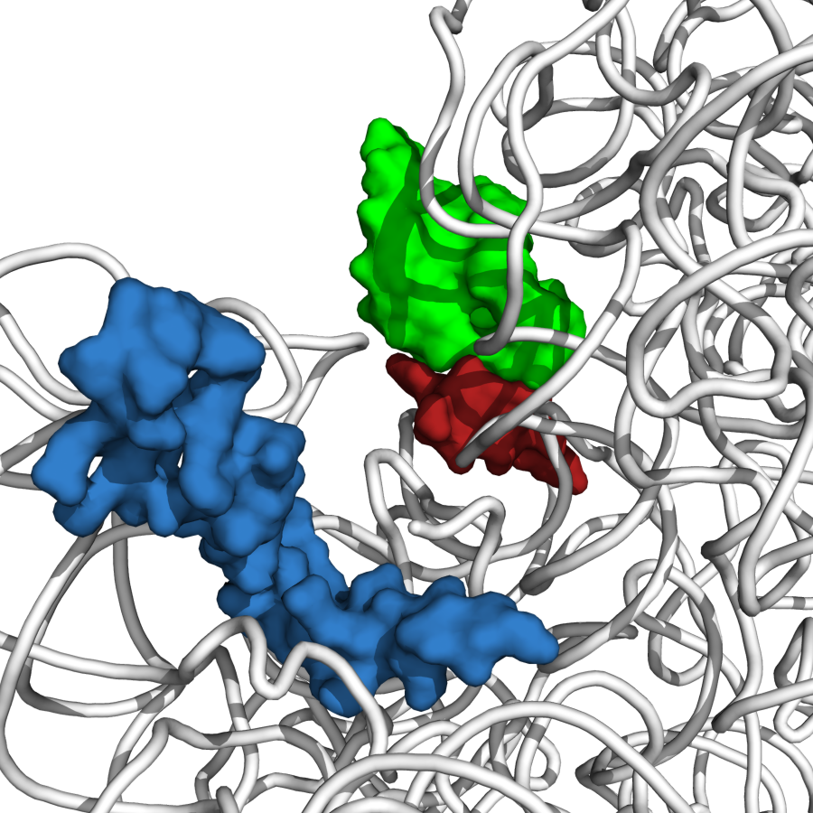
Ribosomal protein bS21
P-site tRNA ASL
bS21
mRNA
Steven Gregory, PDB Entry 4V50

Slide 9
Major questions
Are all three bS21 proteins incorporated into ribosomes?
What are the functional consequences of incorporating different homologs into ribosomes?
Hypothesis: Different classes of ribosomes translate different mRNA species

Slide 10
Purified ribosomes from LVS
bS21 proteins identified:
bS21-2
Normalized Spectral Count: 19
bS21-3
Normalized Spectral Count: 4
Notes:
bS21, bL35

Slide 11
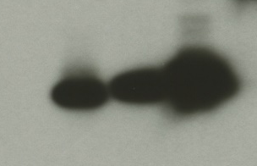
Creating homogenous ribosome populations
1. Deletion strains
2. Ectopic expression
All single mutants
rpsU2 only
rpsU3 only
bS21-2-V
bS21-1-V
bS21-3-V
WT
Still to make:
  rpsU1 only
  Triple deletions
~8 kDa
α-VSVG

Slide 12
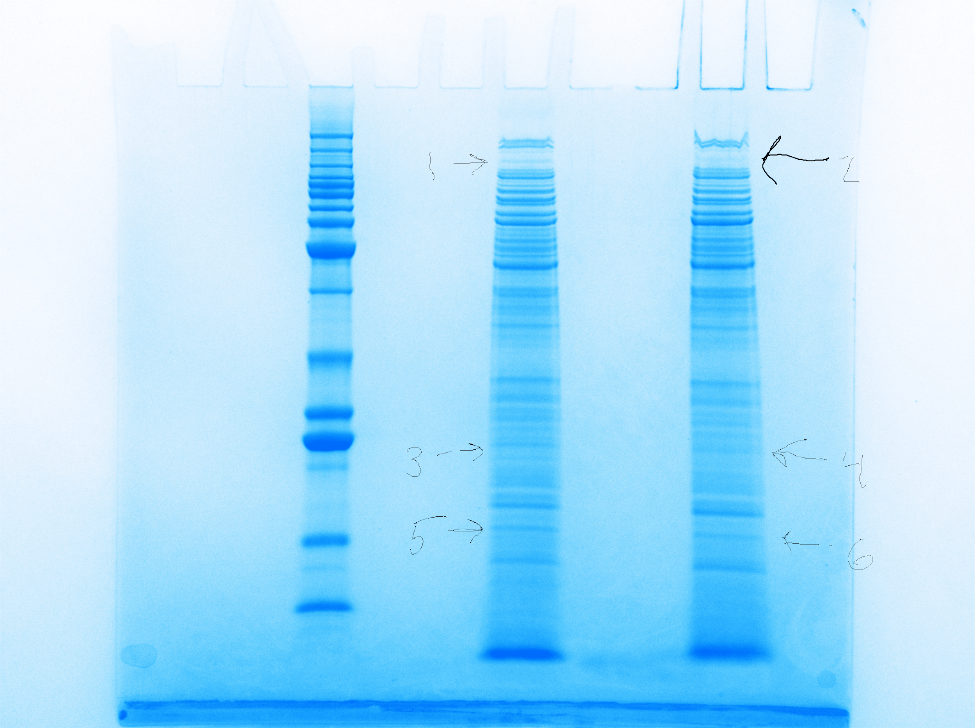
Identifying proteins lost by ΔrpsU2
LVS
∆rpsU2
LVS
~125 kDa
CarB, PdpB
FTL_0009
bL21
Protein | Normalized Spectral Count LVS | Normalized Spectral Count ΔrpsU2
Carbamoyl phosphate synthase B (carB) | 174 | 135
PdpB (TssM homolog) | 103 | 69
Outer membrane protein (FTL_0009) | 77 | 58
50S ribosomal protein L21 (rplU) | 75 | 65
~20 kDa
~13 kDa

Slide 13
ΔrpsU2 Growth Defect
ΔrpsU2
ΔrpsU2 w/ pKR7

Slide 14
Loss of rpsU2 leads to intramacrophage growth defects
ΔrpsU2
rpsU2
ΔrpsU2
Notes:
GT in Vivo Generation Time in Vitro
LVS + pF 156.3858 140.0894
∆rpsU2 + pF 394.6318 177.8443
∆rpsU2 + pKR7 119.5633 160.3448

Slide 15
Generation times in vivo vs. in vitro
 | Generation time in macrophage (mins) | Generation time in vitro (mins)
LVS | 123.4994 | 135.2586
ΔrpsU2 | 450.808 | 179.3978
∆rpsU2 + pF-rpsU2 | 119.5633 | 160.3448

Slide 16
Conditions rpsU1 is Expressed
rpsU1
cspC

Slide 17
Why it matters

Slide 18
Future Directions
Other functional consequences?
  Create homogenous populations
  Antibiotic susceptibility – MIC assays
  Structure – CryoEM
Differences in mRNA translated?
  Targeted approach
  Genome-wide approach

Slide 19



Acknowledgements
Dr. Kathryn Ramsey
Jamie Wandzilak
Tala Allababidi
Maria Santos
Dr. Steven Gregory & Lab
Dr. Jodi Camberg & Lab
Dr. Chris Lane
Janet Atoyan & GSC
Northwestern Proteomics

Slide 20

Questions?

Slide 21
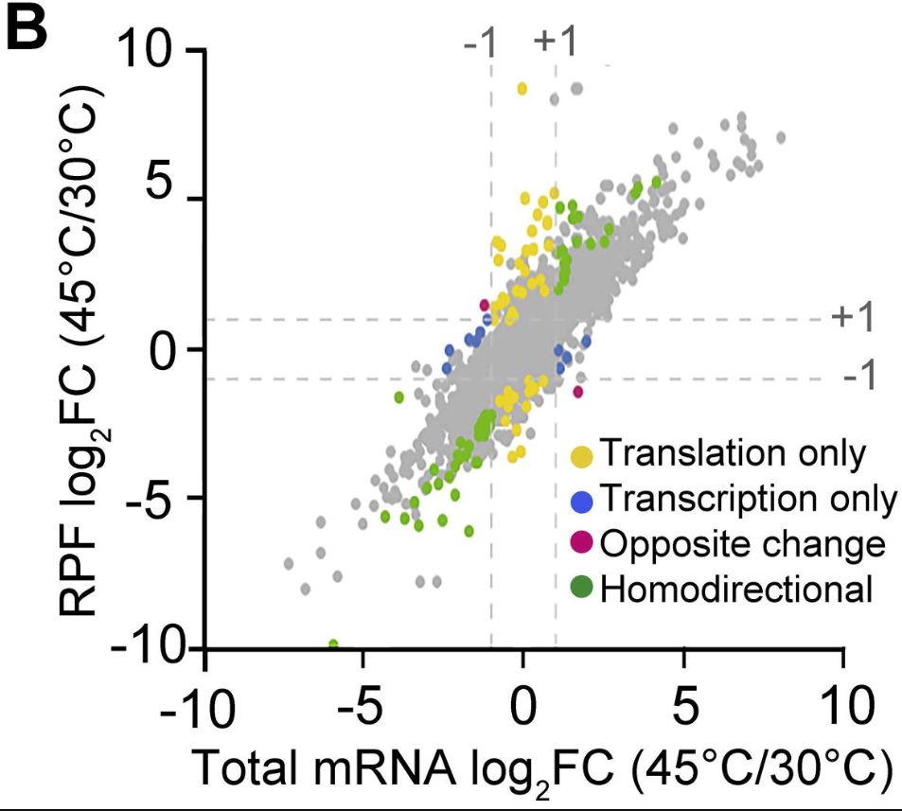
Transcription and translation can be uncoupled
RPF = ribosome-protected mRNA fragments
Zhang et al. 2017

Slide 22
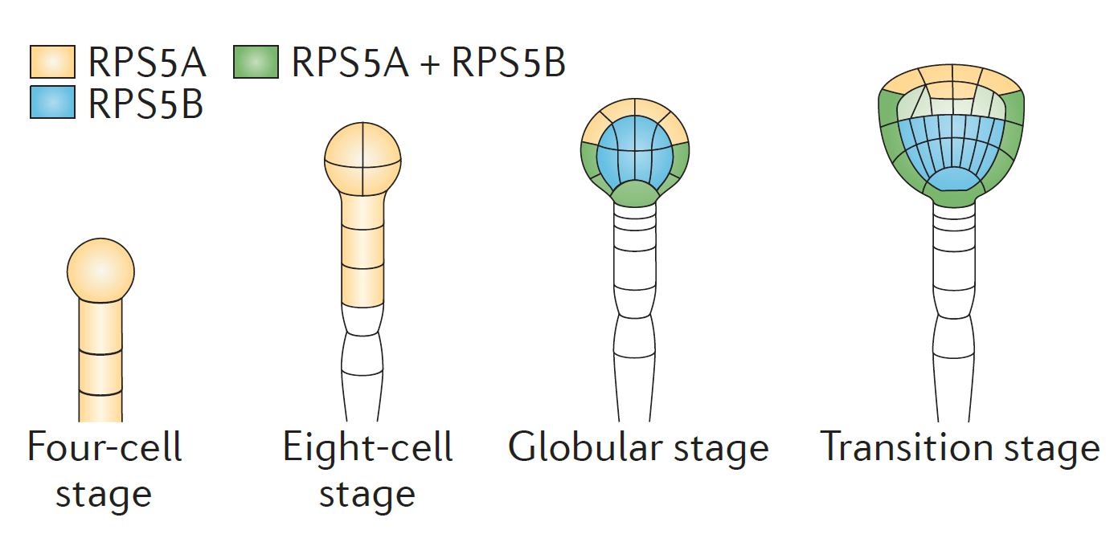
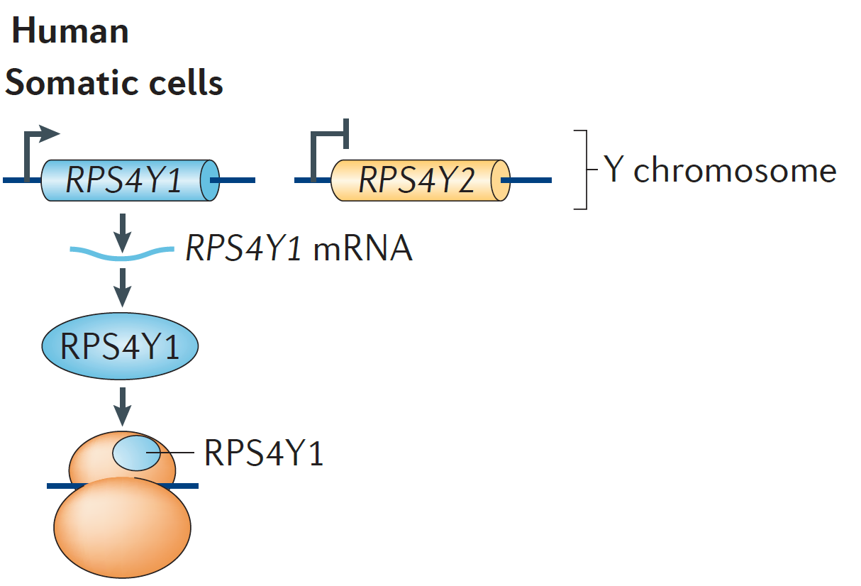
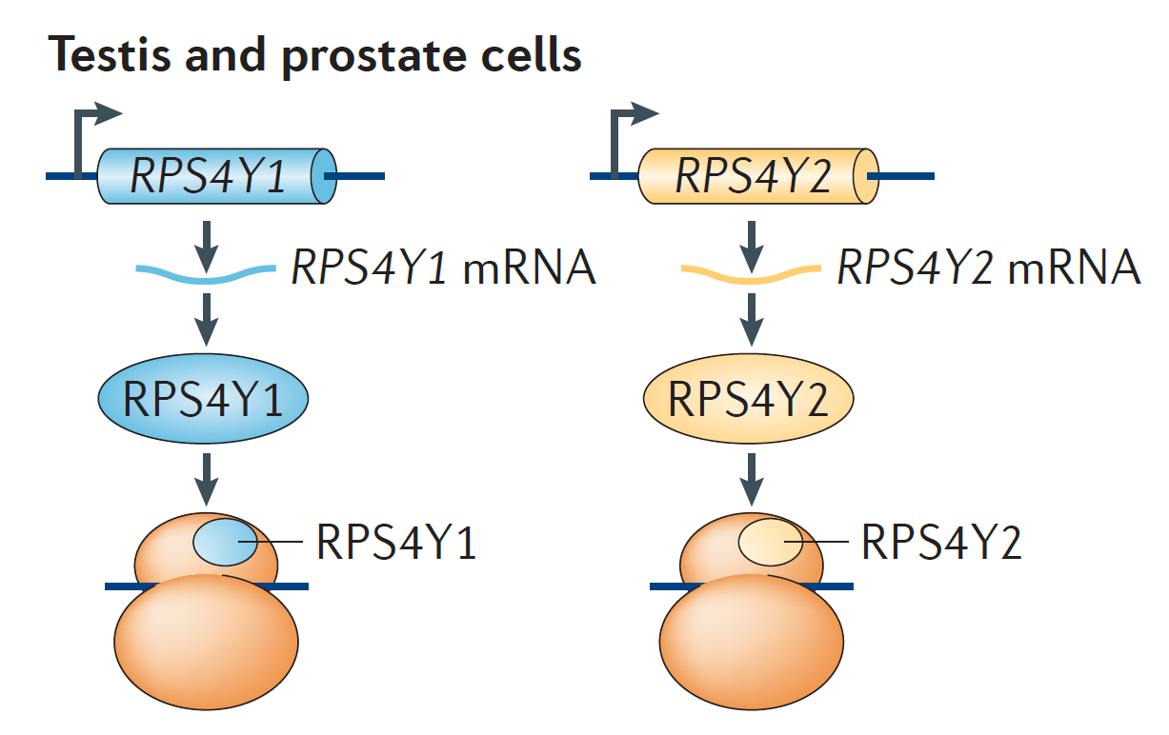
Specialized ribosomes in eukaryotes
Different life stages (Arabidopsis thaliana)
Different tissues (Homo sapiens)
Xue and Barna 2012
Notes:
Arabidopsis thaliana = thale cress, small flowering plant

Slide 23
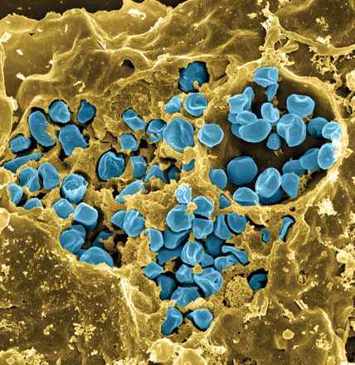
Francisella tularensis
Causes tularemia – ulceroglandular, respiratory
Many hosts and vectors
Highly infectious/ potential bioweapon
Model: F. tularensis subsp. holarctica LVS (live vaccine strain)
Notes:
Francisella is a gram -, facultative intracellular bacteria. It is pathogenic and causes a disease called tularemia, which can take a number of forms based on the route of infection. If infection is via the skin like through a mosquito or tick bite, it produces the ulceroglandular form of the disease, or if infection is by breathing in the bacteria, it causes the respiratory form, which can be fatal.
There are a large number of hosts and vectors including ticks, mosquitos, horse flies, rabbits, and a number of other rodents. It can also be water-borne, which makes understanding its epidemiology rather complex.
It is highly infectious with as few as 10 organisms able to cause the disease, and for this reason, along with the fact that it is potentially lethal, that it is considered as a potential bioweapon. This image here is colored so that the francisella are blue and are in a yellow macrophage, and you can clearly see that a ton of organisms replicate in a single host cell.
Luckily we don’t have to work with the pathogenic form because there is a live vaccine strain that we can work with in the lab.

