Slide 1
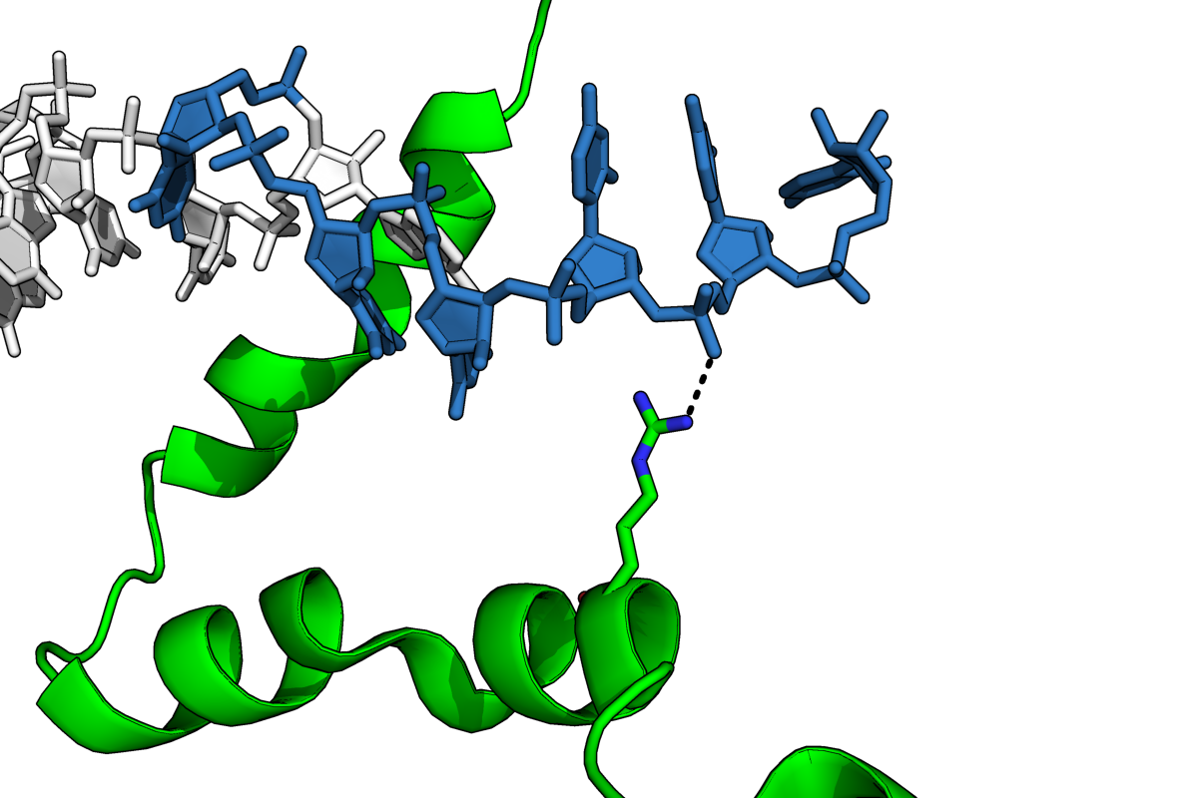
Possible interaction between bS21 and Anti-Shine-Dalgarno (ASD)
C1535
C1538
C1539
3’
16S rRNA
U1540
ASD sequence (1535-1540)
5’-CCUCCU-3’
Ideal Shine-Dalgarno(SD) sequence
5’-AGGAGG-3’
C1536
U1537
R17
bS21
PDB 6o7k
Kaledhonkar et al. (2019) Nature 570:400
Image courtesy of Dr. Gregory
Notes:
As I mentioned earlier, the SD is the component of the mRNA that directly interacts with the 16S rRNA at the anti-shine Dalgarno sequence. We were interested in this because in the E coli ribosome, Dr. Gregory found a possible interaction between bS21 in green here, with the anti-shine Dalgarno on the 16S rRNA in blue. We don’t know if this same interaction may be occurring in Francisella, but there’s a possibility that bS21 may be impacting the structure of the ASD, thereby regulating THE critical step of translation initiation.
I want to remind you all here that an ideal Shine Dalgarno on the mRNA strand is a reverse complement of the anti-shine Dalgarno on the 16S rRNA. For E. coli and Francisella it is the same – AGGAGG – and is generally located about 6 nucleotides upstream of the start codon.

Slide 2
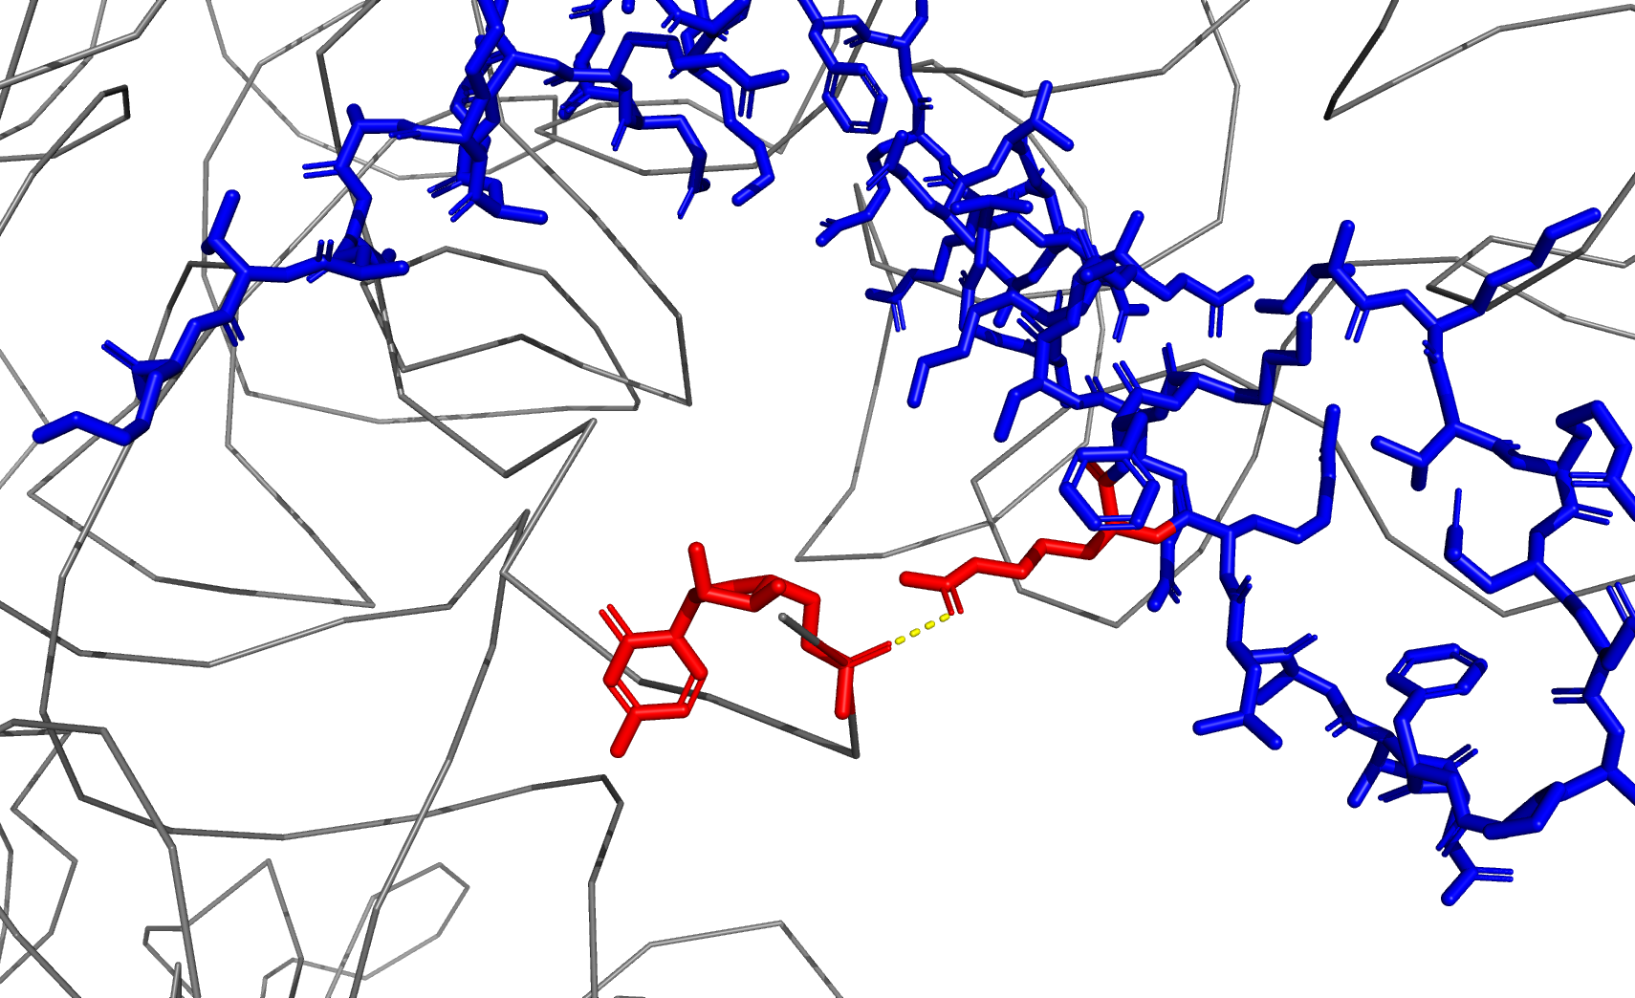
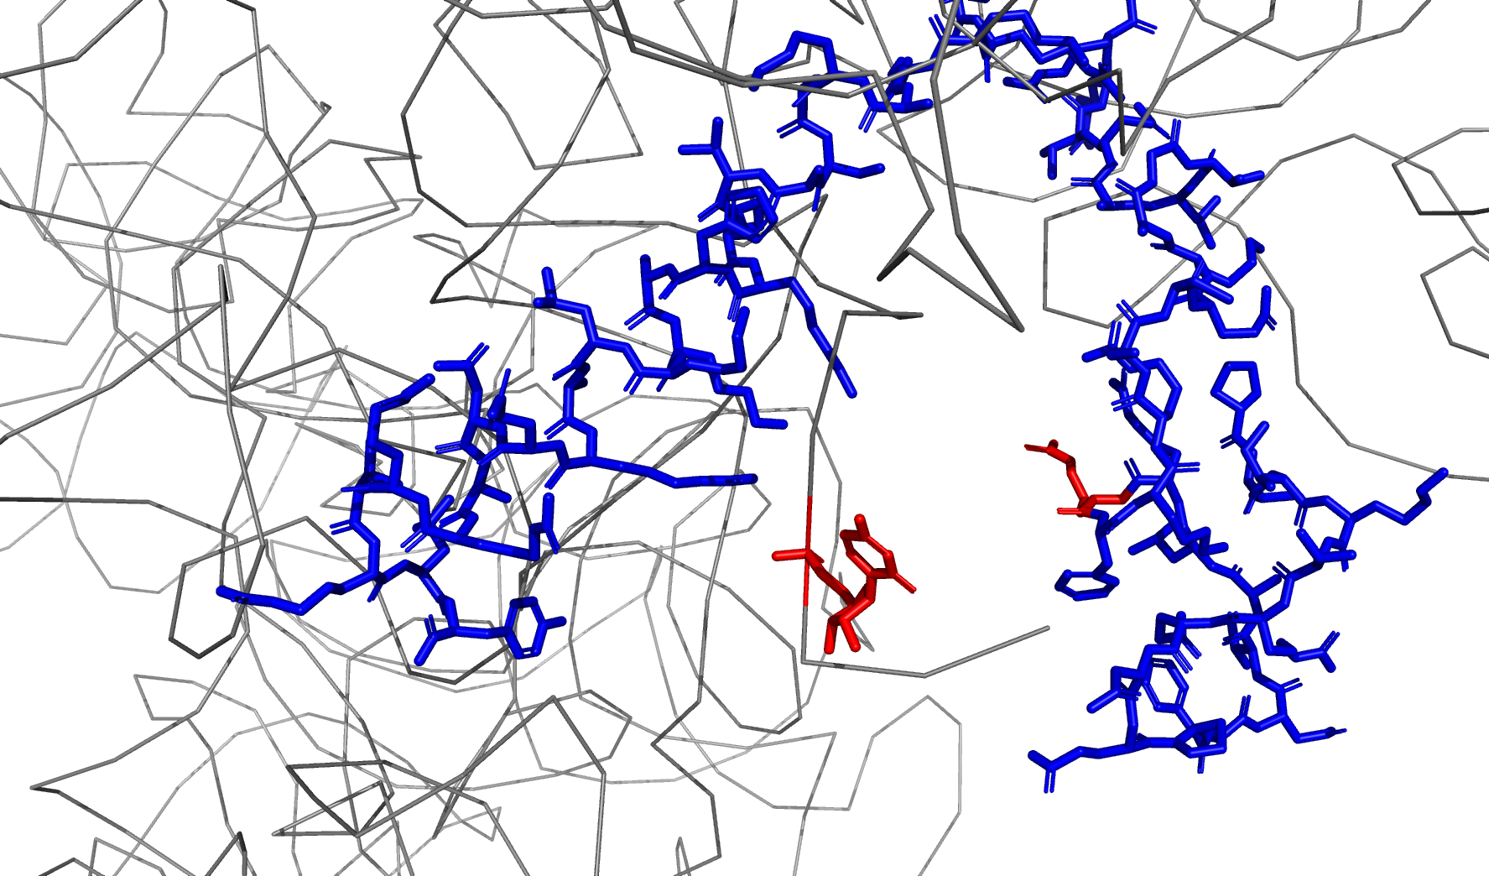
A
B
R17
R17
C1539
C1539
PDB: 6O7K
30S initiation complex
PDB: 4V6P
Translocation intermediate (elongation)

Slide 3
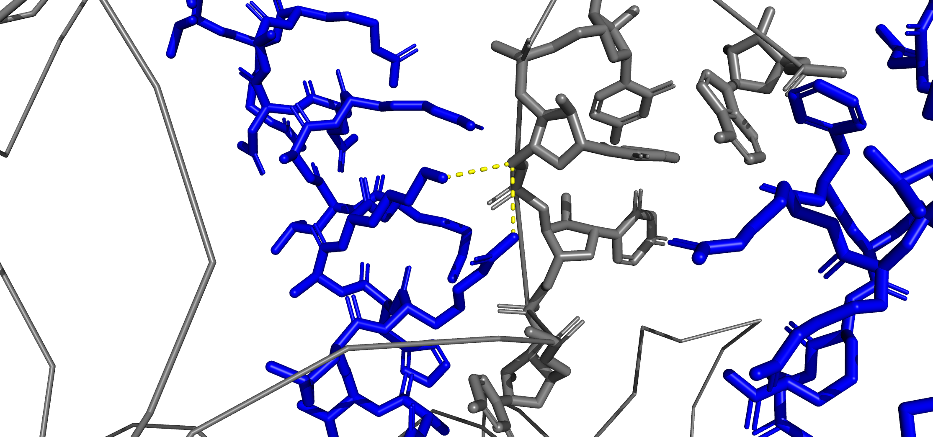
K57
C1538
R54

