Slide 1
Amino acid alignment of bS21 homologs
bS21-1 MLSIRVDEHKPFDISLRNFKRACEKAGIKQELRDRQHYVKPTEKRKIAKRQAVKRARISQ-----RRAFI-
bS21-2 MPSVRIKEREPFDVALRRFKRSCEKAGIVSELRRREYFEKPTWARKRKKTAAVKRAHKSNIIVKR------
bS21-3 MPRIIVDPKKPFDISLRNFKRACEKAGIKQELRDRQHYVKPTQKRKIAKKAAISKAKKEA-----RRSYSY
E.coli MPVIKVRENEPFDVALRRFKRSCEKAGVLAEVRRREFYEKPTTERKRAKASAVKRHAKKLARENARRTRLY
* : : .:***::**.***:*****: *:* *:.: *** ** * *:.: .
* = identical amino acid
: = very similar amino acid
. = somewhat similar amino acid
Notes:
Residues in E coli that are completely different: 2,3, 5, 7,8, 29, 30, 34, 39, 43, 44, 47, 48, 50, 51, 56, 57, 58, 60-71

Slide 2
Amino acid alignment of bS21 homologs
bS21-1 MLSIRVDEHKPFDISLRNFKRACEKAGIKQELRDRQHYVKPTEKRKIAKRQAVKRARISQ-----RRAFI-
bS21-2 MPSVRIKEREPFDVALRRFKRSCEKAGIVSELRRREYFEKPTWARKRKKTAAVKRAHKSNIIVKR------
bS21-3 MPRIIVDPKKPFDISLRNFKRACEKAGIKQELRDRQHYVKPTQKRKIAKKAAISKAKKEA-----RRSYSY
E.coli MPVIKVRENEPFDVALRRFKRSCEKAGVLAEVRRREFYEKPTTERKRAKASAVKRHAKKLARENARRTRLY
* : : .:***::**.***:*****: *:* *:.: *** ** * *:.: .
* = identical amino acid
: = very similar amino acid
. = somewhat similar amino acid
Notes:
All based on 4v50 but the ASD interaction is from 6O7K. ***607K is the initiation complex and may be more informative to look at for this particular question
Yellow: interacting with either s11 or s18
Interactions with bS18: conserved, cys22 and lys19. Partially conserved, ile3. Not conserved, lys4
Interactions with us11:
Conserved – asp12, glu23, lys 24, arg34,
Partially conserved – ile3, val5
Not conserved – lys4, leu28, arg33, arg6
Interactions with 16S rRNA: ARG32, ARG34, LYS45, LYS48,TYR37, GLU38, THR41

Slide 3
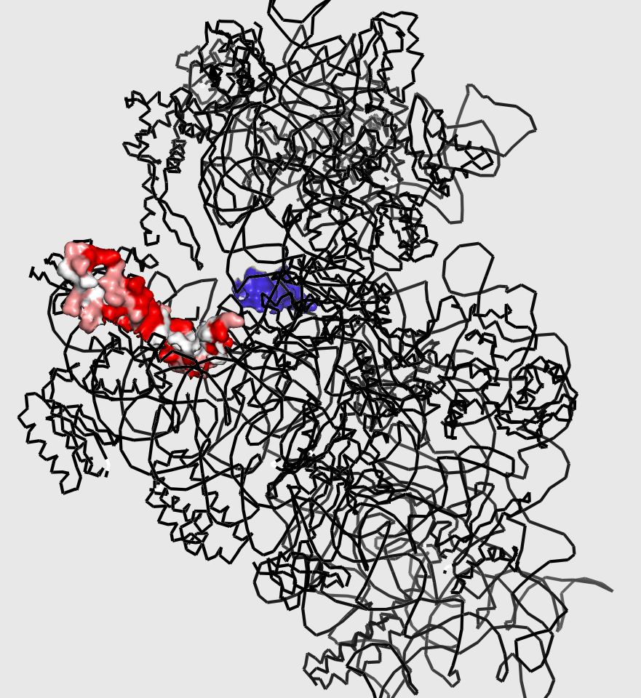
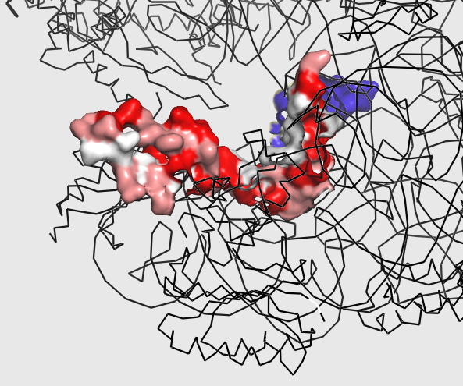
mRNA channel

Slide 4
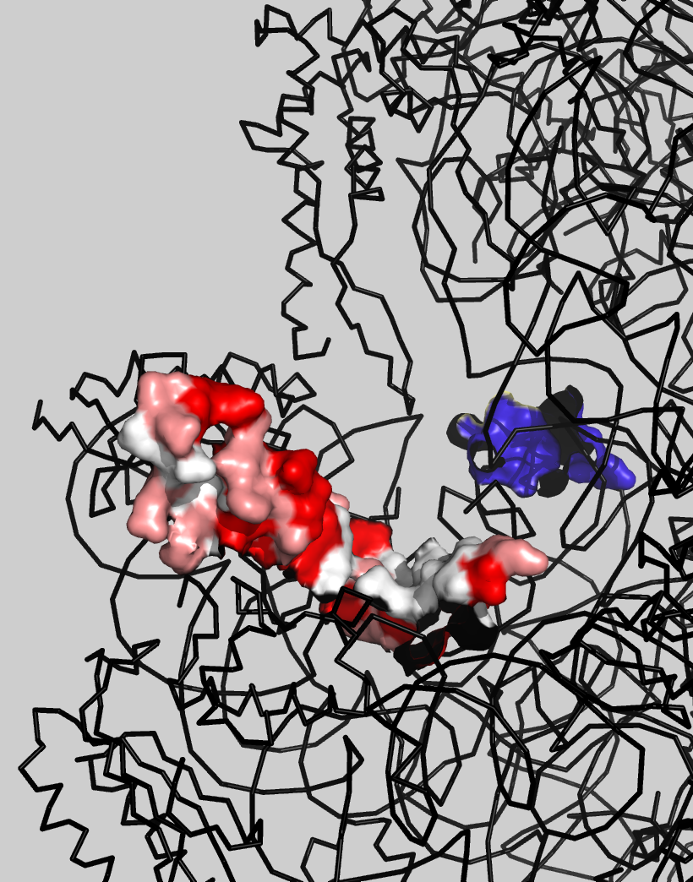
mRNA channel

Slide 5
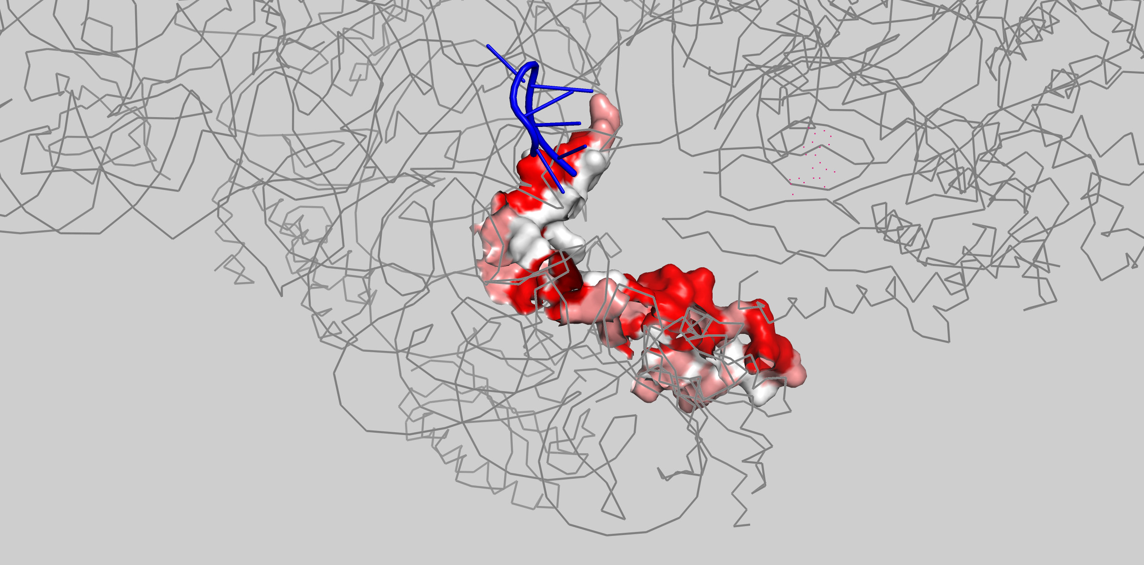
mRNA channel
C-terminus
**
*
N-terminus
Notes:
* Chain AG – closer to viewer
** Chain AG- behind viewer

