Slide 1
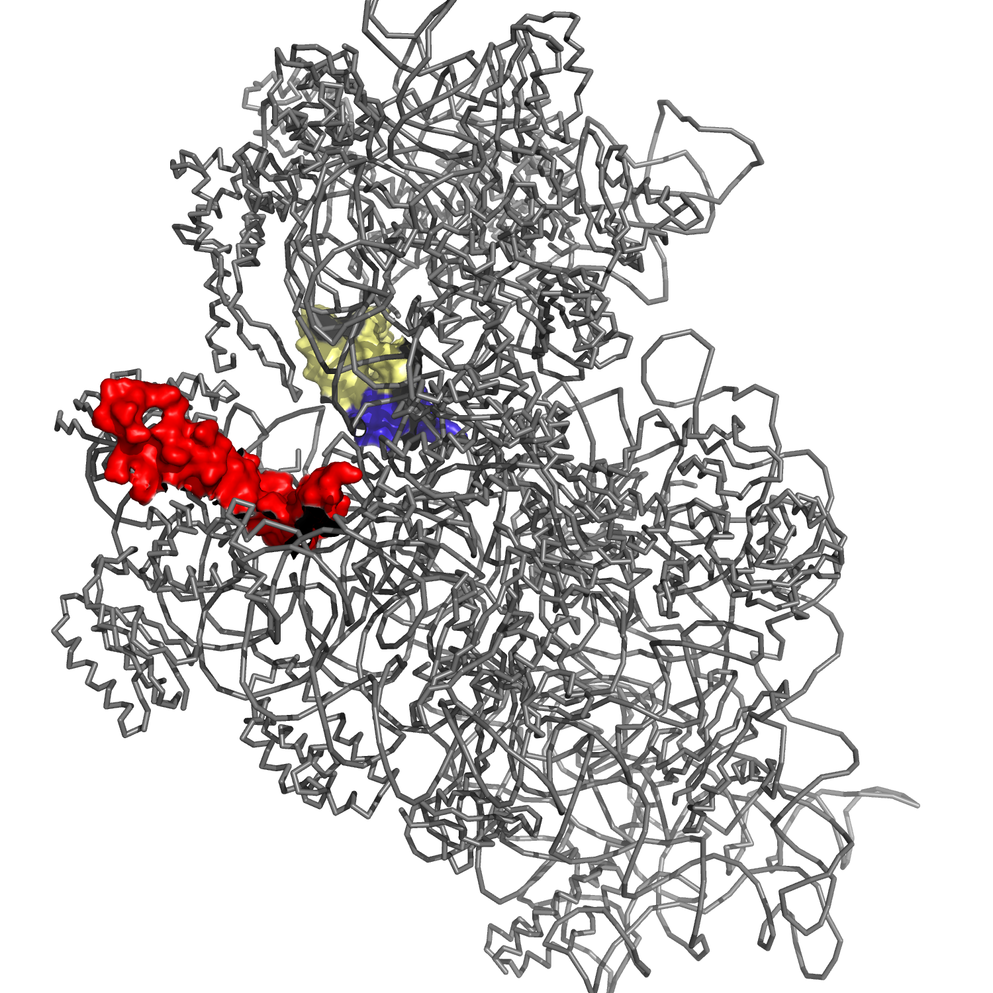
mRNA channel
bS21

Slide 2
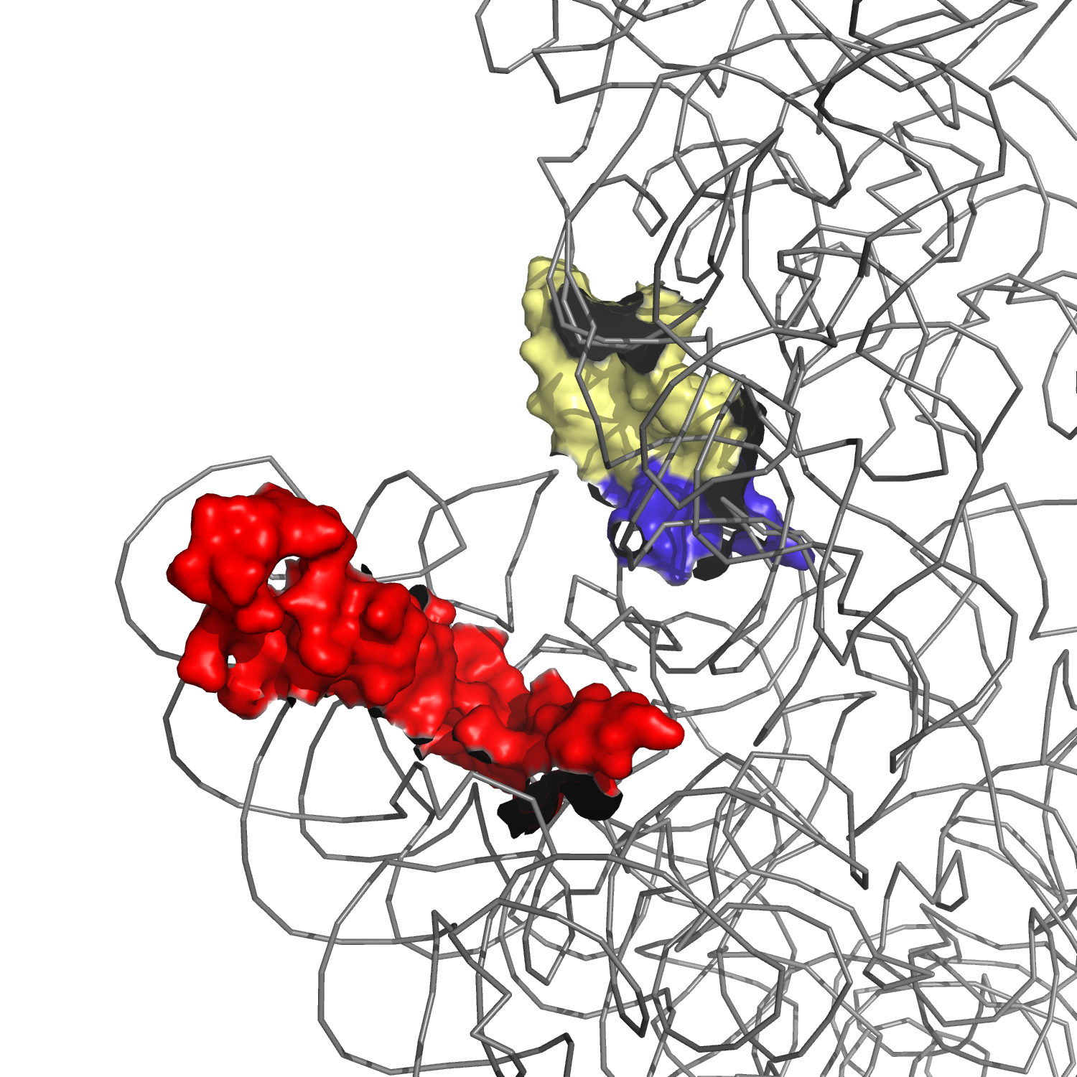
P-site tRNA
mRNA exit channel
bS21
mRNA

