Slide 1
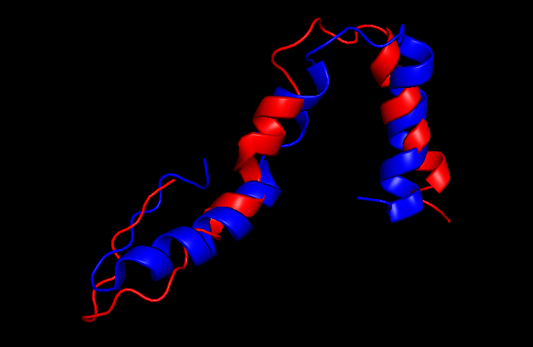
Red = E coli bS21
Blue = B subtilis bS21
C-term
N-term
Aligning the bS21 proteins

Slide 2
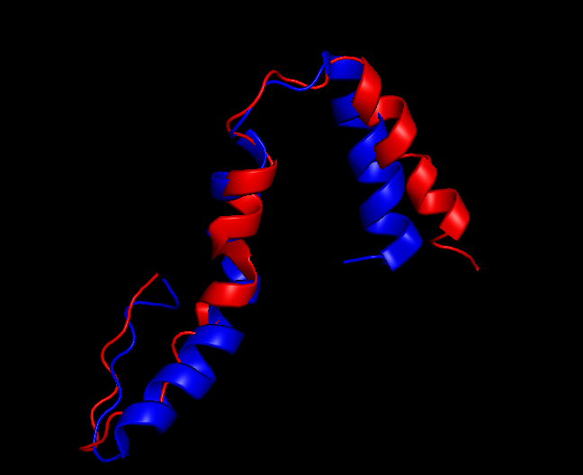
Red = E coli bS21
Blue = B subtilis bS21
C-term
N-term
Aligning the 16S rRNA
Notes:
Ask Steve if there’s a way to predict interactions more rapidly

