Slide 1
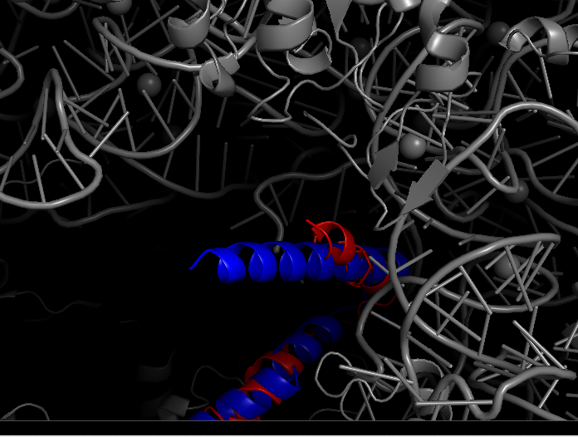
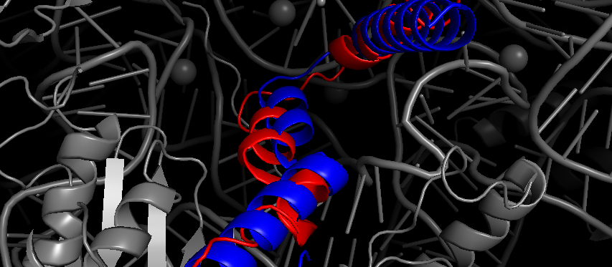
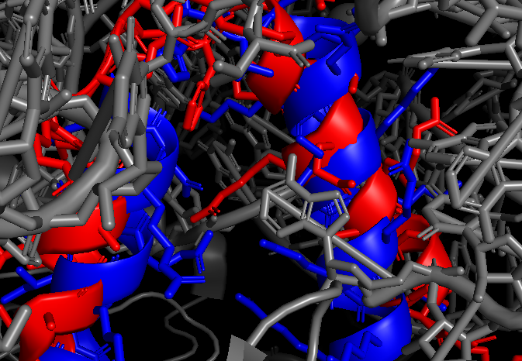
Red = E coli bS21
Blue = bS21-1
No obvious interactions causing the alpha helix to jut out, but there is 16S A1534 nearby that could be interfering with bS21-1’s predicted structure (yellow)
No steric hinderance on C-terminus

Slide 2
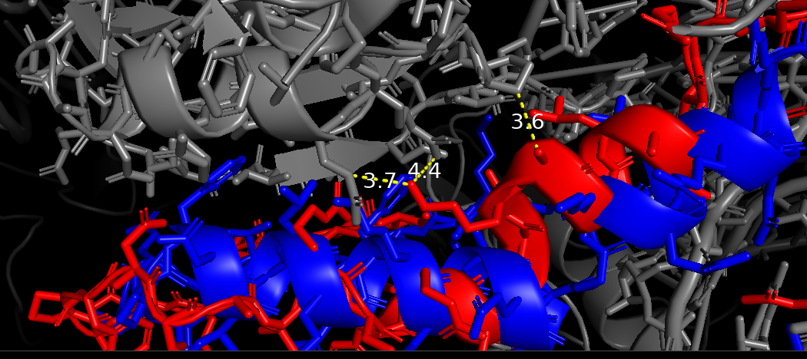
Possible interaction between E coli bS21 with S11 but I couldn’t find a distance less than 3 angstroms (distance for H-bond)
  E coli residues are K24 and A25 which are conserved in all three F tul bS21s

