Slide 1
Comprehensive Exam Topics
Hannah Trautmann
August 6, 2021
Notes:
Hi thank you for coming – I’ll present two topics and then you can ask me some questions, discuss amongst yourselves, and then choose one for me.

Slide 2
CheR Genes in Borrelia burgdorferi
Topic 1

Slide 3
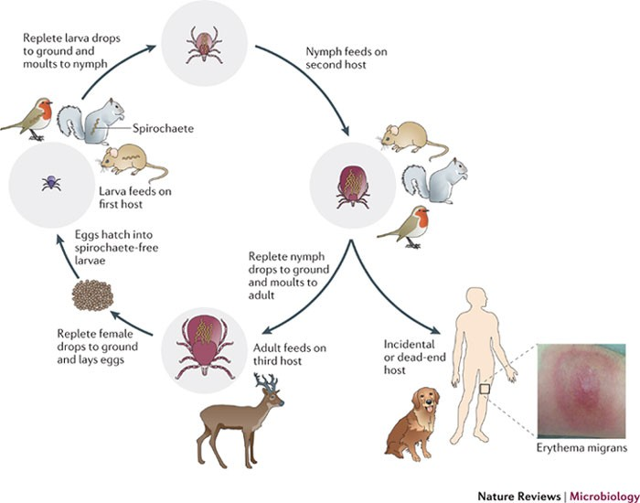
Borrelia burgdorferi
Causative agent of Lyme disease
Spirochete, obligate parasite
Adapts to distinct environments
Complex genome
Chemotaxis and motility are essential
Brisson et al. 2012
Notes:
Borrelia burgdorferi is the causative agent of Lyme disease, something I’m sure we are all very familiar with living in the northeast. The CDC reports from 30,000 to 500,000 cases of Lyme disease in the United States every year. There are actually three species of borrelia that cause human infection, but they are often grouped together and referred to as borrelia burdorferi sensu lato meaning in a broad sense.
The bacteria is a Gram negative spirochete and is an obligate parasite, so it cannot live outside of a vector or host. As you can see on this very general overview of the life cycle, B burgdorferi cycles through living in ticks, ixodes scapularis, and vertebrate hosts, so it must be able to adapt to these very distinct environments.
Genomically borrelia is very complex – it has one large linear chromosome, about 950 kbs, as well as a large number of linear and circular plasmids which varies by clinical strains but at least 20 plasmids.
In order to navigate this enzootic cycle, borrelia must be motile, and utilize chemotaxis which is the ability to move towards or away from a signal, such as a signal telling the spirochete to move out of the ticks gut and into a host.

Slide 4
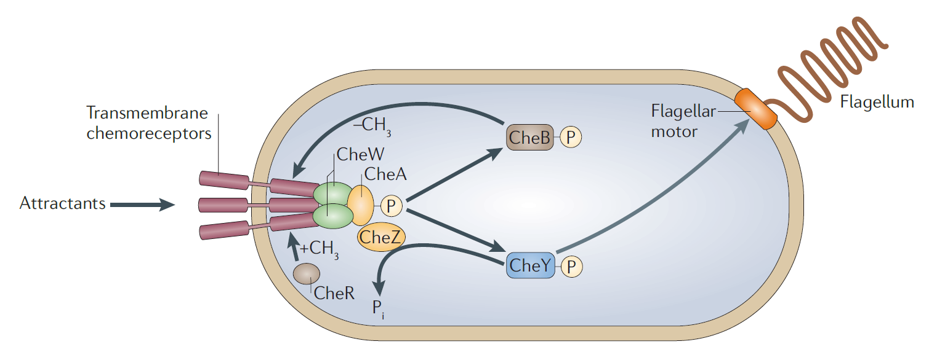
Chemotaxis Pathway
CheR- methyltransferase
Multiple homologs, including CheR1/CheR2
Differential gene expression
Transposon mutant phenotype for CheR2
Biofilm formation in other species
Porter et al. 2011
Notes:
The chemotaxis pathway for E. coli is summarized here. It’s basically a signalling pathway where some sort of attractant is sensed by receptors on the bacterial membrane, the signal is passed by methylation or phosphorylation until the polar flagella gets the signal to move. The gene I am interested in CheR which is a methyltransferase in the early stages of the pathway.
In Borrelia the whole pathway is a little more complex than you see here because there are actually 2-3 homologs of most of these Che genes, including two CheRs - CheR1 and CheR2, but nobody has really identified how these two homologs differ functionally, or even verified if they are indeed involved in this pathway in Borrelia. So what do we know about the CheRs?
One interesting finding is that the CheR genes, along with other chemotaxis homologs, are differentially expressed at the transcript level based on whether the bacteria is extracted from tick larvae, tick nymphs, or mice, which indicates that these two genes likely do have different functions which may be related to the life cycle.
There was also a transposon mutant study that found CheR2, when interrupted, led to a slow growth defect.
And finally, in pseudomonas aureginosa, which has three cheR genes, one is implicated in the chemotaxis pathway and one is implicated in biofilm formation, so there is evidence that these different homologs can modulate very distinct processes.

Slide 5
Aim #1
Are CheR1 and CheR2 implicated in chemotaxis and/or biofilm formation?
Methods:
  Create knockouts and complements (Motaleb et al. 2007)
  Assess motility using soft agar plates (Moon et al. 2016)
  Assess responses to chemoattractants using flow cytometry (Bakker et al. 2007)
  Assess biofilm formation using crystal violet staining (Sapi et al. 2016)
Notes:
This brings me to my first aim, which is really getting at what pathway each of these homologs are involved in, looking at both chemotaxis and biofilm formation as potential first pathways given the literature.
To test this, I would first generate knockouts which should be possible at least for CheR2 since a transposon mutant has been made, using allelic exchange, and then complement those knockouts.
We can assess motility in general as a disrupted chemotaxis pathway will likely affect motility, and this is a very simple assay with soft agar plates where you put the bacteria, both knockouts and wild-type in the center of the plate, incubate, and see how far out they are able to grow.
We can also look more specifically at chemotaxis by determining whether these knockouts have different responses to specific chemoattractants, like glucosamine, glutamate, glucose, by basically inserting these capillary tubes containing the attractants into a cell suspension, incubating, and then using flow cytometry to enumerate the bacteria that swam into the capillary tube. (note to Hannah – this is better than just plating because you can have lower cell densities and still get an accurate estimate, and you don’t need to wait for long generation times).
And then finally, given the pseudomonas findings, we can assess whether biofilm is affected in the knockouts, and yes, there have been studies that Borrelia can form biofilms. This would be a simple assay using crystal violet staining in tissue culture plates, then scaping it up and checking the OD.

Slide 6
Aim #2
What protein(s) regulate expression of cheR1 and cheR2?
Methods:
  Create lacZ fusion reporter strain (Hayes et al. 2010)
  Transposon mutagenesis to identify candidate (Stewart et al. 2004)
  Confirm with knockout of regulatory gene, if non-essential (Motaleb et al. 2007)
Notes:
My second aim would look at how these genes are regulated, since that study found they are differentially transcribed in larvae, nymph, and vertebrate hosts.
I propose doing a transposon mutagenesis study where I can fuse lacZ to each of the CheR genes to generate reporter strains that will show up blue on X-gal plates, and then incorporate a mariner transposon, specifically HimarI and identify colonies that lose the blue appearance. I can then isolate DNA from the transposon mutants that seem interesting, digest with HindIII and self-ligate so it could be rescued in E. coli, then miniprepped and sequenced as a plasmid.
Once we identify some proteins, we can confirm the observation by knocking out the gene and assessing expression of CheR1 and CheR2 fusions with plating on X-gal and B-galactosidase assays.

Slide 7
MarR family protein in Burkholderia pseudomallei
Topic 2

Slide 8
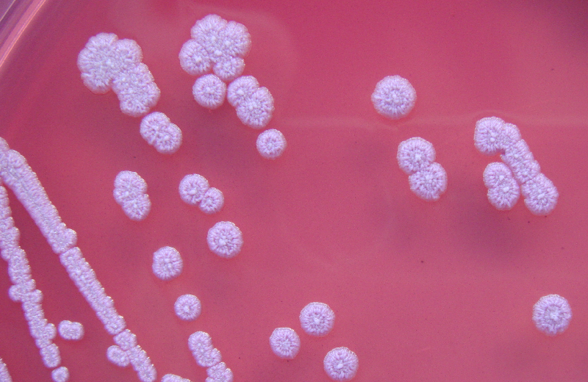
Burkholderia pseudomallei
Causes melioidosis; high mortality rates
Gram-negative, motile, aerobic
Adapts to diverse environments
2 chromosomes, about 7Mb
Notes:
Burkholderia pseudomallei is the causative agent of melioidosis, a global disease that especially impacts southeast asia and Australia, with high mortality rates ranging from 20-50% depending on the region.
Burkholderia is a gram negative, motile, and while previously believed to be aerobic, has been shown that it can survive in hypoxic conditions, though it is non-replicating. This is important clinically, because meliodosis results in abseccess with little or no oxygen present.
Like borrelia, burkholderia has to adapt to diverse environments, including deep in soil (also with little oxygen), surface water, as well as living in hosts ranging from amoeba, to plants, fungi, and animals.
It has two chromosomes, one about 4Mbps and one about 3, and among the almost 6000 genes, there is a Type 3, Type 5, and Type 6 secretion system.

Slide 9
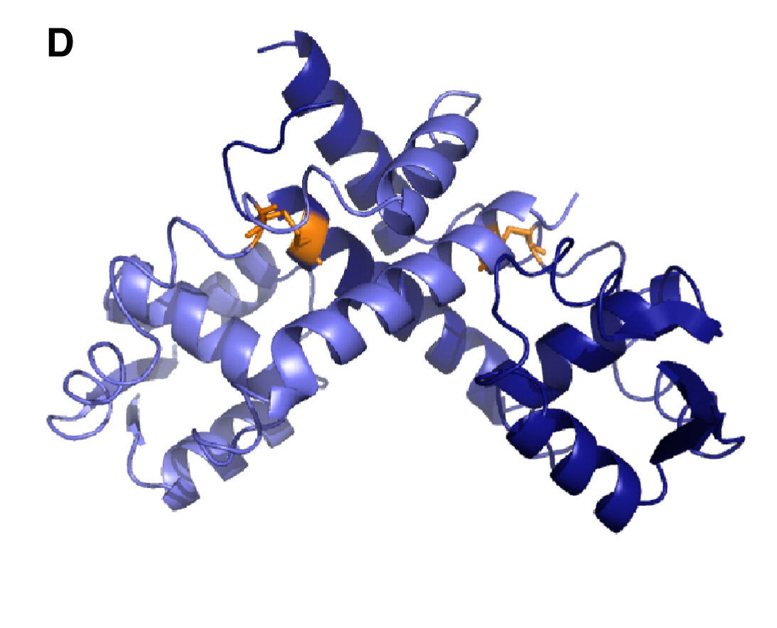
MarR family transcription factors
MarR = multiple antibiotic resistance regulator
Ligand or oxidation responsive
BPSL1750 –
  Conserved in infectious species
  May be essential
  Two cysteine residues
Grove 2013; PDB 2PFB
Notes:
Now changing paths a little bit, I want to introduce you to a family of transcription factors called marR, which stands for multiple antibiotic resistance regulator. These were first identified in E. coli but are found in diverse clades of bacteria and arachaea. They regulate, as the name implies, resistance to antibiotics of many types as well as oxidative stress agents.
MarR genes generally repress gene expression by binding directly to DNA, and they respond either to a ligand or oxidation of cysteine residues, which lead to loss of DNA binding and the gene is expressed. Here you can see an example of a marR protein in Xanthamonas campestris, and highlighted in orange are the cysteine residues.
There are marR genes described across burkholderia species, some that are conserved entirely and some that are unique. One of these transcription factors which hasn’t been studied yet is BPSL1750 which is found in burkholderia pseudomallei and mallei, which is also highly infections. However, it has not been described in the closely related thailandensis, which shows low virulence, indicating it may play an important role in regulating virulence genes.
It was found likely to be essential in a transposon screen.
It also has two cysteine residues which indicates it may be responding to oxidative state of the cells, so it may play a role in gene regulation when oxygen is low.

Slide 10
Aim #1
What genes or sequences are regulated by BPSL1750?
Methods:
  ChIP-Seq (Kong et al. 2015)
  Motif finder to identify consensus sequences or genomic features (Leleu et al. 2010)
  EMSA assay to confirm (Hellman & Fried 2007)
Notes:
My first goal would be to identify genes or sequences that are regulated by BPSL1750.
Since BPSL1750 is likely essential, it won’t really be possible to delete it and look at what RNA levels change, so instead I propose doing ChIP-seq to see where on the genome this protein is binding.
Once we have a bunch of sequences, we can use a motif finder to identify consensus sequences or other genome browsing software to identify common genomic features (i.e. different GC contents, locations of other known DNA binders, etc.)
Then we can verify any interesting genes or sequences identified using an electrophoretic mobility shift assay with purified BPSL1750 to confirm the protein is binding to that DNA.

Slide 11
Aim #2
Is BPSL1750 responding to redox state?
Methods:
  Mutate cysteines to serine or alanine (Lumjiaktase et al. 2006)
  Expose to oxidative stress conditions – hydrogen peroxide or hypoxia (van der Reeset et al. 2018; Peeters et al. 2010; Hamad et al. 2011)
  Targeted: qPCR on cDNA to assess specific genes identified in Aim 1 (Jitprasutwit et al. 2014)
  Broad: RNA-seq to assess changes compared to wild-type or standard growth (Ulrich et al. 2013)
Notes:
My second aim would be to test the hypothesis that BPSL1750 is responding to the redox state of the cell. There’s two ways I think we could do this. First, we could try mutating the cysteines to serines, or if that doesn’t work alanines which has more similar hydrophobicity to cysteine.
The other thing I could try is creating oxidative stress either by exposing the cells to hydrogen peroxide or hypoxic conditions.
Once we’ve made these mutations or generated oxidative stress, I would plan to isolate RNA. I would start with a targeted approach where we do qPCR to assess differences in specific genes we identified using ChIP-seq, with the expectation that the loss of cysteines or oxidative stress would alter transcription of certain genes.
If we confirm there are differences, we can more broadly do RNA-seq to assess changes in transcription across the genome.

Slide 12
Questions and Decision Time
Notes:
Line spacing + Page numbers

