Slide 1
Investigating the roles of the homologous methyltransferase proteins CheR1 and CheR2 in Borrelia burgdorferi
Hannah Trautmann
September 30, 2021
Comprehensive Oral Exam
Notes:
Hi everyone, thanks for coming today. I will be presenting on the mock proposal I wrote into the CheR homologs in borrelia burgdorferi.

Slide 2
Outline
Background
  Lyme Disease
  Chemosensory pathways
  CheR homologs
Statement of the problem and overall goal
Aims 1 and 2
  Methods
  Expected results
  Alternate approaches
Notes:
I’ll start with some background information about the disease caused by Borrelia, then introduce you to chemotaxis and alternate chemosensory pathways, and the specific proteins CheR1 and CheR2.
We’ll go through the problem and overall goal of the study before jumping into the specific aims.
For each aim I’ll tell you about the methods I propose, what we expect to see, and alternate approaches.

Slide 3
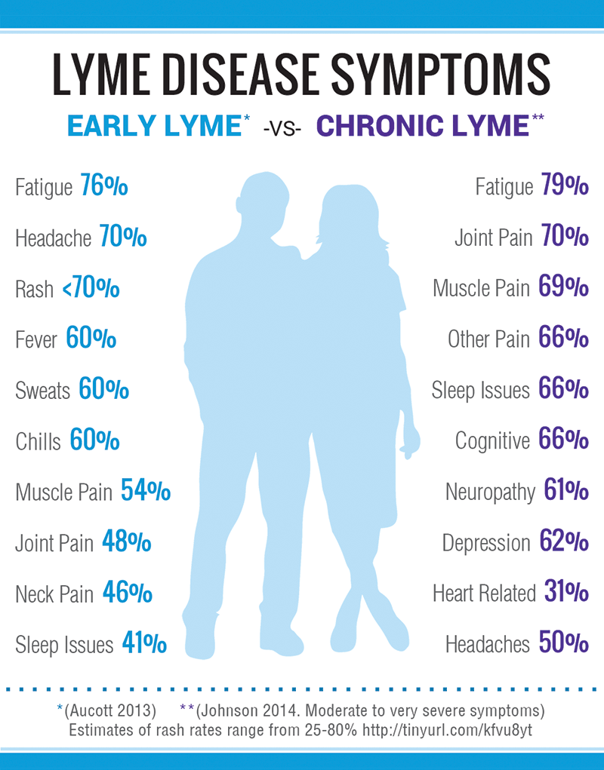
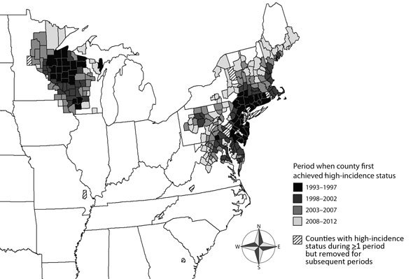
Lyme Disease
No vaccine
Treatable with antibiotics
Difficulty with diagnosis
Antibiotic resistance cases
Kugeler et al. 2015
Lymedisease.org
Notes:
Lyme disease is a systemic disease caused by borrelia burgdorferi. Symptoms after infection generally include fatigue, headaches, and joint pain, what you see here in “early lim”, but the disease can become chronic and involve neurological and heart-related symptoms.
There is no vaccine, but treatment with antibiotics is generally effective. However, there can be difficulty in diagnosing Lyme because a lot of these symptoms leads overlap lots of other illnesses, so the appropriate treatment doesn’t always come in time. There are also cases of antibiotic resistance particularly in recurring or chronic infections, and this is likely related to the bacteria generating biofilms.
The problem of Lyme disease is getting worse as time goes on- cases are now estimated at close to 500,000 in the US. You can see on this map high risk counties, with the shading corresponding to time, with the gray areas showing that the risk has expanded in more recent years.

Slide 4
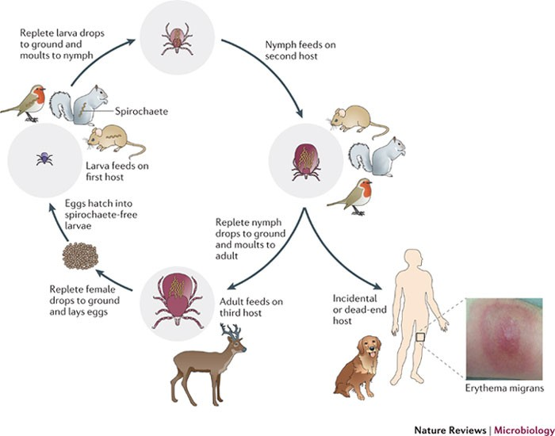
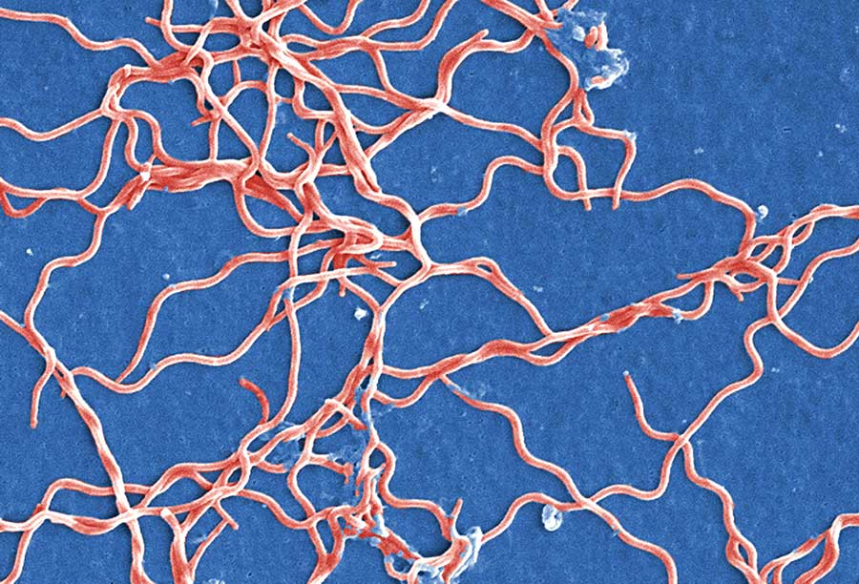
Borrelia burgdorferi
Claudia Molins, CDC, 2011
Brisson et al. 2012
Chemotaxis: Movement towards or away from environments in response to chemical signals
Notes:
So now I’ll tell you about the bacteria that causes this disease – Borrelia burgdorferi. It is a gram-negative spirochete which you can see here, and also in this cool plush toy I have.
It’s an obligate parasite and has to coordinate between this life cycle where it lives in ticks as the primary vectors, then infects vertebrate hosts, then goes back into ticks. Each stage of this requires regulated motility and chemotaxis, which is movement of the bacteria in response to chemical signals. When the tick latches onto a deer for instance, the bacteria will actively move from the mid-gut and into the deer, then it’ll move throughout the deer’s body infecting tissues all over. Eventually when another tick attaches, the bacteria will sense it and move from wherever they are in the deer to the bite site so they can cross back into the tick.
So now I’ll give you the short story about how this chemotaxis pathway works.

Slide 5
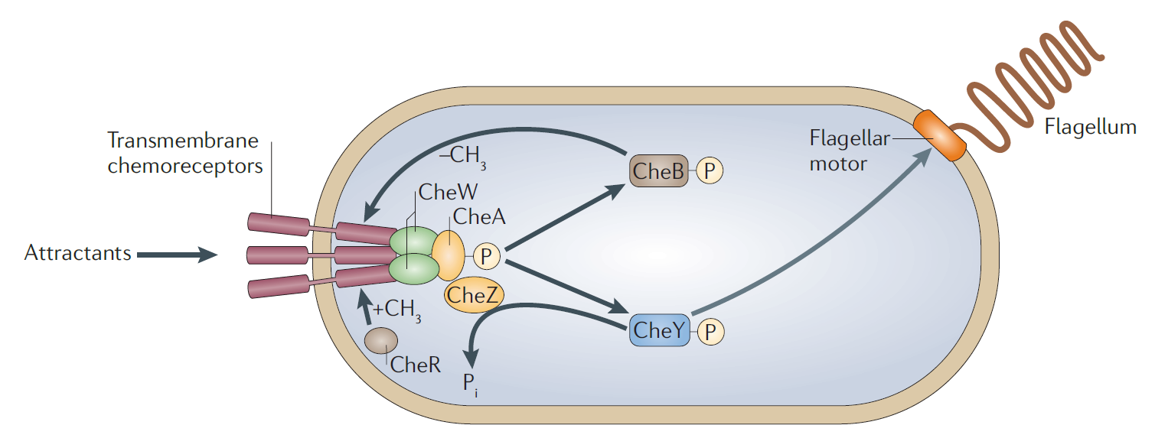
Simple chemotaxis in E. coli
Porter et al. 2011
Notes:
E. Coli has the most well-studied simple chemotaxis pathway, so we will use that as our model here. In brief, the loss of some chemical attractants makes the flagella change directions so the cell tumbles.
It almost boils down to a two-component system, but it’s not quite that simple. Loss of chemoattractant or repellent is sensed by the chemoreceptors which are also called MCP proteins. This leads to auto-phosphorylation of a histidine kinase CheA, which then donates a phosphate group, to the response regulator CheY. Phoshporylated CheY then binds to the flagellar motor and causes it to switch direction. The phosphate group is removed from CheY with CheZ.
At the same time, there are modifications to the receptor proteins that make it more sensitive to very small changes in effector concentration. CheR adds a methyl group to promote auto-phosphorylation of CheA, and phosphorylated CheB, which accepts from CheA-P, will remove the methyl group to return the cell to it’s natural state.
Now as I said, this is the most well-studied simple pathway because in E. coli there is only one of each of these che genes, but in other species, there can be 2, 3, or even 16 different versions of some of these genes, and people have found that they don’t all participate in chemotaxis, but there are actually other chemosensory pathways that are very similar just have different end results.

Slide 6
Alternate chemosensory pathways
Rhodobacter sphaeroides – energy taxis (flagellar)
Pseudomonas aureginosa/putida – biofilm (transcription)
Myxococcus xanthus – fruiting body development (transcription)
Notes:
One of these is in rhodobacter, where the cell actually has receptors in the cytoplasm rather than across the membrane, to sense the metabolic state of its own cell. The same pathway as in chemotaxis occurs, causing flagellar rotation to find more optimal conditions.
Another pathway that uses the che genes is in pseudomonas species, where researchers have found the response regulator, once phosphorylated, actually produces cyclic-di-GMP which leads to changes in transcription of biofilm-forming genes like exopolysaccharides.
A third example is myxococcus xanthus which similarly has transmembrane proteins, the same che pathway and ultimately changes in transcription of genes important for fruiting body development.
So there are examples of pathways very similar to the chemotaxis pathway that have different downstream effects, and our goal is to figure out what that might be in Borrelia.

Slide 7
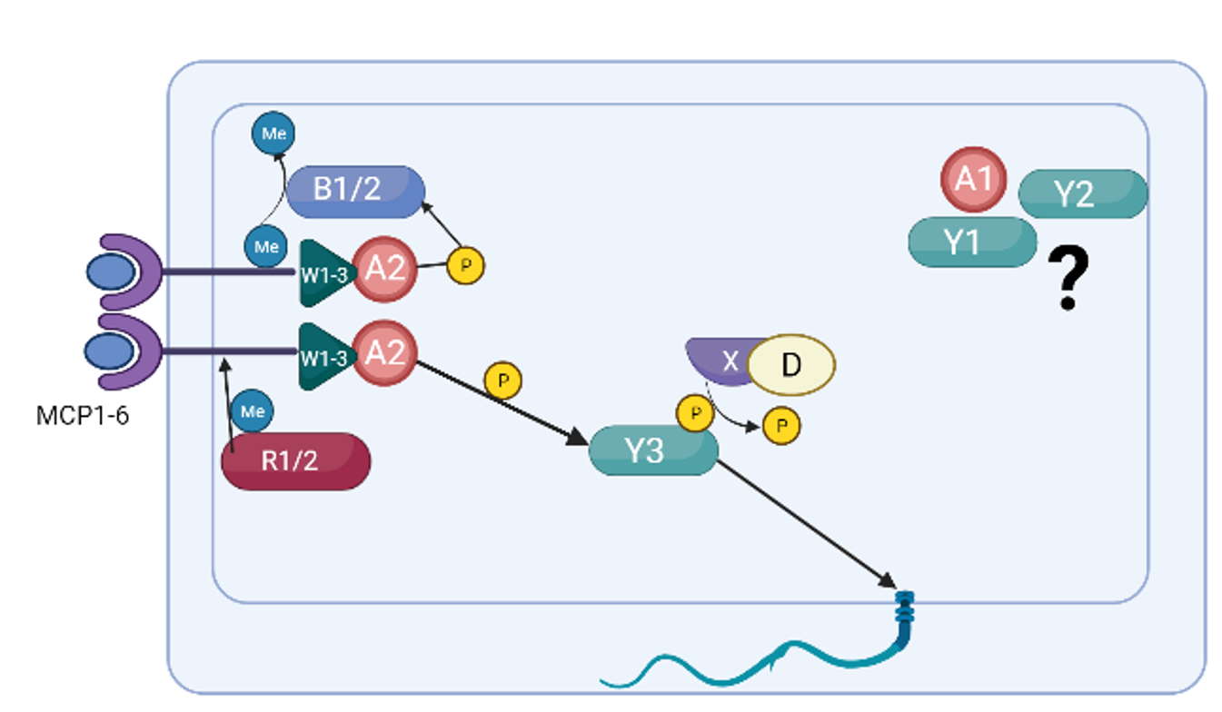
Multiple che homologs in B. burgdorferi
3 cheW
2 cheA
2 cheR
3 cheY
2 cheB
6 MCPs
Notes:
Borrelia has multiple homologs of many of the che genes, opening up the possibility that it has alternate chemosensory pathways. There are 3 cheWs, 2 cheAs, 2 cheRs, 3 CheYs, 2 cheBs, and 6 receptor proteins.
So far, researchers have found that CheY3 is the main response regulator and cheA2 is the main histidine kinase. What we don’t know is which CheB, which CheW, and which CheR genes are involved in chemotaxis, and what exactly all the non-chemotactic homologs are doing. There is a study that found CheY2 is important for mouse infection, but they haven’t identified the mechanism yet.
Now I decided to focus in on CheR for a few reasons…..

Slide 8
CheR2 transposon mutants
Slow-growth
Low infectivity in mice
Possible defect in motility?
No CheR1 transposon mutants recovered
Notes:
First, there were two different transposon mutagenesis studies of Borrelia in which transposon mutants were recovered where the insertion was into cheR2. In one, they found slow-growth of the cheR2 mutant and in the other they found low infectivity in mice. The second study also mentioned a possible defect in motility of the CheR2 transposon mutant, but they didn’t have many details about what assays they used.
Not only is this intriguing because it indicates CheR2 has an important role that may be related to infection and/or motility, but it also tells us that it is possible to knockout cheR2.
In neither of these studies did they recover a cheR1 mutant.

Slide 9
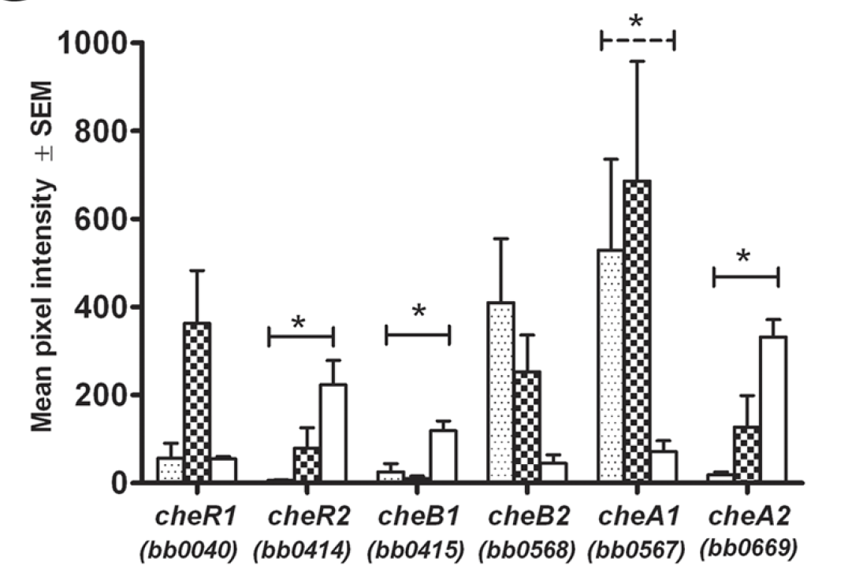

cheR genes are differentially expressed
cheR1 and 7 other chemotaxis genes regulated by RpoN/RpoS/Rrp2
Iyer et al. 2015
Notes:
Another study that really intrigued me about cheR1 and cheR2 was by Iyer et al. that found the two transcripts are differentially expressed at different parts of the bacteria’s life cycle. They isolated RNA and used a microarray to measure transcript abundance. Here you can see they looked in tuck larvae, lymphs, and DMC is a dialysis membrane channel, which is their “model” mammalian host without actually having to use hosts.
-So if you look at CheR1, it seems to be more expressed in the tick nymphs, and cheR2 seems to be more expressed in mammalian model, which suggests that cheR expression is regulated and may be important for navigating the life cycle.
-Now of the other che genes that they looked at, we know cheA2 is involved in chemotaxis from previous studies, and that one looks very similar to cheR2, so we might guess that maybe cheR2 is the homolog involved in chemotaxis, but we really want to confirm this.
-I also want to point out that while this study didn’t identify how these transcripts are regulated, a different study had created mutants of rpoN, rpoS, and rrp2 (a response regulator to acetate metabolism) to see which transcripts change compared to wild-type, and they found CheR1 and some of the other chemotaxis genes were different in the mutants. This is really the only study that looks at this, so we don’t know if other proteins are also regulating expression of cheR1, and what is controlling expression of cheR2.
-They did check with qRT-PCR that it was correlated with a number of the genes, but they didn’t do RNA-seq.
-labelled with aminoallyl UTP, and then put on a microarray with cy3 and cy5 dyes, so on the y-axis you have mean pixel intensity from the

Slide 10
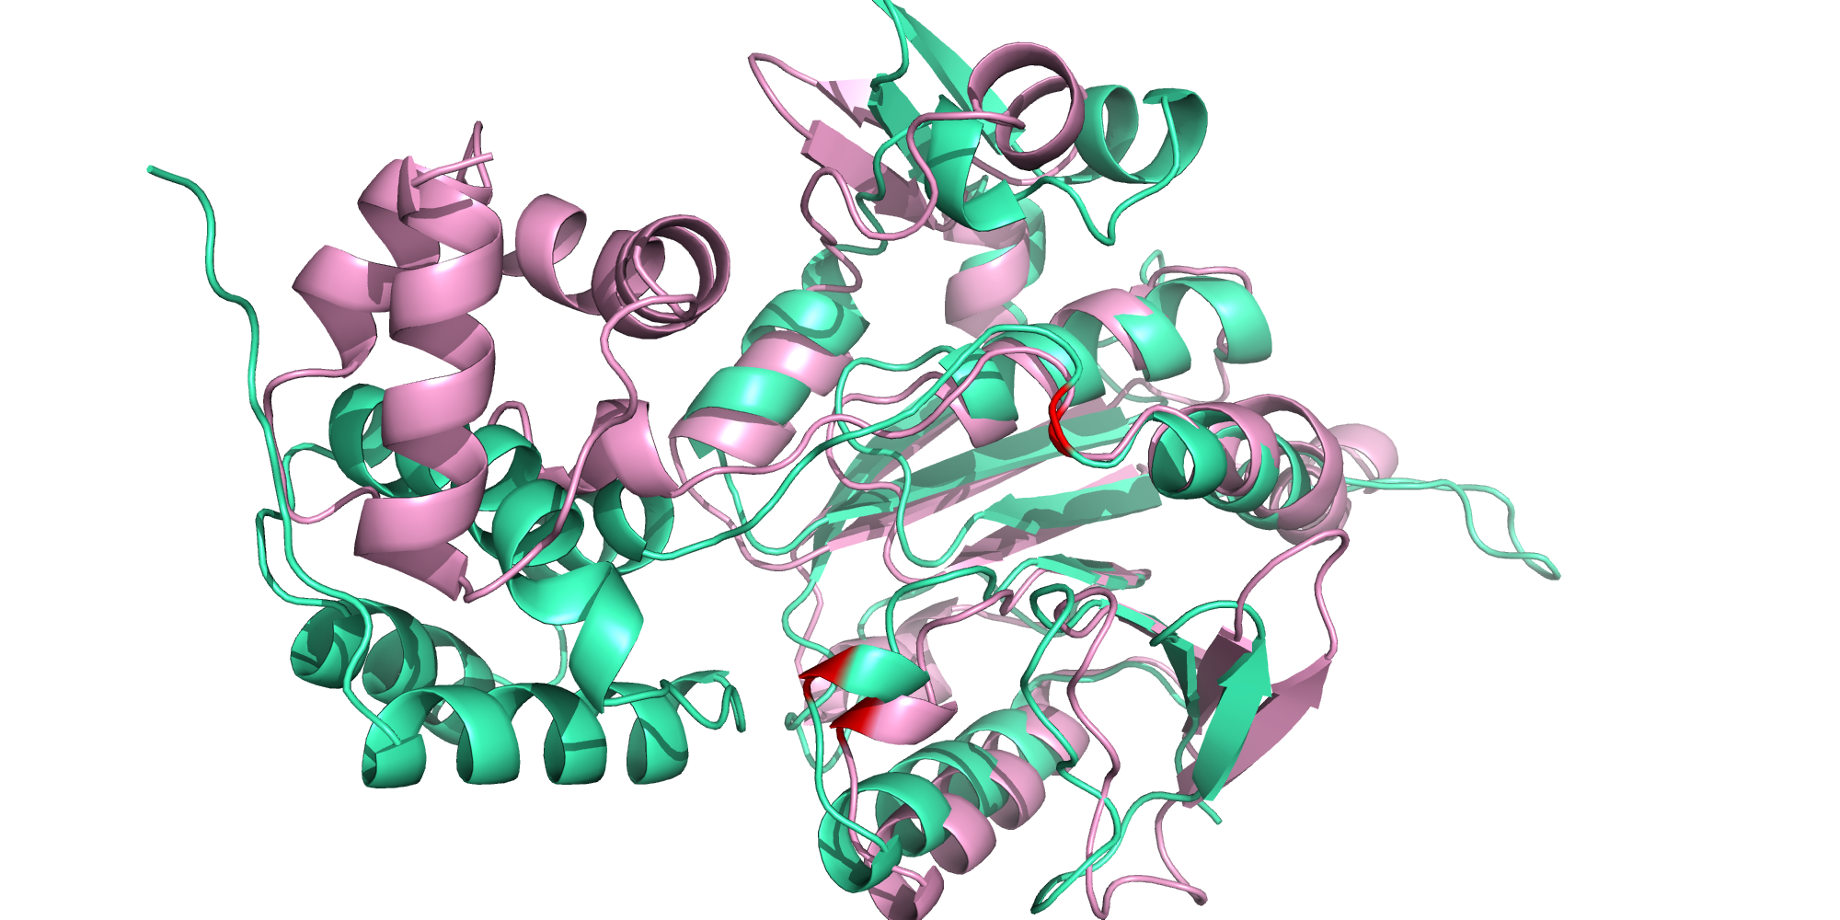
CheR alignments
CheR1 – green
CheR2 – pink
N-terminus
C-terminus
SAM – s-adenosylmethionine
Notes:
Alright, so what do we know about the two CheR proteins structure? They haven’t been solved yet but E. coli’s has so we know a fair amount about homologous proteins. Here I used Phyre2 which predicts a structure based on the amino acid sequence and I then overlaid them so we can look at how similar the two are, CheR1 is green and CheR2 is pink.
There are two domains to CheR proteins – smaller N-terminal domain made up of alpha helices and a larger SAM domain (s-adenosylmethionine) with mostly alpha helices and a subdomain of B-sheet. The binding site of the substrate SAM involves mostly the larger C-terminal domain but the N-terminal domain does contribute. You can see that there are a lot of similarities in our two CheR proteins, but there are differences in the N-terminus, although these are just predicted structures so I wouldn’t put too much weight into that.
I also highlighted the two catalytic residues in red: an arginine and a tyrosine, and they are conserved across all CheR genes I looked at in E. coli, rhodobacter, pseudomonas, and Borrelia.

Slide 11
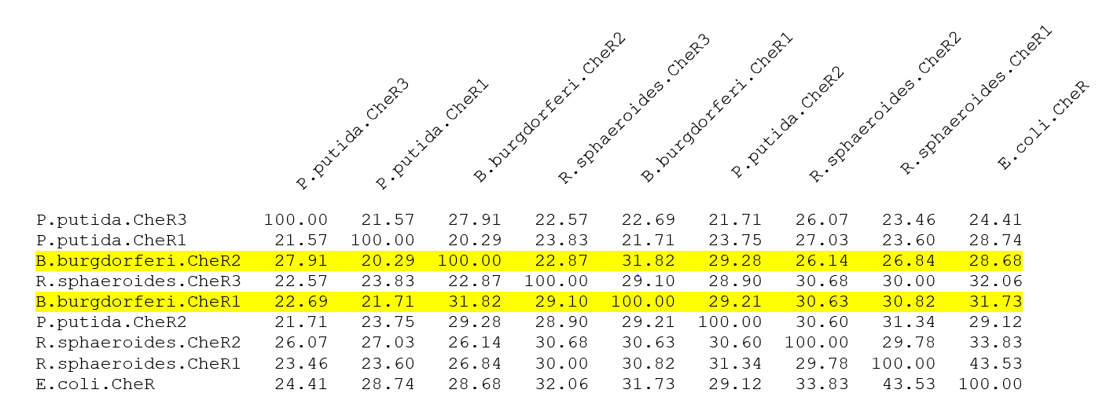
CheR alignments
Notes:
I did amino acid alignments of the CheR proteins in Borrelia along with a few species that have well-studied alternate chemosensory pathways to see if there were high similarities that could help us narrow down which pathway B. burgdorferi’s cheR genes are involved in.
What we found is that CheR1 and CheR2 to each other are only about 32% identical, and to all the other ones we know functions of, even less. So these alignments really didn’t do much to help us figure out which pathway they might be in.

Slide 12
Statement of the problem
Unknown which CheR homolog is involved in chemotaxis
No other known chemosensory pathways in B. burgdorferi
Little research into biofilm formation
Limited understanding of chemotaxis gene regulation
Notes:
This leads me to the problem we are trying to analyze. As of now, we do not know which of the CheR homologs, if any, are involved in chemotaxis.
We also know that in many other species with che homologs there are alternate chemosensory pathways, but none of these have been discovered in B. burgdorferi yet.
One of these pathways may be biofilm formation, as there are examples of this in pseudomonas as I mentioned. There is preliminary research in Borrelia indicating biofilm formation is related to antibiotic resistance and recurring lyme disease, but the research into regulation of biofilm formation is very limited.
Finally, it’s clear that the chemotaxis genes are tightly regulated, but our understanding of this is in its infancy.

Slide 13
Overall goal - to elucidate the roles of CheR1 and CheR2 and to determine how the expression of each gene is regulated
Notes:
My overall goal to address these stated problems is to elucidate the roles of the CheR proteins and determine how the genes are regulated.

Slide 14
Aim 1: Are CheR1 and CheR2 implicated in chemotaxis and/or biofilm formation?
Hypothesis: one cheR gene is involved in the chemotaxis pathway and the other is involved in biofilm formation.
Method: create knockouts and look for changes in motility, chemotaxis, and biofilm aggregation
Notes:
My first aim is focused on the roles of the homologs – looking both at chemotaxis and biofilm formation as a jumping off point. My hypothesis is that XXX, and I’ll test this by creating knockouts and performing a variety of assays.

Slide 15
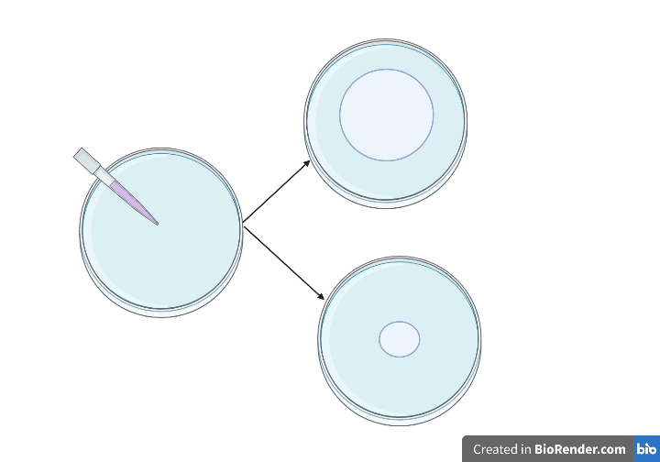
Motility assay
Wild-type
cheR1 knockout
cheR2 knockout
cheR1 complement
cheR2 complement
Notes:
So first I’ll make single knockouts of each of the cheR genes by integrating kanamnycin-resistant cassettes into the middle of the genes and using homologous recombination. I’ll also make complements of these by putting a functional version of the gene at a neutral location in the genome, also by homologous recombination. This will give me four strains plus wild-type that I will use in all of the assays going forward.
The first assay is to assess whether motility is defective. It’s very simple – we make these soft agar plates and put cells from each strain under the surface of the agar with a pipette tip. We incubate them and see how large of a radius the cells have migrated after a few days. So we might expect one of the mutants, perhaps cheR2 knockout, to have a small radius compared to wild-type. We would then expect that any of the complements would restore the wild-type phenotype.

Slide 16
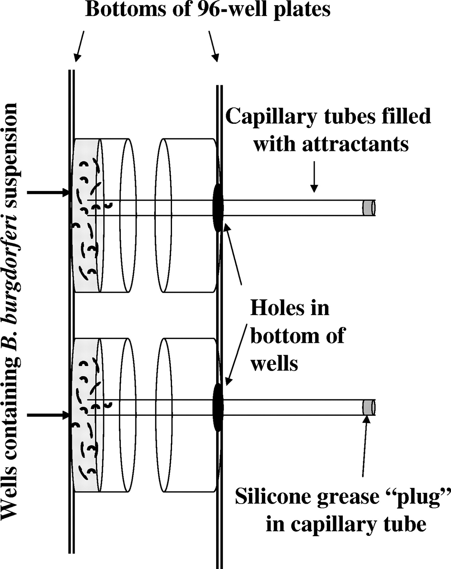
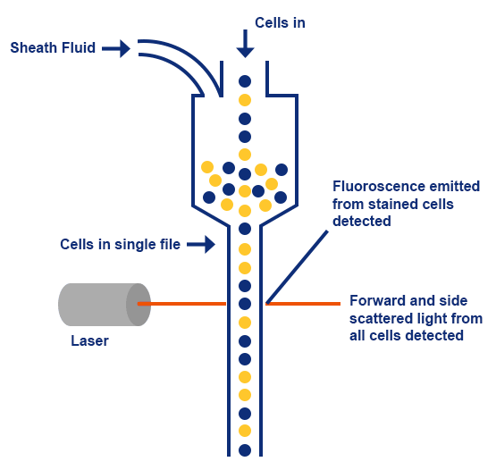
Chemotaxis Assay
Notes:
We can also do a more specific chemotaxis assay which looks at motility in response to particular chemoattractants. So we have these two 96-well plates. The one on the left here has B. burgdorferi cells set to a specific concentration, the one on the right is empty. And then these capillary tubes are filled with chemoattractants, and they poke through a hole in the one on the right and into the cell suspension. Then if the cells are chemotactic, they’ll swim up the capillary tube towards the chemoattractant, and we’ll use ones that have been shown to be strong chemoattractants for wild-type B. burgdorferi which include glucosamine, N-acetylglucosamine, and chitosan dimer.
After incubating, we carefully remove the capillary tube, spin it down to release the liquid and any cells into a new tube, and then we can quantify the number of cells using flow cytometry. The reason we use flow cytometry is because B. burgdorferi is such a slow grower, it’s a faster way to quantify the cells without having to wait weeks for colonies to grow.
Basically you add a fluorescent dye that can permeate through the membrane and bind to nucleic acids and then the cells are dropped one by one through a little tube with a laser pointing at it. The laser excites the fluorescence and shoots of a signal.
We expect that one of the single mutants will have reduced chemotaxis compared to wild-type. We’ll probably still get some cells in the capillary tubes due to basal motility, but that will be normalized out by using a tube with no chemoattractant for each strain. Other B. burgdorferi chemotaxis studies have found che mutants that have normal motility but reduced chemotaxis, so that’s also a possibility.

Slide 17
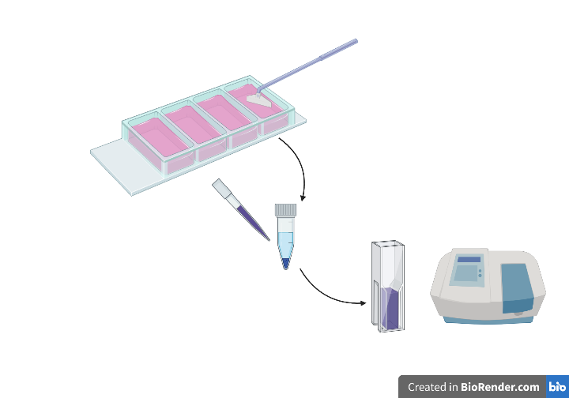
Biofilm Assay
Notes:
And then the last assay I propose for this first aim is a biofilm assay because I’m interested in the regulation of biofilm formation, and previous research has found biofilm may be regulated by a chemosensory pathway.
The assay is pretty simple – cells will be grown in these four-well chamber glass slides which promotes aggregate formation. Then we scrape up the cells into a tube, add crystal violet which should bind to the biofilm matrix, wash away extra crystal violet, and then measure the OD at 595 using a spec. The higher the OD, the greater the mass of biofilm aggregates.
We would expect that wild-type cells and all of the complements can form larger biofilm aggregates, and one of the mutants may form smaller aggregates.

Slide 18
Anticipated results
One CheR knockout has impaired motility and/or chemotaxis
The other CheR knockout has reduced biofilm aggregates
Phenotypes can be restored to wild-type with complements
Future directions
Methyltransferase assays to assess specificity to MCP proteins
Growth and biofilm assay to assess antibiotic sensitivity
Notes:
Just to summarize our anticipated results, we expect that only one of the single knockouts will have impaired motility and/or chemotaxis, and the other knockout will have reduced biofilm masses. We also expect that any phenotypes we observed will be restored to wild-type levels in the complemented strains.
If these results turn out as we hypothesize, I have a few future experiments to try. First, we can test the specificity of whichever CheR homolog is involved in chemotaxis to the MCP receptor proteins using methyltransferase assays with radio-labelled methionine in an in vitro assay with purified CheR and purified MCP proteins. Because there are 6 MCP proteins, we will look at all six to see if our CheR of interest catalyzes the methylation of all, none, or anything in between.
If we find out that one of the single knockouts has a defect in biofilm formation, it would be really interesting to see how this relates to antibiotic sensitivity, because biofilms tend to have increased resistance. So we can do minimum inhibitory concentration assays where we assess how doxycycline affects the mutant and wild-type growth and biofilm formation.

Slide 19
Potential difficulties
Alternate approaches
No phenotypes arise
Repeat assays with double mutant
GFP-tag CheR1 and CheR2 to find localization
RNA-seq knockouts and wild-type to look at changes in transcription
Notes:
The main concern that we may stumble upon is that no phenotypes arise in any of the assays with any of the single mutants. To address this, I suggest we also make a double mutant where both cheR genes are knocked out, and repeat all of the assays. If we see phenotypes in the double mutant, it likely means that the CheR proteins have overlapping roles so presence of either gene is enough for function, but when both are lost function is impaired.
If we still don’t see anything, we may want to see if the CheR genes are involved in other chemosensory pathways. You might remember that one alternate pathway is an energy taxis system seen in rhodobacter, wherein the whole pathway takes place in the cytoplasm, not by the membranes. I propose GFP-tagging the CheR homologs to see if they are near membranes, and if they aren’t, we can look more into the energy taxis system.
A third alternate chemosensory pathway was the myxococcus fruiting body development which resulted in widespread changes in transcription, so we could also complete RNA-seq on the knockouts and wild-type to see if transcription is affected, and if so, what types of genes change may lead us down another pathway.

Slide 20
Aim 2: What protein(s) regulate expression of cheR1 and cheR2?
Hypothesis: expression of cheR1 and cheR2 are regulated by distinct gene products
Method: create lacZ fusion strains and conduct transposon mutagenesis
Notes:
That brings us to aim 2 which is to look at the regulation of the cheR genes. We hypothesize they are regulated distinctly based on the study I showed you where transcript abundance was higher in ticks for one and in mammals for the other. We will assess this by making lacZ fusion strains and transposon mutagenesis.

Slide 21
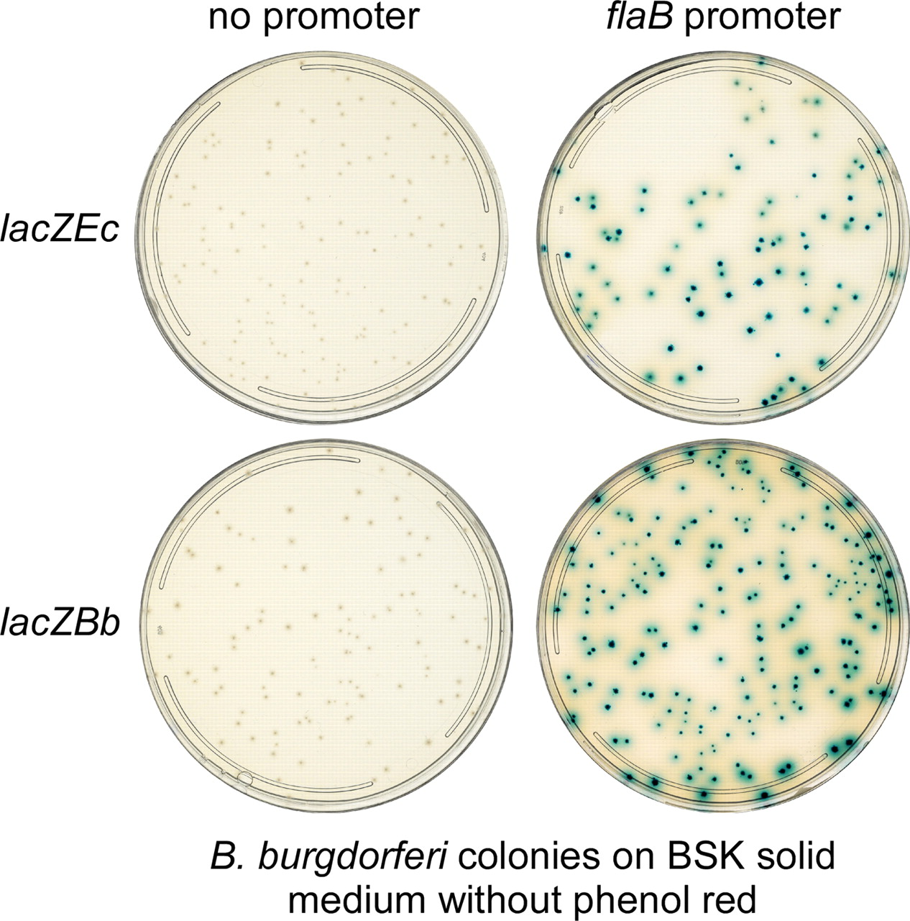
Create lacZ fusion strains
P_{cheR1}
CheR1
lacZ
cheR1::kan
P_{cheR2}
CheR2
lacZ
cheR2::kan
Hayes et al. 2010
Notes:
The first step would be to fuse the promoter and gene of each cheR to a codon-optimized lacZ, and inserting this at a neutral site in the genome of the single knockouts, ensuring there is only one copy of the gene for each strain and it’s this lacZ fusion copy.
We will then make sure that it’s producing lots of B-gal by plating with X-gal, where we expect the colonies to turn a vibrant blue. Once we have these blue constructs, we can see what genes are up or down-regulating the expression of cheR by looking for changes in the blue color in transposon mutants.

Slide 22
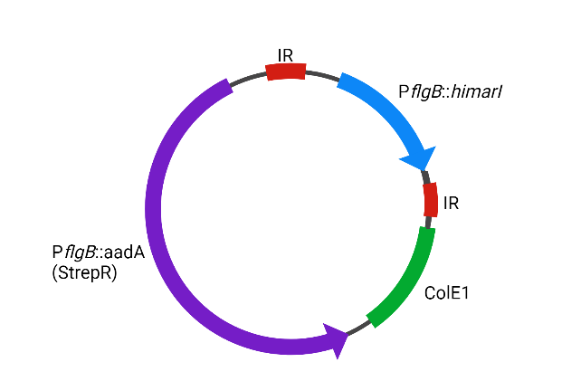
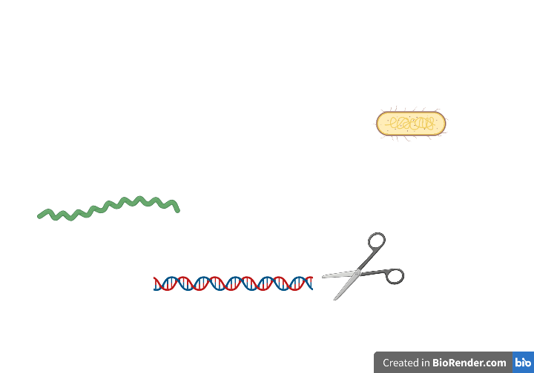
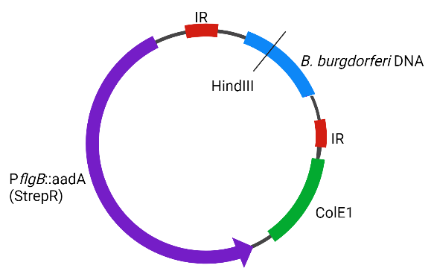
Transposon mutagenesis
Notes:
We’ll start with this plasmid that has an e coli origin, a resistance cassette, inverted repeats and a mariner transposon called himar1 which inserts into TA sites. We can put this into B. burgdorferi and then plate it with X-gal. If we find any colonies that are really white, or much darker blue, these colonies may have a transposon that inserted into a regulatory gene. We’ll isolate DNA from those interesting colonies and cut the DNA with HindIII, an enzyme that cuts all over the genome but doesn’t have cut sites in the plasmid. We can then ligate and recover in E. coli. Because it has the colE1 origin, we should be able to recover plasmid which has pieces of the Borrelia genome surrounding the rest of the plasmid. We can sequence this DNA and identify which gene was interrupted by the transposon.
We’ll of course want to confirm any loss or increase in B-gal activity by doing B-galactosidase assays on any of the interesting colonies we find.

Slide 23
Anticipated results
RpoN, RpoS, and Rrp2 will be identified as regulators of cheR1, with the possibility of other new discoveries
Different gene product(s) regulate cheR2
Future directions
qRT-PCR/Western of other che genes to identify if part of a regulon
Alter signal in identified pathway
Notes:
As I mentioned earlier, a previous study identified cheR1 is induced by RpoN, RpoS, and rrp2 (a response regulator to acetate metabolism). We would expect transposon insertions into these genes would lead to decrease in lacZ production, so the colonies would show up white. This is a great control to confirm our assay is affective and our transposons inserted across the genome. We might find more than just these…if CheR1 is involved in biofilm formation, we might uncover regulators that are important in activating the biofilm forming pathway.
We expect that we will identify other gene products that regulate cheR2 – this could be a transcription factor, sigma factor, or even small RNAs that bind to the transcript of CheR2.
Once we find specific regulators, it would be great to do qRT-PCR on the remaining che genes in the transposon mutant to determine if they have altered transcription compared to the parental strain, which would identify a regulon.
If the regulator we identify has a known pathway associated, we could try to affect this pathway by altering the signal and seeing if the abundance of the cheR transcript is affected. This would be really cool if we could find an external signal that turns on transcription, because it would help us understand what in the tick or vertebrate host is being sensed by Borrelia to regulate chemotaxis and motility.

Slide 24
Potential difficulties
Alternate approaches
β-gal production is toxic
Adjust temperatures of growth
Replace with a luciferase reporter assay
Notes:
The most likely setback will be that X-gal production is toxic and we just can’t make the X-gal fusions. One possibility would be to adjust the temperatures of growth – a study found that at there is significantly different transcription of cheR1 at 25C than at 37C, so that might lower the production to a tolerable amount. This could also actually be used to increase expression if we are finding really low levels of Beta gal activity.
If this doesn’t work, we could try to do a luciferase assay instead – we would make the same fusions but use a codon-optimized luciferase gene and then we would have to pick colonies and use a plate reader to see if luciferase production goes up or down.

Slide 25
Summary and implications
We will elucidate the role(s) of CheR1 and CheR2 in B. burgdorferi
  Understand antibiotic resistance and bacterial transmission
We hope to identify novel regulators of cheR1 and cheR2 gene expression
  New targets for antibiotics
Notes:
Overall, this research will uncover the roles of two CheR homologs in the causative agent of Lyme disease. We will first use knockouts to assess chemotaxis and biofilm formation, but have plans to look at alternate pathways like energy taxis if necessary. This research will improve our understanding of chemotaxis, an essential component of the bacteria’s transmission from vector to host. If we find biofilm is affected by CheR, this would open up a whole new area of research for understanding antibiotic resistance and recurring infections.
We also hope to identify regulators of these genes by using reporter strains and transposon mutagenesis. No genome-wide study of this sort has been done on any chemotaxis genes, to our knowledge, so it’s very possible we will find new regulators which will improve our understanding of how motility and chemotaxis is so tightly regulated in the life cycle of the bacteria, and might uncover new targets for antimicrobials.

Slide 26

Questions

Slide 27
Proposed chemotaxis model for B. burgdorferi
Notes:
So this is a little image I put together of the chemotaxis model for B. burgdorferi based on what we already know or what we assume. This isn’t the perfect image because 1, this is clearly not a spirochete, and 2, the flagella and the chemoreceptors are at the two poles and actually quite close to each other, but this is the best I could do to make it somewhat easy to understand.
Basically, it’s the same as E. coli except we have 6 receptors, 3 cheWs, 2 cheAs, 2 cheRs, 3 CheYs, and 2 cheBs. So far, researchers have found that CheY3 is the main response regulator and cheA2 is the main histidine kinase. The dephosphorylation of Chey3 is done by CheX and aided by CheD. What we don’t know is which CheB, which CheW, and which CheR genes are involved in chemotaxis, and what exactly all the non-chemotactic homologs are doing. There is a study that found CheY2 is important for mouse infection, but they haven’t identified the mechanism yet.
Now I decided to focus in on CheR to try to elucidate which of these is involved in chemotaxis, and if it’s involved in any alternate chemosensory pathways like the ones I outlined on the last slide.

Slide 28
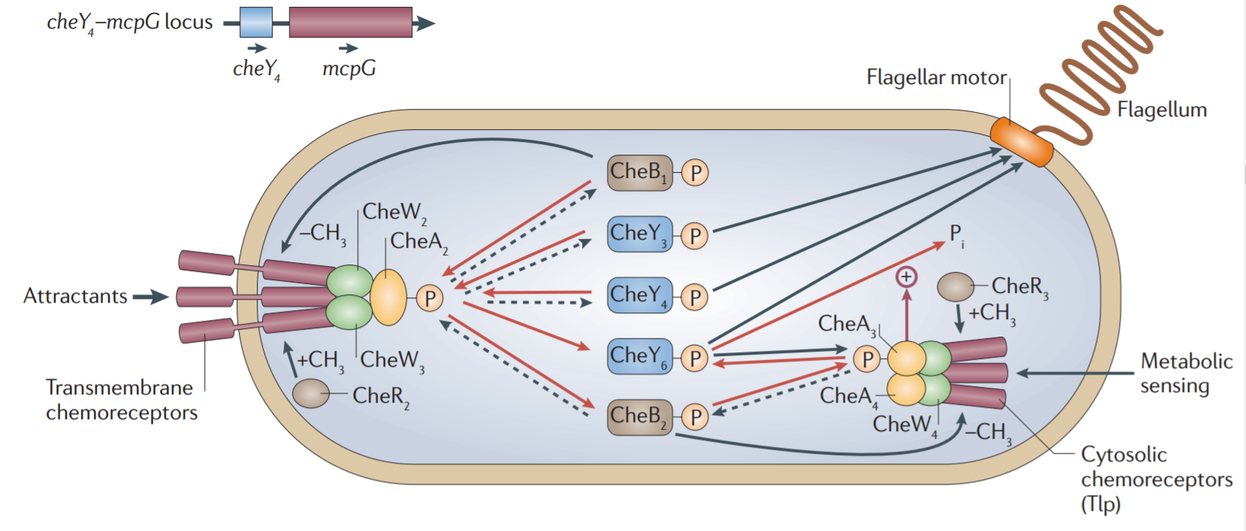
Complex chemotaxis in R. sphaeroides…
Porter et al. 2011

Slide 29
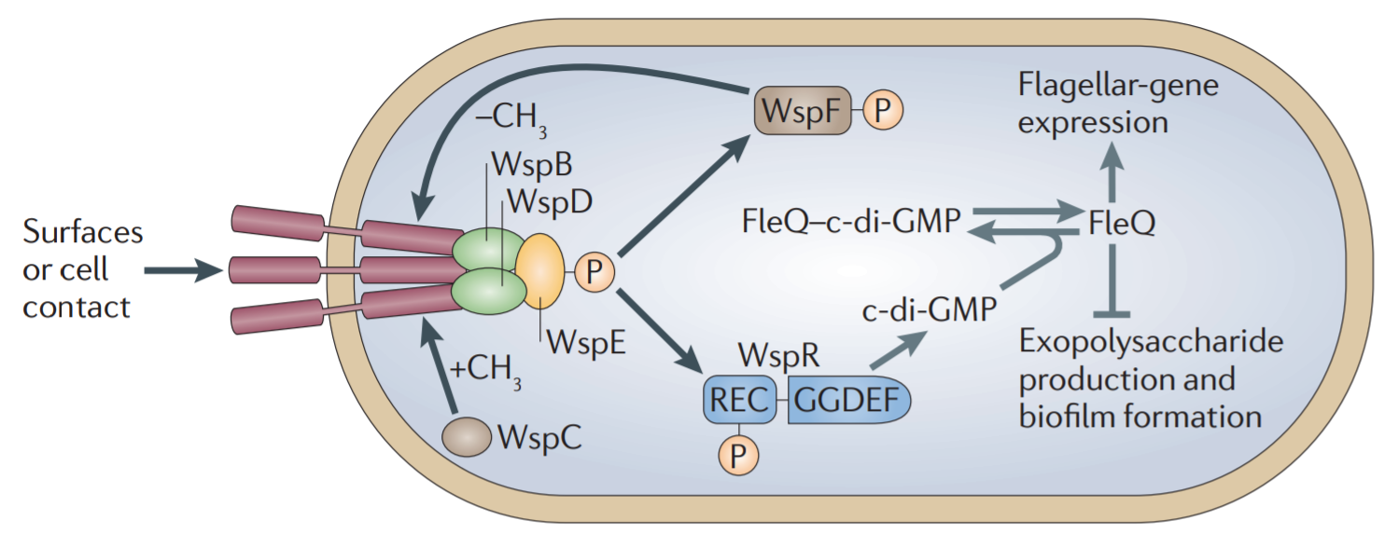
…and Pseudomonas
Porter et al. 2011

Slide 30
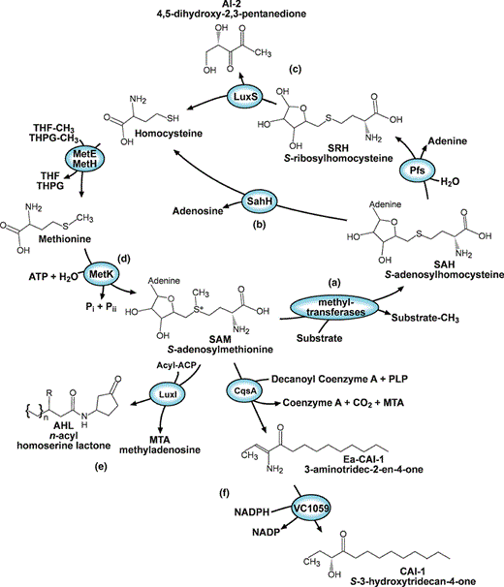
LuxS
Pereira et al. 2013

Slide 31
Consensus sequence on receptors
Glu-Glu*-X-X-Ala-Ser/Thr
*=methylated residue
X=any amino acid

