Slide 1
Comprehensive Exam Topics
09/22/20

Slide 2
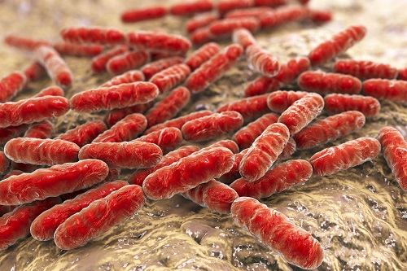
Topic #1: Lactobacillus iners
Part of vaginal microbial community
“Friend or Foe?”
Found in abundance in healthy and dysbiosis communities such as Bacterial Vaginosis
Helps increase adhesion of Gardnerella vaginalis onto HeLa cells

Slide 3
Topic #1: Lactobacillus iners
Reduced genome (~1.3 Mbp) compared to other lactobacilli
  Less niche variability compared to other lactobacilli
  Possible vaginal symbiont
Is not a H₂O₂-producer unlike other lactobacilli
Encodes genes important of stress conditions
  Iron-sulfur proteins
  rpoH, rpoN, and rpoE

Slide 4
Lactobacillus iners Aim #1
Find genes that are directly regulated by rpoH (sigma factor that is usually responsible for stress response to elevated temperature and H₂O₂).
Methods:
  Chip-seq
  Compare knockout and wildtype RNAseq after exposing a sublethal concentration of peroxide

Slide 5
Lactobacillus iners Aim #2
Challenge wildtype and rpoH null mutant against hydrogen peroxide producing lactobacilli
Methods:
  Coculture in liquid medium
  Coculture in cell cultures

Slide 6
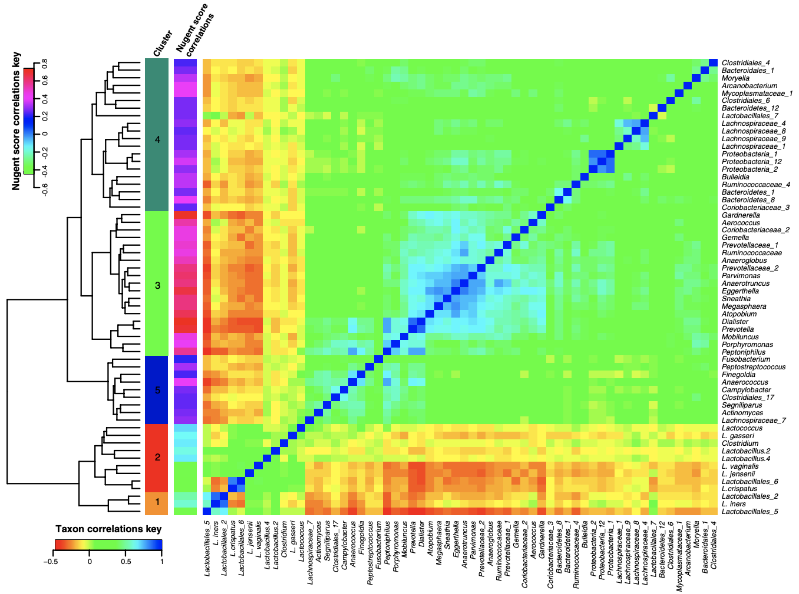
Negative correlation: L. crispatus

Slide 7
Hypotheses
rpoH is a sigma factor responsible for H₂O₂ defense.
rpoH null mutant will not be fit in coculture with peroxide producing lactobacilli.

Slide 8
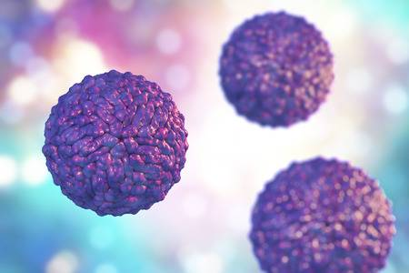
Topic #2: Human Pegivirus
Also called GBV-C virus or hepatitis G virus-HGV
Part of Flaviviridae family
  Positive, single-stranded, enveloped RNA viruses
Transmitted by sexual, parenteral, and vertical (mother to child) mechanisms
“Beneficial STI”
Notes:
1. Have two ideas for proposals to present to us.
2. Each proposal presentation should only be a few slides and take only 10 minutes to present. You are likely to get various questions and suggestions from us.
3. Be sure to have background, your overall goal, two specific aims, and some ideas for experimental approaches for each proposal. You are not expected to have the proposals all worked out, but rather that you have done enough preliminary background reading to have a few ideas that excite you (and, therefore, us). On one level, this is sort of a test, but it is really an opportunity for you to share your ideas with us and to get some advice from your committee members on how to put together a successful proposal.

Slide 9
Human Pegivirus and HIV coinfection
Studies have shown that people coinfected have a delayed progression to AIDS
Reduction in HIV viral load
Higher CD4 cell counts
GBV-c alters cytokine profile, reduces T cell activation, modifies expression of HIV co-receptors, and directly inhibits HIV entry

Slide 10
Ebola Virus Infection
Average fatality ~50%
Symptoms:
  Hemorrhagic fever
  Vomiting
  Blood in stool
  Impaired kidney and liver function
  Low white blood cell and platelet counts
No treatment proven to neutralize the virus

Slide 11
Human Pegivirus and Ebola coinfection
Case study with 49 patients with Ebola
  13 were coinfected with Gbv-C
53% of patients coinfected survived vs 22% of patients only infected with Ebola

Slide 12
Human Pegivirus Aim #1
Identify differences in Ebola viral load of people coinfected with Gbv-c and those only infected with Ebola AND quantify T cell counts of Ebola infected patients w/ and w/out Gbv-c infection.
Methods:
  Ebola viral load: Real time RT-PCR with fluorogenic probes designed for the detection of Ebola virus
  Gbv-c viral load: Real time PCR or quantitative branched-chain DNA (bDNA) assay

Slide 13
Human Pegivirus Aim #2
Quantify proinflammatory cytokines of Ebola infected patients w/ and w/out Gbv-c
  Interferon (IFN)-g, IFN-a, Interleukin (IL)-2, IL10, and Tumor Necrosis Factor-a elevation associated with fatal Ebola infection
Methods:
  Cytokine sandwich ELISA

Slide 14
Hypothesis
When Gbv-c viral count is up in an individual, there will be less Ebola viral load and higher T cell count.
Individuals with Gbv-c will have a different proinflammatory cytokines profile compared to people monoinfected with Ebola.

