Slide 1
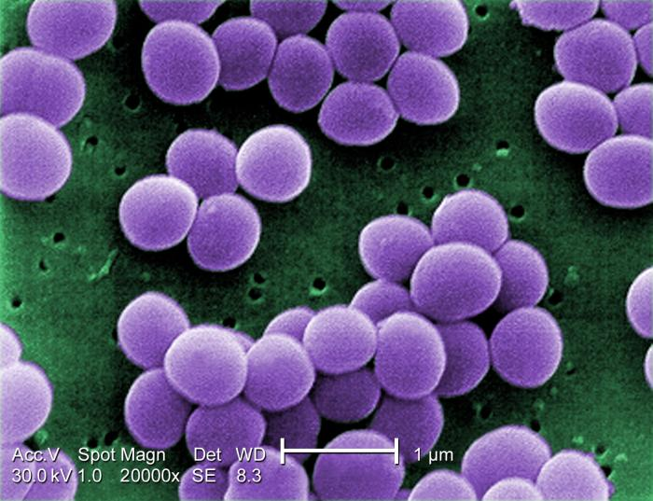
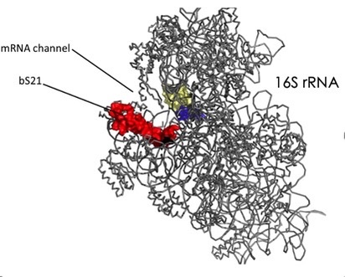
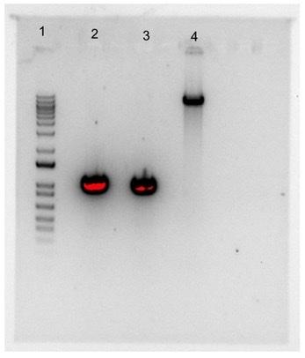
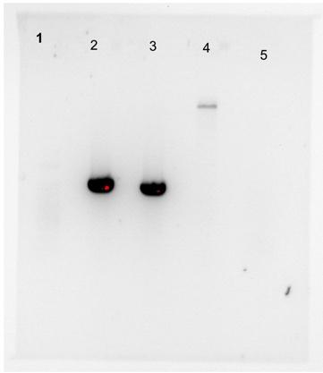


Investigating the role of bS21 in vancomycin-resistant Staphylococcus aureus
Dan Floyd¹, Hannah Trautmann¹, Dr. Kathryn Ramsey^{1,2}
¹Cell and Molecular Biology, University of Rhode Island, Kingston, RI 02881
²Biomedical and Pharmaceutical Sciences, University of Rhode Island, Kingston, RI 02881
S. aureus
Ribosomal Protein bS21
Goal:
Make S. aureus cells lacking bS21
  Clone a plasmid for allelic replacement
  Introduce plasmid into S. aureus
  Screen for cells in which allelic replacement has occurred
Allelic Replacement Strategy
pKR95
FR1
FR2
S. aureus gDNA
FR1
rpsU
FR2
SEM Image of S. aureus CDC PHIL, Matthew J. Arduino, 2001
30s ribosomal subunit in E. coli with bS21 PDB entry: 4V50
Methods
Plan adapted from “From cloning to mutant in 5 days: rapid allelic exchange in Staphylococcus aureus" by Monk and Stinear (2021)
Expected Results After 1st Homologous Recombination Event
Staphylococcus aureus
Gram-positive pathogenic bacterium
Causative agent of infections
Many strains are antibiotic resistant (Blake & O’Neill, 2012)
Chlor-Res
FR1
FR2
Plasmid
FR1
rpsU
FR2
lacZ
pIMAY-Z backbone
PCR of Flanking Regions 1 & 2
I performed a PCR to amplify the flanking regions outside of rpsU to allow for allelic replacement of S. aureus genomic DNA
S. aureus gDNA contains entirety of plasmid and native gene
Expected Results After 2nd Homologous Recombination Event
1
FR1
FR2
rpsU was replaced by the plasmid FRs - deletion
Vancomycin
Antibiotic
Works by binding to the precursors of the cell wall, disrupting its structure (Hiramatsu, et. al, 2014)
Bacteria cannot grow or divide properly without cell wall
Digest of Flanking Regions and the pIMAY-Z backbone
I digested the ends of the flanking regions and the pIMAY-Z backbone to create compatible sticky ends for ligation
  Gel Image Contents
  L = DNA Ladder
  FR1 = flanking region 1 – 1,015 bp
  FR2 = flanking region 2 – 969 bp
  BB = pIMAY-Z backbone – 8,700 bp
S. aureus gDNA
L
FR1
FR2
BB
L
FR1
FR2
BB
- C
2
FR1
rpsU
FR2
The plasmid FRs did not replace rpsU – no deletion
8000 bp
8,700 bp
S. aureus gDNA
1500 bp
1015 bp
969 bp
Labels needed – how would you describe each of these outcomes?
1000 bp
400 bp
Future Directions
Finish making S. aureus without rpsU
Check for vancomycin resistance
Use transmission electron microscopy to compare cell wall sizes
bS21: a ribosomal protein
A small subunit ribosomal protein
Encoded by the gene rpsU
Inactivation of rpsU in S. aureus is linked to vancomycin-resistance (Blake & O’Neill, 2012)
Implicated in gene regulation in other bacteria (Takada et. al. 2014)
FR1
FR2
Plasmid Ligation
I ligated together the backbone and flanking regions, effectively “gluing” the flanking regions into the pIMAY-Z backbone
Chlor-Res
Literature Cited
Basco, M., Kothari, A., McKinzie, P. B., Revollo, J. R., Agnihothram, S., Azevedo, M. P., Saccente, M., & Hart, M. E. (2019, May 28). Reduced vancomycin susceptibility and increased macrophage survival in Staphylococcus aureus strains sequentially isolated from a bacteraemic patient during a short course of antibiotic therapy. Journal of medical microbiology, 68(6), 848–859. https://doi.org/10.1099/jmm.0.000988
Blake, K. L., & O'Neill, A. J. (2012, October 7). Transposon library screening for identification of genetic loci participating in intrinsic susceptibility and acquired resistance to antistaphylococcal agents. The Journal of antimicrobial chemotherapy, 68(1), 12–16. https://doi.org/10.1093/jac/dks373
Cui, L., Iwamoto, A., Lian, J. Q., Neoh, H. M., Maruyama, T., Horikawa, Y., & Hiramatsu, K. (2006, February 1). Novel mechanism of antibiotic resistance originating in vancomycin-intermediate Staphylococcus aureus. Antimicrobial agents and chemotherapy, 50(2), 428–438. https://doi.org/10.1128/AAC.50.2.428-438.2006
Hiramatsu, K., Kayayama, Y., Matsuo, M., Aiba, Y., Saito, M., Hishinuma, T., & Iwamoto, A. (2014, June 7). Vancomycin-intermediate resistance in Staphylococcus aureus. Journal of Global Antimicrobial Resistance. 2(4), 213-224. https://doi.org/10.1016/j.jgar.2014.04.006
Monk, I. R., & Stinear, T. P. (2021, January 7). From cloning to mutant in 5 days: Rapid Allelic Exchange in Staphylococcus aureus. Access Microbiology, 3(2), 193-199. https://doi.org/10.1099/acmi.0.000193
Hiraku Takada, Masato Morita, Yuh Shiwa, Ryoma Sugimoto, Shota Suzuki, Fujio Kawamura, Hirofumi Yoshikawa. (2014, May 4) Cell motility and biofilm formation in Bacillus subtilis are affected by the ribosomal proteins, S11 and S21, Bioscience, Biotechnology, and Biochemistry, 78(5) 898–907, https://doi.org/10.1080/09168451.2014.915729
lacZ
pIMAY-Z backbone
IMO8B E. coli Transformation
The ligated plasmid was transformed into IMO8B E. coli to generate more plasmid with a methylation pattern compatible with introduction into S. aureus
Hypothesis
bS21 may be a regulator of cell wall biosynthesis and cells lacking bS21 may have thicker cell walls, leading to vancomycin resistance
Chlor-Res
FR1
FR2
lacZ
Plasmid Sequencing
After transformation, the plasmid was sequenced to confirm that it contained the flanking regions and there were no mutations introduced
pKR95
Acknowledgements
I would like to thank the Ramsey Lab and Gregory Lab for productive lab meeting discussions along with the INBRE lab
Be consistent in citation style. Many citations need fixing (list journal volume, issue, page numbers, make sure capitalization is correct).
Include citations in the poster – you wouldn’t need this section if you don’t cite any papers

