Slide 1
Investigating the role of bS21 in vancomycin-resistant Staphylococcus aureus
Dan Floyd, Hannah Trautmann, DR. Kathryn Ramsey, and Aisling Macaraeg

Slide 2
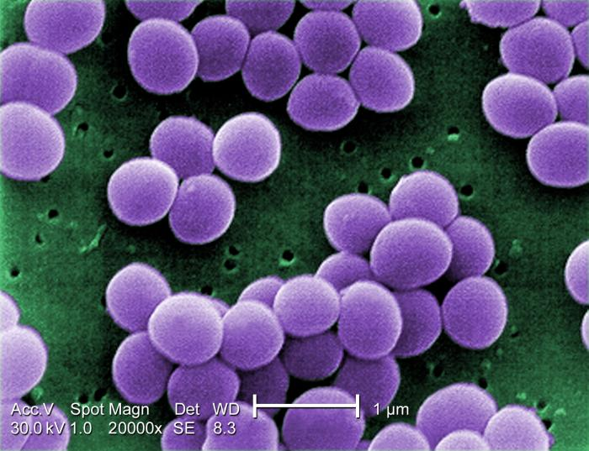
Staphylococcus Aureus
Gram-positive pathogenic bacterium
Causative organism of staph infections
Many antibiotic-resistant strains
  Penicillin
  Methicillin
  Vancomycin
  Daptomycin
My project focuses on the interaction between S. aureus, vancomycin, and bS21

Slide 3
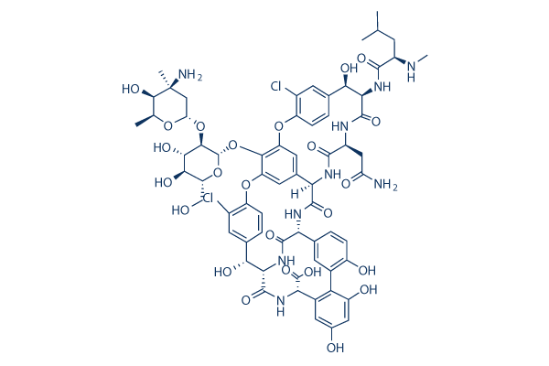
Mechanism of Action
Cell wall biosynthesis halted
Improper Cell wall synthesis
Vancomycin
The cell cannot grow or divide properly without the cell wall
Notes:
Vancomycin prevents cross-linking of peptidoglycan

Slide 4
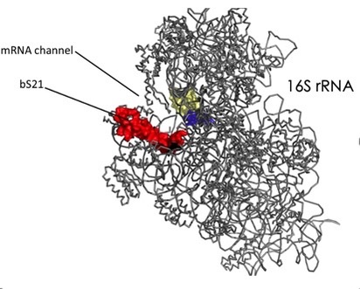
rpsU / bS21
rpsU encodes the ribosomal protein bS21
bS21 has been implicated in the control of gene expression in multiple bacteria
Inactivation of rpsU in S. aureus is linked to vancomycin resistance
Notes:
It has been seen in previous literature that:

Slide 5
Hypothesis
Why would cells lacking bS21 be resistant to vancomycin?
We hypothesize cells lacking bS21 may have thicker walls
We hypothesize the absence of bS21 may lead to improper regulation of cell wall synthesis
Notes:
The absence of bS21 may result in improper synthesis of the peptidoglycan cell wall

Slide 6
Plans for Honors project
Strategize how to delete bS21 in S. aureus
Clone the plasmid necessary for deleting bS21
Use the plasmid to delete bS21
Check to see if there is resistance to vancomycin
  If there's resistance, compare cell wall sizes

Slide 7
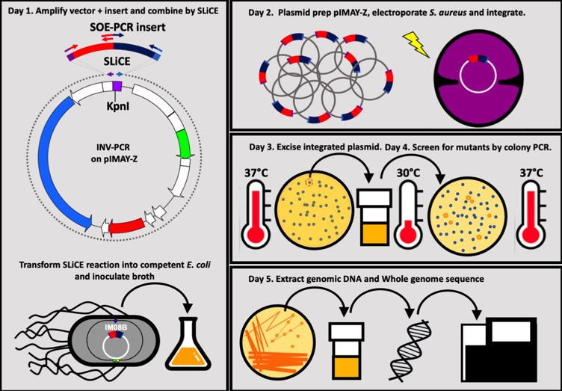
Strategy to delete rpsU in S. aureus
FR1
FR2
Plan adapted from “From cloning to mutant in 5 days: rapid allelic exchange in Staphylococcus aureus" by Ian R. Monk and Timothy P. Stinear
Chlor-Res
pIMAY-Z
lacZ

Slide 8
Steps so Far
pKR95 Plasmid Construction
Make plasmid with FR1 and FR2 to knockout rpsU in S. aureus
  Amplify FR1 and FR2 via PCR; these flanking regions will flank rpsU
  Digest to cut pIMAY-Z and FRs
  Ligate FRs into pIMAY-Z backbone
  Transform into IMO8B E. coli
  Confirm plasmid sequence
  Prepare electrocompetent S. aureus
Notes:
I have been working to create a plasmid with two flanking regions that would knockout rpsU via homologous recombination in S. aureus
This plasmid (which contains the pIMAY-Z plasmid backbone) also contains the gene for chloramphenicol resistance and lacZ, so the plates I have been growing the E. coli transformations on have contained 25 ug/ml chloramphenicol and 100 ug/ml XGAL to aid me in selecting colonies which contain the desired plasmid
The ligation plates contained a lot more colonies than the backbone ligation plate; this ratio indicates a high probability that the desired plasmid is present

Slide 9
Colony selection
Selecting colonies on LB chloramphenicol and XGAL plates
pKR95 has chloramphenicol resistance and lacZ
Select E. coli with the plasmid
No growth due to lack of chlor resistance
Growth due to presence of chlor resistance and blue colonies due to lacZ

Slide 10
Next Steps
Electroporate into S. aureus
Plasmid Excision, Colony PCR, and Isolation of Genomic DNA
Antibiotic Assay?
Transmission Electron Microscopy on resistant cells?

Slide 11



Acknowledgments
I would like to thank the Ramsey Lab
  Hannah Trautmann
  Dr. Kathryn Ramsey
  Aisling Macaraeg
  Sierra Schmidt
  Caterina Ramirez

Slide 12
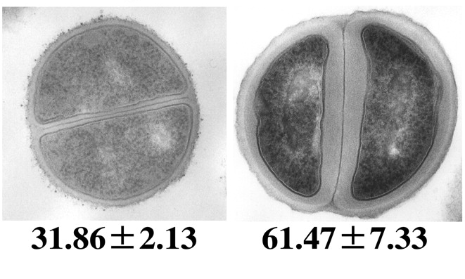
Inactivation of rpsU in S. aureus is linked to antibiotic resistance
Clinical isolates
  Frameshift insertion from 4th amino acid on; van-R (Basco 2019)
  Stop codon at 31st amino acid; van-R (Matsuo et al. 2013)
  Frameshift deletion at 53rd amino acid; van-R (Cameron et al. 2012)
  Promoter region of rpsU; dap-R (Friedman et al. 2006)
In vitro experiments
  Transposon insertion in start codon; van-R and dap-R (Blake and O'Neill 2012)
Cui et al. 2006

