Slide 1
Using the Tn7 system to incorporate an extra priM into the genome
Carly Sautter

Slide 2
Introduction
Francisella tularensis
Transcription factor PmrA
Anti-virulence factor PriM
Overall goal: Uncover how PriM functions to prevent intramacrophage survival
Identify factors critical to the function of PriM

Slide 3
PmrA
PmrA identified as being essential for virulence
  Mutants incapable of survival in macrophage and murine models (Sammons-Jackson, 2008)
PmrA is a response regulator
Had been suggested as a regulator of the Francisella Pathogenicity Island (FPI) (Mohapatra et al., 2007)
  Not found at FPI promotors (Ramsey & Dove, 2016)
Functions mainly as a negative regulator of priM

Slide 4
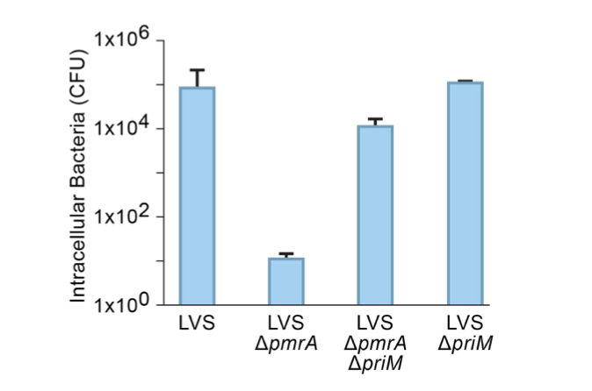
PriM is inhibitory to intramacrophage survival

Slide 5
Identifying factors critical to PriM function
Transposon: genetic element capable of inserting itself into the genome
Transform ΔpmrA PriM+ cells with transposon containing plasmid
    Use the pSD26 plasmid containing the mariner transposon
Inactivates the genes it inserts itself into
    Create a transposon mutant library
Can select for mutants that can rescue virulence in macrophage

Slide 6
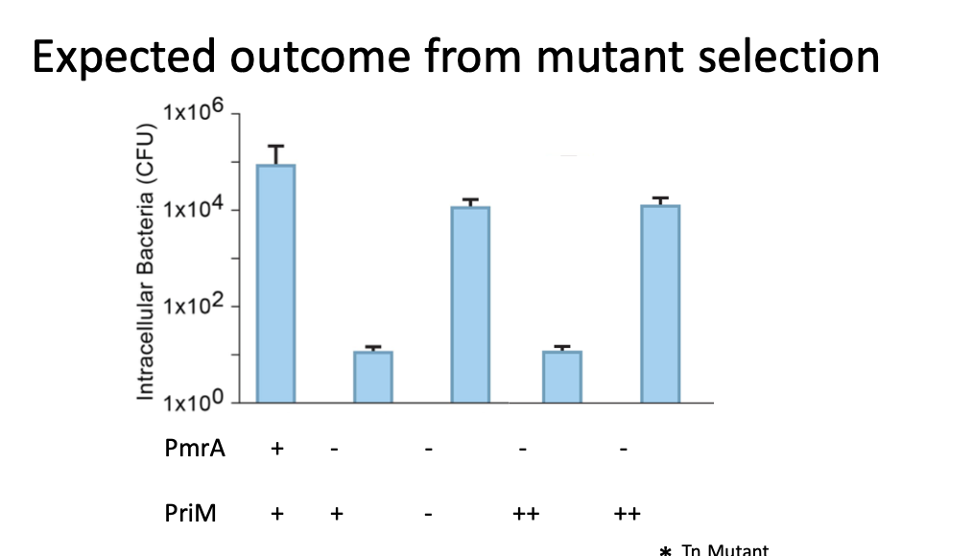

Slide 7
The Tn7 System
A way of introducing genetic elements into the genome
Tn7 Transposon
  Site and orientation specific
  Inserts downstream of highly conserved glmS
Initiation requires transformation with plasmids

Slide 8
Plasmids
pMP720 – Helper plasmid
  Delivers the transposase complex
  Hygromycin resistance
pMP749 – Transposon plasmid
  Delivers your gene of interest to the insertion site
  Multiple cloning site
pMP672 – Resolvase plasmid
  Removes the kanamycin resistance cassette

Slide 9
Overview
1. Transform with helper plasmid
  Select on hygromycin
  make electrocompetent cells for transformation
2. Transform with Tn7 plasmid
  Select on kanamycin
  KanR cells will have mini-Tn7 element
  Make electrocompetent cells from transformants
3. Cure helper plasmid then transform with resolvase plasmid
  Select on hygromycin
4. Cure resolvase plasmid to lose hygromycin resistance

Slide 10
Transforming strains with the helper plasmid
Two strains all transformed with helper plasmid pKR54
Patched out colonies and created electrocompetent cells
  Two colonies from each strain
Colony counts from Tn7 plates: (all controls had 0 colonies)
Strain | 500 uL | 100 uL | 20 uL | Remaining
LVS-1 | 88 | 20 | 4 | ~200
LVS-2 | TMTC | ~450 | 133 | TMTC
Delta PmrA-1 | 39 | 17 | 2 | ~142
Delta PmrA-2 | 24 | 10 | 0 | 36

Slide 11
Cloning the transposon containing plasmid pKR57

Slide 12
Transforming transposon containing plasmid into cells
Electroporated pKR57 into cells with the helper plasmid (pKR54)
  5 uL of plasmid
  2 electroporation's per strain
  Left to recover for 3 hours
  Plated 20 uL, 100 uL, 500 uL, and remaining for each onto hygromycin CHA plates
  2-3 days to obtain colonies

Slide 13
Curing the transposase plasmid (pKR54)
Patch out colony inoculated into MHB
Next day, subculture 1:10 in 5 mL culture tubes
Following day, from the liquid media we streaked for single colonies
Cross patched 6 single colonies onto hygromycin and kanamycin plates to make electrocompetent cells that don't grow on hygromycin
Froze down 3 patches as electrocompetent cells

Slide 14
Getting rid of kanamycin resistance
Picked hygromycin sensitive colonies to make electrocompetent cells
Electroporated resolvase plasmid into cells (pKR56) – time and amount of plasmid electroporated
Plated 500 uL, 100 uL, 20 uL, and remaining on CHA-kan plates after 3 hours
Good replication was seen (20-100 colonies per plate)

Slide 15
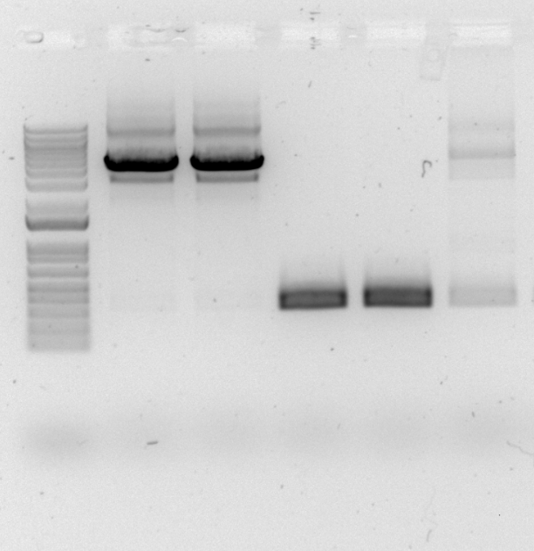
LVS Colony
pKR57 Tn7 PriM+
LVS PriM+ A
LVS PriM+ B
LVS gDNA
Primers attF and attR amplify Tn7 insertion site
350bp without insertion
1808bp with PriM insertion

Slide 16
Future Steps
We think we have cells that are kanamycin sensitive and hygromycin resistant
The next step is to cure the plasmid in order to lose the hygromycin resistance
Conduct a PCR and sequence the PCR product for the region of interest

Slide 17
Overall Goal
Transform ΔpmrA PriM+ cells with transposon containing plasmid
Inactivates the genes it inserts itself into
    Create a transposon mutant library
Can select for mutants that can rescue virulence in macrophage

Slide 18
Questions?

Slide 19
Overview
Transform with helper plasmid
pMP720
+ LVS
tnsABCD
Select on hygromycin
make electrocompetent cells for transformation
LVS pMP720 (Hyg^{R})
pMP749
Tn7R
Term
res
aphA-1
res
yfg
Tn7L
Transform with Tn7 plasmid
gDNA
glmS
Tn7att
FTL-0455
tnsABCD
Select on kanamycin
KanR cells will have mini-Tn7 element
Make electrocompetent cells from transformants
glmS
Tn7R
res
aphA-1
res
yfg
Tn7L
FTL-0455
Cure helper plasmid then transform with resolvase plasmid
Select on hygromycin
Cure resolvase plasmid to lose hygromycin resistance
glmS
Tn7R
res
yfg
Tn7L
FTL-0455

Slide 20
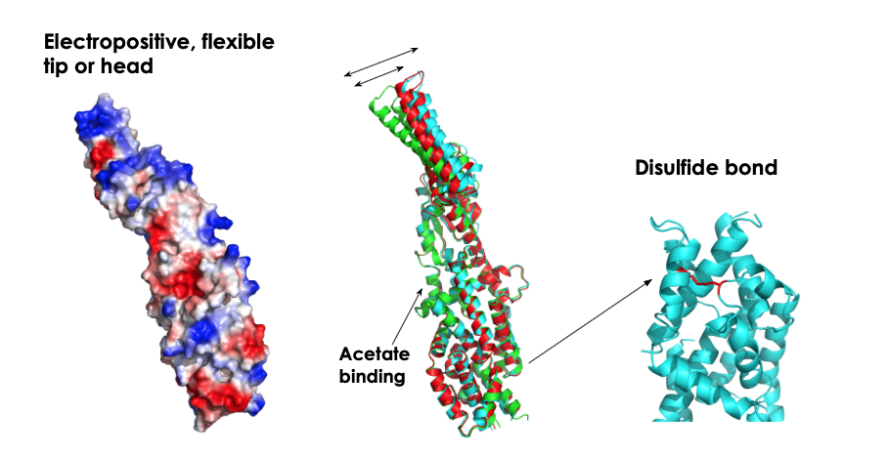
Identifying Critical Structural Features of PriM
Use the structure of PriM to create targeted mutations
  Use allelic exchange protocol to create mutants in the wildtype and ΔpmrA background
Test these mutants for the ability to replicate in macrophage
  Identify structural mutants that regain ability to survive in macrophage

Slide 21
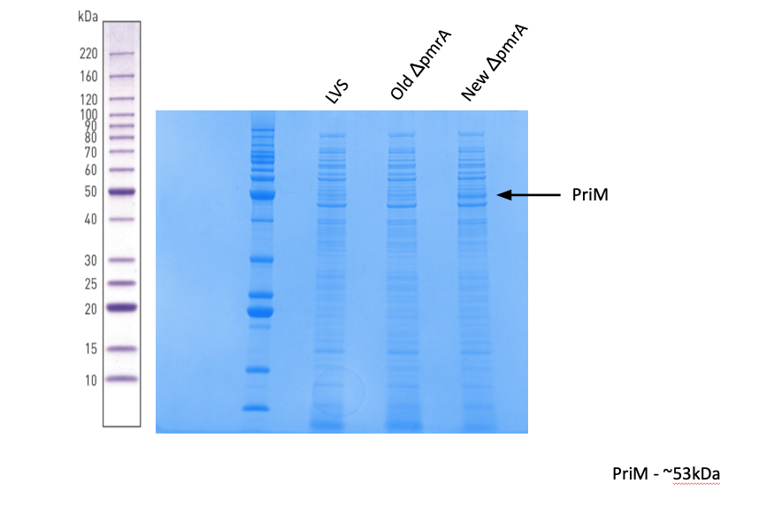

Slide 22
