Slide 1
Gene Regulation within Francisella tularensis
Aisling Macaraeg
April 12, 2022
Notes:
Hi everyone, my name is Aisling and I am an undergraduate researcher in Dr. Ramsey’s Lab. Today I will be talking about gene regulation in F. tularensis. If you have any questions, or if something doesn’t make sense, please be free to stop me!

Slide 2

Dr. Kathryn Ramsey’s Lab
Organism of interest: Francisella tularensis LVS
Gene of interest: rpsu2
Codes for protein: bS21 (ribosomal protein)

Slide 3
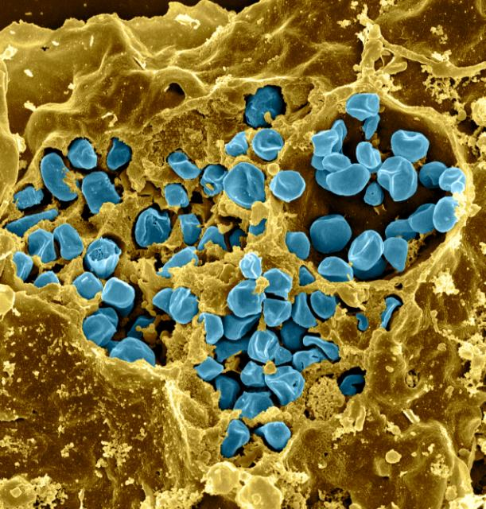
Francisella tularensis
Gram (-)
Causative agent of tularemia
Sometimes fatal in both humans and animals ₁
Highly virulent ₂
Found in 49 states ₃
Minnesota Dept. Health Staff, 2006
WHO, 2007
CDC, 2021
National Institute of Allergy and Infectious Disease (NIAID) Laboratory of Intracellular Parasites, Tularemia Pathogenesis Section
Notes:
Gram-negative pathogenic bacterium
Causes the disease tularemia
Fatal in both humans and in animals
The mortality rate is less than 2% with treatment, without treatment it is around 30-60%. (Minnesota Dept. Health Staff, 2006)
Highly virulent with ~10 cells through injection and 25 through inhalation (WHO, 2007)
infections have been reported in 49 states, with the exception being Hawaii. (CDC, 2021)

Slide 4
Ribosomes can be heterogenous
Multiple sources of heterogeneity
Multiple genes (homologs) encode the same ribosomal protein
  Homologs = different version of the same gene
50S
50S
50S
30S
30S
30S
Notes:
There are multiple sources of heterogeneity,
The main one of interest for this project is
That multiple genes encode the same ribosomal protein
Just to clarify, a homolog is a different version of the same gene

Slide 5
There are multiple bS21 homologs in Francisella tularensis
cspC
rpsU1
rpsU2
yqeY
dnaG
rpoD
rpsU3
Notes:
Here are depicted is the promoter, which is this arrow, and then the genes and the ones that are highlighted in different colors are the homologs that I was describing before
Most bacteria have 1 or no bS21
Our lab is most interested in rpsu2
Why?

Slide 6
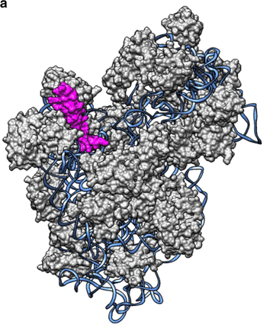
bS21-2
Most abundant homolog
Reduces abundance of proteins that are important for type VI secretion system (virulence factor)
Critical for intramacrophage growth
Unknown mechanisms of regulation
bS21
30s subunit from E. coli
Mizuno, Carolina & Guyomar, Charlotte & Roux, Simon & Lavigne, Régis & Rodriguez-Valera, Francisco & Sullivan, Matthew & Gillet, Reynald & Forterre, Patrick & Krupovic, Mart. (2019). Numerous cultivated and uncultivated viruses encode ribosomal proteins. Nature Communications. 10. 752. 10.1038/s41467-019-08672-6.
Notes:
Three homologs of ribosomal protein bS21
bS21-2 is most abundant
it is important because it reduces the abundance of proteins that are important for type VI secretion system, which is a virulence factor
it is critical for intramacrophage growth
These are all reasons why we are interested in this particular protein, and want to better understand the mechanisms of regulation

Slide 7
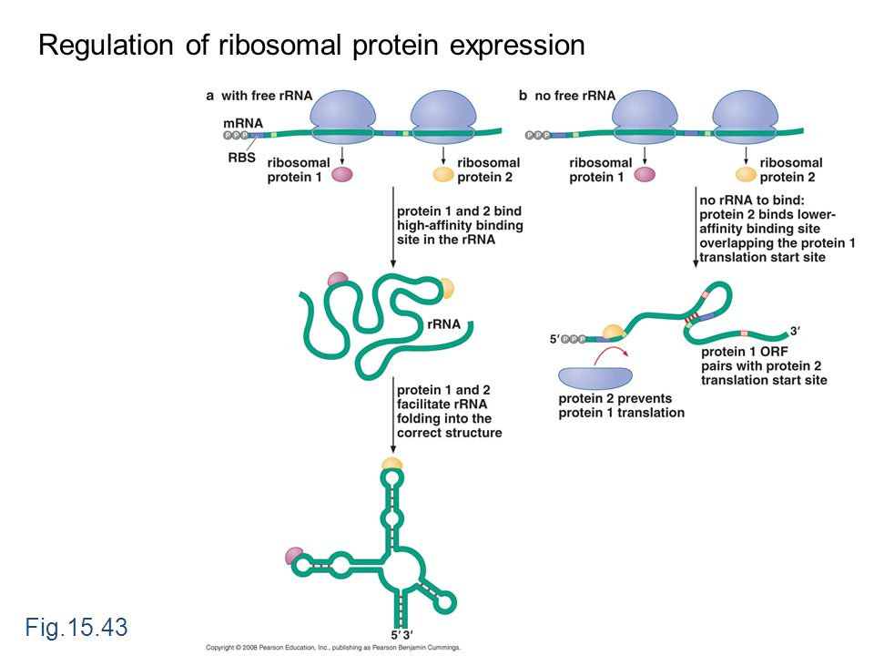
Example of “regular” ribosomal protein regulation
Important for regulating overproduction of protein
Is this what happens with bS21-2?
Expectations: if bS21-2 is “ribosomal protein 2” and it could be binding to the mRNA and preventing translation of itself, leading to degradation
Degradation of mRNA
Notes:
Starting off with the example of regular ribosomal protein expression
In option A there are two proteins 1 and 2, which both have sites so that they both bind to their appropriate places on the rRNA
This binding leads to the correct folding of the structure
In option B there are the same two proteins, but only 2 binds to the translational site of protein, which then leads to the degradation of mRNA
Could this be what is happening with bS21-2?
Our expectation is
If bS21-2 is the same as ribosomal protein 2 in scenario b, and there is no bS21-2 produced, and there is more

Slide 8
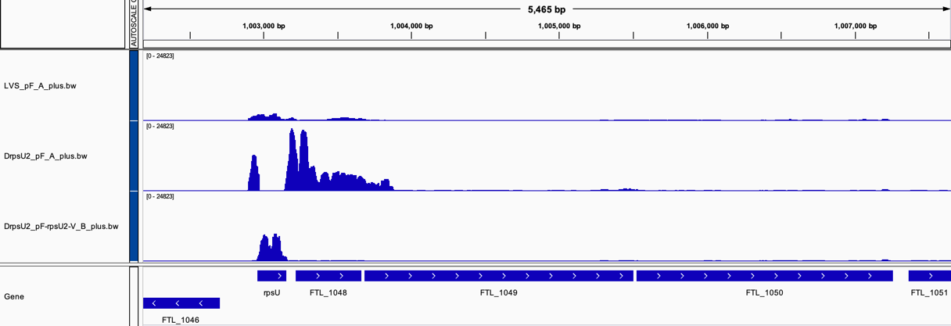
rRNA seq data suggest bS21-2 suppresses own mRNA
Wild-type
(bS21-2+)
Δrpsu2
(bS21-2 -)
rpsu2 overexpression
(bS21-2 +)
rpsU2
yqeY
dnaG
rpoD
Notes:
Our first piece of Data is showing the amount of transcript abundance (like a histogram situation)
X-axis are the genes
At the bottom is the sequence aligned and the red arrow is pointing to area that was of interest
Wild type cells, which have bS21-2, have low expression of rpsU2 and other genes surrounding
Delta rpsu2 have an increased abundance of genes surrounding
And the final is sort of like a control, it was a plasmid with rpsu2 and bS21 and there was a decent amount of rpsU2 transcript and none of anything else
Conclusion: When there is no bS21-2 present, there is an increased abundance of the rest of the operon

Slide 9
Real-Time PCR
Isolate RNA, turn it into DNA (cDNA)
Quantifiable method of measuring amplification of a specific sequence of cDNA
Different primers designed for targeted region
Known initial amount of cDNA
1
2
4
8
Notes:
Just to quickly review the method behind RT – PCR
You isolate RNA, and turn it into cDNA, which is a type of DNA made from mRNA
This process is a quantifiable method of measuring amplification of a specific sequence of cDNA
You design primers that are made for a specific region of interest

Slide 10
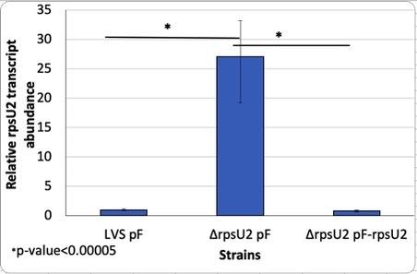
Previous RT-PCR suggest that bS21-2 is suppressing itself
When there is no protein present, there is an increase in transcript. Protein suppresses itself.
This protein could be:
Preventing its own transcription (transcriptional regulation)
bS21-2 inhibts translation of its own mRNA, leading to its quick degradation (post-transcriptional level)
Notes:
Another piece of preliminary data that was used is showing transcript abundance between LVS and delta rpsU2
As you can see, when there the rpsu2 gene is deleted there is a 25 fold increase in transcript abundance
This is clearly showing that when there is no protein present, there is an increase in transcript. The protein is suppressing itself.
What could be happening?
One option is that it is preventing its own transcription.
Binding to DNA for example
Another option is that it could be inhibiting translation leading to quick degradation
Which would be similar to the example that I showed you earlier
With this idea that the protein bS21-2 is preventing its own transcription, we were interested to investigate which specific part of the sequence could the protein be influencing? Is this regulation occuring at the level of transcription or translation?

Slide 11
Question
regulatory sequence influences post-transcription and translation
regulatory sequence upstream of gene
Is the activity of the promoter or the 5’ UTR sequence of the rpsU2 gene in F. tularensis responding to the presence of bS21-2?
Ribosomal protein
(homolog 2)
Gene of interest
?
-10 and -35
5’UTR
rpsu2
bS21-2
Notes:
IS regulation occurring at the level of transcription or translation?

Slide 12
Using reporter gene fusions to assess gene regulation
Attached to a gene of interest in order to measure an output
Examples: GFP, β-galactosidase
Can incorporate into F. tularensis and measure reporter activity
RNA Pol
RNA Pol
Beta-galactosidase
Regulatory stuff
Gene of interest
lacZ
Notes:
Using reporter gene fusions to assess gene regulation
When you take a strain and attach to a gene interest in order to measure an output
Some examples are GFP, and Beta gal
For our purposes, we would be able to use this method of reporter gene fusion to incorporate it into F. tularensis and measure reporter activity
Wanted to use this method instead of RT-PCR because it is faster, cheaper and simpler
Lil animation

Slide 13
Question
regulatory sequence influences post-transcription and translation
regulatory sequence upstream of gene
Is the promoter or the 5’ UTR sequence of the rpsU2 gene in F. tularensis responding to the presence of bS21-2?
Gene of interest
Ribosomal protein
(homolog 2)
Notes:
Going back to the question one more time… So how can we use the reporter gene in order to determine which sequence is being effected?
Need:
A control
A baseline
Switchero

Slide 14

Reporter Constructs and Expectations
If in cells with bS21-2 (WT) | If in cells without bS21-2 (∆rpsU2)
rpsU2 promoter
rpsU2 5’ UTR
LacZ
tul 4 promoter
tul 4 5’ UTR
LacZ
rpsU2 promoter
tul 4 5’ UTR
LacZ
?
?
tul 4 promoter
rpsU2 5’ UTR
LacZ
?
?
Notes:
Different constructs
rpsU2 promoter and rpsU2 5’ UTR with lacZ
Validating the system accurately represents what we have done previously with other methods
“Baseline”
Expectations: no rpsU2, higher beta-gal activity
Tul 4 promoter and tul 4 5’ UTR
Expectations: the same beta-gal activity
Last two compare to the first two, whichever looks like the first, would be the sequence that is responding to the presence of bS21-2
rpsU2 promoter and tul 4 5’ UTR
tul 4 promoter and rpsU2 5’ UTR
an important side not: this was all hinged upon the baseline acting as expected.

Slide 15
Results of β-galactosidase assay
Reporter only shows ~30% increase in output in cells lacking bS21-2
Expecting: ~25 fold increase
Reporter expected to reflect RNA abundance, but is measuring b-gal activity
Drastically not what expected so what to do?
LVS
ΔrpsU2
Notes:
Plot twist: it did not act as expected.
The reporter only shows about a ~30% increase not what we were expecting at all
As a reminder we were using this Beta-gal as a proxy to measuring transcript abundance and because we didn’t want to go through with the tedious process of isolating RNA
So it didn’t go as planned… now what?

Slide 16
Possibilities for difference
β-galactosidase
RT-PCR
≠
LVS
ΔrpsU2
Error when labeling tubes…?
Maybe didn’t include all of regulatory sequence fused to reporter?
Post-translational?
  A ton of mRNA (transcript) but then a lot less protein?
Notes:
Here are some possibilities of the differences
Error when labeling the tubes
Maybe didn’t include all of the regulatory sequence fused to the reporter?
Something is happening post-translationally instead?
This is because a lot of mRNA is being made but then isn’t being translated into as much protein….
Not error cause did a colony pcr

Slide 17
RT-PCR Experiment
Goal: To compare the results of this previous experiment to our strains.
Our strains have the reporter fusion somewhere else on the chromosome
Is there still a lot of transcription but less translation of beta-galactosidase?
Genes in native context
Expectation: cells without bS21-2 will have more lacZ transcript
Notes:
So we did have to go back and do the tedious and time consuming isolating RNA in order to complete a real-time PCR experiment
Our goal was to compare the results of this experiment to our strains because our strains have the reporter fusion
The main question was is there still a lot of transcription but less translation of beta-gal?

Slide 18
Discrepancies in reporter gene constructs and native bS21-2 gene regulation
 | mRNA | protein
WT: rpsu2 operon | 25x | 1x
rpsu2 promoter + 5’UTR + lacZ | 4x | 30% increase
~ 4-fold increase
?
Notes:
The results were again not as expected…
There was about a 4x increase in delta rpsu2 in comparison to LVS
There are discrepancies between the 4x and the 30% as well as
Between the WT and our engineered strain between transcript abundance (25 fold and 4 fold)

Slide 19
Where does that leave us?
Difference between transcript abundance in Δrpsu2 WT and our engineered strain
  Mutation impacting bS21-2 regulation (Boring!)
  Less lacZ mRNA because transcript abundance decreases along the length of the transcript
  Needed more of the rpsU2 promoter fused to reporter construct to allow complete regulation
Difference between transcript and protein abundance
  ?????? TBD
Notes:
Difference between transcript abundance (between the two strains or the 25 and 4)
Mutation impacting bS21-2 regulation (Boring!)
Less lacZ mRNA because transcript abundance decreases along the length of the transcript
Needed more of the rpsU2 promoter fused to reporter construct to allow complete regulation
Difference between transcript and protein abundance
?????? TBD

Slide 20
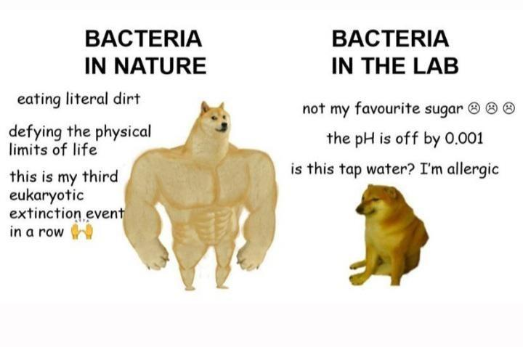
Major Take-Aways
Making mistakes is ok
Biology isn’t perfect and doesn’t always go as planned

Slide 21


Acknowledgements
I would like to thank the Ramsey Lab
  Hannah Trautmann
  Dr. Kathryn Ramsey
  Sierra Schmidt
  Caterina Ramirez
  Especially my lab partner, Dan Floyd, who worked on this project with me
INBRE and Janet
URI^2 for funding

Slide 22
Thanks!
Any questions ?

Slide 23
rpsU2 promoter
rpsU2 5’ UTR
LacZ
tul 4 promoter
tul 4 5’ UTR
LacZ
rpsU2 promoter
tul 4 5’ UTR
LacZ
Tul 4 promoter
rpsU2 5’ UTR
LacZ
Different Reporter Constructs

Slide 24
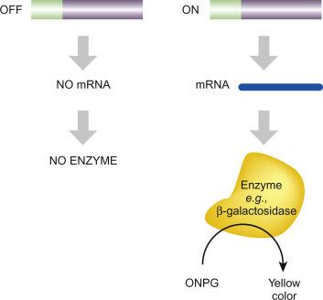
β-galactosidase assay
Measures enzymatic activity
A proxy for transcript abundance post-transcriptionally?
(Clark et al., 2019)
Notes:
Image from Molecular Biology, 2019
Chapter 21

Slide 25
Procedure
Amplify DNA
Digestion
Ligation
Transform into E. coli
β-galactosidase assay
Electroporate
Sequence
Purify DNA

Slide 26
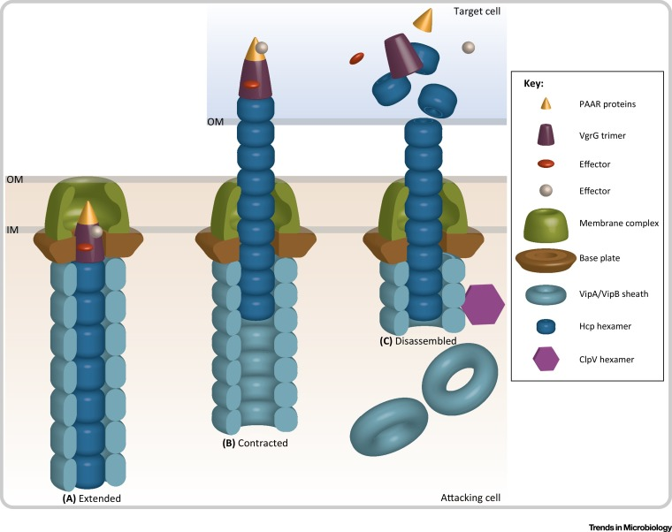
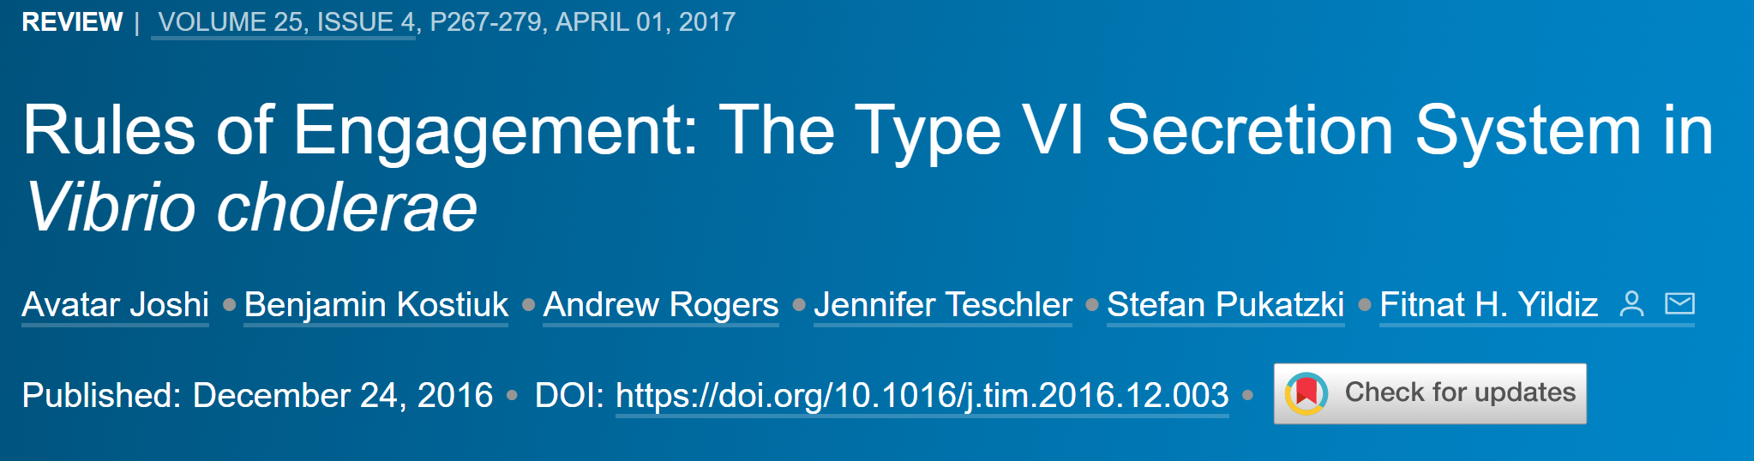
Type VI Secretion System

Slide 27
LVS: has bS21-2
ΔrpsU2: no bS21-2
pKR121
pKR121
rpsU2 promoter
rpsU2 5’ UTR
LacZ
rpsU2 promoter
rpsU2 5’ UTR
LacZ
pKR111
pKR111
tul 4 promoter
tul 4 5’ UTR
LacZ
tul 4 promoter
tul 4 5’ UTR
LacZ
pKR122
pKR122
rpsU2 promoter
tul 4 5’ UTR
LacZ
rpsU2 promoter
tul 4 5’ UTR
LacZ
pKR123
pKR123
tul 4 promoter
rpsU2 5’ UTR
LacZ
tul 4 promoter
rpsU2 5’ UTR
LacZ
Different Cell Types Used

Slide 28
How do we answer this question?
Clone plasmids
w/ reporter gene
Incorporate into LVS F. tularensis
β-galactosidase assay

Slide 29
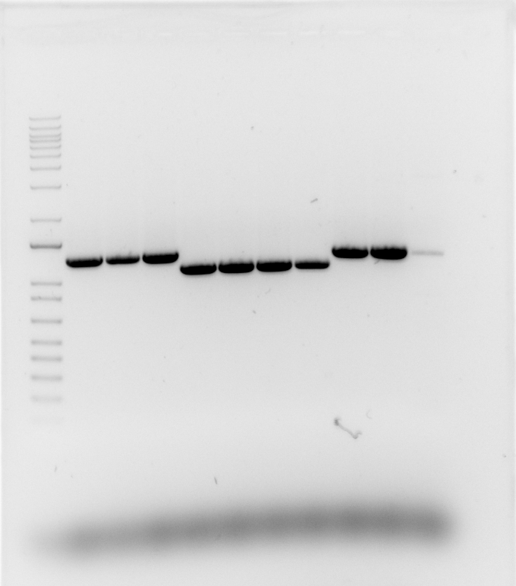
Colony PCR
Genotype | Lane | Expected | Y/N
LVS | 1 | 1300 | Y
LVS | 2 | 1300 | Y
LVS | 3 | 1300 | Y
Δrpsu2 | 4 | 1100 | Y
Δrpsu2 | 5 | 1100 | Y
Δrpsu2 | 6 | 1100 | Y
Δrpsu2 | 7 | 1100 | Y
Pos control | 8 | 1300 | Y
Pos control | 9 | 1300 | Y
Neg control | 10 | 0 | Y

Slide 30
Transformation
Plasmid now a part of the chromosome
Chromosome in bacterial cell
Arbitrary plasmid

Slide 31
Previous Data
Cells lacking bS21-2 (ΔrpsU2) had a 25 times more transcript abundance in comparison to the LVS
ΔrpsU2 pF-rpsU2 = the gene present in the cell in a plasmid
How can we analyze this data?
Consistant with known regulation of ribosomal proteins.

