Slide 1
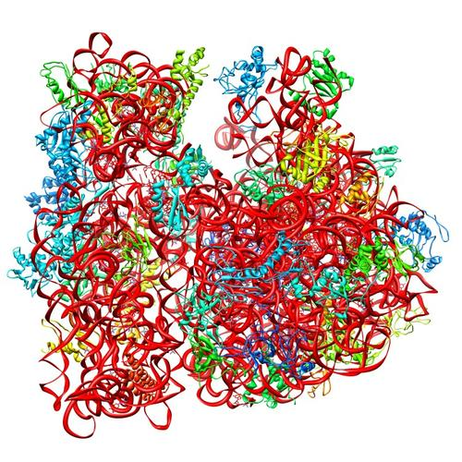
Ribosomes can be heterogenous
E. coli ribosome
3 rRNAs
49 proteins
Multiple sources of heterogeneity
Multiple genes (homologs) encoding the same ribosomal protein
  Homologs = different version of the same gene
50S
30S
PDB 4V50
Berk et al., 2006

Slide 2
There are multiples bS21 homologs in Francisella tularensis
cspC
rpsU1
Implicated in virulence
rpsU2
yqeY
dnaG
rpoD
bS21-2 containing ribosome
rpsU3
When is this gene expressed? When is bS21-2 used?
Notes:
Even though francisella has a reduced genome, it encodes three copies of the rpsU genes, which encode bS21, a protein in the small ribosomal subunit. Most bacteria have 0 or 1 of this gene. We originally, hypothesized, and have since shown, that these three proteins are produced and incorporated into ribosomes. This is a western blot of purified ribosomes from our wild-type strain as well as strains ectopically expressing each of the bS21 proteins, with a VSVG tag. This, along with some mass spec data we have of purified ribosomes, indicates that multiple classes of ribosomes are possible and occurring
This protein is also interesting to us because it is located close to the mRNA exit channel in the ribosome, and early research has identified that it is involved in translation initiation, so it is in an ideal location to be regulating gene expression at the level of translation initiation.
So this heterogeneity of ribosomes may be a mechanism of regulation, but you may not know that ribosomes are heterogeneous so let me show you other ways that may occur.

Slide 3
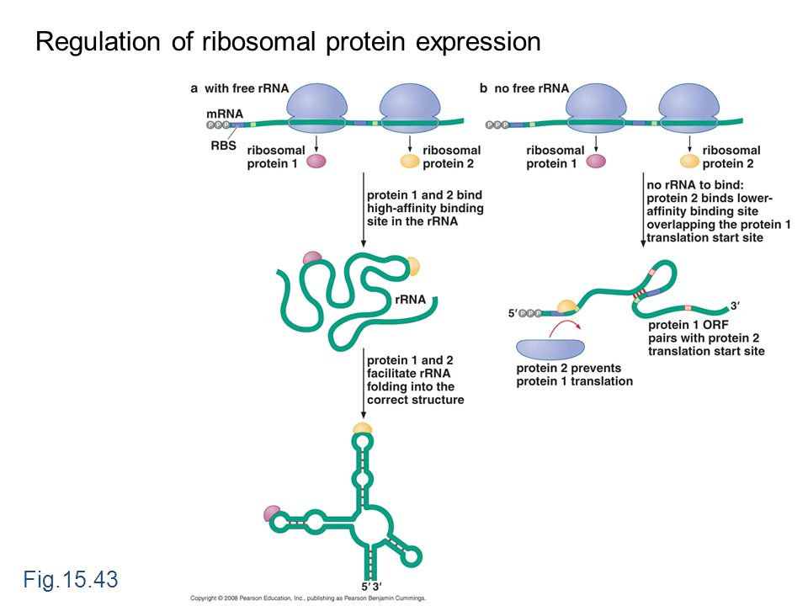
-> degradation of mRNA
Is this what happens with bS21-2?
Expectations:
if bS21-2 is “ribosomal protein 2” and there is no bS21-2-> more translation and stabilization of transcript – more RNA from same operon

Slide 4
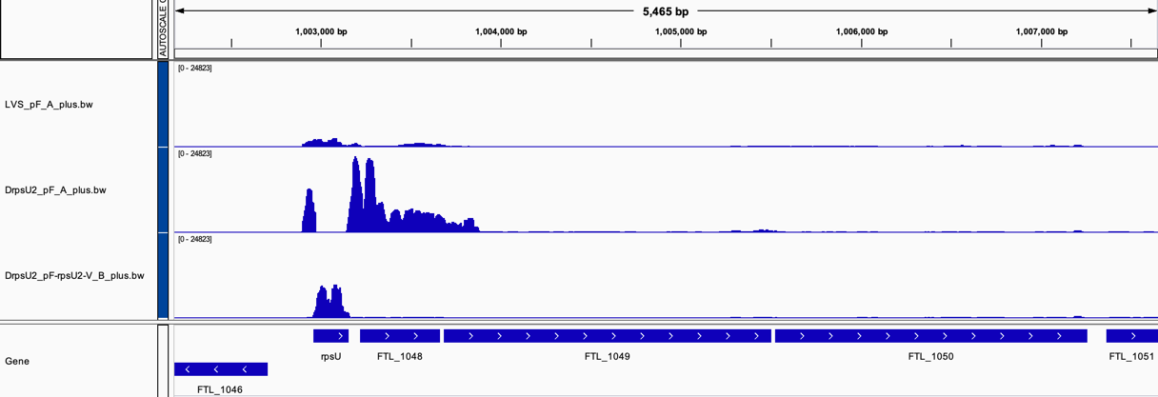
There are multiples bS21 homologs in Francisella tularensis
Wild-type
(bS21-2+)
rpsU2
yqeY
dnaG
rpoD
Notes:
Even though francisella has a reduced genome, it encodes three copies of the rpsU genes, which encode bS21, a protein in the small ribosomal subunit. Most bacteria have 0 or 1 of this gene. We originally, hypothesized, and have since shown, that these three proteins are produced and incorporated into ribosomes. This is a western blot of purified ribosomes from our wild-type strain as well as strains ectopically expressing each of the bS21 proteins, with a VSVG tag. This, along with some mass spec data we have of purified ribosomes, indicates that multiple classes of ribosomes are possible and occurring
This protein is also interesting to us because it is located close to the mRNA exit channel in the ribosome, and early research has identified that it is involved in translation initiation, so it is in an ideal location to be regulating gene expression at the level of translation initiation.
So this heterogeneity of ribosomes may be a mechanism of regulation, but you may not know that ribosomes are heterogeneous so let me show you other ways that may occur.

Slide 5
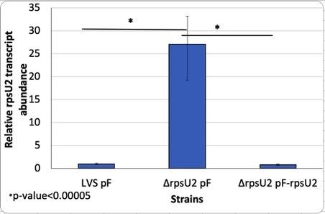
Previous Data - Analysis
When there is no protein present, there is an increase in transcript. Protein suppresses itself.
This protein could be:
Preventing its own transcription (transcriptional regulation)
bS21-2 inhibts translation of its own mRNA, leading to its quick degradation (post-transcriptional level)

Slide 6
Question
Is regulation occurring at the level of transcription or translation?
regulatory sequence influences post-transcription and translation
regulatory sequence upstream of gene
Is the promoter or the 5’ UTR sequence of the rpsU2 gene in F. tularensis responding to the presence of bS21-2?
Gene of interest
Ribosomal protein
(homolog 2)
?
-10 and -35
5’UTR
rpsu2
bS21-2
Notes:
Add image in the bottom

