Slide 1



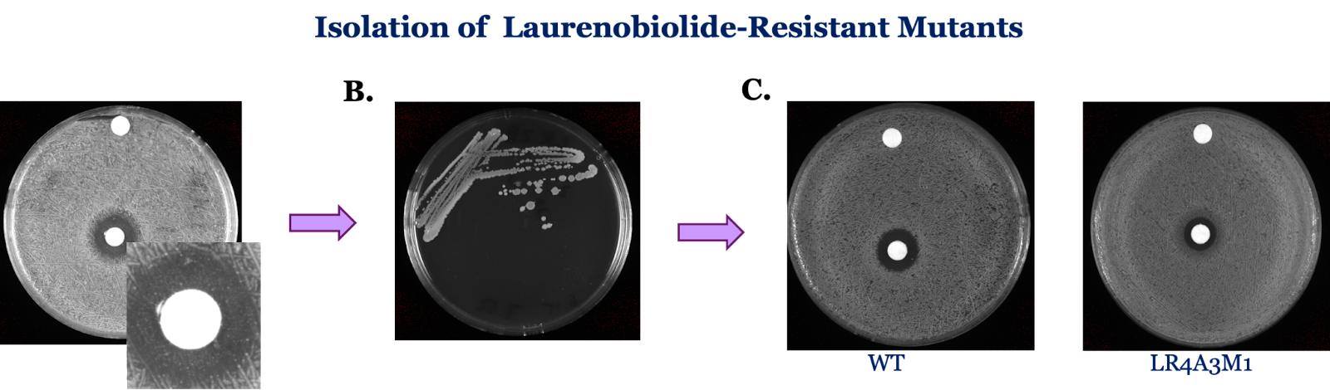
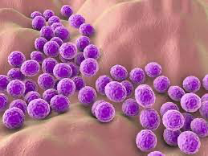
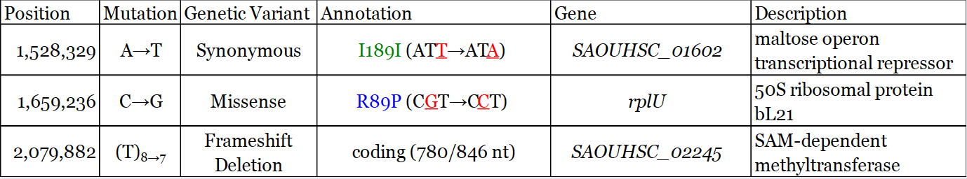
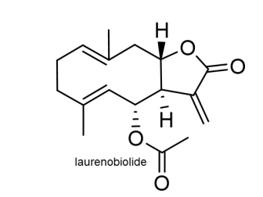
Investigating the Antimicrobial Compound Laurenobiolide in Staphylococcus Aureus
Adja-Seyba Cissokho¹, Kira Bernabe¹,Mathew Bertin¹, Oli Horyn¹, Kathryn M. Ramsey^{1,2}
¹Department of Cell and Molecular Biology, University of Rhode Island, Kingston, RI 02881
²Department of Biomedical and Pharmaceutical Sciences, University of Rhode Island, Kingston, RI 02881
Introduction
Previous work
RESULTS
Antimicrobial resistance is a major worldwide health concern that seriously endangers public health, medical treatments, and healthcare systems on a global scale. It arises when microorganisms acquire the ability to withstand the impact of antimicrobial drugs, rendering them ineffective in fighting infections. The development of new drugs to combat antimicrobial resistance is crucial to address this growing problem.
Staphylococcus Aureus
Gram-positive spherically shaped bacterium
Normal member of the body's microbiota
Pathogenic potential
Multidrug resistant
Laurenobiolide
-Lactone compound Isolated from North American tulip tree Liriodendron tulipifera
-Used by indigenous tribes as a treatment
-Effective against MRSA
-Potential antibiotic
The Ramsey lab performed experiments to study the resistance of colonies thriving in the laurenobiolide zone. Initially, they identified potential mutants from laurenobiolide plates and then isolated individual colonies of these mutants. In Part C, a disc diffusion assay was conducted to compare the sensitivity of these potential mutants to wild type S. aureus.
Three colonies were successfully confirmed to be resistant to laurenobiolide. Genome re-sequencing revealed two distinct mutations in these strains that potentially confer laurenobiolide resistance. The mutation in the rPLU gene caused a single base pair alteration, resulting in a change in the amino acid sequence. The other mutation was a frameshift mutation in the Sam-dependent methyltransferase gene, leading to base pair deletions and protein modifications. The main objective of the study is to determine the specific mutation responsible for the observed laurenobiolide resistance.
Disk Diffusions and chart?
Methods and Work
During this project, I performed various tasks, including replicating data to demonstrate S. aureus sensitivity to laurenobiolide, isolating plasmids for introduction into S. aureus (minipreping), generating mutant S. aureus strains by adding plasmids for modified gene expression, testing the sensitivity of mutant strains to laurenobiolide, and ultimately formulating hypotheses on how laurenobiolide inhibits S. aureus cell growth.
To provide more detail, I began by creating competent cells using the M. Ramsey lab protocol. I grew overnight cultures in a shaking incubator, diluted them to the desired optical density (OD), and then subjected them to glycerol washes and centrifugation before storing them as aliquots at -80°C until needed. Subsequently, I performed electroporation to transform the cells by subjecting them to a high voltage, which punctured the cell wall and facilitated uptake of the plasmid DNA. In the case of strain components KRSA-2 and KRSA-1, KRSA-2 exhibited greater ease in incorporating foreign DNA due to genetic modifications. Hence, I first transformed the plasmid from E. coli into KRSA-2, and then transferred it to KRSA-1. It is common practice in genetic engineering to initially introduce plasmids into E. coli before transferring them to the target bacteria. However, in this scenario, we needed to insert the plasmid into KRSA-2 before transferring it to KRSA-1.
Hypothesis and Research Question
Conclusion and further steps
Can we introduce mutant genes into both wild-type (wt) and mutant (mt) strains? Similarly, can we introduce wt genes into the strains?
What impact will these genetic alterations have on antibiotic resistance in the strains?
We already know that Laurenobiolide is an effective agent against Staph bacteria, leading to their death. However, the specific mechanisms behind its action remain unclear. It is crucial to identify the mutations that cause resistance. We need to investigate whether introducing gene A into the mutant strain (MT) will restore sensitivity or if it will remain resistant.
Identification of Mutations: Two genes, rplU and SAOUHSC_02245, have been identified as potential contributors to resistance. Through the process of complementation, we will reintroduce the wild-type version of each gene into the resistant mutant strain. It is anticipated that reintroducing the wild-type version of one of these genes will restore sensitivity to Laurenobiolide. This outcome will indicate that the gene plays a crucial role in the function of Laurenobiolide, and its mutation is likely responsible for the resistance observed. Obtaining this knowledge will provide valuable insights into the mechanisms of Laurenobiolide action.”
Experimental Setup
References
 | WT | MT
EV | Sensitive | Resistant
WT(plasmid) | Sensitive | ?
Kirk RD, Rosario ME, Oblie N, Jouaneh TMM, Carro MA, Wu C, Kim AM, Leibovitz E, Hunter ES, Literman R, Handy SM, Rowley DC, Bertin MJ. Screening the PRISM Library against Staphylococcus aureus Reveals a Sesquiterpene Lactone from Liriodendron tulipifera with Inhibitory Activity. ACS Omega. 2022 Sep 30;7(40):35677-35685. doi: 10.1021/acsomega.2c03539. PMID: 36249352; PMCID: PMC9558601.
Acknowledgments
“Research reported in this poster was supported by the Rhode Island Institutional Development Award (IDeA) Network of Biomedical Research Excellence from the National Institute of General Medical Sciences of the National Institutes of Health under grant number P20GM103430.”

