Slide 1
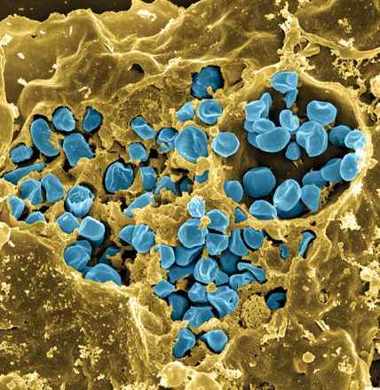
Francisella tularensis
Causes tularemia
Highly infectious
Potential bioweapon
Model:
  F. tularensis subsp. holarctica LVS
Intracellular growth is essential to cause disease
Fischer, PNAS cover 2006
Notes:
Gram-negative, gamma facultative intracellular pathogen
Infectivity similar to Mtb, can upwards of 30% mortality
Tier 1 Select Agent like Ebola
Cover image: Scanning electron micrograph of a murine macrophage infected with Francisella tularensis strain LVS. Macrophages were dry-fractured by touching the cell surface with cellophane tape after critical point drying to reveal intracellular bacteria. Bacteria (colored in blue) are located either in the cytosol or within a membrane-bound vacuole.

Slide 2
Leader sequence controls rpsU2 transcript abundance and protein synthesis
bS21 homologs repress rpsU2 transcript abundance
  Mediated by rpsU2 5ʹ UTR
Translation of rpsU2 5ʹ UTR is influenced by unidentified factor(s)

Slide 3
Leader sequence controls rpsU2 transcript abundance and protein synthesis
bS21 homologs repress rpsU2 transcript abundance
  Mediated by rpsU2 5ʹ UTR
Translation of rpsU2 5ʹ UTR is influenced by unidentified factor(s)

Slide 4
bS21-2 is uniquely important for intramacrophage growth
* p < 0.05
Trautmann and Ramsey, 2022
Notes:
On the y-axis we have recovered bacteria after 24 hours in murine macrophage-like cells, and we see about ten-fold less growth in our cells lacking bS21-2, showing that in fact bS21-2 is important for intramacrophage growth.
When we look at the strain with ectopic expression of bS21-2 we see restoration of growth in macrophage. We would expect homologs 1 and 3 could complement if the type 6 secretion system is the only thing defective in bS21-2, but that’s not what we see. Neither bS21-1 or bS21-3 restore intramacrophage replication.
Therefore, we hypothesize that bS21-2 is influencing something distinct from type 6 that is not regulated by 1 or 3 that allows for intramacrophage growth.
Now I’m going to propose our model suggesting how bS21 may exert its effects.

