Slide 1


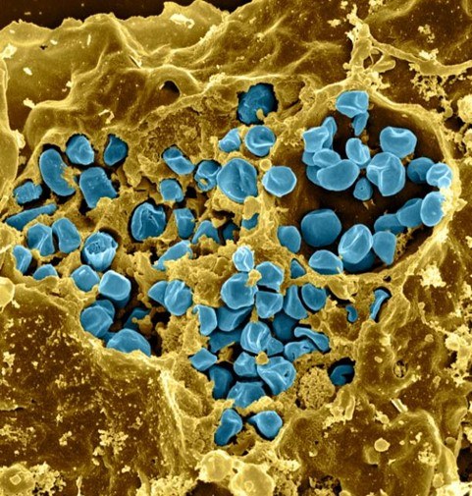
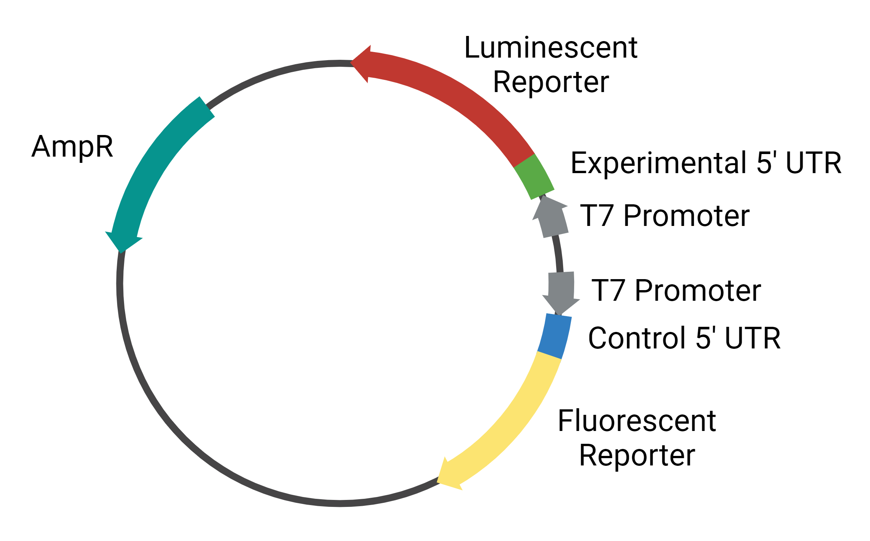
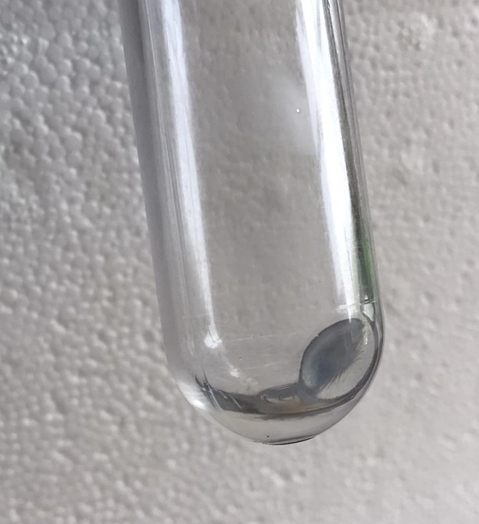
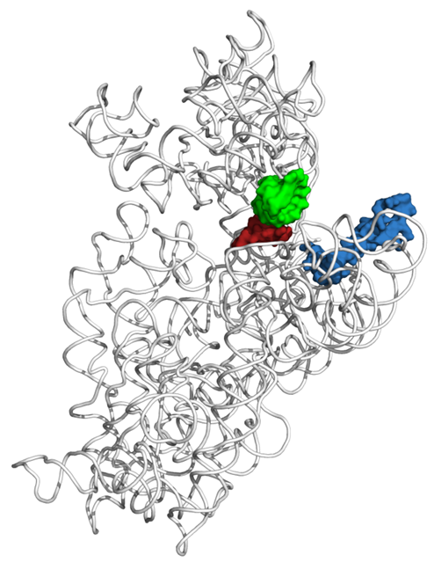

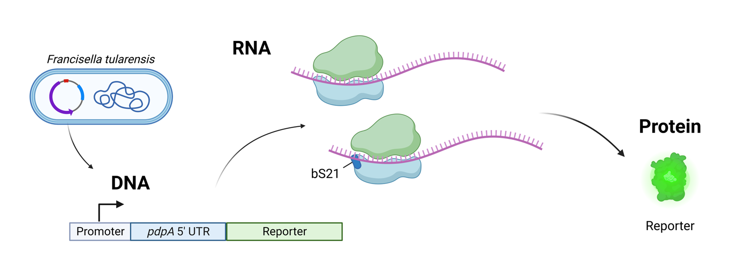
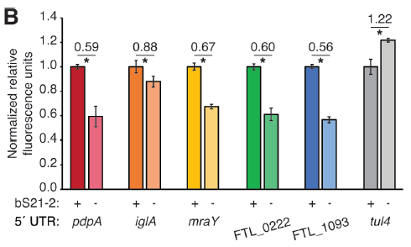
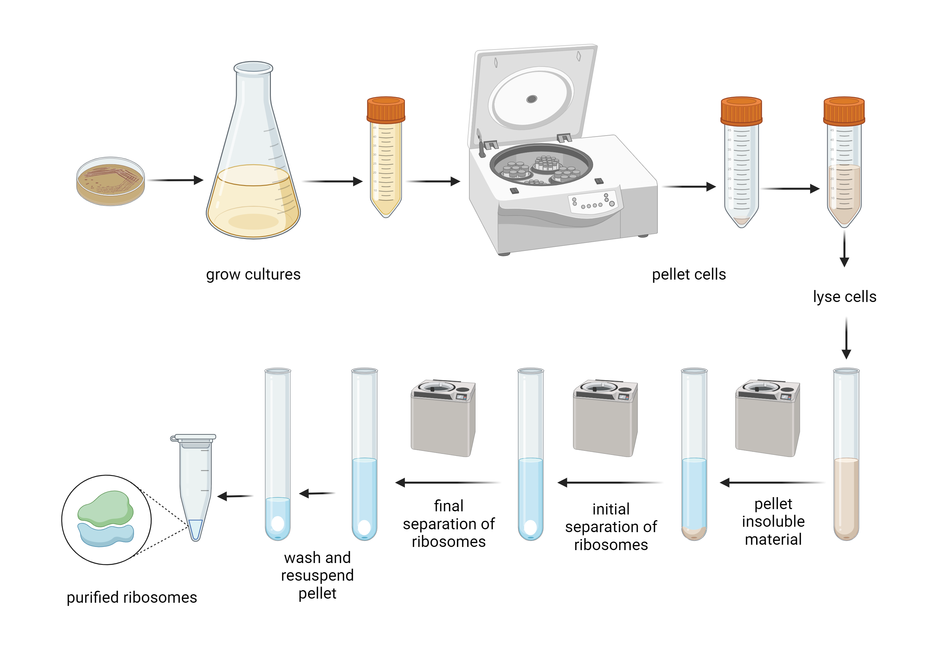
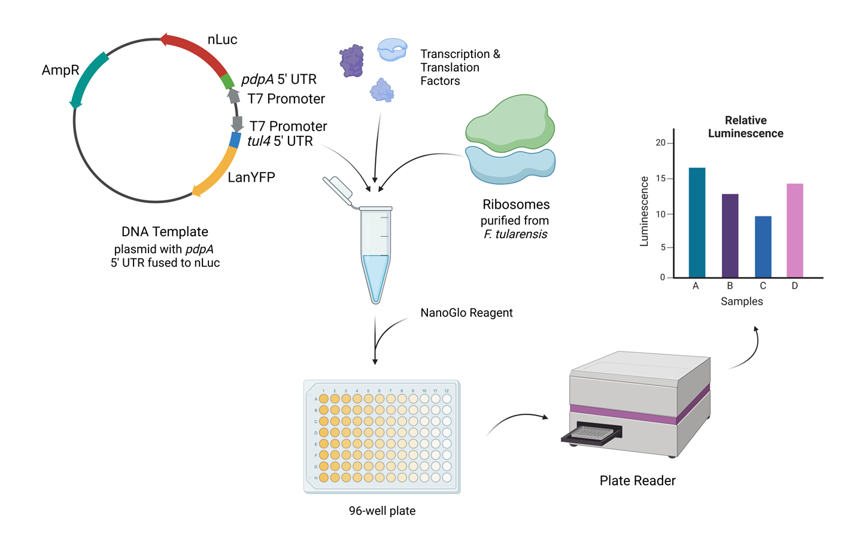
Assessing in vitro control of gene expression in Francisella tularensis by ribosomal protein bS21
Benjamin Moore¹, Sara Negash², Hannah Trautmann¹, Kathryn M. Ramsey^{1,3}
¹Cell and Molecular Biology, University of Rhode Island
²Kinesiology, University of Rhode Island
³Biomedical and Pharmaceutical Sciences, University of Rhode Island
Introduction
Specific Components
Results
The bacterial pathogen Francisella tularensis and ribosomal protein bS21
Dual-Reporter Plasmids
Ribosome Purifications
Francisella tularensis
Gram-negative
Causes tularemia
Potential bioweapon
Type VI secretion system is critical for virulence
A dual-reporter system can look at translation efficiency of two distinct proteins and measure them using either luminescence or fluorescence.
Components:
Experimental 5’ untranslated region (5’ UTR) fused to luminescent reporter (nLuc)
Control 5’ UTR fused to fluorescent reporter (LanYFP, iLov, or eGFP)
Purified high concentrations of E. coli ribosomes.
Purified F. tularensis ribosomes, concentrations not sufficient for in vitro assay.
Dual-Reporter Plasmid Cloning
We have cloned easily-modifiable versions of the plasmids that we can use to test the assay.
We can detect all reporters (nLuc, LanYFP, iLov, eGFP).
Figure 1. F. tularensis cells (blue) inside macrophage (yellow). Fischer, PNAS cover, 2006.
mRNA channel
In Vitro Assay Results
bS21
Figure 6. Diagram depicting a dual-reporter plasmid.
Our purified E. coli ribosomes have reproducibly similar activity to kit-provided ribosomes.
Previously purified F. tularensis ribosomes demonstrated less activity.
Recently purified F. tularensis ribosomes have yet to be tested.
Small subunit ribosomal protein bS21
Three homologs encoded by F. tularensis
Possibly regulate translation initiation
bS21-2 positively controls translation of type VI secretion system proteins
bS21-2 necessary for intramacrophage growth
P-site tRNA ASL
mRNA (P-site codon)
Figure 9. E. coli ribosome pellet after purification.
Figure 2. The location of bS21 in the 30S subunit in Escherichia coli. PDB 4V50; figure made by Dr. Gregory.
Dual-reporter plasmid
with LanYFP
Dual-reporter plasmid
with iLov
Assessing regulation of translation by bS21-2
In vivo assay
Single reporter plasmid
(backup in case
dual-reporter system fails)
Figure 10. Relative luminescence values for nLuc after translation by purified E. coli ribosomes.
Dual-reporter plasmid
with eGFP
In Progress
Purify active Francisella tularensis ribosomes.
  Optimize growth conditions for cells and purification steps.
Test translation efficiency of specific 5’ UTRs using the in vitro assay.
Figure 3. Diagram of plasmid-encoded translational reporter and processes leading to reporter production.
Leader sequences lead to preferential translation by ribosomes with bS21-2
Figure 7. Reporter constructs we have generated to test in in vitro assay.
Ribosome Purifications
Acknowledgements
Figure 4. 5´ UTRs are sufficient to cause bS21-2 mediated changes in translation. 5’ UTRs of indicated genes are fused in frame with GFP (as in Fig. 3) and introduced into cells with or without bS21-2. *P < 0.05. ns = not significant. Trautmann et al., 2023.
We thank the members of the Ramsey lab for their support on this project as well as Dr. Steven Gregory and the Gregory lab.
Funding Sources
USDA National Institute of Food and Agriculture, Hatch project 1017848; RI0019-H020
RI-INBRE Early Career Development Award and RI-INBRE SURF Award, NIH/NIGMS P20GM103430
CARTD-COBRE Pilot Project Award, NIH/NIGMS Grant P20GM121344
NIH/NIGMS Grant R35GM150599
In vitro assay
Figure 5. Diagram depicting process of in vitro assay. Assay requires NEB PURExpress ∆ Ribosome Kit, Nano-Glo® Luciferase Assay System, purified ribosomes, and a reporter template.
References
Trautmann, H. S., Ramsey, K. M. (2022). A Ribosomal Protein Homolog Governs Gene Expression and Virulence in a Bacterial Pathogen. Journal of Bacteriology, 204(10), e0026822. https://doi.org/10.1128/jb.00268-22
Trautmann, H.S., Schmidt, S.S., Gregory, S.T, Ramsey, K. M.(2023) Ribosome heterogeneity results in leader sequence-mediated regulation of protein synthesis in Francisella tularensis. Journal of Bacteriology. In press.
Figure 8. Workflow for ribosome purifications.

