Slide 1
Developing an assay to compare translation by Francisella tularensis ribosomes with different bS21 homologs
Marisa Cogswell

Slide 2
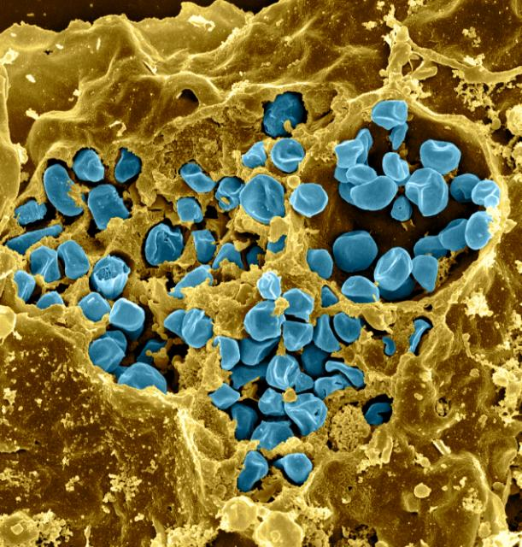
Francisella tularensis
Gram negative bacterium
Causes tularemia
Highly infectious
Potential bioweapon
Fischer, PNAS cover, 2006

Slide 3
F. tularensis encodes three homologs of bS21
Ribosomal protein
Plays role in translation initiation
bS21-2 has been shown to play a role in virulence
Notes:
bS21 is a ribosomal protein encoded by three homologous genes in Francisella tularensis known to play a role in translation initiation.

Slide 4
F. tularensis has heterogeneous populations of ribosomes
bS21-1
cspC
bS21-2
yqeY
dnaG
rpoD
bS21-3
Notes:
Even though francisella has a very small genome, it encodes three copies of the small ribosomal protein bS21.
We originally hypothesized that because of these homologs, francisella has heterogeneous ribosomes, and in fact we have evidence that in wild-type cells there are populations of ribosomes with multiple homologs AND each of these homologs can be incorporated into ribosomes. This led us to start investigating whether these heterogenous ribosomes can have different functions and perhaps influence gene expression.
We made knockouts for each bS21 but we only see phenotypic changes in bS21-2, so we decided to narrow our focus to just this protein for now. Because we are interested in translation, we looked at the effect of a bS21-2 mutant on genome-wide proteomics.

Slide 5
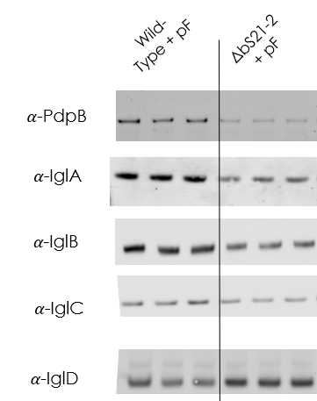
Lack of bS21-2 changes T6SS protein abundance
ΔbS21-2
*
*
*
*
*
* : p< 0.05
Notes:
So here we have antibodies for 5 of the FPI proteins. Looking first at Wild-type vs. our mutant, we see a significant decrease in PdpB, IglA, IglB and IglC, and an increase in IglD. These are consistent with and even more significant than we detect with the mass spec.
Now in the interest of time I won’t show you this but we did do qPCR on a number of these genes and found there are not significant differences in transcript abundance, consistent with the RNA-seq. Additionally, we see impaired intramacrophage growth with loss of bS21-2, so this really led us to ask the question HOW is bS21-2 impacting protein abundance? To get at that, I want to give you all a little more background information.
Work from the Ramsey laboratory has shown that cells with and without bS21-2 have changes in protein abundance that cannot be explained by changes in mRNA abundance, consistent with bS21 regulating translation. In particular, type VI secretion system proteins, which are essential for virulence, are less abundant in cells lacking bS21-2.

Slide 6
Cells without bS21-2 translate from the pdpA 5´UTR less efficiently
Normalized β-galactosidase activity
Wild-type
ΔbS21-2
Wild-type
ΔbS21-2
pdpA UTR
tul4 UTR
pdpA: aguuauguucuaauuaaguagaca AUG auagcaguaaaagau
tul4: gaguauaugugaauauuuaaaaauaggaguaucuau AUG aaaaaaauaauuaag
Notes:
PdpA is one such protein, and its 5´ UTR has been shown to be sufficient to lead to differential translation of reporter genes in cells with and without bS21-2

Slide 7
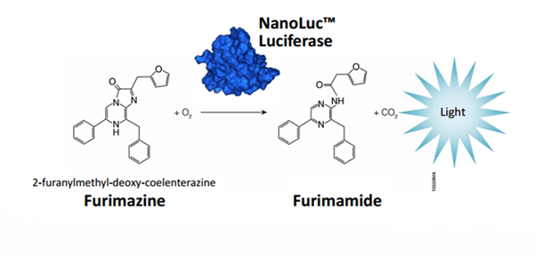
Developing an in vitro luciferase assay
Luciferases are a class of oxidative enzymes that produce bioluminescence
Nano Luciferase (NLuc) has approximately 150-fold stronger specific activity
Create highly sensitive system to detect and measure translational efficacy of different ribosomes
Notes:
many aspects of our current cell-based assay (cloning, strain construction, assay timeline) are difficult and/or laborious. The in vitro assay, as designed, would allow more flexibility in testing elements of the pdpA 5´ UTR and may help us determine if the bS21-2-mRNA interaction is direct or indirect.

Slide 8
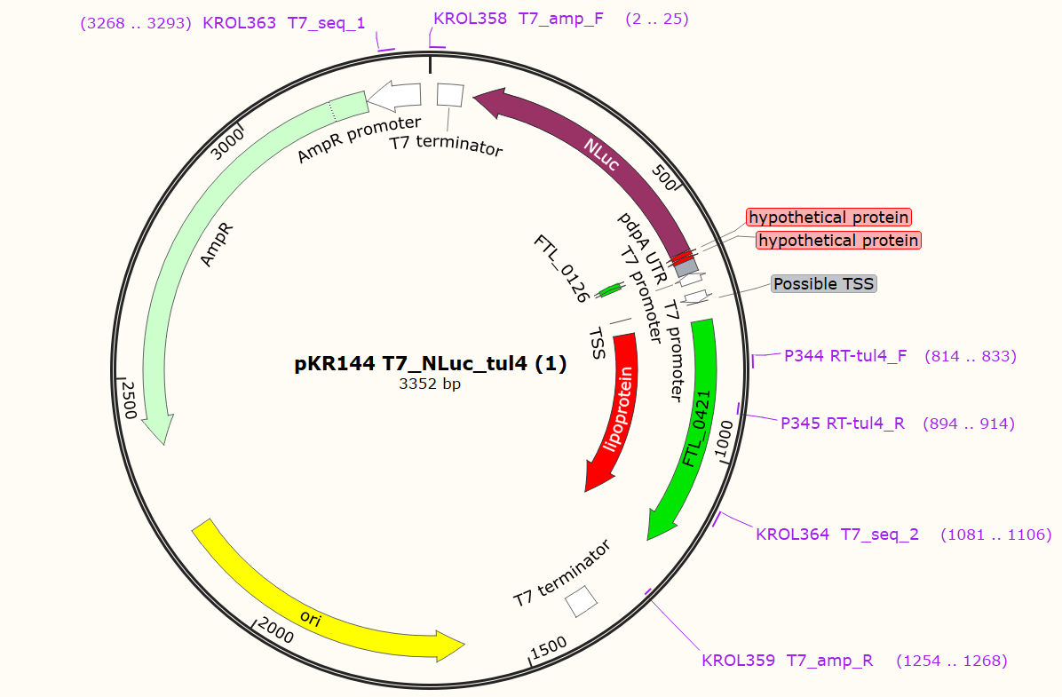
Clone plasmid containing NLuc gene with pdpA 5’ UTR
Notes:
The hypothesis is that ribosomes that contain bs21-2 (encoded by rpsU2) can better recognize the 5’ UTR (known as pdpA) compared to ribosomes containing bs21-1 and bs21-3. This will result in bs21-2 producing the same level of fluorescence as wild type ribosomes.

Slide 9
Ribosomes containing rpsU3 produce the highest levels of luminescence
Luminescence
Wild-type
rpsU1
rpsU2
rpsU3
Buffer

Slide 10
Next Steps: perform western blot
Determine if rpsU3 has higher levels of tul4
Measure NLuc/tul4 ratios for each class of ribosome
Repeat assay

