Slide 1
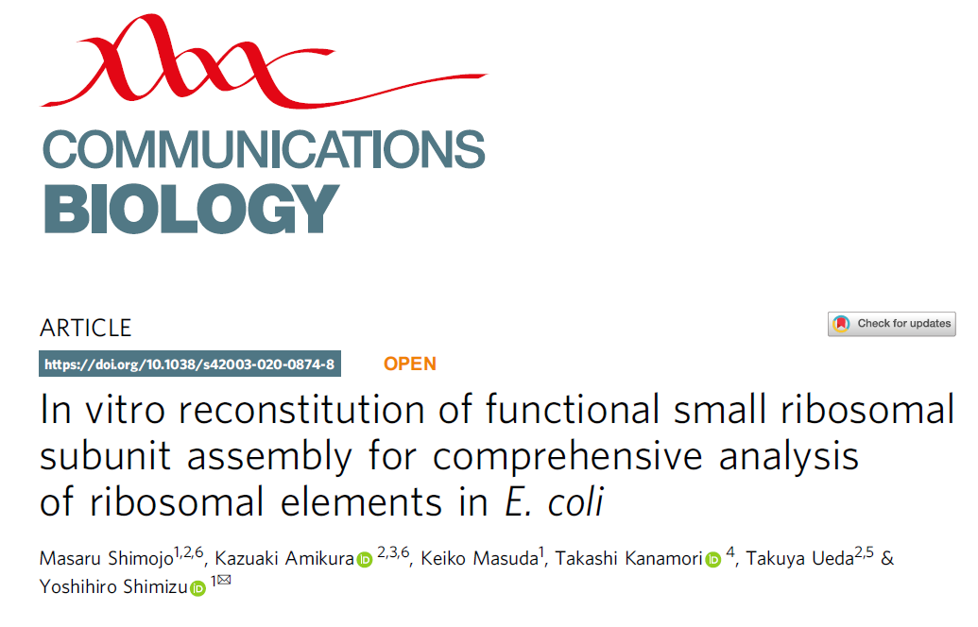

Slide 2
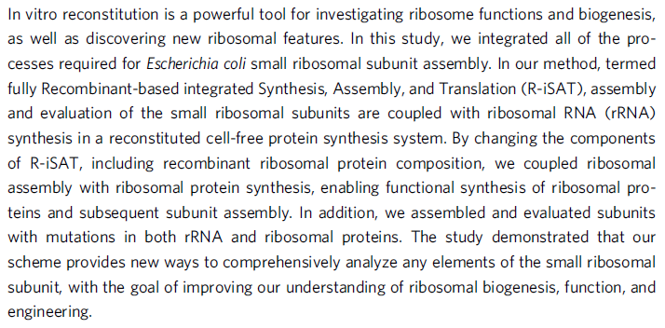

Slide 3
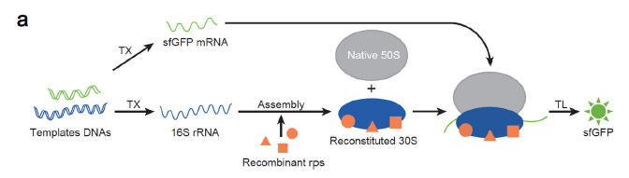
Fig. 1 Fully Recombinant-based integrated
synthesis, assembly, and translation (R-iSAT).
Schematic of R-iSAT
Notes:
Two template DNAs encoding 16S rRNA and sfGFP are added into the PURE system. Recombinant ribosomal proteins (recombinant rps) bind to the transcribed 16S rRNA, and they are assembled into 30S subunits that interact with native 50S subunits to form the ribosome. Transcribed sfGFP mRNA is translated on the ribosome to synthesize sfGFP synthesis.

Slide 4
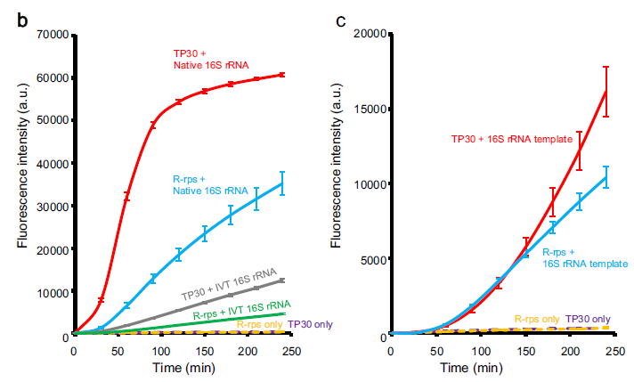
Time-course analysis of sfGFP synthesis in reactions without coupling of 16S rRNA transcription.
Time-course analysis of sfGFP synthesis in reactions with coupling of 16S rRNA transcription.
Notes:
R-rps represents recombinant ribosomal proteins, and IVT 16S rRNA represents in vitro transcribed 16S rRNA. Fluorescence intensities after subtracting the background intensity are shown. Error bars indicate standard deviation of triplicate measurements.

Slide 5
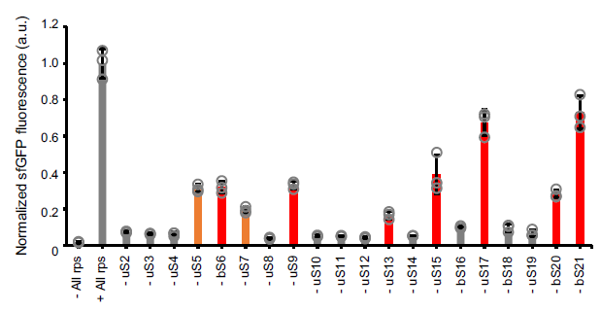
Fig. 2 Effects of removal of a
single ribosomal protein from R-iSAT.
Notes:
Increase in sfGFP fluorescence after 4 h incubation was normalized by dividing by the average value of the control reaction. Red bars indicate nonessential ribosomal proteins, as revealed by genome deletion studies. Orange bars indicate putative nonessential ribosomal proteins identified in this study. Error bars indicate standard deviation of triplicate measurements. Each dot represents individual observed value.

Slide 6
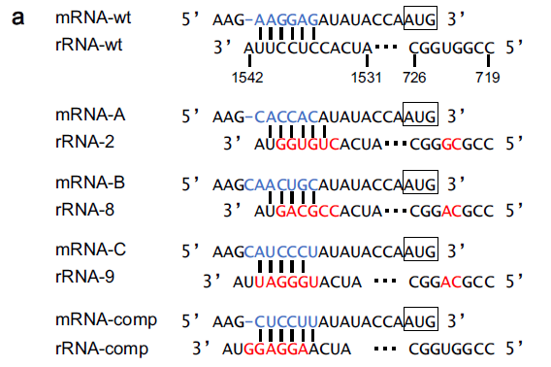
Fig. 3 A mutational study of 16S rRNA to search for applicable orthogonal SD/anti-SD pair for differentiating “host” and “newly assembled” ribosomes.
Sequences of 16S rRNA and mRNA examined in this study.
Notes:
SD sequences are indicated by light blue characters, and mutated nucleotides in 16S rRNA by red characters.

Slide 7
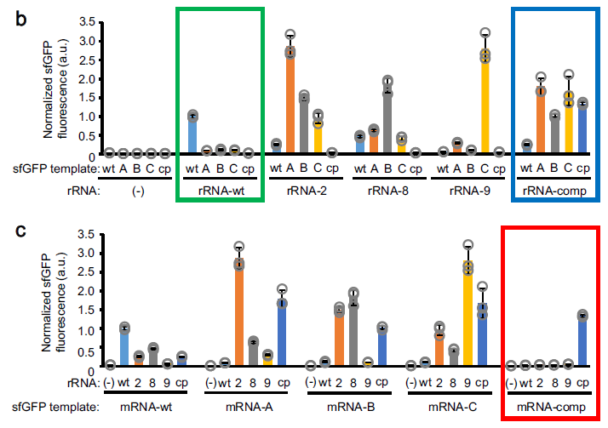
Synthesis of sfGFP using various SD/anti-SD pairs.
Notes:
Increase in sfGFP fluorescence after 4 h incubation was normalized by dividing by the average value of the control reaction. Graphical display is different, but the same data were used in (b) and (c).
Symbols “wt”, “A”, “B”, “C”, and “cp” for sfGFP template represent mRNA-wt, mRNA-A, mRNA-B, mRNA-C, and mRNA-comp, respectively, as shown in (a).
Symbols “wt”, “2”, “8”, “9”, and “cp” for rRNA represent rRNA-wt, rRNA-2, rRNA-8, rRNA-9, and rRNA-cp, respectively, as shown in (a).
A green box indicates a data set obtained using rRNA-wt, a blue box indicates a data set obtained using rRNA-comp, and a red box indicates a data set obtained using mRNA-comp.
Error bars indicate standard deviation of triplicate measurements. Each dot represents individual observed value.

Slide 8
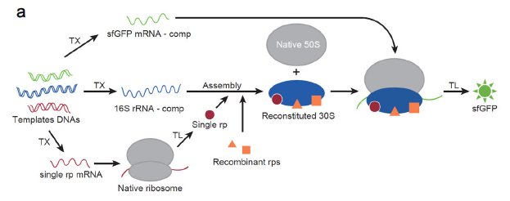
Fig. 4 Co-translational coupling of ribosomal proteins synthesis in R-iSAT.
Schematic of R-iSAT coupled with ribosomal proteins synthesis.
Notes:
Three template DNAs encoding 16S rRNA-comp (shown in Fig. 3a), a ribosomal protein under the wild-type SD, and sfGFP under the SD encoded in mRNA-comp (shown in Fig. 3a) were added into the PURE system. A ribosomal protein synthesized by the native ribosome and recombinant ribosomal proteins (Recombinant rps) in the reaction mixture bind to transcribed 16S rRNA-comp, and these components are assembled into 30S subunits that interact with native 50S subunits to form a partially orthogonal ribosome for subsequent sfGFP synthesis. Transcribed sfGFP mRNA-comp is translated on the newly assembled ribosome to synthesize sfGFP.

Slide 9
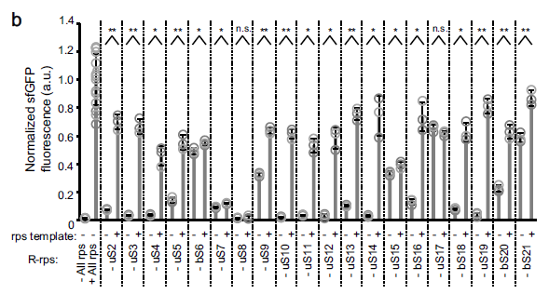
Effects of ribosomal protein synthesis in R-iSAT.
Notes:
The increase in sfGFP fluorescence after 4 h incubation was normalized by dividing by the average value of the control reaction. Error bars indicate standard deviation of at least triplicate measurements. Each dot represents individual observed value. Double asterisk, single asterisk, and n.s. indicate that P values are less than 0.003, P values are less than 0.05, and P values are more than 0.05, respectively. Welch’s t test was applied between in the presence and absence of the rps template.

Slide 10
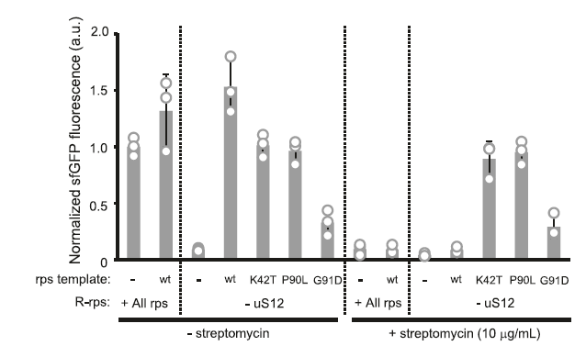
Fig. 5 Mutational analysis of uS12.
Notes:
Reactions were separated into two steps: uS12 synthesis and the 30S subunit assembly were performed in the first step (2 h), and then streptomycin and sfGFP template DNA were added for sfGFP synthesis in the second step (4 h). The increase in sfGFP fluorescence after the 4-h incubation in the second step was normalized by dividing by the average value of the control reaction. Error bars indicate standard deviation of at least triplicate measurements. Each dot represents individual observed value.

