Slide 1
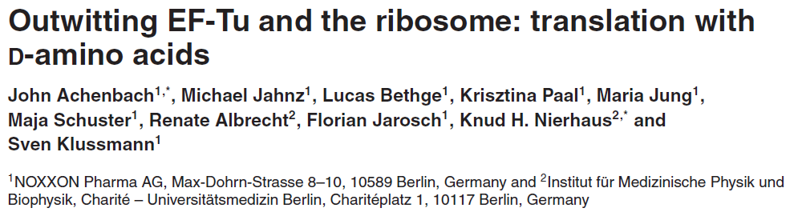

Slide 2
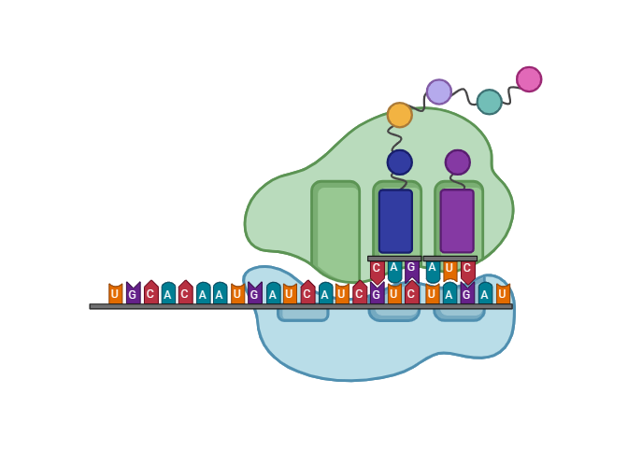
Translation
Amino acids incorporated
into a growing polypeptide chain
Ribosome
mRNA

Slide 3
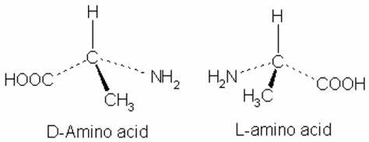
Amino Acid Configuration
Bacterial cell walls
Antibiotics
Peptide hormones
Animal venoms
Homochirality of life
Some amino acids in the
D-configuration
have important roles
Most naturally-occurring amino acids are in the
L-configuration

Slide 4
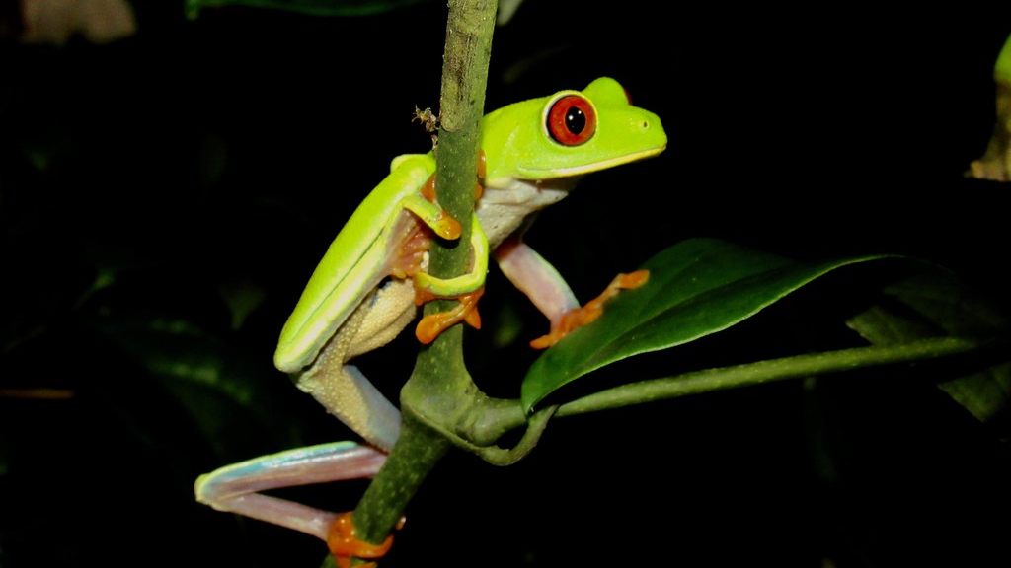
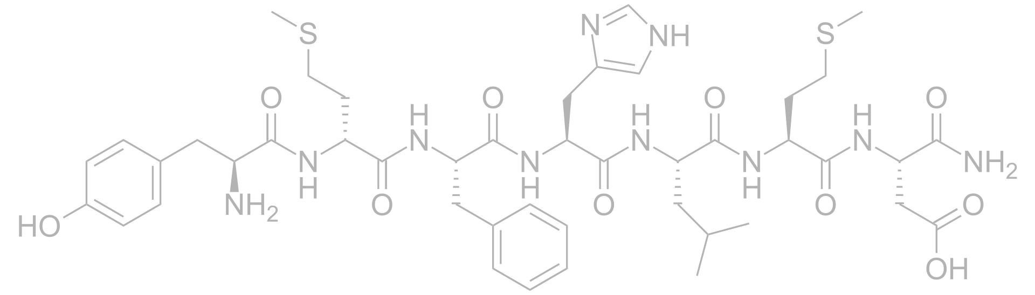
Phyllomedusinae:
Agalychnis callidryas
Red-eyed tree frog
Deltorphins
Heptameric peptides
Produced in the skin
Contain D-Ala, D-Leu, or D-Met in position 2
Highly selective agonist of delta-opioid receptor
in the brain
Deltorphin A
D-Met

Slide 5
Where do D-amino acids come from?
Non-ribosomal synthesis
Post-translational isomerization
Not incorporated by ribosomal synthesis

Slide 6
Stereoselectivity
Most aminoacyl-tRNA synthetases
Elongation factor EF-Tu
Previous Attempts
Non-canonical amino acids
Mutant ribosomes
N-terminus

Slide 7
The Authors’ Approach
Goal: Incorporation of D-amino acids into a polypeptide chain
Obstacles: Chiral discrimination against D-amino acids
Solution: An in vitro translation system with native factors and ribosomes
Results: Successful incorporation of 17 different D-amino acids

Slide 8
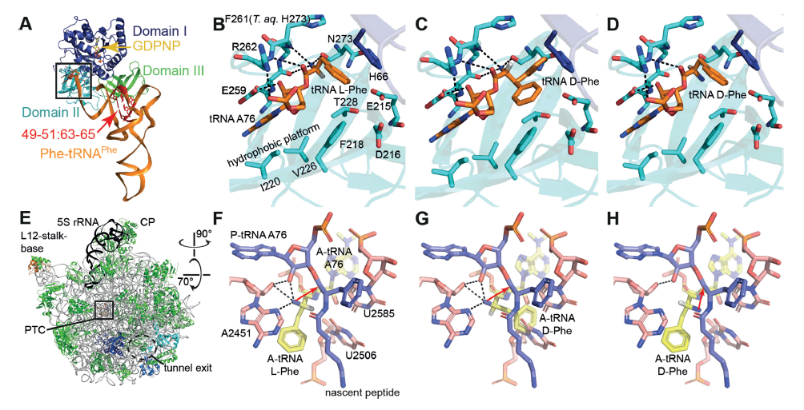

Slide 9
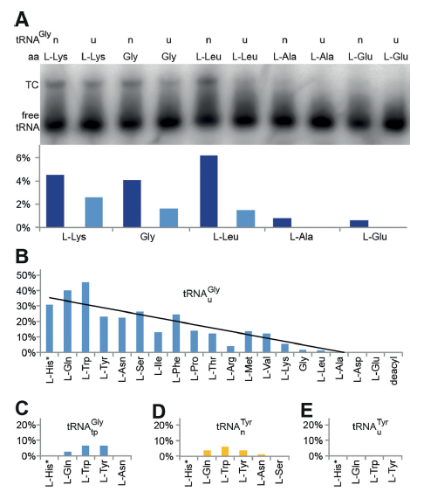
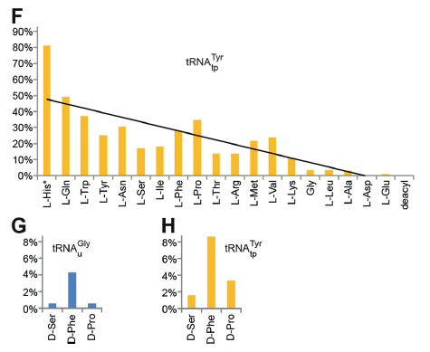

Slide 10
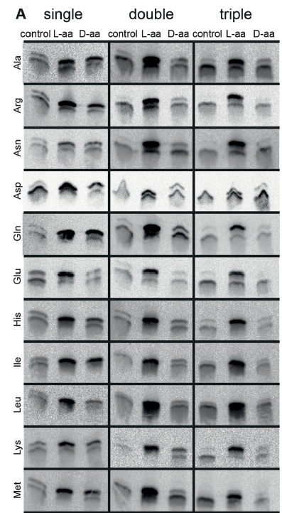
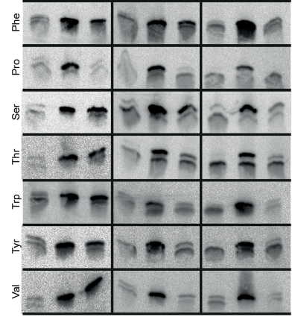

Slide 11
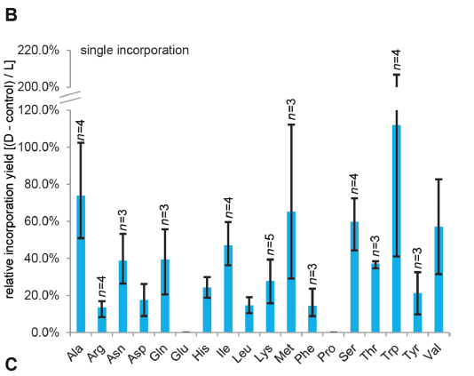

Slide 12
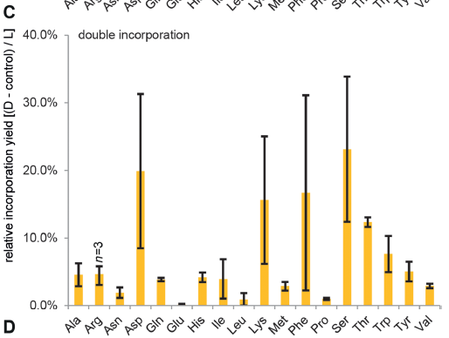

Slide 13
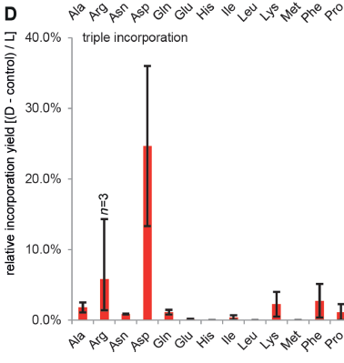

Slide 14
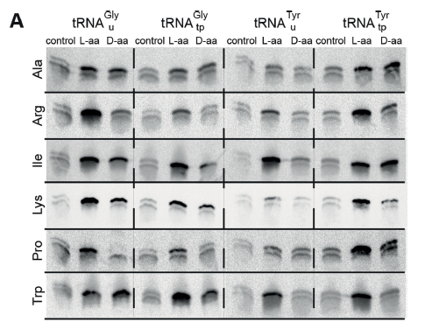
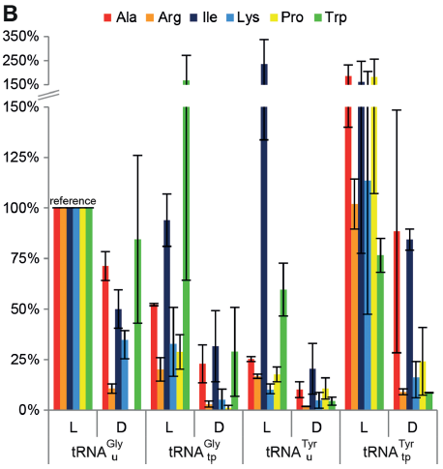

Slide 15
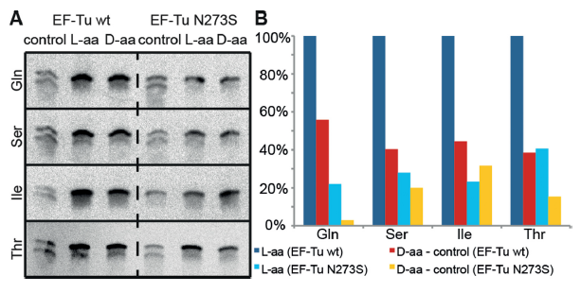

Slide 16
