Slide 1

Assessing in vitro control of gene expression in Francisella tularensis by ribosomal protein homolog bS21-2
Benjamin Moore
Ramsey Lab
August 11, 2023

Slide 2
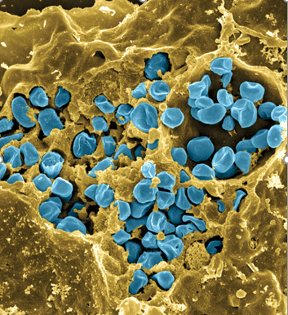
Research Area
Investigating regulation of gene expression in Francisella tularensis
Francisella tularensis
Causes tularemia
Highly infectious/potential bioweapon
Model: Francisella tularensis
  Subspecies holarctica
  LVS (live vaccine strain)
Fischer, PNAS cover, 2006
Notes:
First, I would like to introduce you to the bacterium we study in the lab, Francisella tularensis.
It is pathogenic and causes a disease called tularemia, which can manifest with flu-like symptoms. If infection is by breathing in the bacteria, it causes the respiratory form, which can be fatal.
It is highly infectious and potentially lethal, it is considered as a potential bioweapon.
It’s nonpathogenic to humans but retains its pathogenicity in animal models, so we can continue to use it in infection assays.
-macrophage injest pathogens
In the Ramsey Lab, our specific focus is the mechanisms which allow Francisella tularensis to control gene expression, more specifically, at the level of translation in the ribosome.
next well talk about a specific ribosomal protein that likely plays a role in regulating gene expression during translation.
The image
The blue is the francesella cells
Cells in yellow are macrophage cells

Slide 3


Gene Regulation in Bacteria
DNA
RNA
protein
translation
transcription
regulation
Notes:
I’ll start by going over the central dogma of molecular biology. DNA is the main code or instruction manual in all cells, RNA polymerase then transcribes this into RNA which is the messenger, and then the ribosome translates that into proteins which are sort of the soldiers of the cell. Now at every step along this way, there can be regulation – at the level of transcription, translation and post-translationally.
We are going to be focusing in on regulation at the level of translation because we’re interested in regulation by the ribosome itself.

Slide 4
The role of ribosomal protein bS21 in translation
30S subunit
PDB entry: 4V50
Notes:
Overall, We are studying the role of Bs21 in translation.
this is the 30s subunit in e.coli
talk about bs21 being close to mRNA during initiation which causes us to hypothesise theres interaction or regulation
- dont hae good structure for fran. so we use the structire for e.coli
Here we have images of the 30S subunit of the E. coli ribosome.
Here we have images of the 30S subunit of the E. coli ribosome.
During initiation, the mRNA would be here, very close to the position of bS21, and in fact people have published data that bS21 is important for translation initiation of specific mRNAs, perhaps moderating the interaction between the ribosome and the mRNA molecule.
Transition: Why are we interested in studying bS21? We hypothesize that bS21 might be a regulator of translation initiation. Also, even though Francisella has a small genome, it encodes three homologs of this small ribosomal protein.
Use E;.coli because we don’t have amazing structures of francisella and its more widely studied.

Slide 5
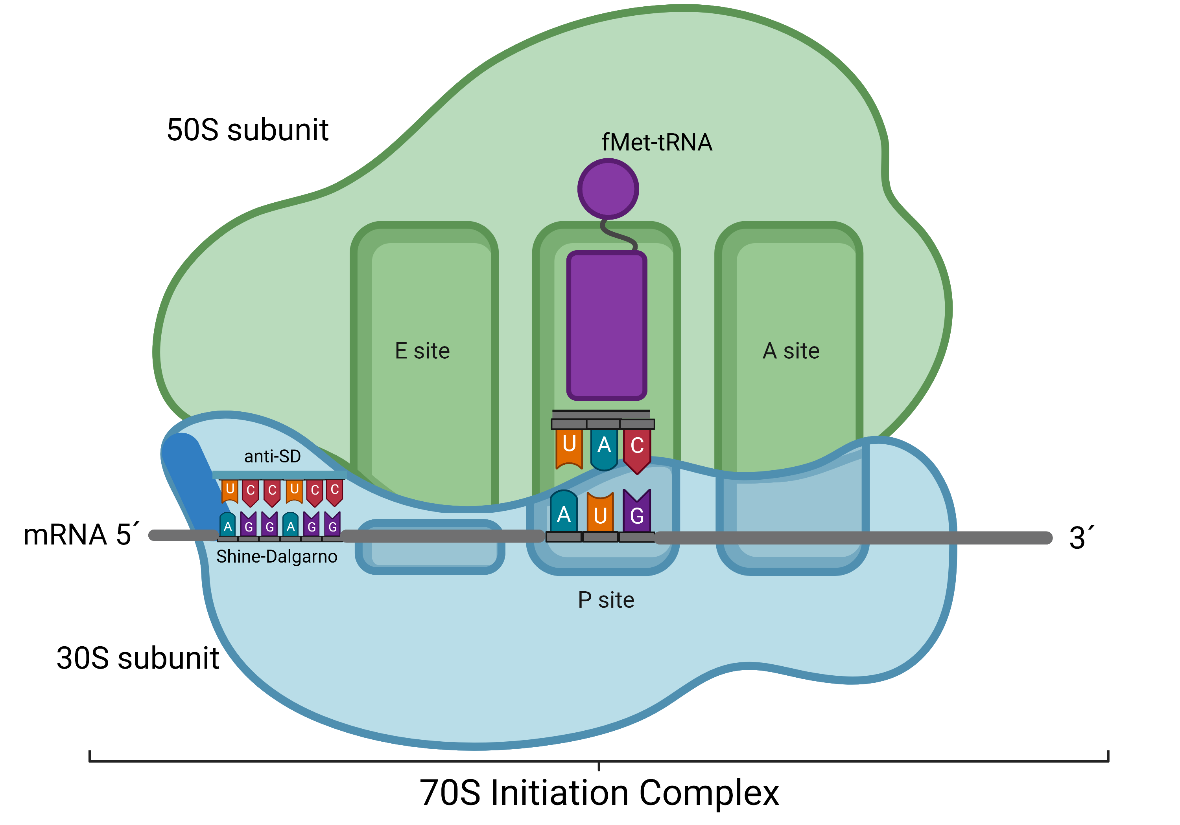
Research Objective
Examine the role of ribosomal protein bS21 in regulating gene expression during translation
bS21
Notes:
during initiation, the ribosome binds at the start codon to the the mrna and to help the ribosome bind at proper location the anti sd on ribsoome binds to SD on the mRNA
protein in ribosome next to sd called bs21- this is the one we investigate(add animation)
because they're so close we hypothesize that there's some regulation.
Second image: Overall, We are studying the role of Bs21 in translation.
this is the 30s subunit in e.coli
talk about bs21 being close to mRNA during initiation which causes us to hypothesize that theres interaction or regulation
to briefly explain translation
next stage Translation
From RNA to protein- happened in ribosome (made up of 2 subunits - 30s and 50s subunit)
RNA is fed through ribosome and as it encounters a specific region w/I ribosome, its matched up w molecules of TRNA
RNA that goes into ribosome is mRNA(messenger RNA)
Ribosome paired onto that is tRNA(transfer RNA)
tRa has an amino acid at end of it that is joined together to form protein
Translation is the process that takes the information passed from DNA as messenger RNA and turns it into a series of amino acids bound together with peptide bonds.
The ribosome is the site of this action
The ribosome matches the base sequence on the mRNA in sets of three bases (called codons) to tRNA molecules that have the three complementary bases in their anticodon regions.
ribosome moves along the mRNA, matching 3 base pairs at a time and adding the amino acids to the polypeptide chain
When the ribosome reaches one of the "stop" codes, the ribosome releases both the polypeptide and the mRNA. This polypeptide will twist into its native conformation and begin to act as a protein in the cells metabolism.
Goal: make protein from MRNA

Slide 6
The F. tularensis genome codes for three different variants of bS21
bS21-1
cspC
bS21-2
yqeY
dnaG
rpoD
bS21-3
1. Why does the genome of Francisella tularensis encode for three different homologs of bS21?
2. Does the incorporation of each homolog of bS21 into the ribosome affect translation efficiency?
Notes:
In francisella, there are 3 diff kinds of BS21( variants of that protein)
We focus on BS21-2( the second) because its most abundant variant.
3 diff variants of that protein
We use the second because its most abundant.

Slide 7
bS21-2 impacts the abundance of type VI secretion system proteins
Francisella Pathogenicity Island (FPI)
Notes:
That variant impacts the abundance of proteins in the FPI
Its virulence- ability to infect a host
within this, theres genes including pdpA
The Type VI secretion system in francisella tularensis is encoded on the Francisella pathogenicity island, and is absolutely essential to virulence. Here you can see the francisella gene names, and the corresponding Type 6 secretion system proteins in other species which you may be more familiar with.
pdPA
Gene in francisella - associated w infections properties of francicella
BS21 has an effect on regulating the translation of PdpA gene through its interaction with the SD sequence
Causes disease tularemia
franc. Has clusters of genes called franc. Pathogenicity island
part of pathogenicity island

Slide 8
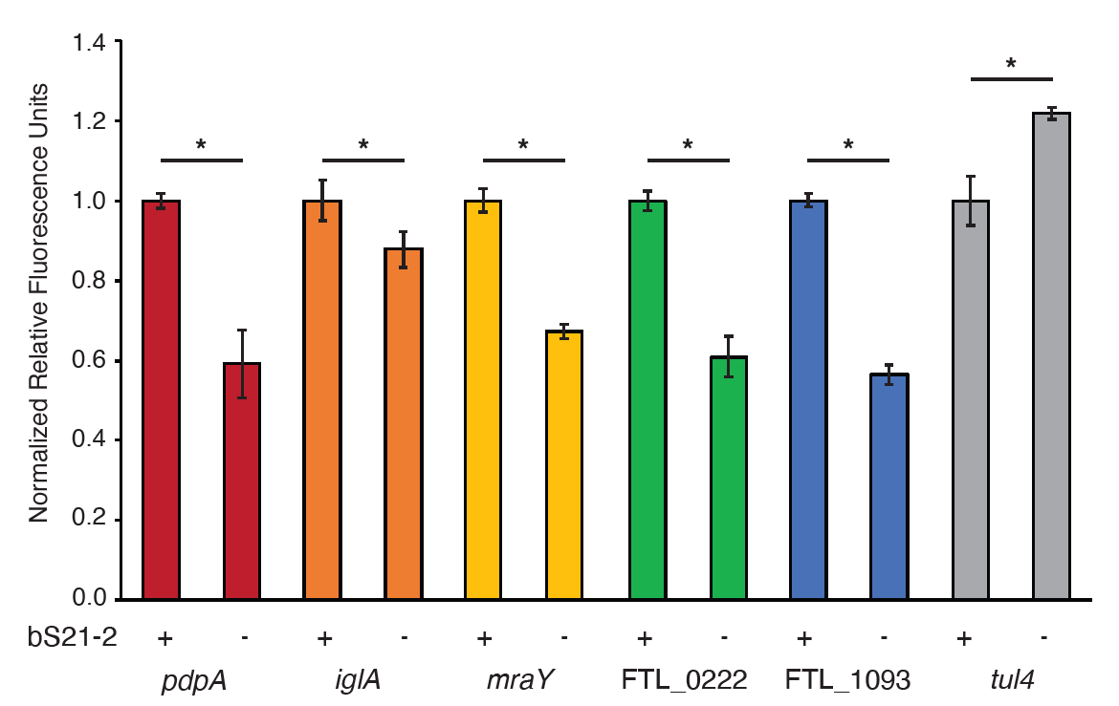
The 5´ UTR is sufficient to cause changes in translation
Levels of translation for the 5’ UTR sequences of various genes are affected by the presence or absence of bS21-2
5´ UTR:
Notes:
This is work done by former graduate student Hannah who is now a PHD but we are continuing her work by looking at regulation of translation for the gene pdPA.

Slide 9
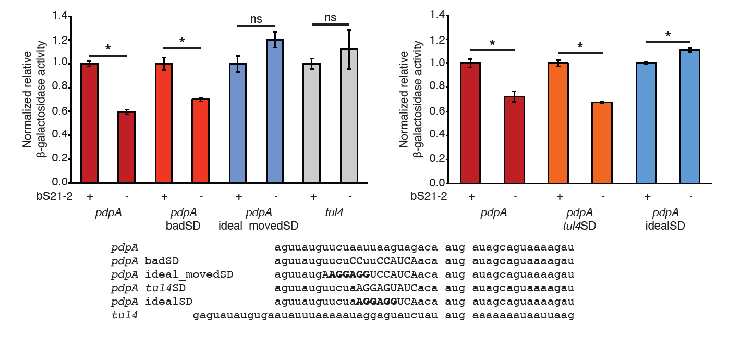
Translation of pdpA 5’UTR
Levels of Translation for the 5’ UTR Sequence of pdpA are Affected by the Presence or Absence of bS21-2
Changes in levels of translation disappear when the Shine-Delgarno sequence of pdpA is modified
5´ UTR:
Notes:
So to assess this, Hannah took the pdpA UTR and tried to mess with the Shine Dalgarno to see what happened.
There are two experiments:
-First is the really bad SD, and we still saw this decrease in our translational reporter output when bS21-2 is lost. We tried making an almost perfect SD by taking the SD from an unaffected gene tul4, and we see it still responds to bS21-2.
Then we tried making the perfect SD in two different places shown in bold here, and we see that there is no meaningful change in translation whether bS21-2 is there or not.
This suggested that genes with ideal SDs are not responsive to bS21-2 but we wanted to confirm it with one more 5’UTR.
We think theres a relation w bs21-2 and natural shine delgarno sequence
Bs21-2 present- normal translation
Not present- efficiency of translation goes down
When you change sequence, the differences disappear.

Slide 10
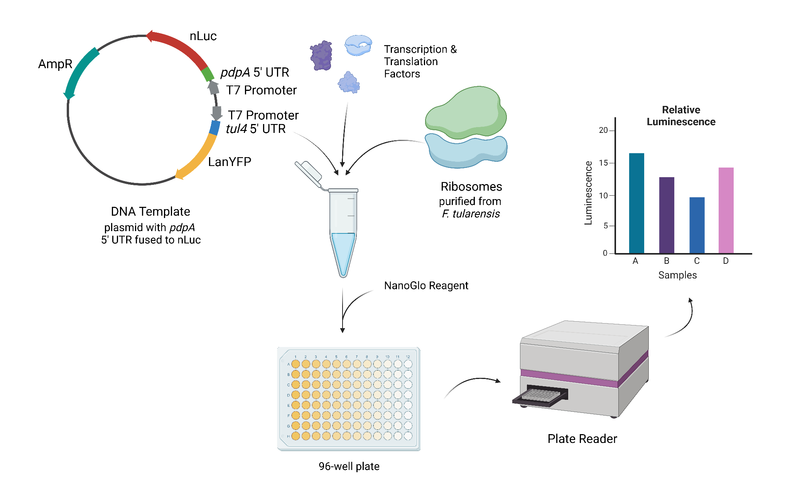
Research
Methods
*
*
Measure translation efficiency using an in vitro reporter assay.
Design a plasmid template for the assay.
Purify active ribosomes from Francisella tularensis.
*

Slide 11
*
*
Measure translation efficiency using an in vitro reporter assay.
Design a plasmid template for the assay.
Purify active ribosomes from Francisella tularensis.
*

Slide 12
Need a template with dual-reporters for measuring activity of control UTR (tul4) and test UTR (pdpA)
  Control UTR fused to fluorescent gene (LanYFP or iLov)
  Test UTR fused to luminescent gene (nLuc)
Verified that we can purify active ribosomes from E. coli (MRE600)
Purify ribosomes from Francisella (LVS)
  Compare with activity of E. coli ribosomes
SpectraMax plate reader in INBRE broken
Ramsey lab moving to CBLS
Testing plate readers in Matthew Ramsey and Camberg labs
  Fluorescence
  Luminescence

Slide 13
DNA Template Design
Goal: Create a reporter assay that is sensitive and easy to modify
Need a template with dual-reporters for measuring activity of control UTR (tul4) and test UTR (pdpA)
  Control UTR fused to fluorescent gene (LanYFP or iLov)
  Test UTR fused to luminescent gene (nLuc)
Can easily cut out UTRs and switch them
Can modify the SD sequence in the pdpA 5’ UTR

Slide 14
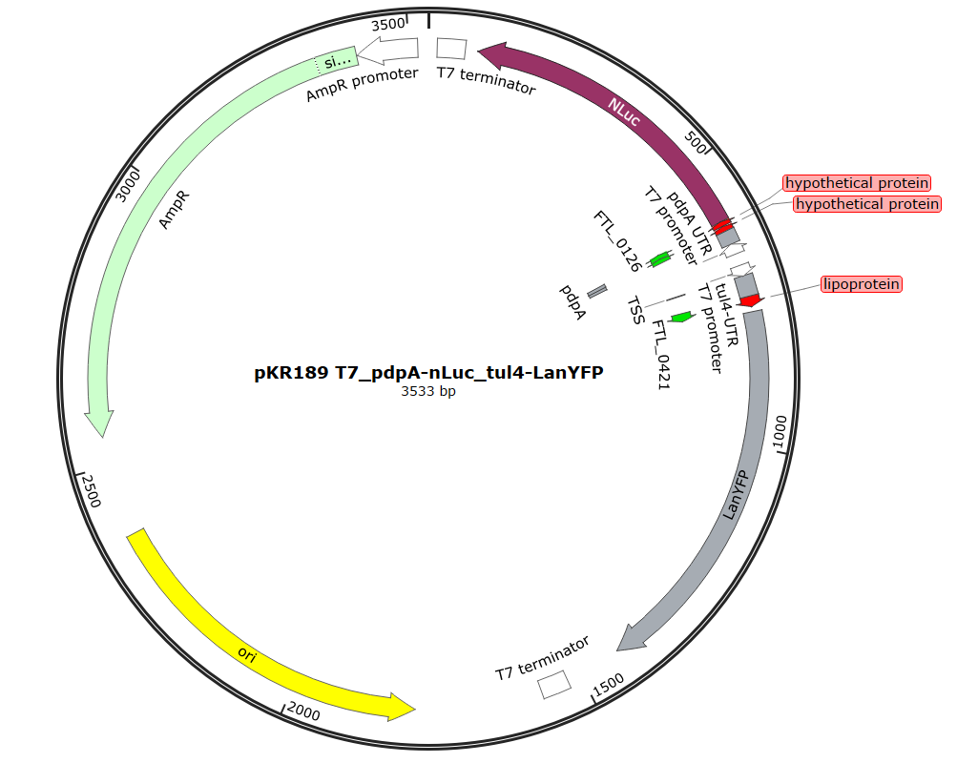
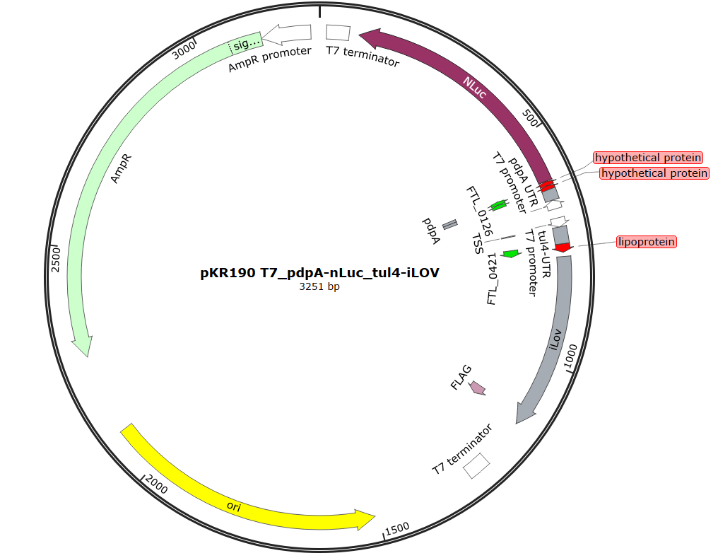
?

Slide 15
Fragment 1
Backbone
Fragment 2

Slide 16
Fragment 1
Backbone
Fragment 2

Slide 17
Clone a plasmid that will allow us to easily modify and switch out the 5’ UTR sequences for genes we want to study, including pdpA
Clone a plasmid with the pdpA 5’ UTR containing an ideal Shine-Dalgarno sequence to see if we can recapitulate the loss of regulation by bS21-2 in vitro

Slide 18
Plasmid Name | Plasmid Description | Plasmid Purpose
pKR204 | pdpA UTR fused to nLuc and tul4 UTR fused to LanYFP | NotI cut sites for easy modifications to UTRs
pKR205 | pdpA UTR fused to nLuc and tul4 UTR fused to iLov | NotI cut sites for easy modifications to UTRs
pKR206 | pdpA UTR fused to nLuc and tul4 UTR fused to LanYFP | NotI cut sites for easy modifications to UTRs, ideal pdpA SD
pKR207 | pdpA UTR fused to nLuc and tul4 UTR fused to iLov | NotI cut sites for easy modifications to UTRs, ideal pdpA SD
pKR208 | tul4 UTR fused to nLuc and pdpA UTR fused to LanYFP | NotI cut sites for easy modifications to UTRs, ideal pdpA SD, ability to use tul4 to drive nLuc
pKR209 | tul4 UTR fused to nLuc and pdpA UTR fused to iLov | NotI cut sites for easy modifications to UTRs, ideal pdpA SD, ability to use tul4 to drive nLuc

Slide 19
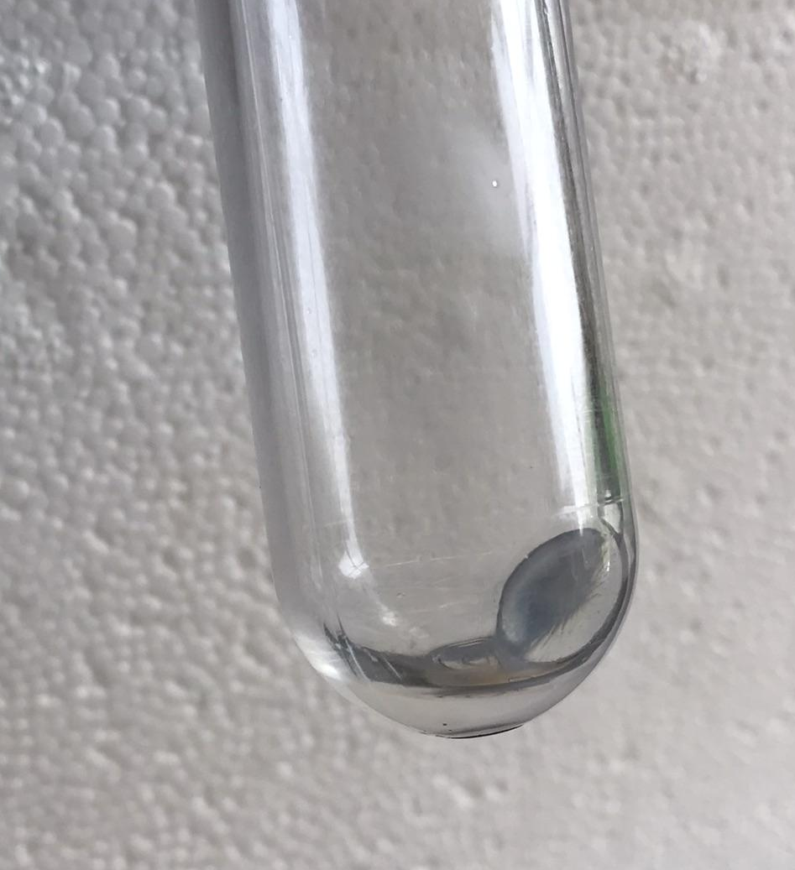
Ribosomes
Goal: obtain highly active ribosomes
Verified that we can purify active ribosomes from E. coli (MRE600)
Purify ribosomes from Francisella (LVS)
  Compare with activity of E. coli ribosomes
  Measure variability between replicates
  Measure variability between assays
  Measure effects of storage time on ribosome activity

Slide 20
Sucrose Cushion Purification
Importance of pure and functional ribosomes
  Harvesting at OD of 0.2-0.3
  Minimizing unnecessary wash steps
  Washing orange film away
  Resuspending in minimal volume

Slide 21
Plate Reader
Goal: recapitulate bS21-2 control of protein synthesis in vitro
SpectraMax plate reader in INBRE broken
Ramsey lab moving to CBLS
Testing plate readers in Matthew Ramsey and Camberg labs
  Fluorescence
  Luminescence

Slide 22
Preliminary Data for LanYFP in vivo

Slide 23
Preliminary Data for iLov in vivo

Slide 24
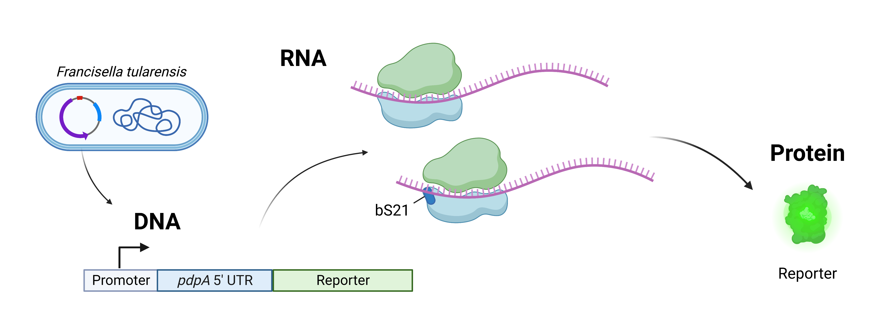
Previous Results
Preliminary Findings
In cells without bS21-2, translation of mRNAs with the pdpA 5´ UTR is reduced.
Introduction of an ideal Shine-Dalgarno sequence negates the positive effect of bS21-2 on translation.
These observations were made in the in vivo system of F. tularensis cells.

Slide 25
In Vitro Replication and Methodology
Using an in vitro translation kit.
Introducing a plasmid with modified 5´ UTR of pdpA fused to a reporter gene.
Including F. tularensis ribosomes.
This approach will help identify the minimal components necessary for bS21-2 regulation.

Slide 26
Plasmid Modification and Ideal Shine-Dalgarno
Discuss the plasmid design that enables modification of 5´ UTRs.
Explain the rationale behind modifying the pdpA Shine-Dalgarno to an ideal sequence.
Emphasize the significance of this modification in testing the role of bS21-2 in translation regulation.

Slide 27
Expected in vitro Findings
We anticipate that the regulatory effects of bS21-2 will disappear.
Learn more about the relationship between 5´ UTR sequences and bS21-2 regulation.

Slide 28
Implications and Future Directions
Broader Implications
Advancing the understanding of gene expression regulation in F. tularensis.
Shedding light on the role of ribosomal protein bS21-2 in bacterial virulence.
Possible Future Directions
Investigating other virulence genes and their regulatory mechanisms.
Exploring the applicability of these findings to other bacterial species.

Slide 29
Conclusion
Summarize the key points of your presentation:
  The role of ribosomal protein bS21-2 in regulating gene expression.
  The impact of 5´ UTR sequence modifications on bS21-2 regulation.
Reinforce the significance of your research in advancing the field of microbiology.

Slide 30

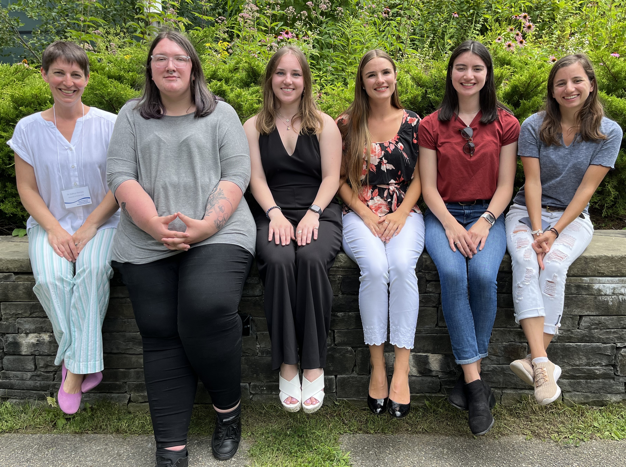





Acknowledgments
Dr. Kathryn Ramsey
Hannah Trautmann
Sierra Schmidt
Kira Bernabe
Sara Negash
Aisling Macaraeg
Oli Horyn
Dr. Steven Gregory Lab
Janet Atoyan
Notes:
In conclusion, I would like to thank Dr. Kathryn Ramsey and the members of the Ramsey lab for their support on this project. I would also like to thank Dr. Steven Gregory and the Gregory lab and Janet from the INBRE Core facility.Thank you all for attending and I’d be happy to take your questions!
thank ramsey and memebrs of lab as well as gregry lab and janet from sequencing center. Thank you and id be happy to take any questions.

