Slide 1
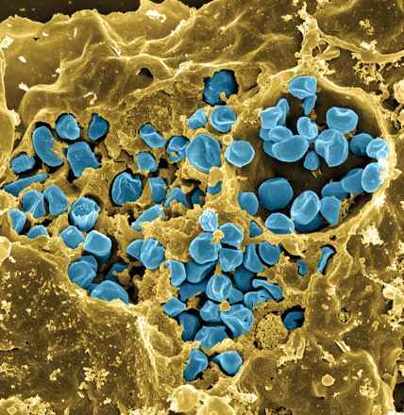
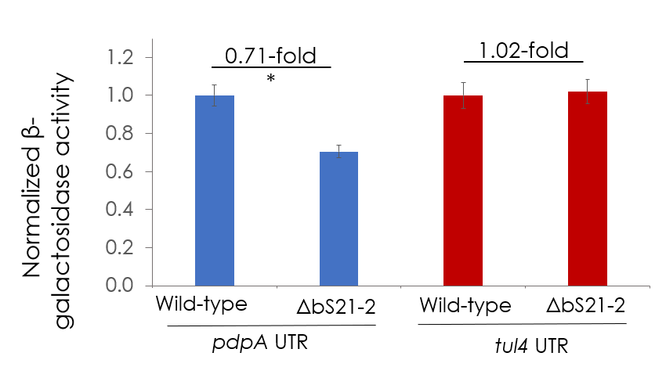
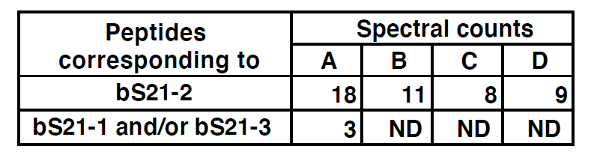
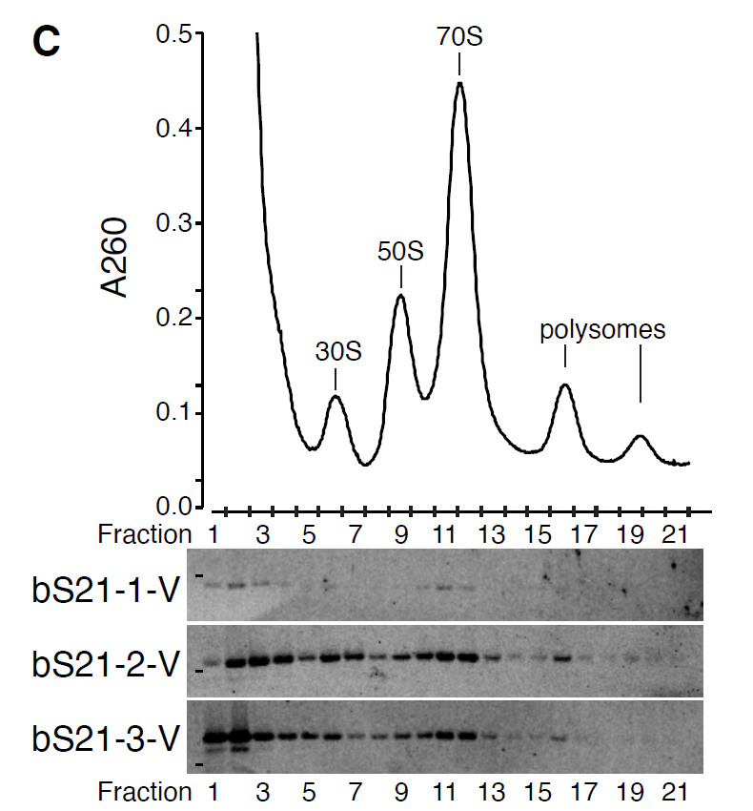
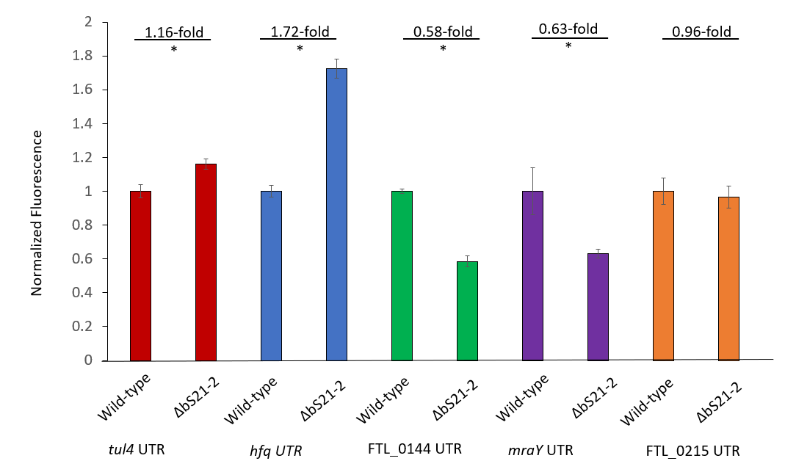
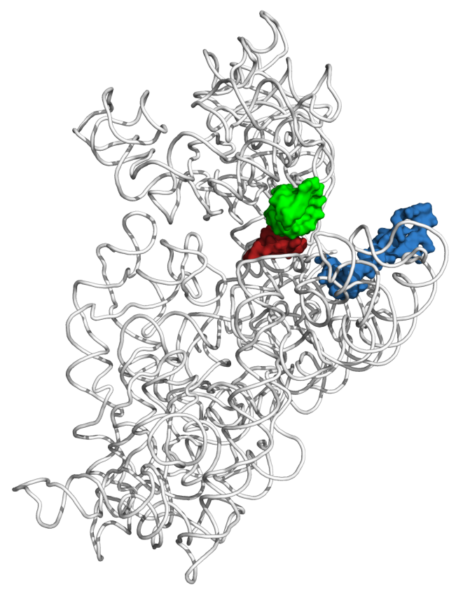
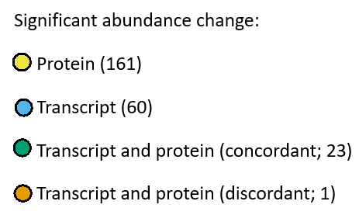
Changes in gene expression associated with ribosome heterogeneity in a bacterial pathogen
Benjamin Moore and Kathryn M. Ramsey^{1,2}
Department of Cell and Molecular Biology, University of Rhode Island, Kingston, RI 02881
Department of Biomedical and Pharmaceutical Sciences, University of Rhode Island, Kingston, RI 02881
Introduction
Results
bS21-2 controls the abundance of type VI secretion system proteins
Cells lacking bS21-2 translate from the specific UTRs less efficiently
Francisella tularensis
Ribosomes in F. tularensis are heterogenous
Causes tularemia
Highly infectious
Potential bioweapon
Model: F. tularensis subsp. holarctica LVS
Intracellular growth is essential to cause disease
A
A
A
B
Type six secretion system is essential for intracellular suvival
B
The role of bS21 in translation
B
Involved in translation initation
(Chang and Craven, 1977; Van Duin and
Wijnands, 1981)
Encoded by thousands of bacteriophage
(Mizuno et al., 2019; Al-Shayeb et al., 2020)
In representative Bacteroidetes, sequesters ASD (Jha et al., 2020)
mRNA channel
P-site tRNA ASL
mRNA (P-site codon)
bS21
Figure 3. bS21-2 influences T6SS component protein abundance. (A) Immunoblot analysis of indicated T6SS protein abundance. As indicated, cells either contained (wild-type) or lacked (∆rpsU2) bS21-2 and either an empty vector control (pF) or a vector ectopically expressing VSV-G-tagged bS21 homologs. Immunoblot against VSV-G was included to demonstrate production of bS21 homologs. (B) Quantification of immunoblots from A. Band intensities for each protein w normalized to total protein on the membrane. Error bars represent 1 SD. Lines above bars indicate statistical comparison among groups by t-test. Asterisk indicates group to which all other groups are compared, if horizontal line connects to line above group,*p < 0.05 using Benjamini-Hochberg correction.
Figure 1. F. tularensis ribosomes are heterogenous with respect to bS21. (A) Number of spectral counts corresponding to bS21 homologs identified from individual ribosome purifications from wild-type cells. Spectral counts corresponding to bS21-1 and/or bS21-3 cannot be unambiguously assigned due to complete sequence identity of detected peptides. ND: not detected. (B) Each bS21 homolog can be incorporated into ribosomes. Top: Sucrose gradient sedimentation profile from actively-translating wild-type cells. Nucleic acid content was monitored by A260 (y-axis). Fractions collected are indicated on the x-axis. Bottom: Immunoblot analysis of fractions from sucrose gradient sedimentation performed on actively-translating cells ectopically expressing indicated bS21 homolog with VSV-G epitope tag. Wells correspond to fractions 1 – 21 from profile above.
Figure 5. bS21-2 influences translation from some 5` untranslated regions.
(A) β-galactosidase assay of cells with or without bS21-2. All reporter strains had the tul4 promoter fused to the indicated UTR with the first 6 codons of the gene and lacZ at a neutral site in the chromosome. (B) Green fluorescence was measured for reporter strains and normalized to OD600. . All reporter strains had the tul4 promoter fused to the indicated UTR with the first 6 codons of the gene and GFP on a plasmid. Error bars represent 1 SD. Lines above bars indicate statistical comparison among groups by t-test. *p<0.05
F. tularensis encodes multiple distinct bS21 homologs
bS21-2 is important for intramacrophage growth
Loss of bS21-2 leads to changes in protein, not transcript, abundance
Model for gene regulation by bS21
50S
bS21-2
30S
bS21-3
bS21-1
 | LVS bS21-1 | LVS bS21-3 | LVS bS21-2 | E. coli bS21
LVS bS21-1 | 100.0 | 72.3 | 54.0 | 50.8
LVS bS21-3 |  | 100.0 | 47.6 | 48.5
LVS bS21-2 |  |  | 100.0 | 60.0
E. coli bS21 |  |  |  | 100.0
bS21-1
bS21-2
bS21-3
- bS21
T6SS proteins
?
T6SS proteins
Other virulence genes
T6SS proteins
?
?
Protein Log2FC
∆rpsU2 vs WT
Conclusions
Table 1. F. tularensis bS21-2 is most similar to E. coli bS21. Percent identities of amino acid sequences for F. tularensis LVS bS21-1, bS21-2, bS21-3 and E. coli bS21 were calculated using the multiple sequence alignment tool ClustalOmega.
Ribosomes in Francisella tularensis can be heterogeneous with respect to bS21
The ribosomal protein bS21-2 influences protein abundance, including abundance of key virulence factors
bS21-2, uniquely among bS21 homologs, is important for intramacrophage growth
Ribosomes without bS21-2 translate from specific 5` UTRs with different efficiencies
Changing ribosome composition may be a way for bacteria to quickly regulate gene expression
References
Al-Shayeb B, Sachdeva R, Chen L, Ward F, Munk P, Devoto A, Castelle C, Olm MR, Bouma-Gregson K, Amano Y, et al. Clades of huge phages from across Earth’s ecosystems. Nature 2020; 578(7795): 425–431. PMCID: PMC7162821
Chang C, Craven GR. Identification of several proteins involved in the messenger RNA binding site of the 30 S ribosome by inactivation with 2-methoxy-5-nitrotropone. J Mol Biol. 1977; 117(2):401–18. PMID: 604509
Van Duin J, Wijnands R. The function of ribosomal protein S21 in protein synthesis. Eur J Biochem. 1981; 118(3):615–9. PMID: 7028483
Jha V, Roy B, Jahagirdar D, McNutt ZA, Shatoff EA, Boleratz BL, Watkins DE, Bundschuh R, Basu K, Ortega J, Fredrick K. Structural basis of sequestration of the anti-Shine-Dalgarno sequence in the Bacteroidetes ribosome. Nucleic Acids Res. 2020; 49(1): 547-567. PMID: 33330920
Mizuno CM, Guyomar C, Roux S, Lavigne R, Rodriguez-Valera F, Sullivan MB, Gillet R, Forterre P, Krupovic M. Numerous cultivated and uncultivated viruses encode ribosomal proteins. Nat Commun . 2019;10(1):752. PMCID: PMC6375957
Figure 4. Cells without bS21-2 have an intramacrophage growth defect, which can be complemented by ectopic expression of bS21-2. Growth of F. tularensis LVS cells within J774A.1 cells. Murine macrophage-like J774A.1 cells were infected with indicated bacterial cells at a multiplicity of infection of 5 – 10. J774A.1 cells were lysed and bacteria were plated for enumeration (CFU) 24 hours post-infection. Error bars represent 1 SD. Experiments were repeated at least twice and data from a representative experiment are shown. Lines above bars indicate statistical comparison among groups by t-test. Asterisk indicates group to which all other groups are compared, if horizontal line connects to line above group,*p < 0.05 using Benjamini-Hochberg correction.
RNA Log2FC
∆rpsU2 vs WT
Figure 2. Loss of bS21-2 leads to changes in protein abundance that cannot be explained by changes in transcript abundance. Cells with (WT, wild-type) and without bS21-2 (∆rpsU2) were compared using RNA-Seq (x-axis) and DIA whole cell mass spectrometry (y-axis). Horizontal dashed lines indicate +/-1.5-fold cutoff for differential protein abundance; vertical dashes indicate +/-2-fold cutoff for differential transcript abundance. Colored dots represent genes with significant changes in either protein and/or transcript abundance as indicated above (adjusted p-value <0.05), while grey dots without outline represent genes with changes that did not meet the statistical thresholds.
Funding Sources
USDA National Institute of Food and Agriculture, Hatch project 1017848; RI0019-H020
Rhode Island Foundation Medical Research Grant #2798_20190602
RI-INBRE Early Career Development Award, NIH/NIGMS P20GM103430
CARTD-COBRE Pilot Project Award, NIH/NIGMS Grant P20GM121344

