Slide 1
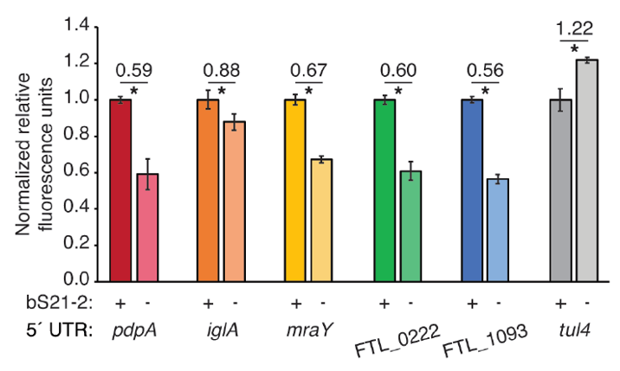

Slide 2
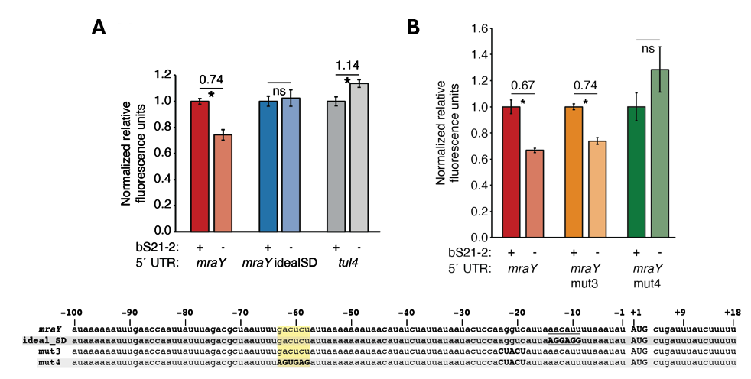

Slide 3
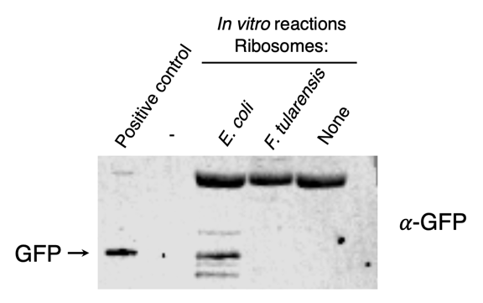

Slide 4
A
*
B
*
*
E. coli

Slide 5
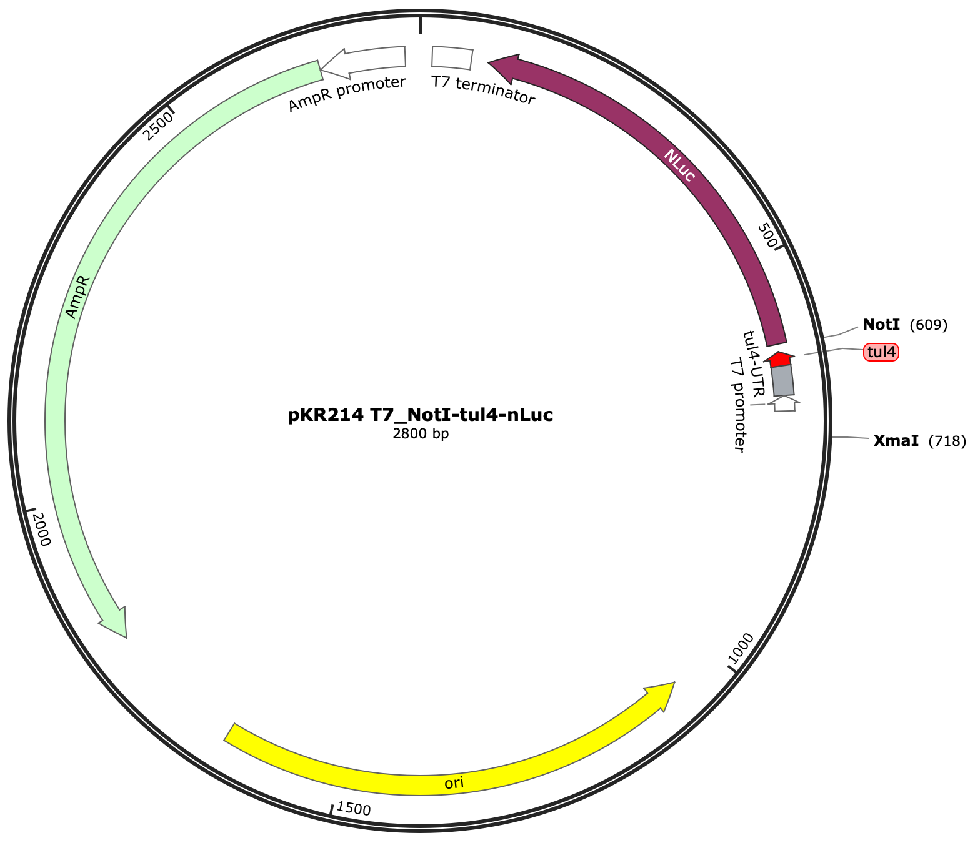

Slide 9
E. coli
F. tularensis

Slide 10
Notes:
Sucrose gradients are from 6/21/24.

Slide 15
LVS Total RNA
EC
rRNA
FP
LVS rRNA
RNA-
Snap
kb
RNA Ladder
FP1
FP2
FP3
FP4
BB1
BB2
BB
6
5
4
23S rRNA
3
Figure 11. F. tularensis LVS ribosomes purified from BugBuster-lysed cells have fragmented 23S rRNA. Agarose gel electrophoresis of indicated RNA (total RNA extracted from cells or rRNA extracted from 70S ribosomes) denatured by glyoxal treatment. FP indicates a French press was used for cell lysis. BB indicates BugBuster was used for cell lysis. Note that gel image was cropped and re-ordered for clarity. LVS: F. tularensis LVS; EC: E. coli.
2.5
2
16S rRNA
1.5
1
0.5

Slide 16
Jul 24 Assay |  | Aug 9 Assay
Aug 1 Assay

Slide 17
Assay 1 |  | Assay 3
Assay 2

