Slide 1
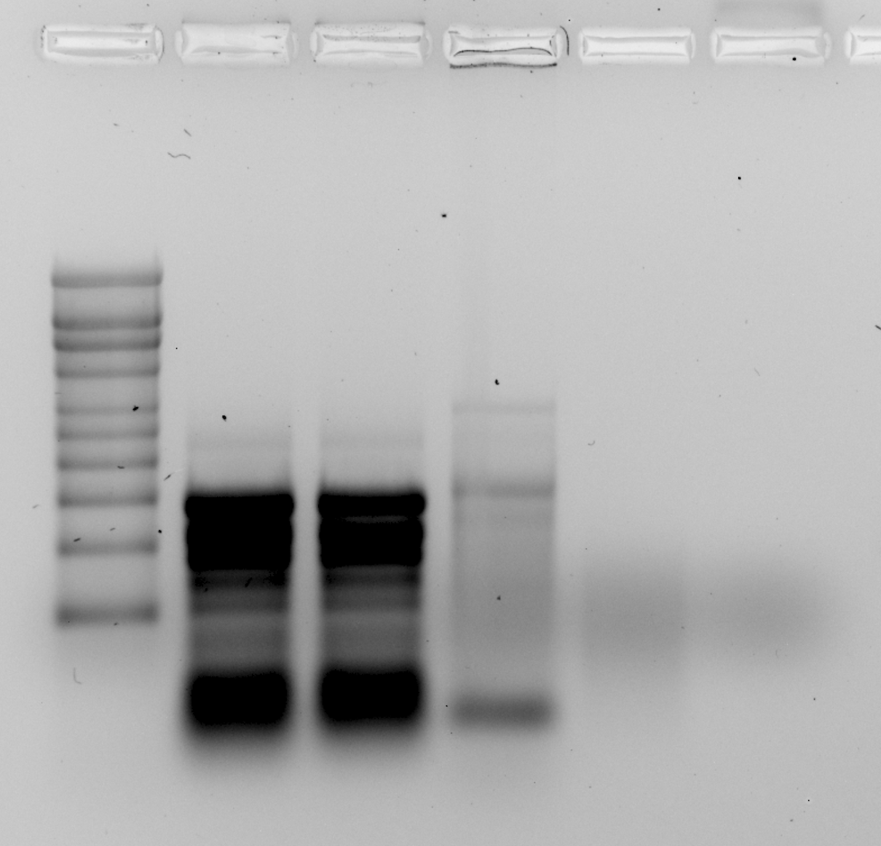
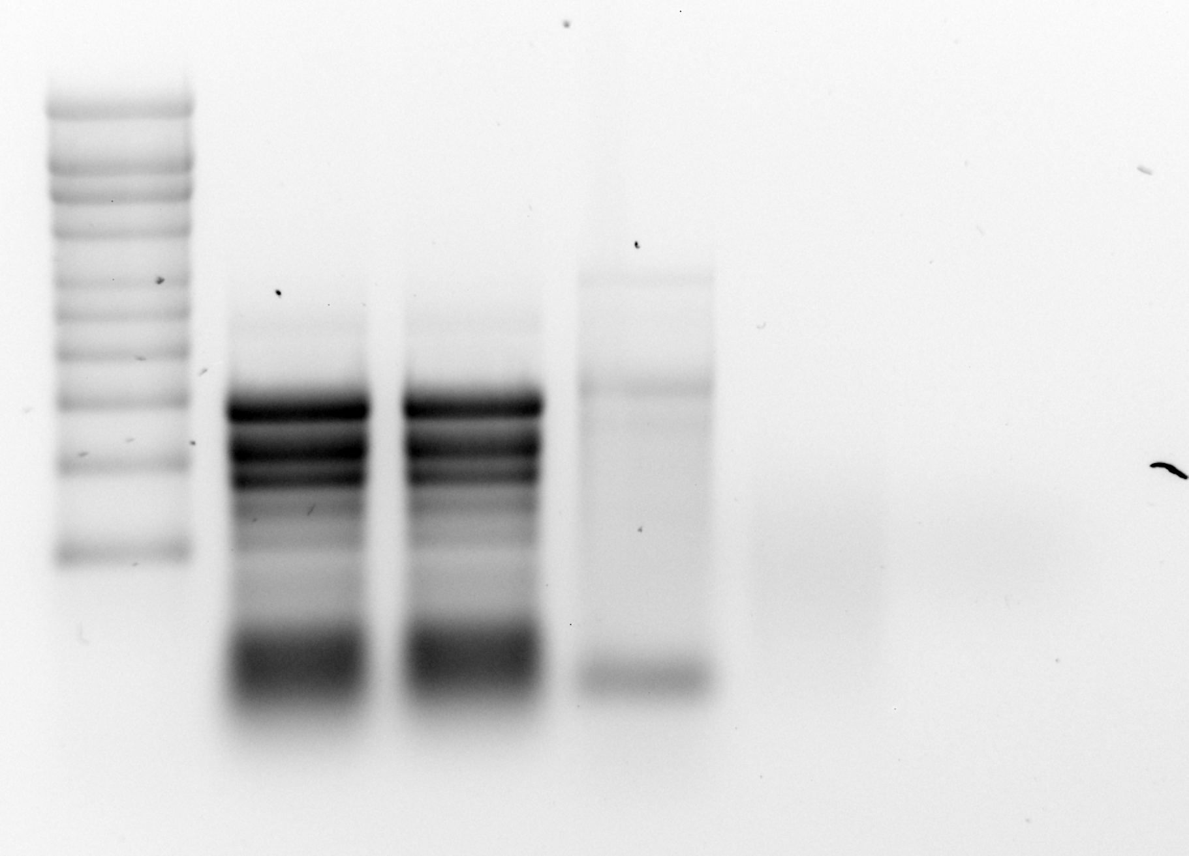
kb
RNA Ladder
Whole Cell Lysate 1
7/24/24
Whole Cell Lysate 2
7/24/24
Alex
RNA 3
3/14/24
Alex cDNA 3
3/18/24
Alex Water & Glycogen
9
6
5
4
3
2.5
2
1.5
1
0.5

