Slide 1
French Press and Bug Buster Extracted Ribosome Samples Before and After Dialysis into Various Concentrations of Mg²⁺
May 6-7, 2024

Slide 2
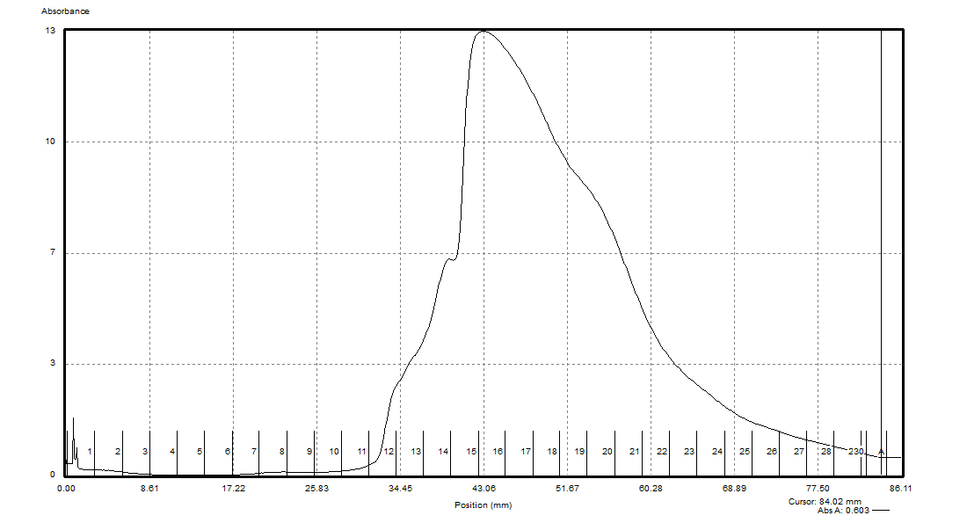
French Press Sample Comparison (Original & Pre-Dialysis, 10mM Mg²⁺)
Overlay (Not to Scale)

Slide 3
French Press Sample Comparison (Original & Pre-Dialysis, 10mM Mg²⁺)
To Scale

Slide 4
French Press
Pre-Dialysis
10 mM Mg²⁺

Slide 5
French Press
Post-Dialysis
0.3 mM Mg²⁺

Slide 6
French Press
Post-Dialysis
3 mM Mg²⁺

Slide 7
French Press
Post-Dialysis
6 mM Mg²⁺

Slide 8
French Press
Post-Dialysis
10 mM Mg²⁺

Slide 9
French Press
Post-Dialysis
12 mM Mg²⁺
Messed Up!!

Slide 10
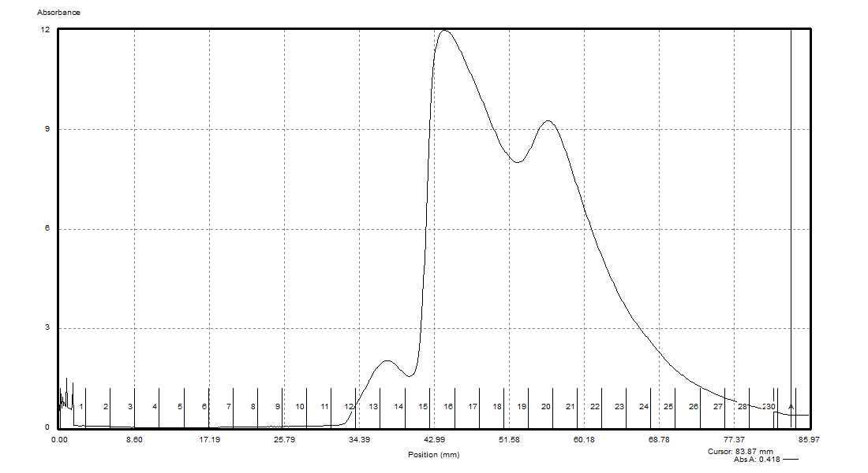
Bug Buster Sample Comparison (Original & Pre-Dialysis, 10mM Mg²⁺)
Overlay (Not to Scale)

Slide 11
Bug Buster Sample Comparison (Original & Pre-Dialysis, 10mM Mg²⁺)
To Scale

Slide 12
Bug Buster
Pre-Dialysis
10 mM Mg²⁺

Slide 13
Bug Buster
Post-Dialysis
0.3 mM Mg²⁺

Slide 14
Bug Buster
Post-Dialysis
3 mM Mg²⁺

Slide 15
Bug Buster
Post-Dialysis
6 mM Mg²⁺

Slide 16
Bug Buster
Post-Dialysis
10 mM Mg²⁺

Slide 17
Bug Buster
Post-Dialysis
12 mM Mg²⁺

