Slide 1
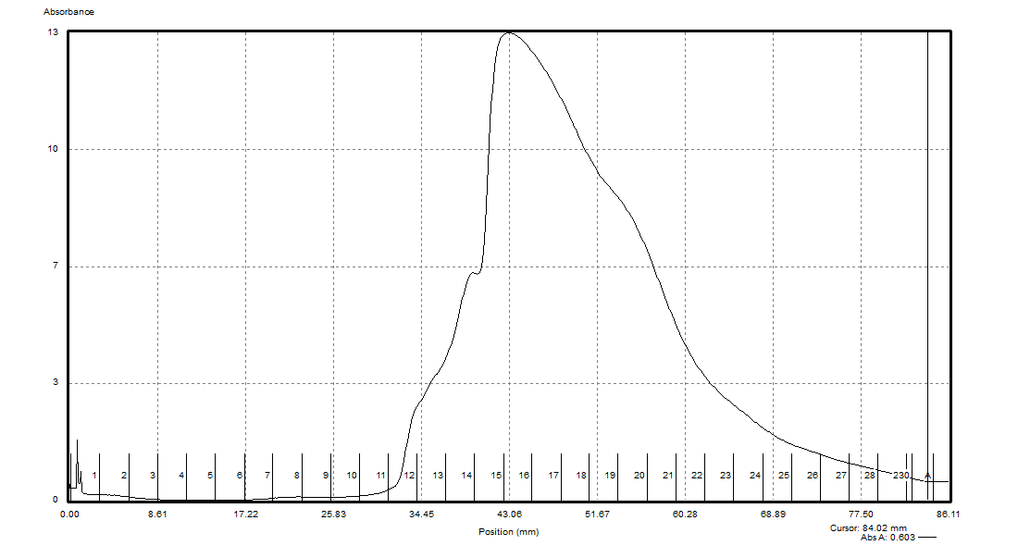
French Press Sample Comparison (Original & Pre-Dialysis, 10mM Mg²⁺)
Overlay (Not to Scale)

Slide 2
French Press Sample Comparison (Original & Pre-Dialysis, 10mM Mg²⁺)
To Scale

Slide 3
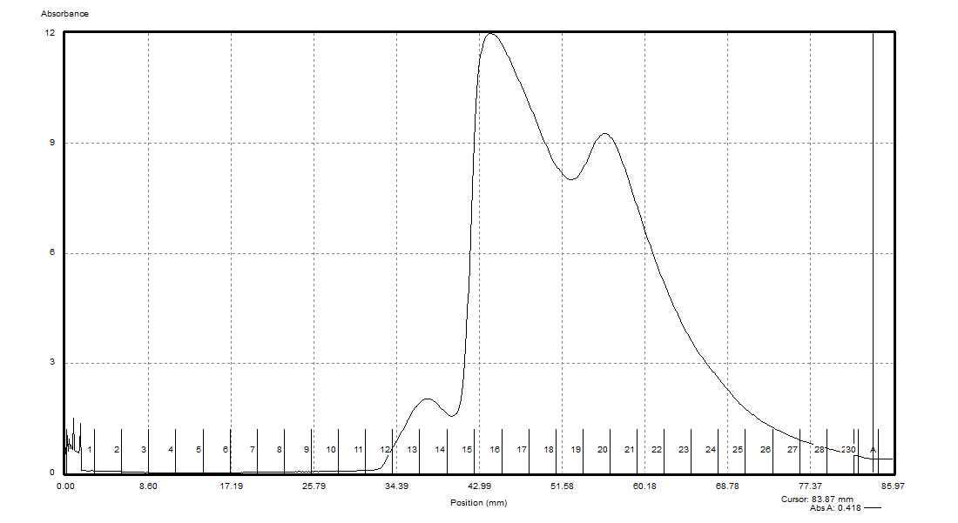
Bug Buster Sample Comparison (Original & Pre-Dialysis, 10mM Mg²⁺)
Overlay (Not to Scale)

Slide 4
Bug Buster Sample Comparison (Original & Pre-Dialysis, 10mM Mg²⁺)
To Scale

