Slide 1
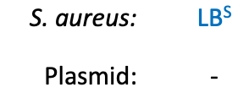
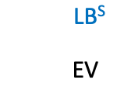



Mutation in bL21 leads to resistance to laurenobiolide
bL21 R89P

