Slide 1
An intro to P. ging

Slide 2
Porphyromonas gingivalis
Endogenous oral pathogen
Gram negative
Anaerobic
Has three different cell surface glycans
Helps pathogenesis with immune evasion, immune modulation and biofilm development
Major agent contributing to chronic periodontitis

Slide 3
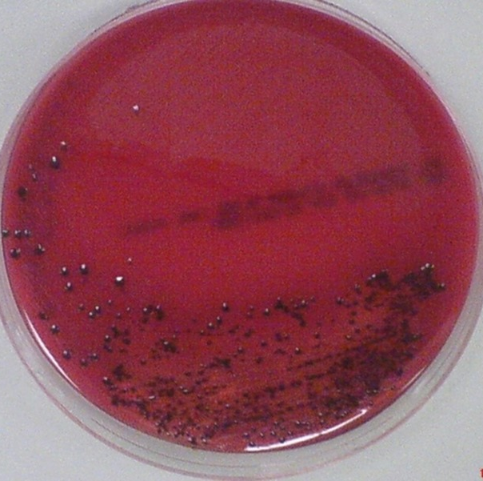
Chronic Periodontitis
Keystone species in development
Occurs more often with patients with other systemic diseases (diabetes, AIDS, leukemia, Down’s syndrome)
Can enhance risk of other deadly comorbities like cardiovascular disease and diabetes
How, K. Y., Song, K. P., & Chan, K. G. (2016). Porphyromonas gingivalis: An Overview of Periodontopathic Pathogen below the Gum Line. Frontiers in microbiology, 7, 53. https://doi.org/10.3389/fmicb.2016.00053

Slide 4
P. gingivalis
Ferments amino acids for energy production
Lives in subgingival sulcus of human oral cavity
Secondary colonizer of dental plaque
Requires iron

Slide 5
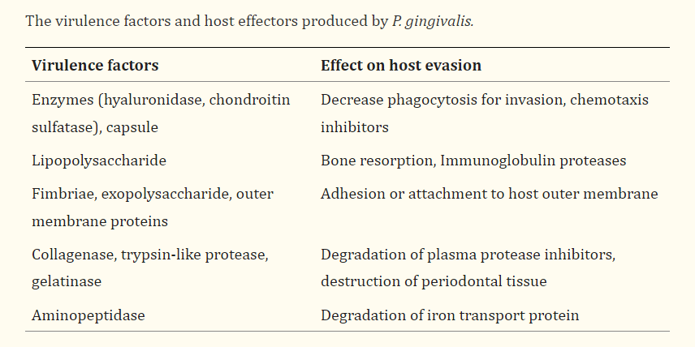
How, K. Y., Song, K. P., & Chan, K. G. (2016). Porphyromonas gingivalis: An Overview of Periodontopathic Pathogen below the Gum Line. Frontiers in microbiology, 7, 53. https://doi.org/10.3389/fmicb.2016.00053

Slide 6
Virulence Factors we’re focusing on
Capsules
Lipopolysachharide

Slide 7
Capsules / why capsules are important
Adherence (allows resistance to flow of saliva)
Capsules protext bacteria from being cleared by immune defense
Masks cell surface and reduces access to cell
Cell wall components or associated with cell structures
Six capsular antigens
Increased encapsulation (decreased autoagglutination, more hydrophilic, increased resistance to phagocytosis and serum)
More virulent
(no capsules adhere more to epithelial cells and cause localized abscess)

Slide 8
How gets turned on / off and asSuGR
Two DNABII proteins (HU PG0121 and HU PG1258) involved in controlling capsule production
DNABII proteins usually criticial for regulation of cell metabolism, response to environmental changes, controlling transition to/from quiescent state
Antisense RNA = asSuGR = antisense Surface Glycan Regulator. Encoded at 5’ end of capsule locus in a 77bp inverted repeat
Deleting or overexpressing asSuGR alters LPS synthesis and K-antigen capsule expression
  Controlled by two-component response regulator PG0720

Slide 9
What do we know about how capsule gets turned on / off
Synthesis of sphingolipids influences presentation of K-antigen capsule on cell surface
Capsule and SL-synthesis coordinated by antisense RNA which is activated by regulator PG0720 from the 77bp inverted repeat. Antisense RNA expression results in higher transcript levels of genes in capsule operon.
Genes in PG0104-PG0121 locus required for K1 synthesis
HU PG0121 controls production of surface polysaccharides of genes in k-antigen and APS locus

Slide 10
An antisense RNA molecule withing the 77bp inverted repeat element near 5’ end of K-antigen capsule synthesis genes affect expression of capsular surface in W83. diminished capsule synthesis and altered structure LPS
Is antisense RNA genuine? Does it encode for signaling peptide? Are there other regulator genes that interact with other proteins or enzymes in capsule production?

Slide 11
Why capsule is important
Strains that produce k-antigen induce neuroinflammation, astrogloisos, cognitive decline and histopathological signs of Alzheimer's which aligns with earlier studies that show purified capsule elicit chemokine production from phagocytic cells (host response to this antigen can contribute to formation of inflammatory cell lesion observed)
Important virulence determinant
ROLE OF OTHER SURFACE GLYCANS IN DEREGULATION OF HOST RESPONSE NOT UNDERSTOOD

Slide 12
Lipopolysachharides
Has distal polysaccharide (o-antigen), non-repeating core oligosaccharide and hydrophobic domain called lipid A
Lipid A is biologically active region. Interacts with toll-like receptors 2 and 4
Acylation patterns change with microenvironmental condition which affects host immune signaling.
Maintains cell and structural integrity and entry of hydrophobic molecules
Disrupt innate host surveillance because it interferes with leukocytes around bacteria
Different strains have variation of LPS

Slide 13
So what am I trying to answer?
long-term goal of our research program is to elucidate the regulatory mechanisms and
environmental and nutritional parameters that control the expression of genes involved in modifying the surface properties of Pg,
and to determine how changes in synthesis relate to biofilm persistence and pathogenicity.
Determine if PG0121 and PG1258 are competing for the same DNA sequences or interacting to bind to the same sequences

Slide 14
Known regulatory mechanisms
Tyrosine phosphatase
DNABII protein HU beta subunit

Slide 15
Strains I’m looking at to study this
W83 – Wildtype – thicker capsules (cause decrease in production of leukocytes)
PG0121 – causes decrease in expression of k-antigen synthesis locus

Slide 16
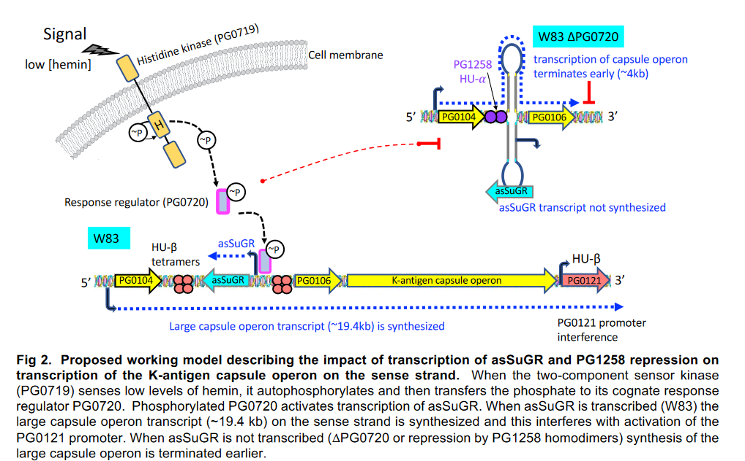

Slide 17
Where I’m at

Slide 18
What am I addressing and how
How 77bp element is involved in regulating synthesis and presentation of capsule and LPS

Slide 19
How am I addressing this
ChIP-Seq
qRT-PCR

Slide 20
Central Hypothesis
asSuGR is cis and trans acting molecule that controls changes in cell surface properties by coordinating expression levels of genes involved in synthesis of surface glycans and SLs and thus plays a fundamental role in modulating Pg virulence.

Slide 21
HU and IHF are two forms of DNABII faily of proteins. HU condenses DNA like histones do. HU promoter structure highly conserved, Individual subunits dimerize and have a conserved hydrophobic core with protruding antiparallel beta ribbon sheets (which are the things that make contact with the DNA). Typical functions include gene regulation, maintenance of DNA topology, and replication initiation.
IHF affects transcription. Binds to specific sequence
HU also stimulates transcription, translation, and binds similar DNA and RNA structures

Slide 22
Sphingolipids
Synthesis of sphingolipids required for presentation of A-LPS and K-antigen capsule on cell surface of Pg strain W83
Hypothesis: SLs play role be either positioning protein assemblies in membrane for synthesis or subset of Sls may play a role in anchoring capsule to outer membrane
Slnull mutant defective in presentation of k-antigen capsule

Slide 23
In conclusion
Brush your teeth

