Slide 1
An introduction to
P. gingivalis
Alex Farah
Joint Lab Meeting
August 21, 2024

Slide 2
Overview
Introduction to P. gingivalis
Background on what is known
Questions I’m looking into
How I’ll address questions
Where we currently are

Slide 3
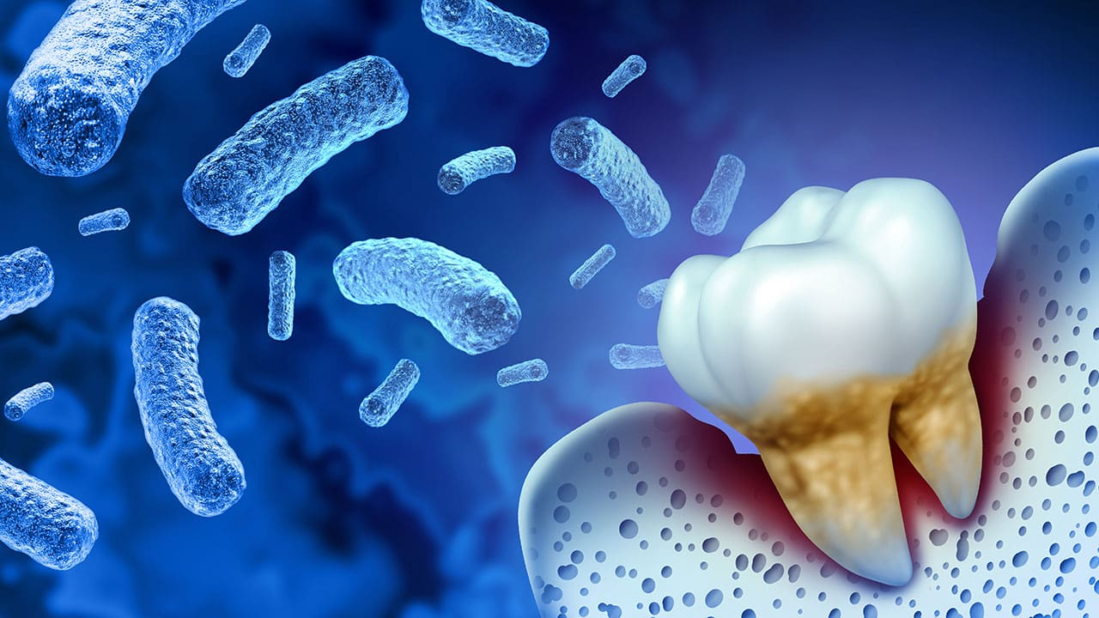
Porphyromonas gingivalis
Gram negative
Anaerobic
Endogenous oral pathogen
Major agent contributing to chronic periodontitis
https://decisionsindentistry.com/2023/05/role-of-porphyromonas-gingivalis-in-periodontal-diseases/

Slide 4
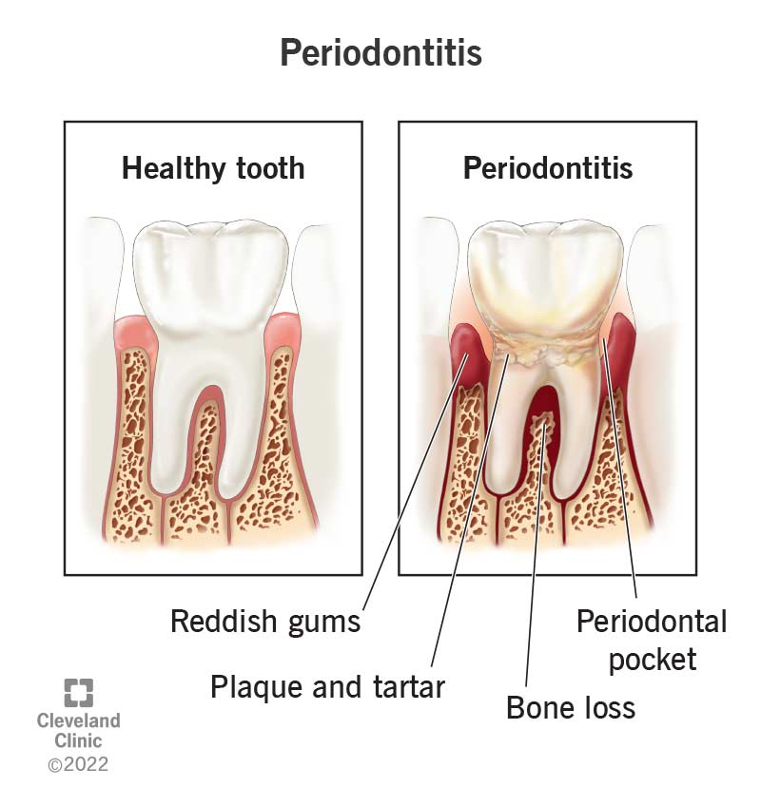
Chronic Periodontitis
Often occurs in patients with other systemic diseases
Can enhance risk of other morbidities

Slide 5
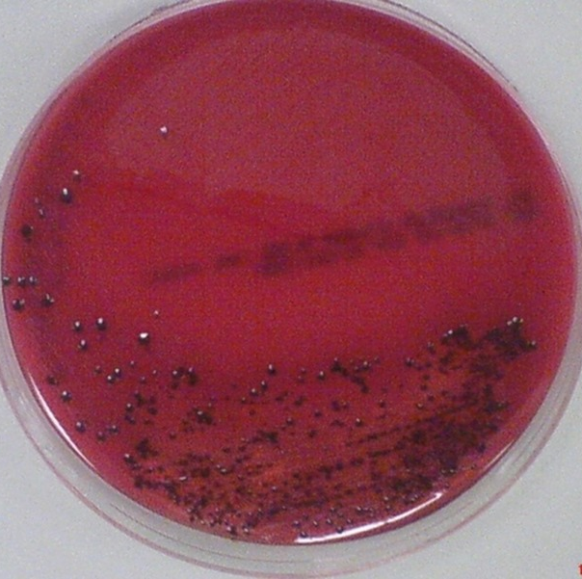
Where Pg is during periodontitis
Secondary colonizer of dental plaque
Requires iron
Ferments amino acids for energy production
How, K. Y., Song, K. P., & Chan, K. G. (2016). https://doi.org/10.3389/fmicb.2016.00053

Slide 6
How P. gingivalis effects pathogenesis
Immune evasion
Immune modulation
Biofilm development

Slide 7
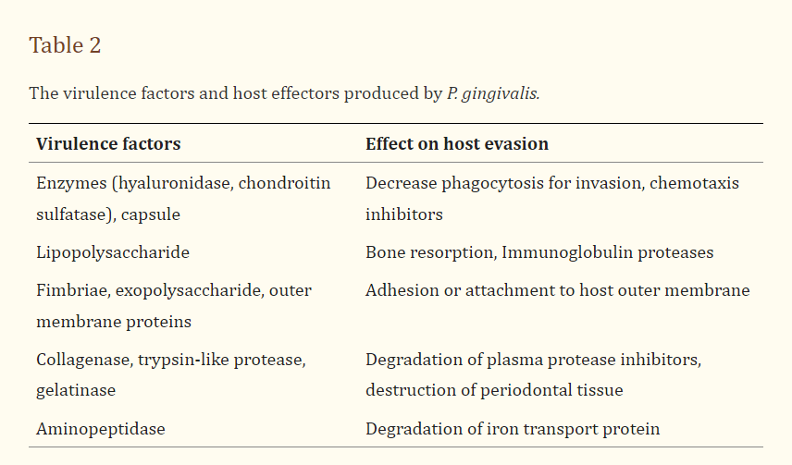
Virulence Factors of P. gingivalis
How, K. Y., Song, K. P., & Chan, K. G. (2016). https://doi.org/10.3389/fmicb.2016.00053

Slide 8
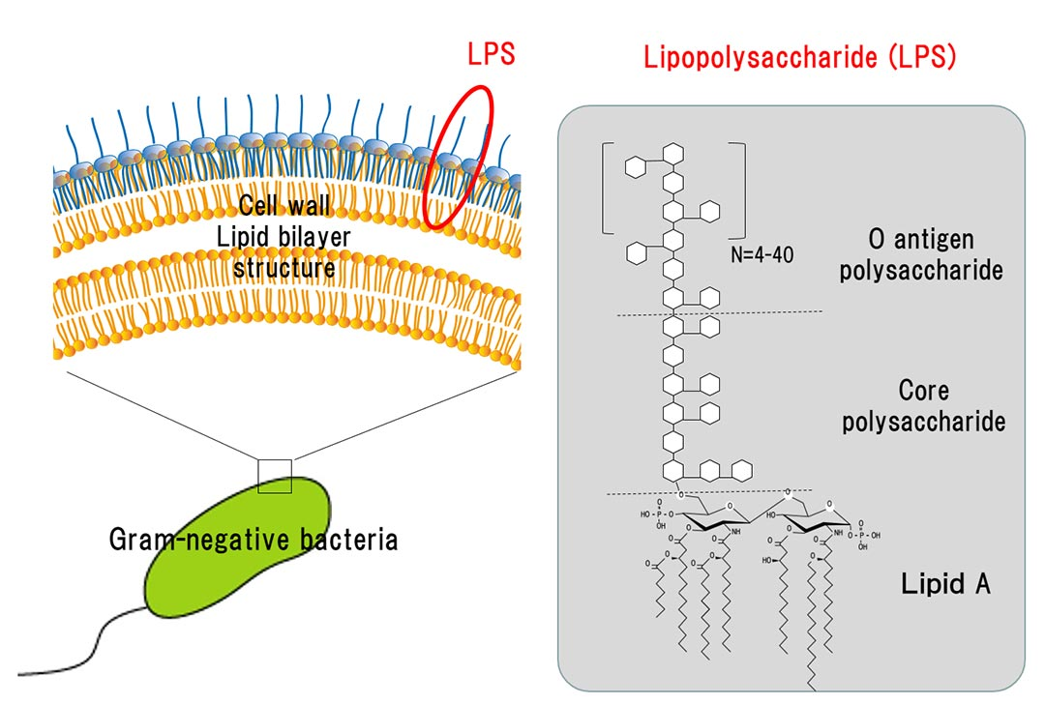
Brief intro to lipopolysaccharides (LPS) and their importance
Outer bacterial membrane
Protects cell from toxic molecules entering
Maintains cell and structural integrity
Disrupts innate host surveillance
LPS helps evade host immune system
https://www.macrophi.co.jp/english/lps/1-1.html
Notes:
Main component of membrane in gram negative bacteria
Permeability barrier
Lipid A is biologically active region that interacts with toll-like receptors 2 and 4
Interferes with leukocytes around bacteria

Slide 9
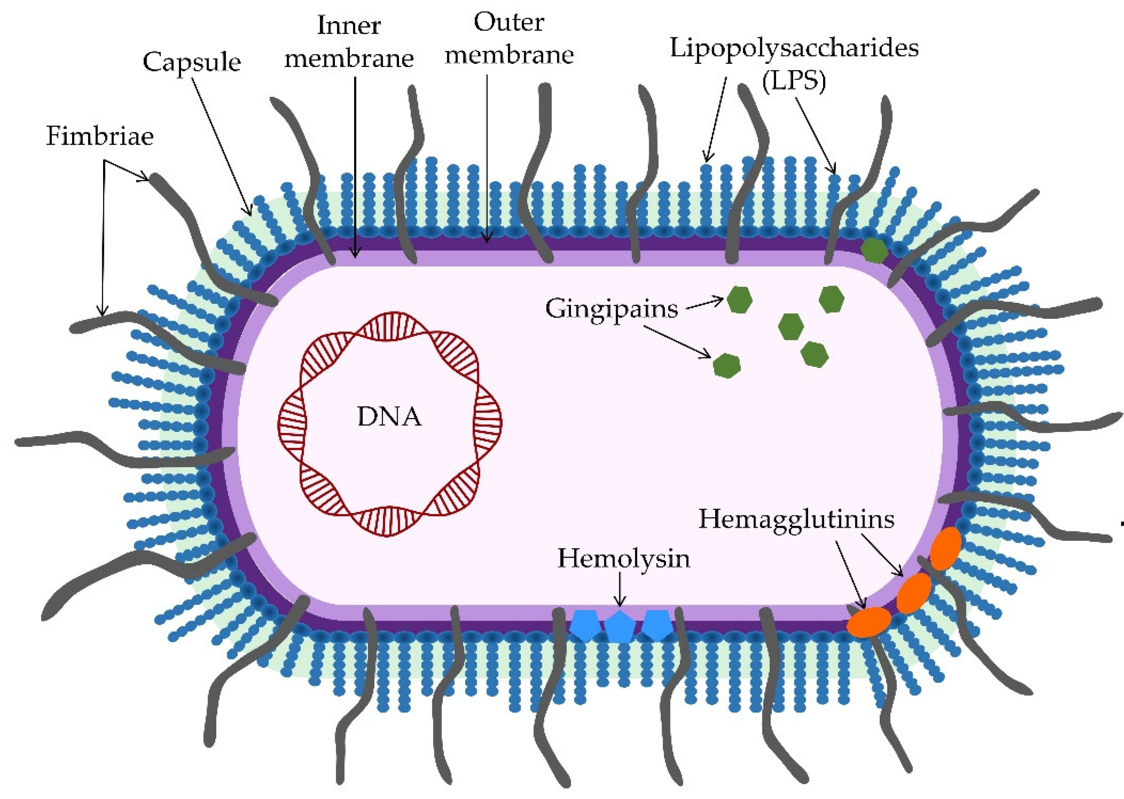
Importance of capsules
Polysaccharide layer around cell wall
Protects bacteria
Adheres the bacteria to tooth/gums
More virulent
Without capsules, bacteria cause localized abscess
Aleksijević LH, Aleksijević M, Škrlec I, Šram M, Šram M, Talapko J. https://doi.org/10.3390/pathogens11101173
Notes:
Protects bacteria from host immune defense
Masks cell surface and reduces access to cell
Increased encapsulation means decreased autoagglutination, more hydrophilic, increased resistance to phagocytosis and serum
Adherence allows resistance to flow of saliva

Slide 10
What we know about the P. Gingivalis capsule
Six capsular antigens – we focus on K-antigen K1
Genes in PG0104-PG0121 locus required for K1 synthesis
Strains with k-antigen induce:
  Neuroinflammation
  Astrogliosis
  Cognitive decline
  Histopathological signs of Alzheimer’s
Notes:
This aligns with earlier studies that show purified capsule elicits chemokine product from phagocytic cells

Slide 11
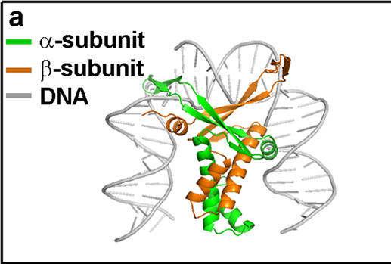
What’s controlling the capsule production?
Two DNABII proteins -- HU PG0121 and HU PG1258
HU PG0121 controls production of surface polysaccharides of genes in k-antigen and APS locus
Sphingolipids synthesis influences presentation of K-antigen capsule on cell surface
Capsule and sphingolipids synthesis coordinated by antisense RNA called antisense Surface Glycan Regulator
Novotny, L.A., Goodman, S.D. & Bakaletz, L.O. Redirecting the immune response towards immunoprotective domains of a DNABII protein resolves experimental otitis media. npj Vaccines 4, 43 (2019). https://doi.org/10.1038/s41541-019-0137-1
Notes:
DNABII proteins usually critical for regulation of cell metabolism, response to environmental changes, controlling transition to/from quiescent state
Sphingolipids important for signal transduction

Slide 12
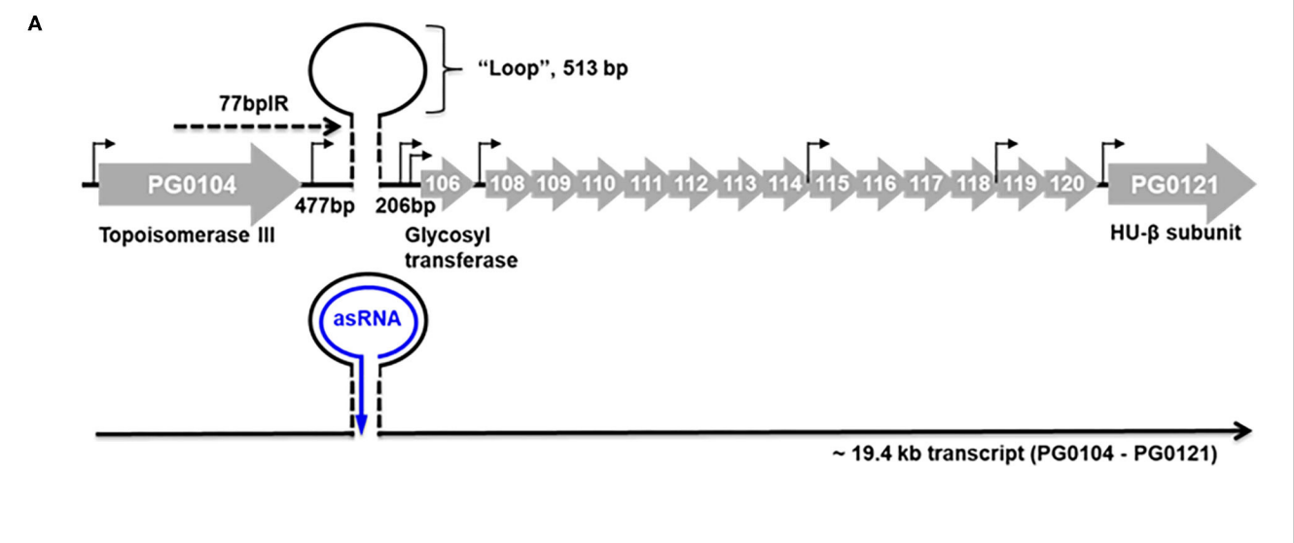
What we know about specific antisense RNA
77bp inverted repeat in 5’ end of K-antigen capsule synthesis gene
Deleting or overexpressing antisense RNA alters LPS synthesis and k-antigen capsule expression
Controlled by two-component response regulator PG0720
Kim, H. M., Ranjit, D. K., Walker, A. R., Getachew, H., Progulske-Fox, A., & Davey, M. E. (2021) https://doi.org/10.3389/froh.2021.701659
Notes:
he region of K-antigen capsule locus is predicted to encode 16 open reading frames (PG0104 to PG0121). The position of the predicted hairpin structure created by base pairing of the 77-bp inverted repeat is indicated. The number of base pairs on either side of the hairpin and those contained within the loop are indicated. Promoter regions are identified with black arrows, and the black line at the bottom of the figure represents the large 19.4-kb operon transcript, PG0104-PG0121, which encodes the 77 bpIR element (shown as a stem-loop) near the 5′ end of the transcript. (

Slide 13
DNABII Proteins
HU PG0121
HU PG1258
Huβ
Binds DNA in sequence independent fashion
Affinity for 77bpIR sequence
Condenses DNA
Behaves more IHF-like
Essential
Binds sequences to specific WATCAANNNNTTR
Binds 77bp sequence
Does one subunit bind better to the 77bpIR?
Notes:
HU and IHF are two forms of DNABII faily of proteins. HU condenses DNA like histones do. HU promoter structure highly conserved, Individual subunits dimerize and have a conserved hydrophobic core with protruding antiparallel beta ribbon sheets (which are the things that make contact with the DNA). Typical functions include gene regulation, maintenance of DNA topology, and replication initiation.
IHF affects transcription. Binds to specific sequence
HU also stimulates transcription, translation, and binds similar DNA and RNA structures
Form heterodimers in vitro
HU is nucleoid associated protein as it is highly conserved, condensed DNA like histones do, and the beta ribbon that are antiparallel makes initial contact with the DNA. Binds DNA in sequence independent fashion. Stimulates transcription, translation, and binds to similar structures in DNA and RNA
IHF affects transcription through site specific supercoliong. W is A or T. N is any nucleotide. R is a purine (A or G)
These two dimers react by cross-linking

Slide 14
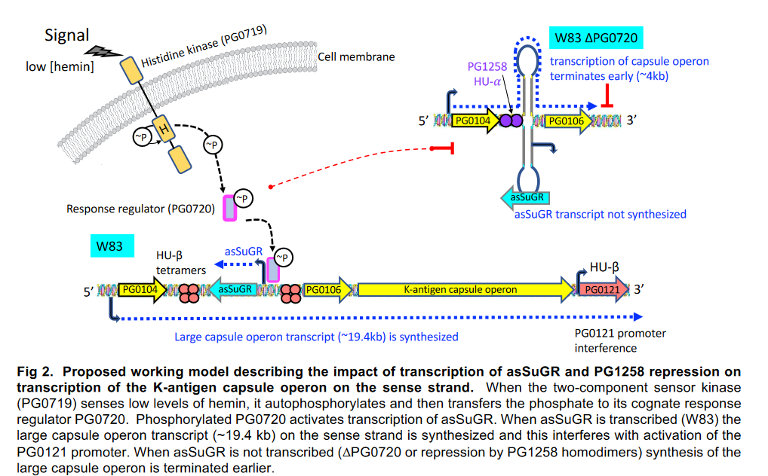
PG1258 repression on transcription interferes with k-antigen capsule operon transcription
Working model: PG0121 activates k-antigen expression by alleviating direct binding and early transcriptional termination via PG1258

Slide 15
What don’t we know?
Role of surface glycans in deregulation of host response
Does the antisense RNA encode for a signaling peptide?
What other regulator genes interact with other proteins or enzymes in capsule production?

Slide 16
What am I trying to answer?
Long term: elucidate regulatory mechanisms and environmental and nutritional parameters that control expression of genes involved in modifying surface properties of Pg
Do PG0121 and PG1258 compete for the same DNA sequences? Or do they interact with each other to bind to the same sequences?
What are the binding sites?
Does the antisense RNA impact RNA Stability?
Notes:
asSuGR is cis and trans acting molecule that controls changes in cell surface properties by coordinating expression levels of genes involved in synthesis of surface glycans and SLs and thus plays a fundamental role in modulating Pg virulence.

Slide 17
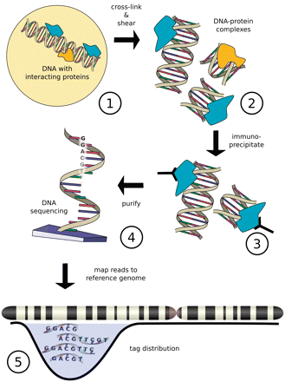
How will I answer these questions?
Chromatin immunoprecipitation sequencing (ChIP-Seq)
Grow Pg strains to early and late exponential phase
Validate top six association sites with mobility shift assays
RNA Stability Assay
https://www.eaglegenomics.com/news/what-can-chip-seq-data-tell-us
Notes:
Are they competing for the same or different sites?
Chip-Seq maps in vitro association sites of DNABII proteins encoded by PG0121 and PG1258. study interactions of these proteins with entire genome. Finds the binding sites of chromosomal locations where regulatoru proteins are found

Slide 18
Strains and Plasmids
Strains
Plasmids
W83 – wildtype, yes capsule
ΔPG0121 – no capsule
ΔPG1258 – no growth**
Hup1 – DNA binding protein
Hup2 – DNA binding protein
rpoN - σ54 RNA polymerase
rpoC – RNA polymerase
**not really a strain because nothing grows

Slide 19
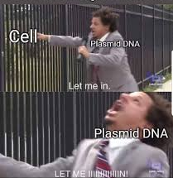
Where am I currently?
Trained at Forsyth!
Have colonies for 3 of the 4 transformations!!

Slide 20
Future Steps
Electroporation with pKR229
Conjugation
Confirmatory tests
ChIP-Seq
Mobility shift assays
RNA stability assays
Notes:
RNA polymerase as well as pg0121 and pg1258

Slide 21



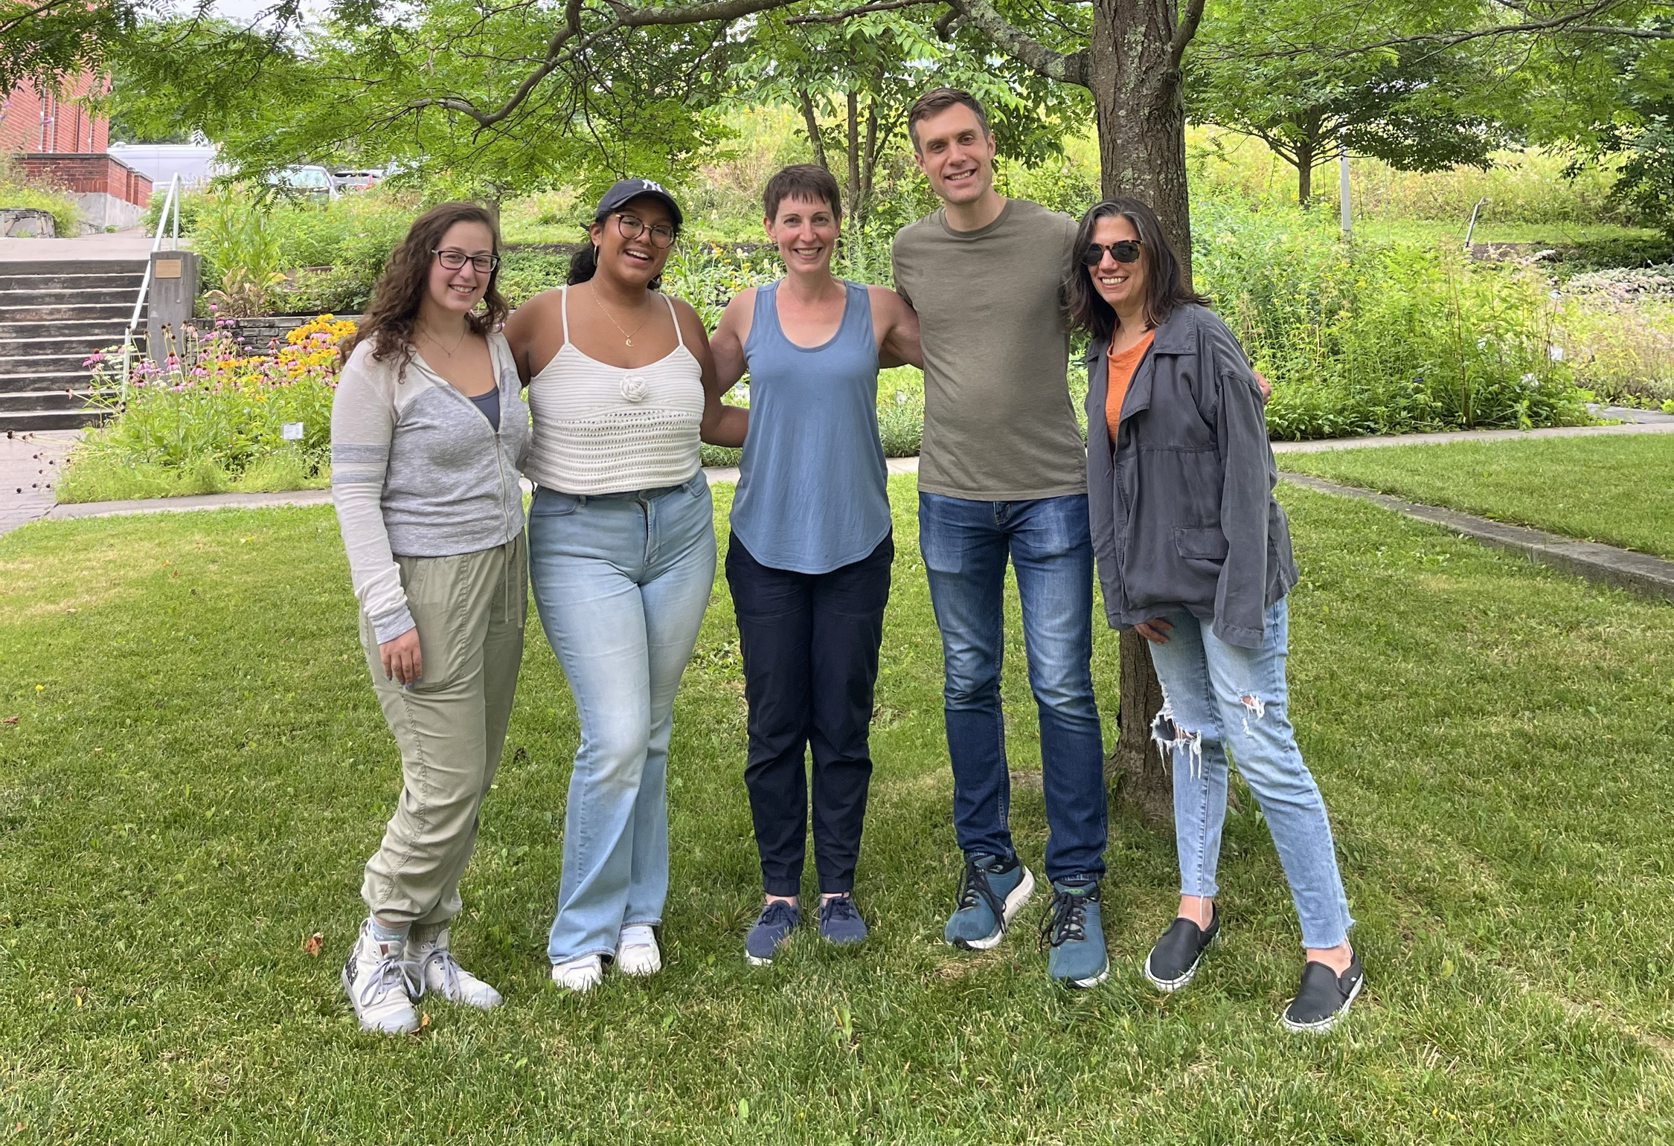



Thank You!
Dr. Kathryn Ramsey
  Kira Bernabe
  Ben Moore
  Johanyx Rodriguez
  Christina Surace
Dr. Steven Gregory
URI INBRE core
Forsyth Institute
Dr. Mary Ellen Davey
Davey Lab
Remember to brush your teeth!!!
Notes:
I want to thank everyone in the Ramsey lab for their support especially Kathryn. We have fantastic collaborators at URI and Duke whom I want to thank, and then our funding sources, and I will happily take any questions.
Notes:
Motility and biofilm – bacillus subtilis
Acid stress resistance – listeria monocytogenes
Antibiotic resistance – staph aureus
Virulence – burkholderia pseudomallei and francisella in this work
Phage paper – Mizuno et al. 2019, Chen 2022
Bacteriodetes – Jha et al 2020 – probably autoregulating its own expression because rpsU is one of the few genes with a strong SD

