Slide 1
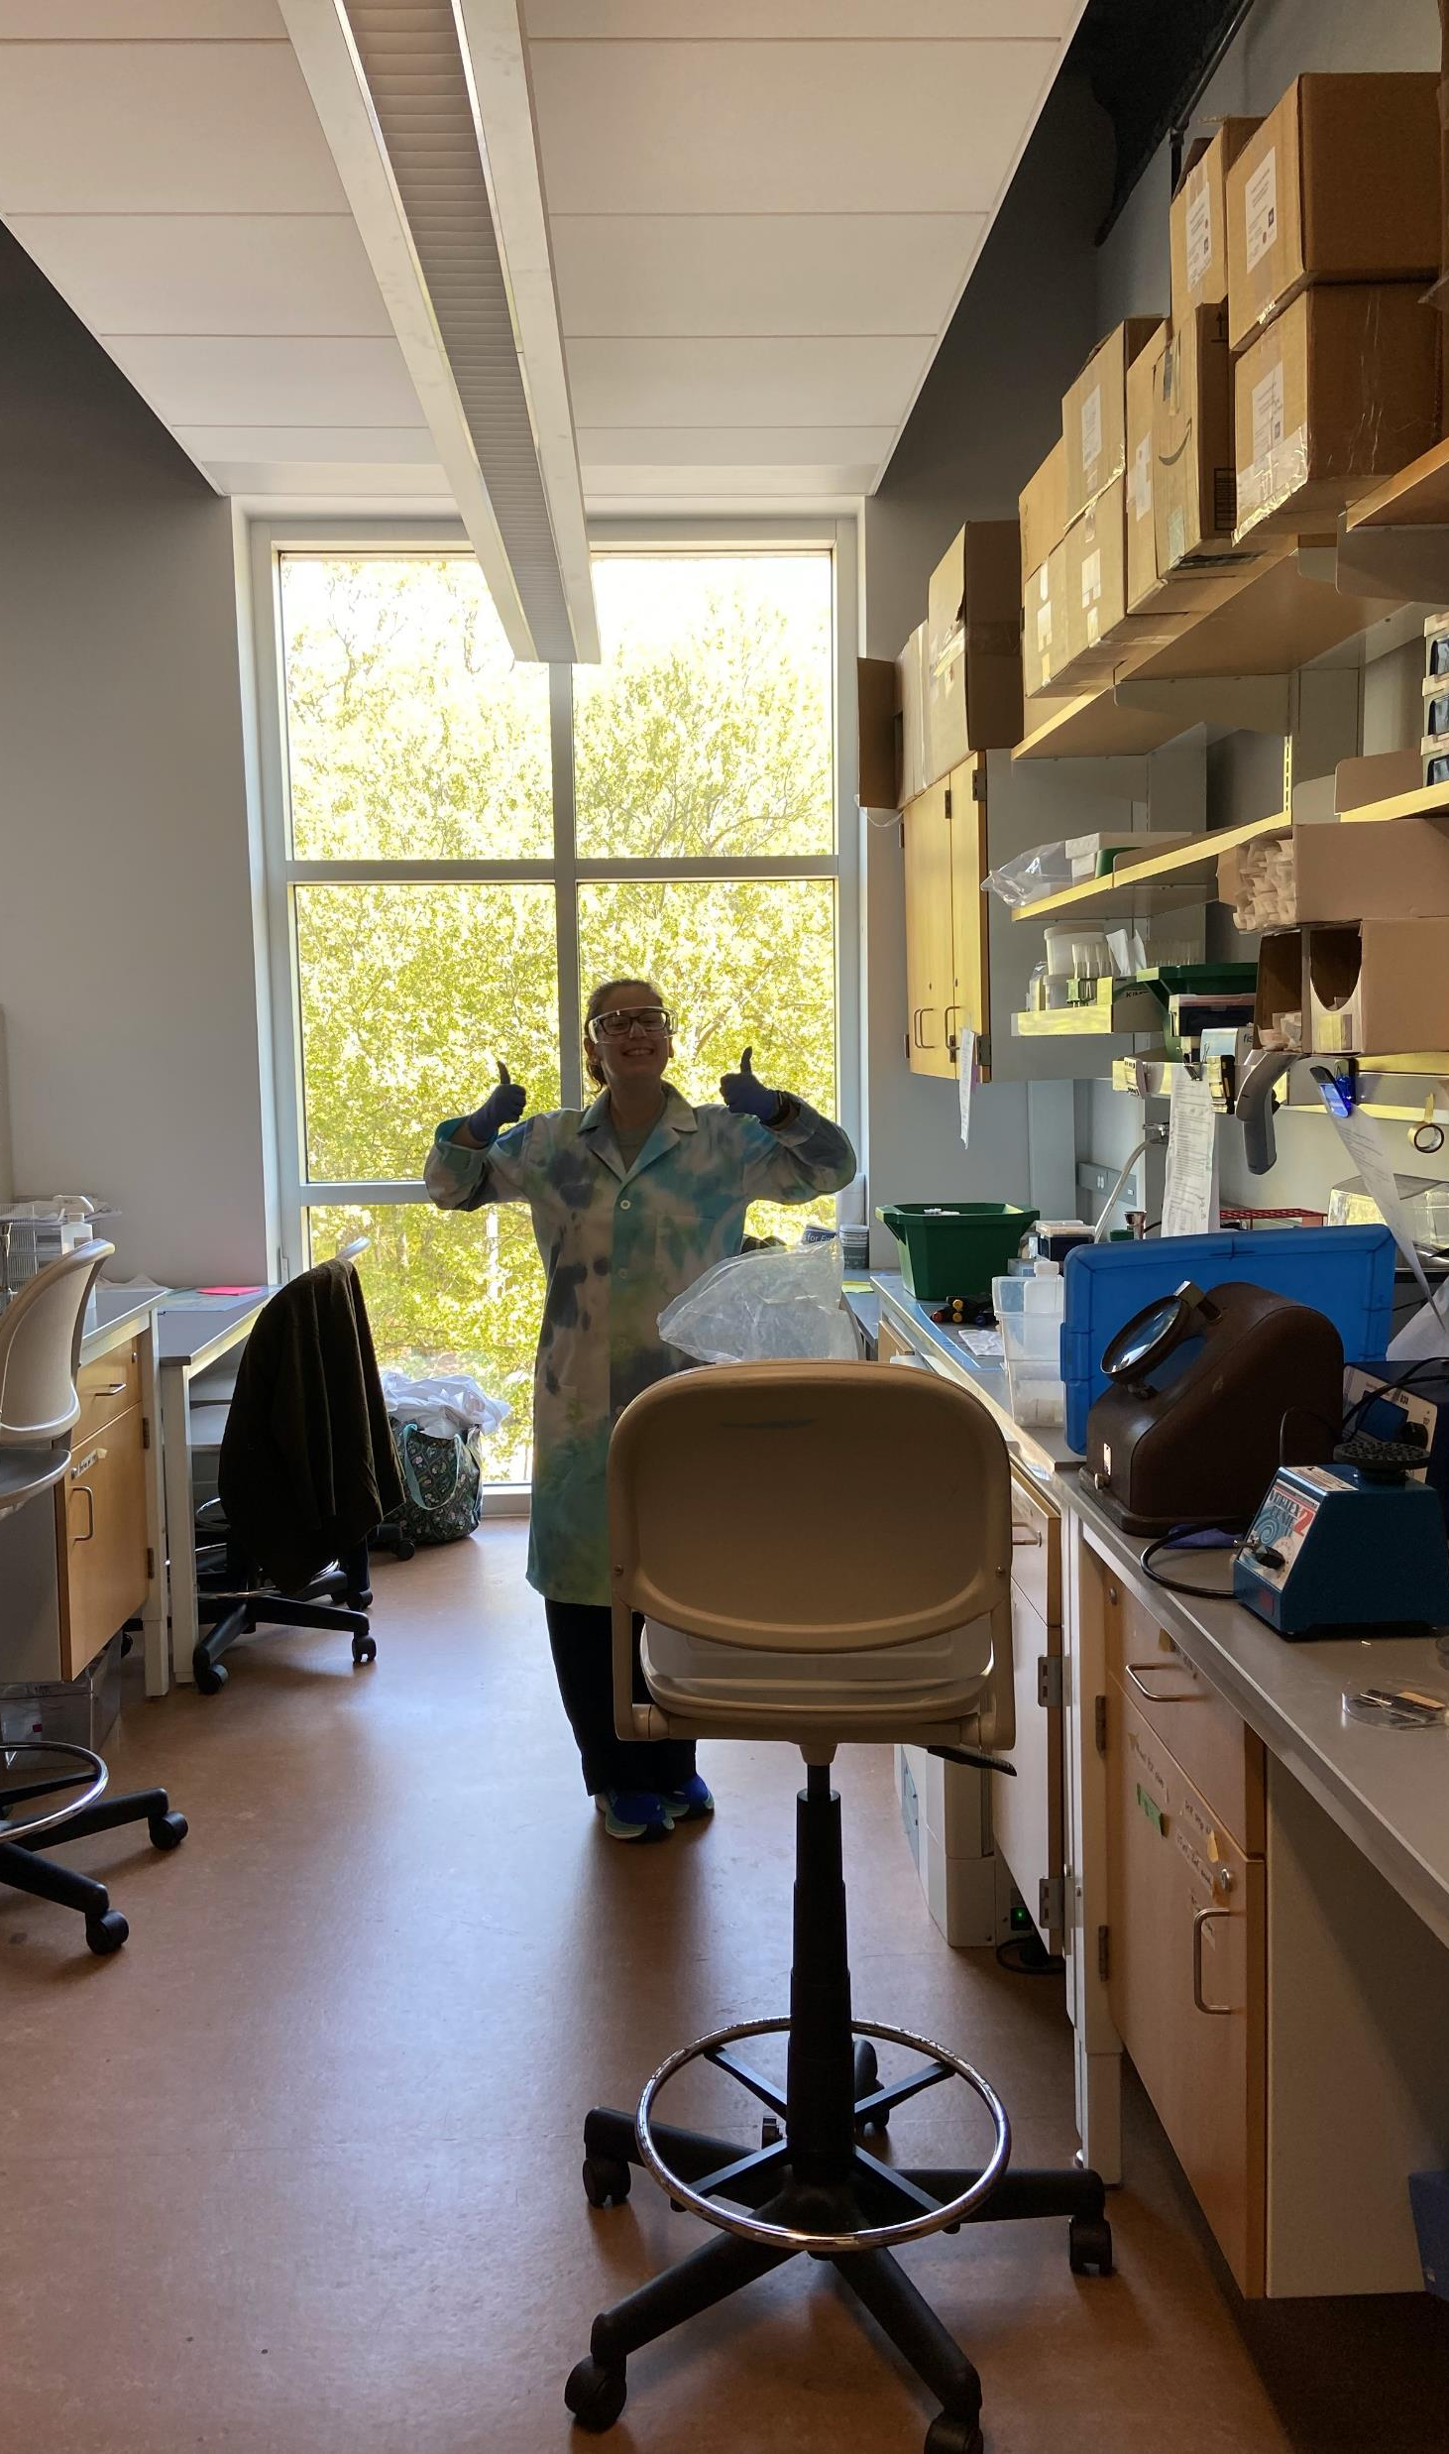
Studying how bS21 controls its own production
Alex Farah
KRamsey Lab
Joint Lab Meeting
June 20, 2024

Slide 2
Outline
Background
Francisella tularensis
bS21 and its homologs
R-proteins and autoregulation
Methods
RNA extraction
qRT-PCR
Stability Assay
Results
More transcript without bS21-2
Less bS21-2 means more stable mRNA
Future Directions
Does bS21-2 directly interact with its own transcript?

Slide 3
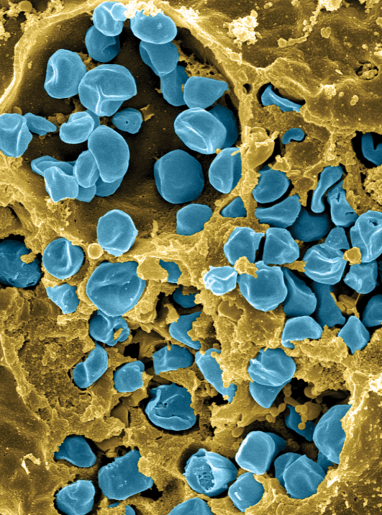
Francisella tularensis
Causes tularemia
Highly infectious
Potential bioweapon
Intracellular growth is essential to cause disease
F. tularensis subsp. holarctica LVS
Fischer, PNAS cover 2006

Slide 4

bS21 is found on the ribosome
50S
bS21
30S

Slide 5
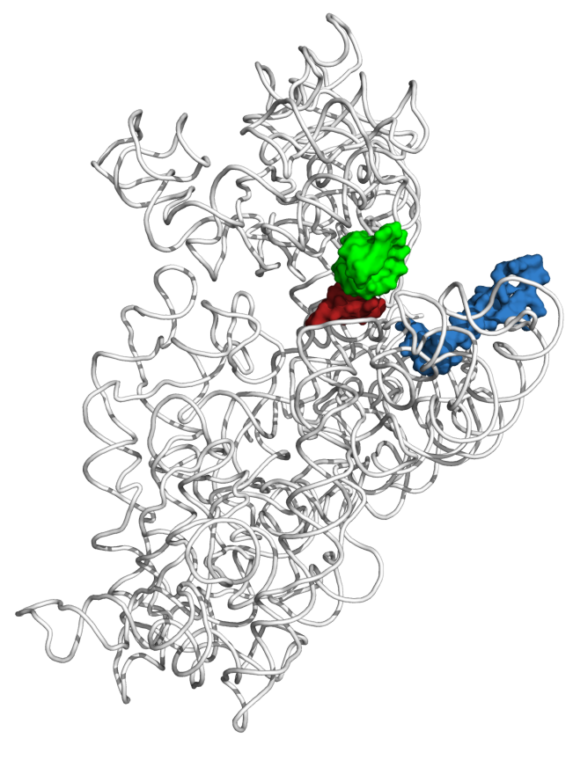
bS21s role in the ribosome
mRNA channel
30S subunit
Last protein to join during ribosome assembly
Non-essential
Thought to be a regulator of translation
How is expression of bS21 controlled?
P-site tRNA ASL
mRNA (P-site codon)
bS21
Dr. Steven Gregory
Notes:
Pic from steve add PDB number

Slide 6
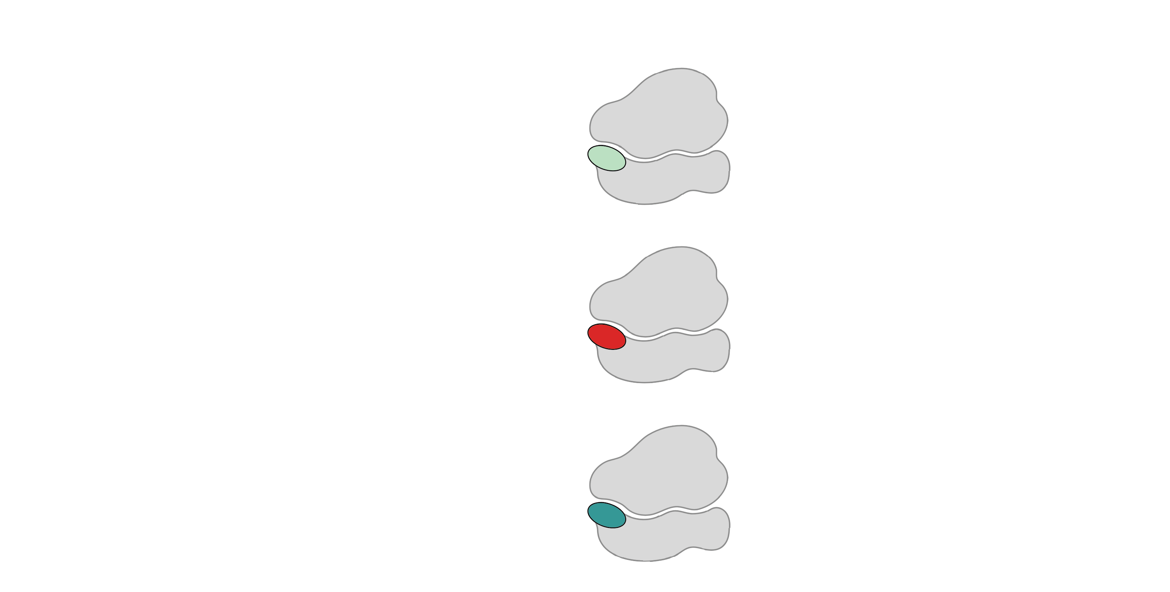
Multiple bS21 homologs means heterogeneous ribosomes
70S containing:
cspC
rpsU1
bS21-1
dnaG
bS21-2
rpsU2
yqeY
rpoD
rpsU3
bS21-3
Trautmann and Ramsey, 2022
How is ribosome composition regulated?
Notes:
Even though francisella has a reduced genome, it encodes three copies of the rpsU genes, which encode bS21, a protein in the small ribosomal subunit. Most bacteria have 0 or 1 of this gene. We originally, hypothesized, and have since shown, that these three proteins are produced and incorporated into ribosomes
This protein is also interesting to us because it is located close to the mRNA exit channel in the ribosome, and early research has identified that it is involved in translation initiation, so it is in an ideal location to be regulating gene expression at the level of translation initiation.
So this heterogeneity of ribosomes may be a mechanism of regulation,.

Slide 7
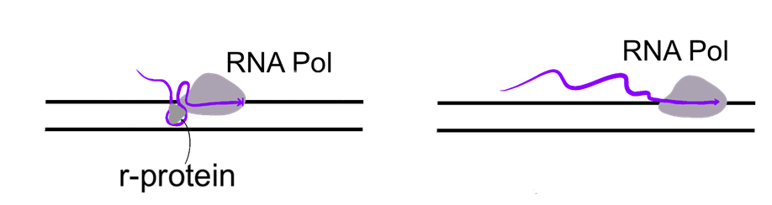
Some r-proteins Autoregulate
With excess r-protein
Without excess r-protein
Attenuation
r-protein interacts with secondary structures as transcription occurs
Stalls the RNA polymerase
No translation no protein made
Yes translation yes protein made
Notes:
Translation is very highly regulated because of how energetically costly it is to the cell. Therefore, if there is too much r-protein it can bind to itself to turn off translation.

Slide 8
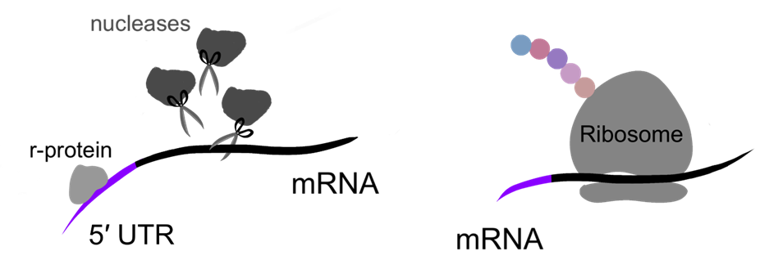
Some r-proteins Autoregulate
With excess r-protein
Without excess r-protein
Post-Transcriptional Control
Regulating r-protein may recruit nucleases and degrade transcript
Translation is unable to proceed
No translation no protein made
Yes translation yes protein made
Notes:
Translation is very highly regulated because of how energetically costly it is to the cell. Therefore, if there is too much r-protein it can bind to itself to turn off translation.

Slide 9
Some r-proteins Autoregulate
Depends on new transcription
Depends on previous transcription
With excess r-protein
Without excess r-protein
Notes:
Translation is very highly regulated because of how energetically costly it is to the cell. Therefore, if there is too much r-protein it can bind to itself to turn off translation.

Slide 10
bS21 – 2 is autogenously regulated
Evidence that its autogenously regulated
Notes:
Looking at the rpsU2 operons transcript
1 and 3 also controls expression of bs21-2
Other experiments show that this is in part of the 5’ UTR region

Slide 11
Questions
Can I replicate the RNA-Seq results with qRT-PCR?
Does bS21-2 alter mRNA stability?

Slide 12
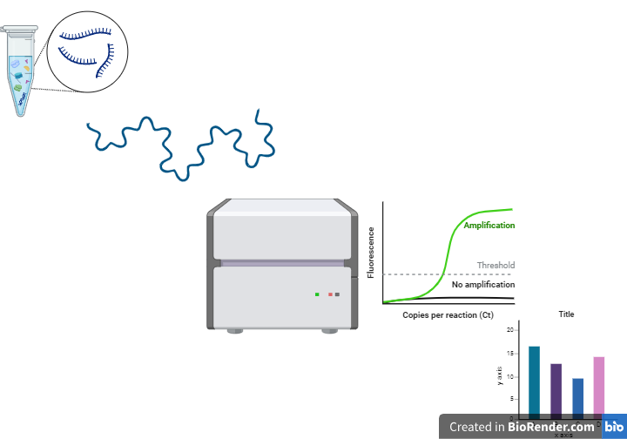
Methods
RNA Extraction
cDNA generation
qRT - PCR
Analysis

Slide 13
Methods
RNA Extraction
cDNA generation
qRT - PCR
Analysis

Slide 14
Methods
RNA Extraction
cDNA generation
qRT - PCR
Analysis

Slide 15
Methods
RNA Extraction
cDNA generation
qRT - PCR
Analysis

Slide 16
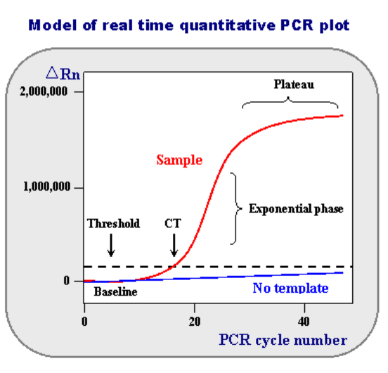
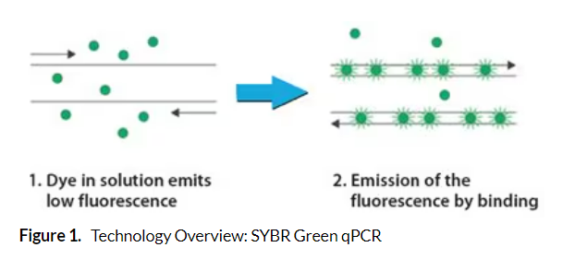
How qRT-PCR works
Quantitative Real Time Polymerase Chain Reaction
Shows the replication of strands in real time
Quantify how much DNA is in a sample
With every cycle, you double the amount of product
https://www.sigmaaldrich.com/US/en/technical-documents/protocol/genomics/qpcr/sybr-green-qpcr
https://www.ncbi.nlm.nih.gov/probe/docs/techqpcr/#:~:text=(Real%2DTime%20Quantitative%20Reverse%20Transcription,each%20cycle%20of%20PCR%20process.
Notes:
With every cycle, we double the product

Slide 17
More transcript is made without rpsU2
With the deletion of rpsU2, more transcript is made

Slide 18
Summary of qRT-PCR
More transcript with deletion of rpsU2!

Slide 19

New Question
What leads to more transcript abundance? More transcription? Or less degradation?

Slide 20
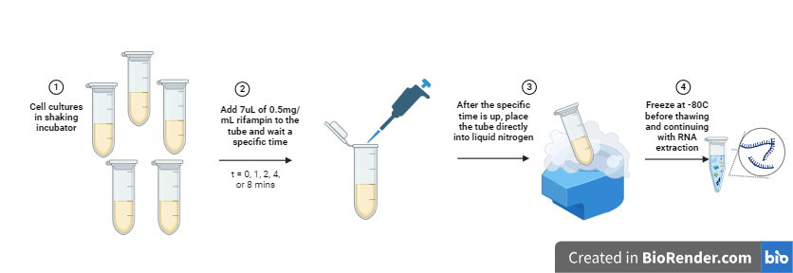
Stability Assay
Stop the transcription of mRNA by adding rifampin
Halts transcription at initiation by halting RNA polymerase
No more transcript made
Shows the stability of the mRNA transcript already made

Slide 21
Primers amplify downstream of rpsU2
Notes:
Looking at the rpsU2 operons transcript
1 and 3 also controls expression of bs21-2
Oter experuments show that this is in part of the 5’ UTR region

Slide 22
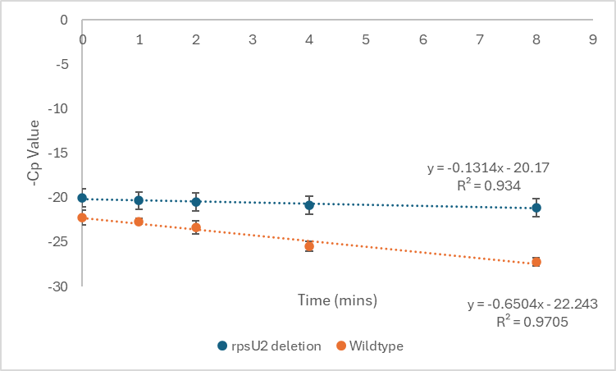
ΔrpsU2 strain has more stable transcript
ΔrpsU2

Slide 23
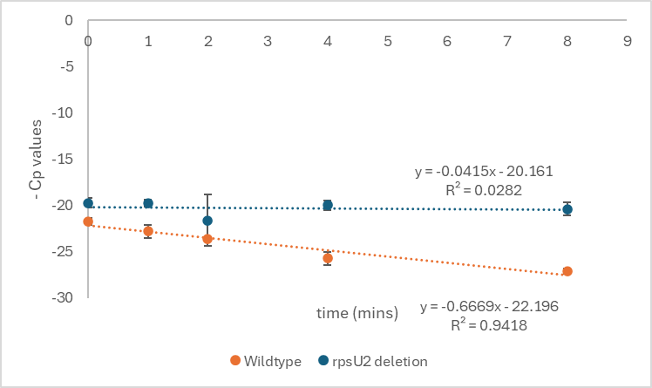
ΔrpsU2 strain has more stable transcript
ΔrpsU2

Slide 24
Summary of Stability Assay
Strain without bS21-2 has more stable mRNA
Strain with bS21-2 has less stable mRNA

Slide 25
Future Directions
How does bS21-2 exert its regulation?
Does bS21-2 directly interact with its own transcript?
Does that interaction lead to degradation?

Slide 26

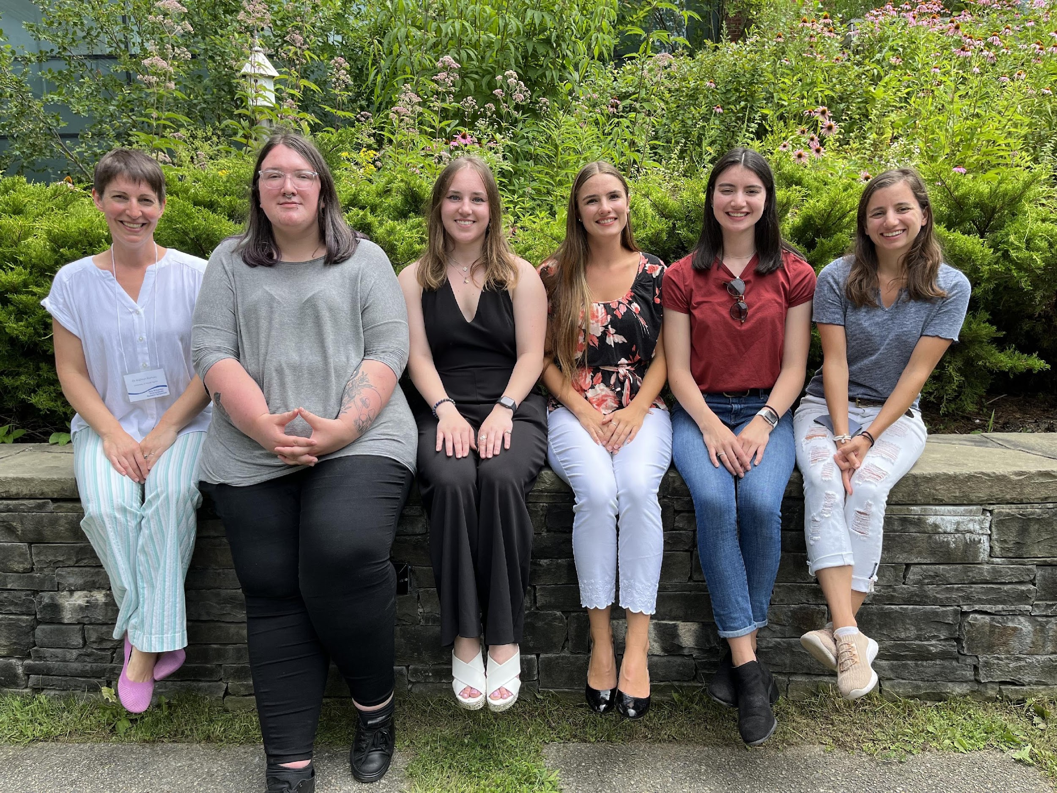





Thank You!
Dr. Kathryn Ramsey
  Kira Bernabe
  Ben Moore
  Sierra Schmidt
  Hannah Trautmann
  Aisling Macaraeg
  Dan Floyd
  Dan Ruggerio
  Johanyx Rodriguez
  Christina Surace
  Former lab members
Dr. Steven Gregory
URI INBRE core
Notes:
I want to thank everyone in the Ramsey lab for their support especially Kathryn. We have fantastic collaborators at URI and Duke whom I want to thank, and then our funding sources, and I will happily take any questions.
Notes:
Motility and biofilm – bacillus subtilis
Acid stress resistance – listeria monocytogenes
Antibiotic resistance – staph aureus
Virulence – burkholderia pseudomallei and francisella in this work
Phage paper – Mizuno et al. 2019, Chen 2022
Bacteriodetes – Jha et al 2020 – probably autoregulating its own expression because rpsU is one of the few genes with a strong SD

Slide 27
Leader sequence controls rpsU2 transcript abundance
bS21 homologs repress rpsU2 transcript abundance
  Mediated by rpsU2 5ʹ UTR
Translation of rpsU2 5ʹ UTR is influenced by unidentified factor(s)
If just UTR is sufficient, then this suggests stability is important
Notes:
After I reintroduce transcript, be like we can use b gals to look at protein and woo
after protein talk about stem loop structures, we didn’t know what it would affect if it would affect transcription or maybe translation so we looked into it and structure is bullshit

