Slide 1
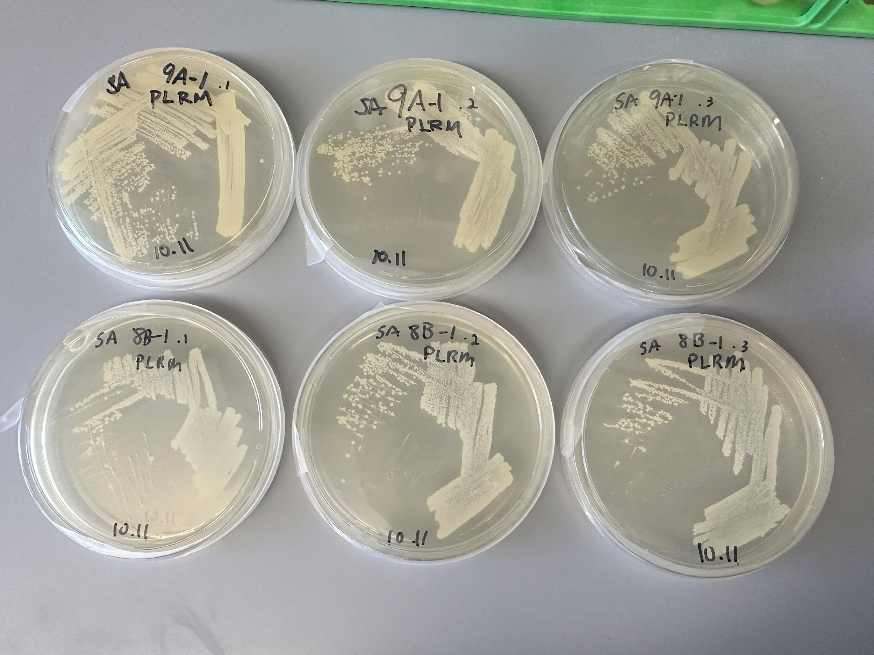
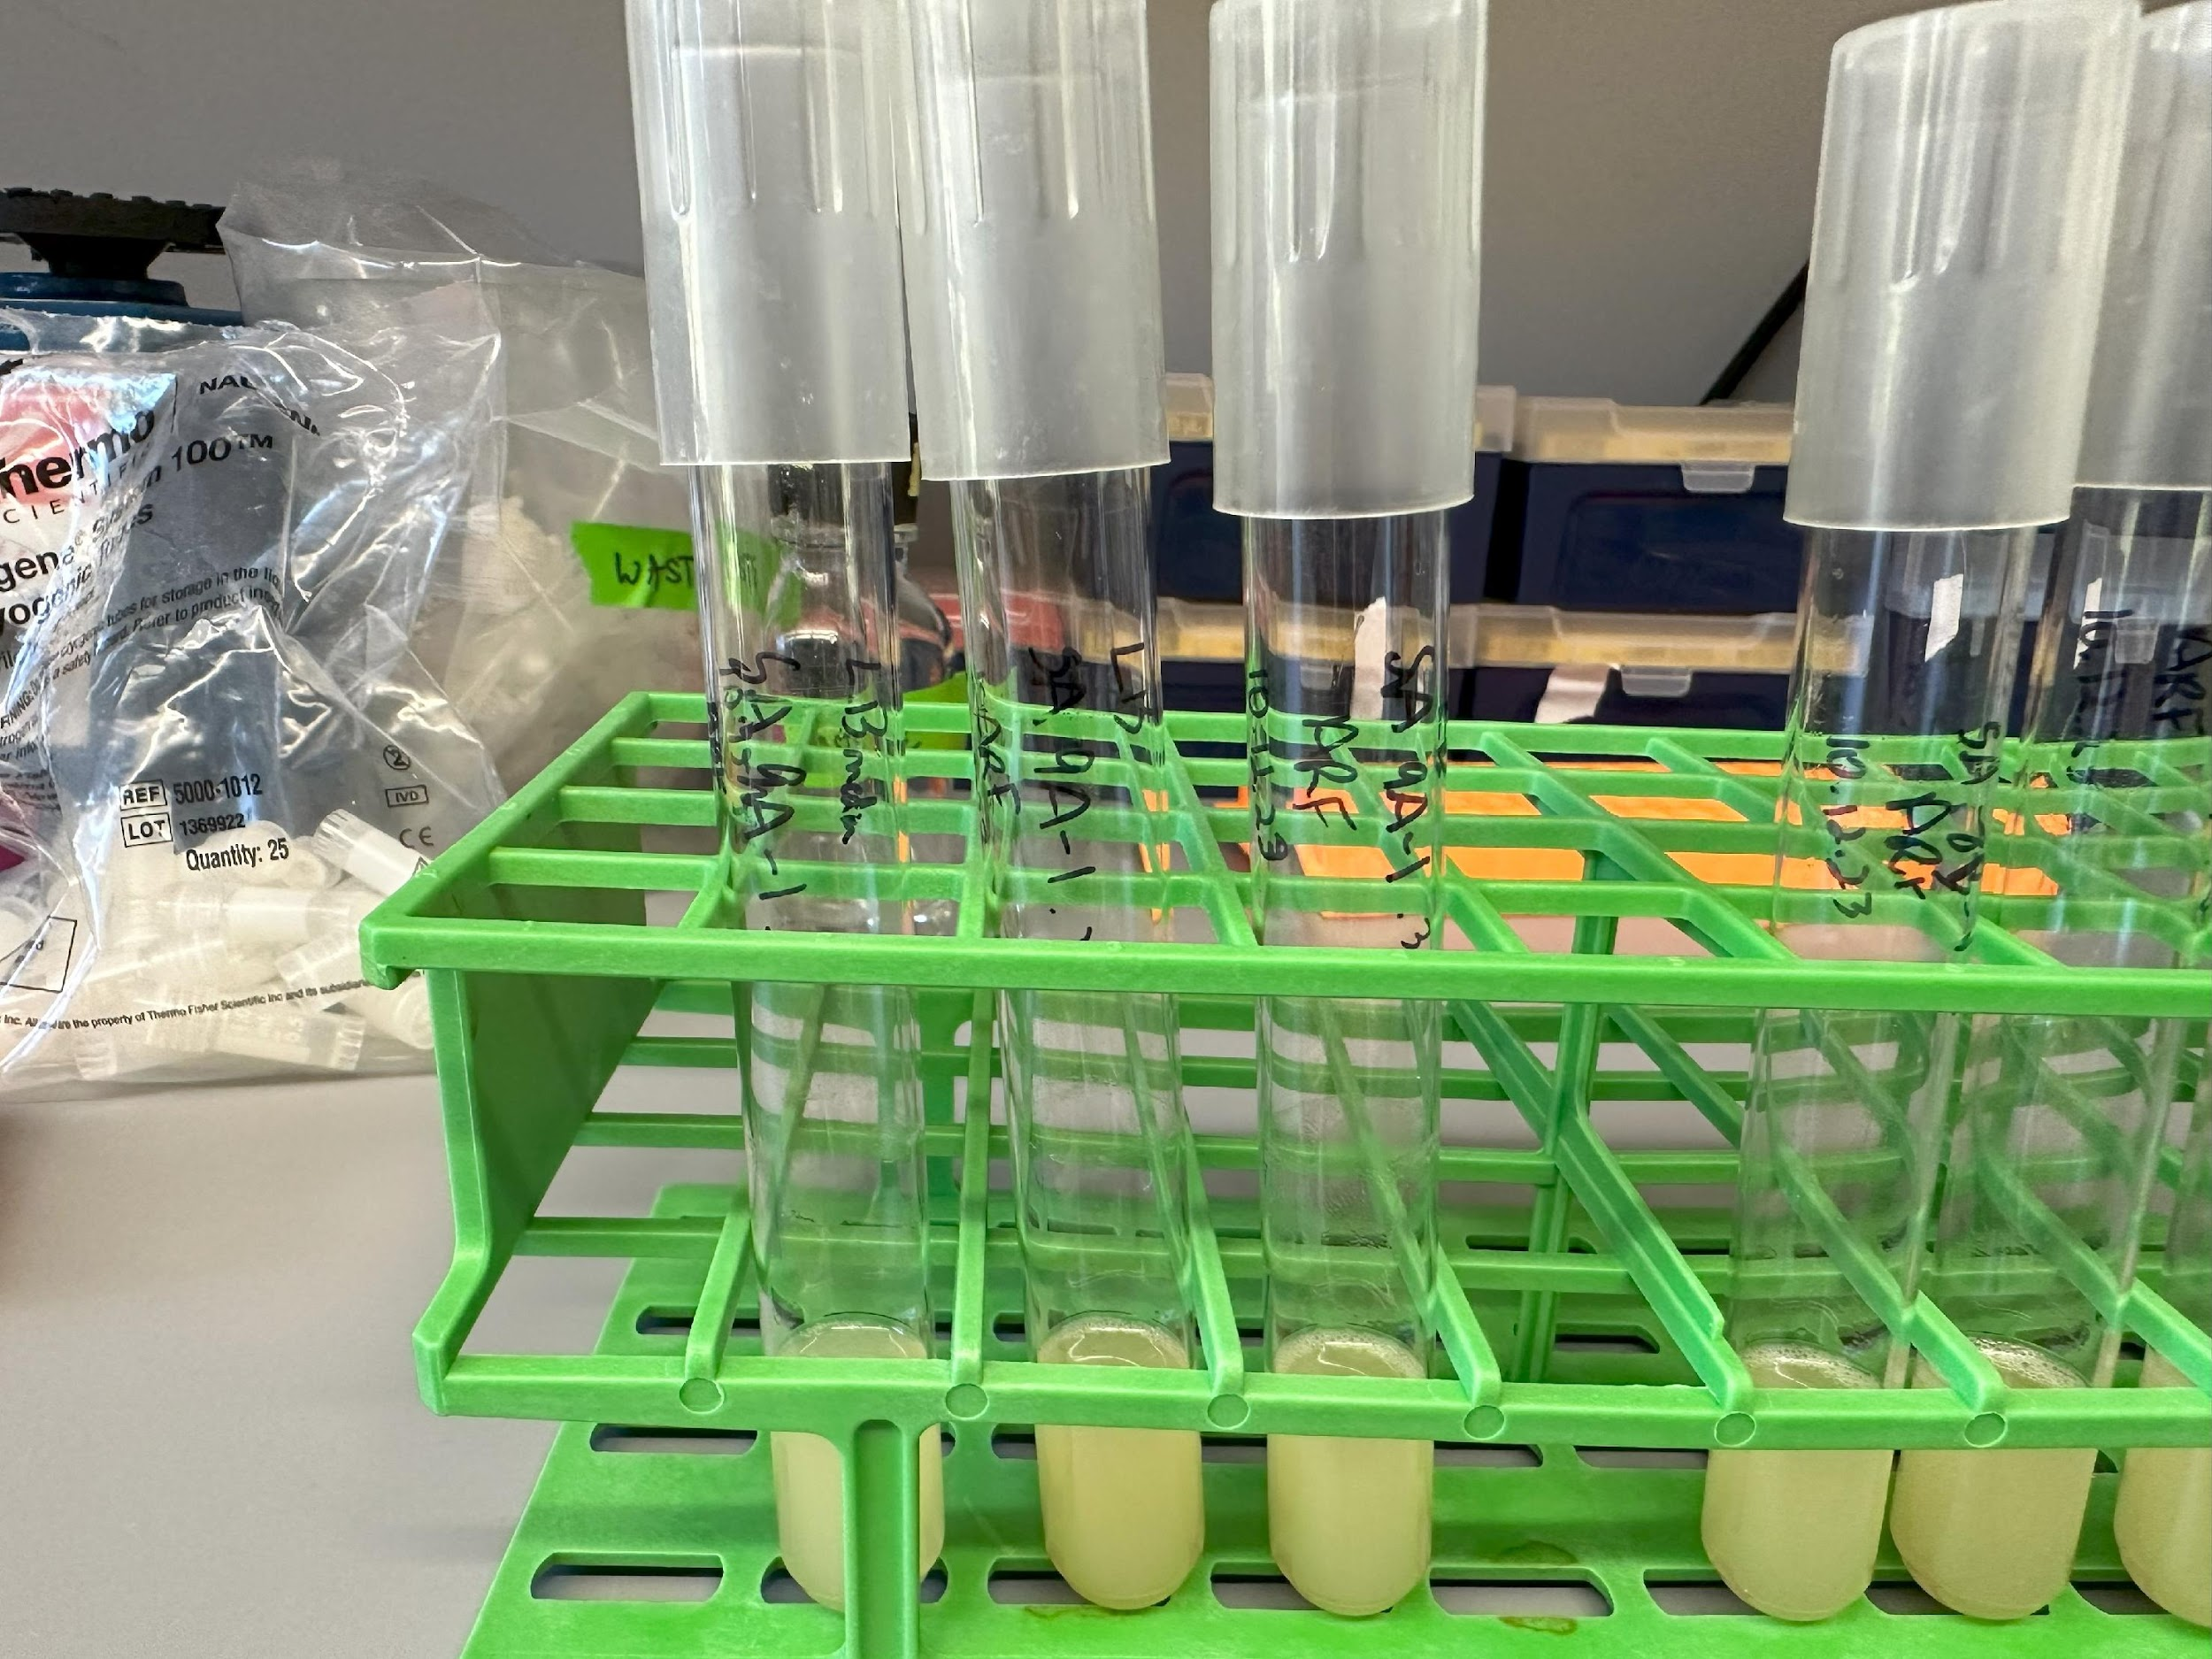
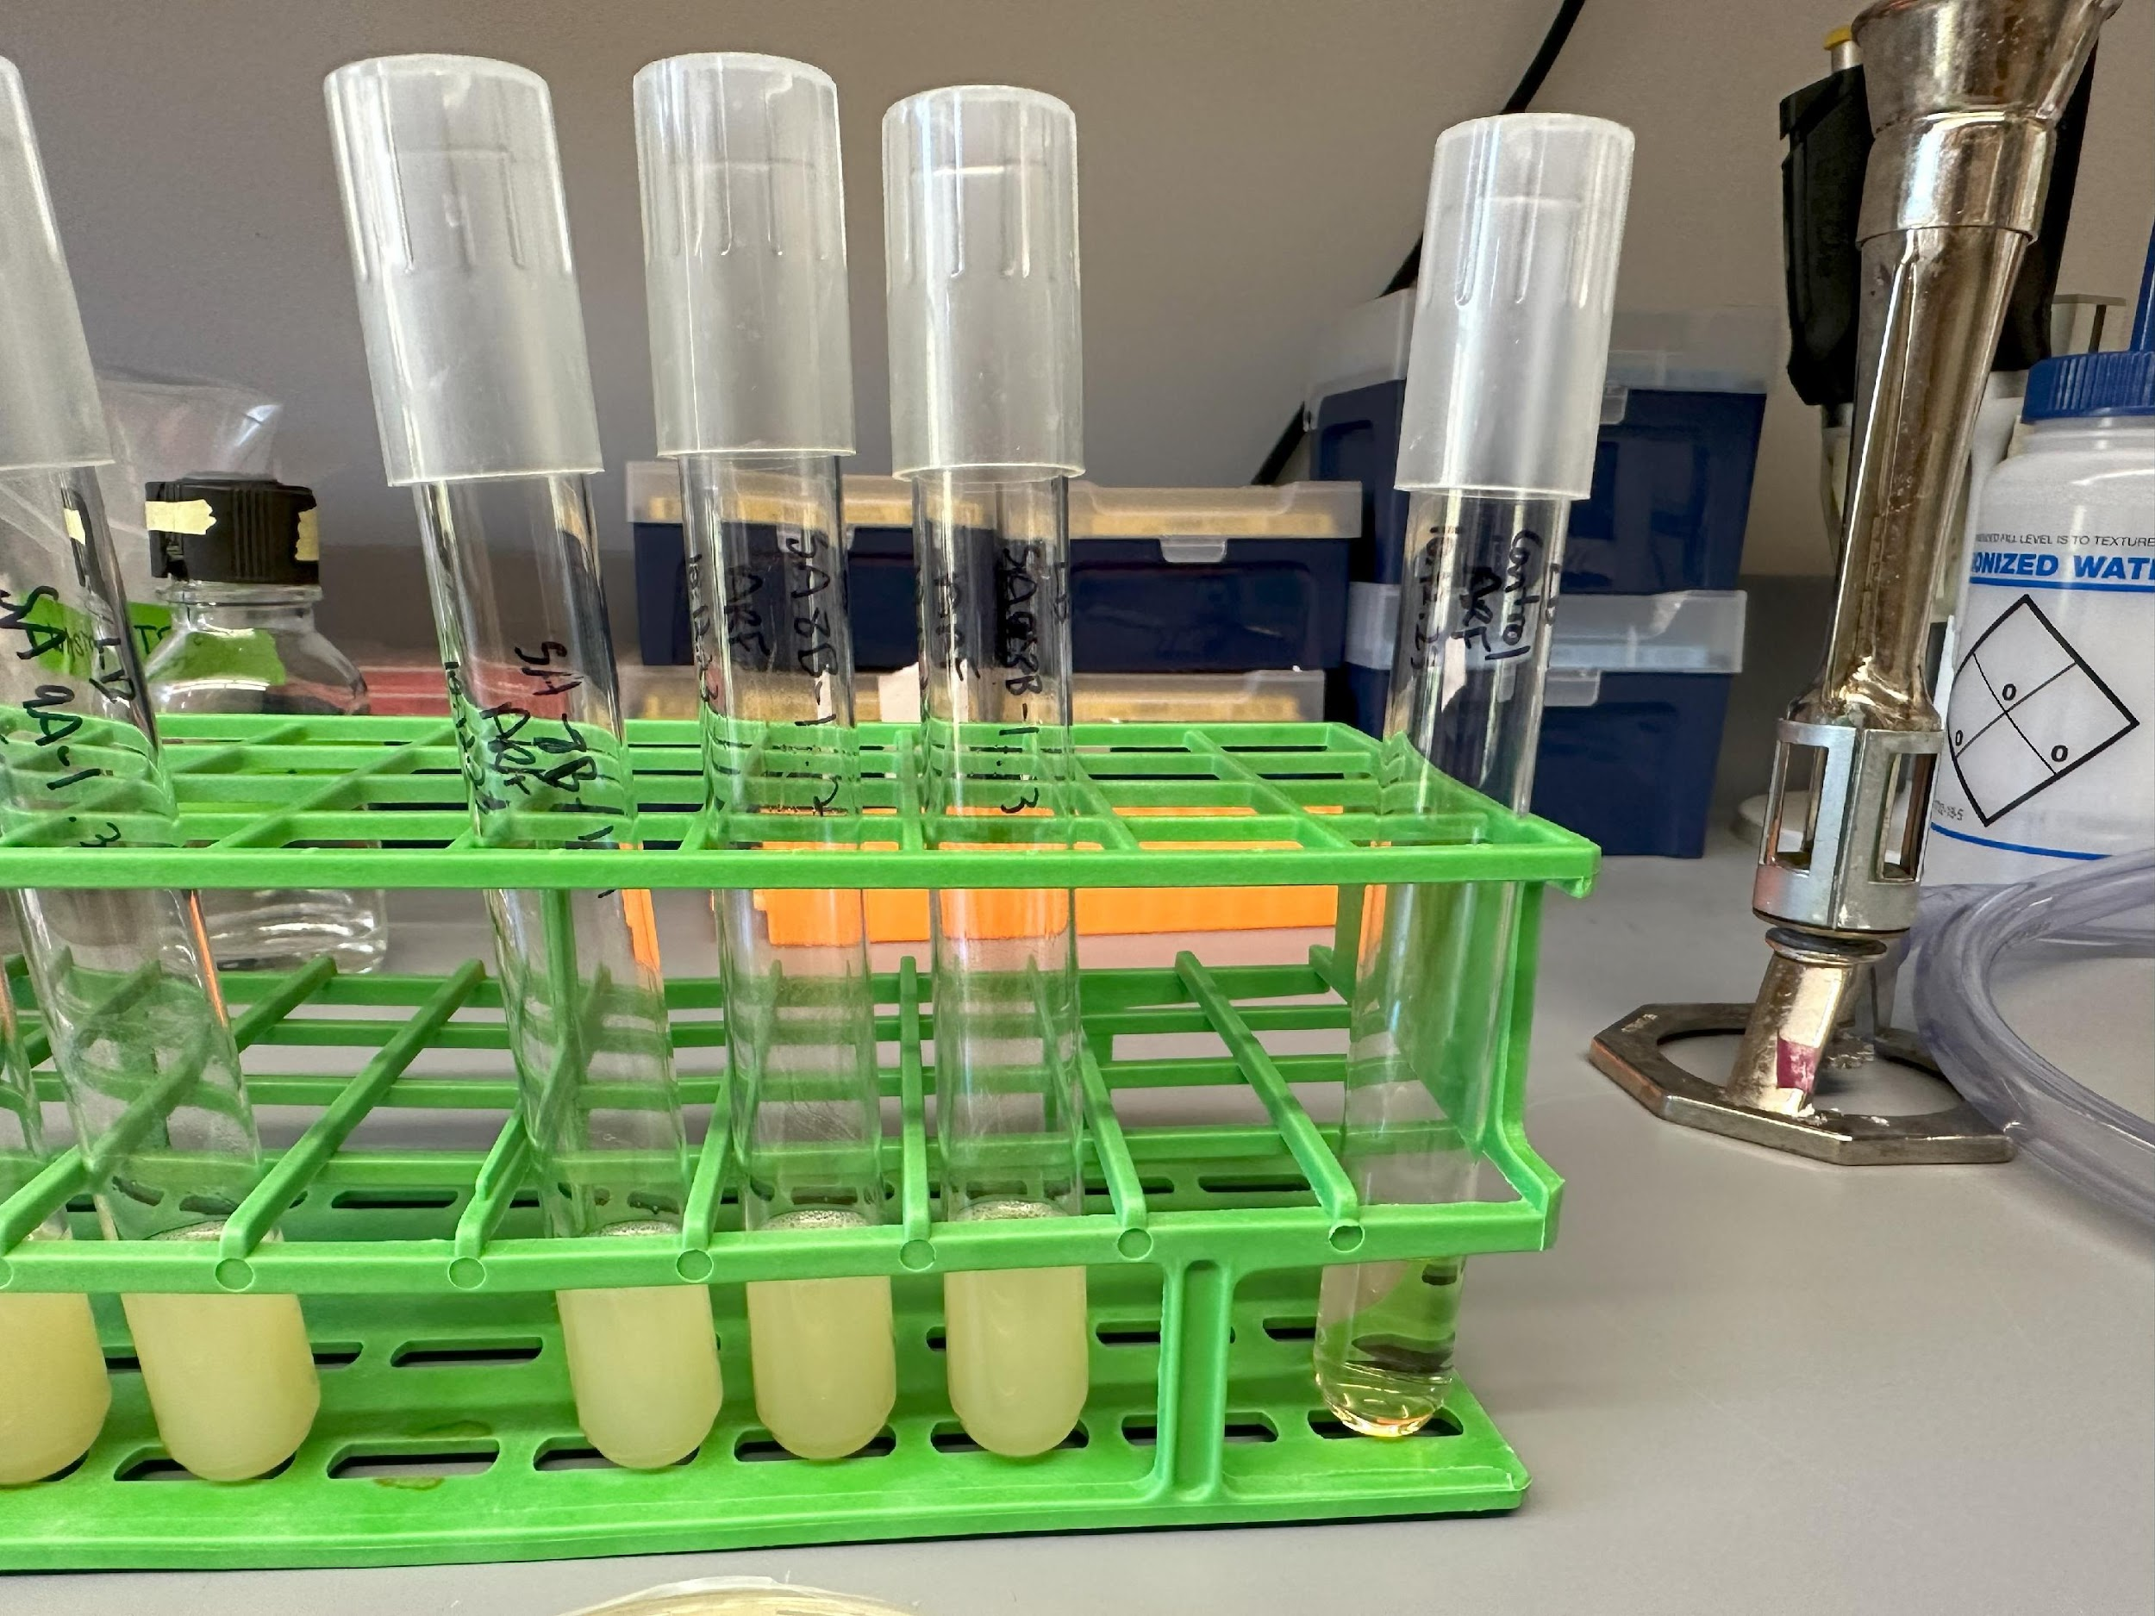
Lab Meeting 10.16.23
Streaked potentially resistant colonies for isolation
Picked individual colonies and inoculated LB cultures
Made glycerol stocks
This week: resistant disk experiments (if enough drug)

Slide 2
Lab Meeting 10.23.16
Disk diffusion assays on potentially resistant S. aureus strains
Laurenobilide drug used
Results: KRSA 9 looks to be resistant, KRSA 8 does not
Future tests: genetic testing on KRSA 9A (PCR, WGS)

Slide 3
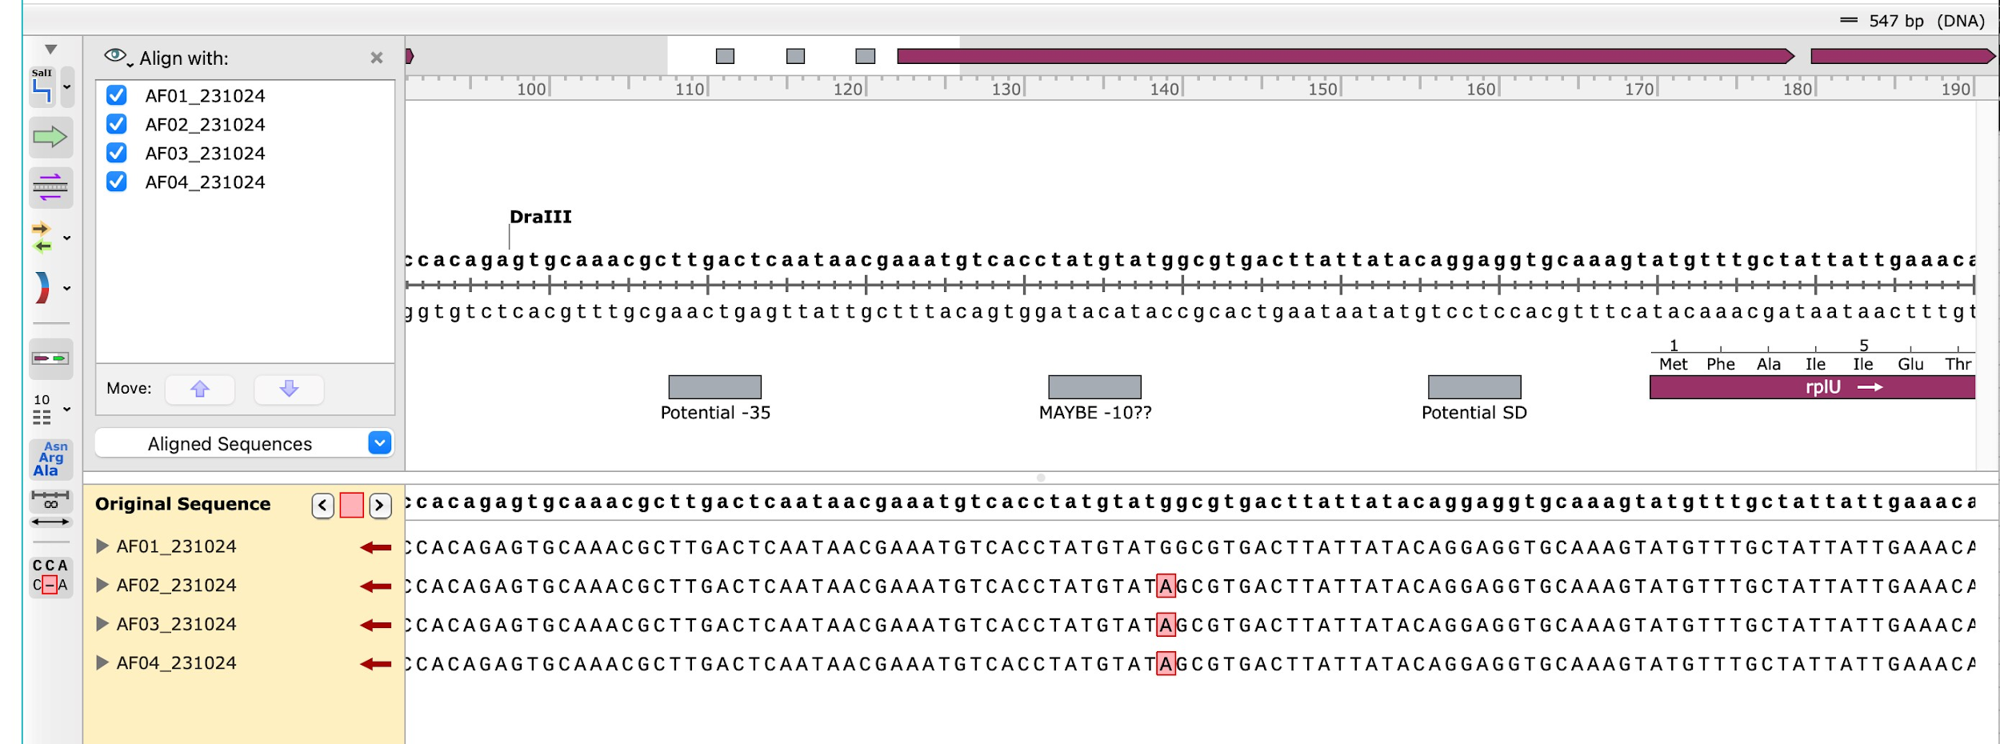
Lab Meeting 10.30.23
Sanger sequencing on resistant mutants
Mutation in regulatory region upstream of rplU
Future tests: WGS

Slide 4
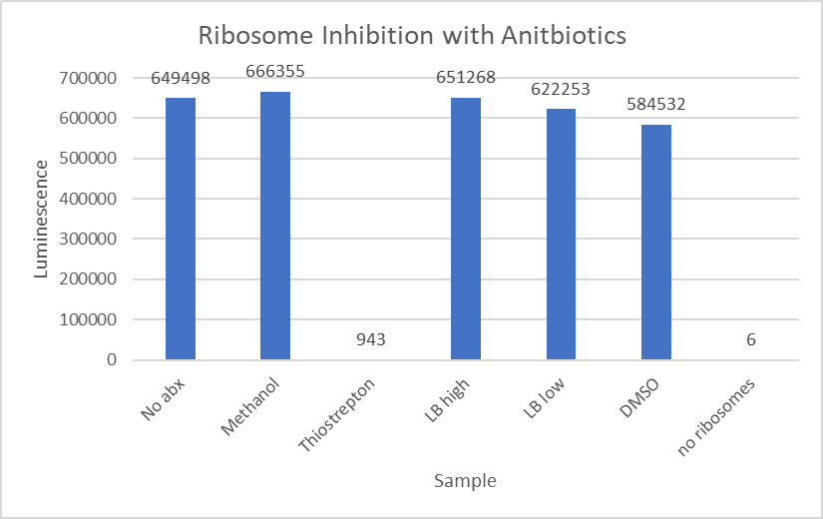
Lab Meeting 10.30.23
Ribosome Inhibition Assay
Used E.coli ribosomes
Results: this assay can be used to show inhibition of ribosomes due to antibiotics
Laurenobiolide doesn’t inhibit E.coli ribosome function at 46uM
Try again using higher concentration of Laurenobiolide

Slide 5
Lab Meeting 1.25.24
Nanodrop Results (all nucleic acids stage)
# | Sample ID | Nucleic Acid | Unit | 260/280 | 260/230
1 | LVS pF A | 862.4 | ng/µl | 1.91 | 1.08
2 | LVS pF B | 742.1 | ng/µl | 1.79 | 0.86
3 | LVS Δ rpsU2 pF A | 423.6 | ng/µl | 1.49 | 0.81
4 | LVS Δ rpsU2 pF C | 543.7 | ng/µl | 1.74 | 0.74
5 | LVS ΔrpsU2 pF - rpsU2-V D | 850.5 | ng/µl | 1.71 | 0.74
6 | LVS ΔrpsU2 pF - rpsU2-V E | 777.8 | ng/µl | 1.71 | 0.72
RNA isolation!
Next week:
  Agarose Gel on samples
  redo RNA isolation – aiming for better quality especially at gelatinous pellet step
    Begin streaking colonies tomorrow
Notes:
Question
Expectation
Interpretation/Conclusion

Slide 6
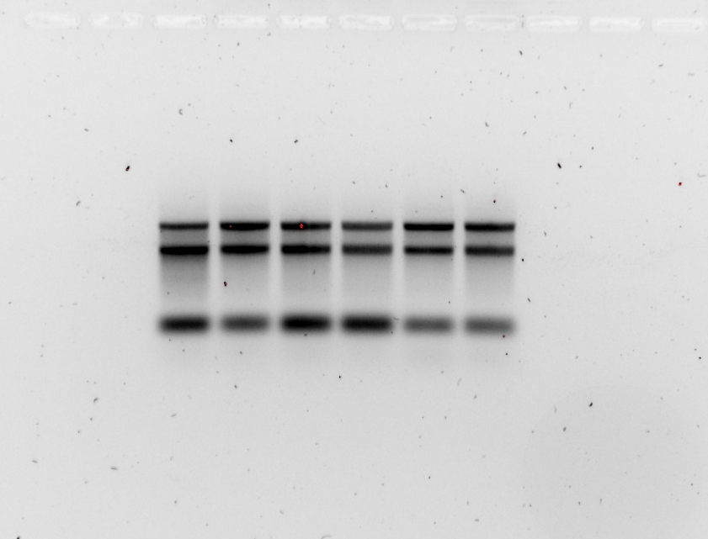
Lab Meeting 2.1.24
LVS pF
LVS ΔrpsU2 pF
LVS ΔrpsU2 pF - rpsU2 V
Question: can RNA be isolated and generated into cDNA – in good quality?
Expectation: Yes.
Interpretation/Conclusion: Not good quality yet, will repeat.
1
2
3
4
5
6
cDNA Nanodrop
# | Sample ID | Nucleic Acid | Unit | 260/280 | 260/230
1 | KRLVS 120 A | 6.8 | ng/µl | 2.28 | 0.48
2 | KRLVS 120 B | 9.5 | ng/µl | 2.13 | 0.74
3 | KRLVS 121 A | 12.5 | ng/µl | 1.87 | 0.51
4 | KRLVS 121 C | 7.7 | ng/µl | 2.12 | 0.58
5 | KRLVS 123 D | 9.3 | ng/µl | 2.02 | 0.73
6 | KRLVS 123 E | 13.5 | ng/µl | 1.93 | 0.84

Slide 7
Lab Meeting 2.8.24
# | Sample ID | Nucleic Acid | Unit | 260/280 | 260/230
1 | LVS pF A | 527.5 | ng/µl | 1.98 | 1.59
2 | LVS pF B | 480.4 | ng/µl | 1.98 | 1.54
3 | LVS Δ rpsU2 pF A | 350.4 | ng/µl | 1.93 | 1.41
4 | LVS Δ rpsU2 pF C | 294.3 | ng/µl | 1.99 | 1.51
5 | LVS ΔrpsU2 pF - rpsU2-V D | 417.2 | ng/µl | 2 | 1.62
6 | LVS ΔrpsU2 pF - rpsU2-V E | 354.5 | ng/µl | 2.01 | 1.66
Question: Did the blue dye interfere with the 260/230 value?
Expectation: Assumed yes
Interpretation/ Conclusion: Inconclusive, will be able to tell with cDNA
# | Sample ID | Nucleic Acid | Unit | A260 (Abs) | A280 (Abs) | 260/280 | 260/230
1 | LVS pF (KRLVS 120) A | 365.7 | ng/µl | 9.144 | 4.452 | 2.05 | 1.67
2 | LVS pF (KRLVS 120) E | 374.8 | ng/µl | 9.37 | 4.576 | 2.05 | 1.74
3 | LVS ΔrpsU2 pF (KRLVS 121) A | 405.6 | ng/µl | 10.139 | 4.996 | 2.03 | 1.61
4 | LVS ΔrpsU2 pF (KRLVS 121) B | 358.9 | ng/µl | 8.972 | 4.408 | 2.04 | 1.62
5 | LVS ΔrpsU2 pF - rpsU2 - V (KRLVS 123) A | 294.9 | ng/µl | 7.371 | 3.65 | 2.02 | 1.56
6 | LVS ΔrpsU2 pF - rpsU2 - V (KRLVS 123) D | 263.5 | ng/µl | 6.588 | 3.268 | 2.02 | 1.54

Slide 8
Lab Meeting 2.8.24
P. gingivalis strains came in!
Checking if they survived travel now

Slide 9
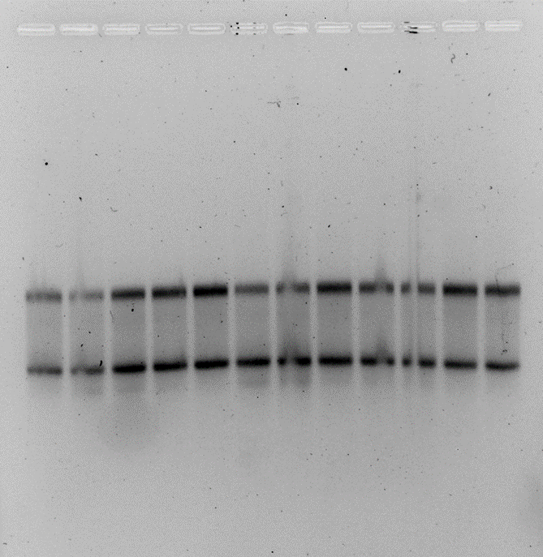
Lab Meeting 2.15.24
1
2
3
4
5
6
Older Samples
Question: Can cDNA be generated in good quality?
Expectation: Yes, it should be able too
Interpretation/Conclusion: Something is interfering with the purity of the cDNA.
Future steps: generate cDNA from RNA that’s already been converted

Slide 10
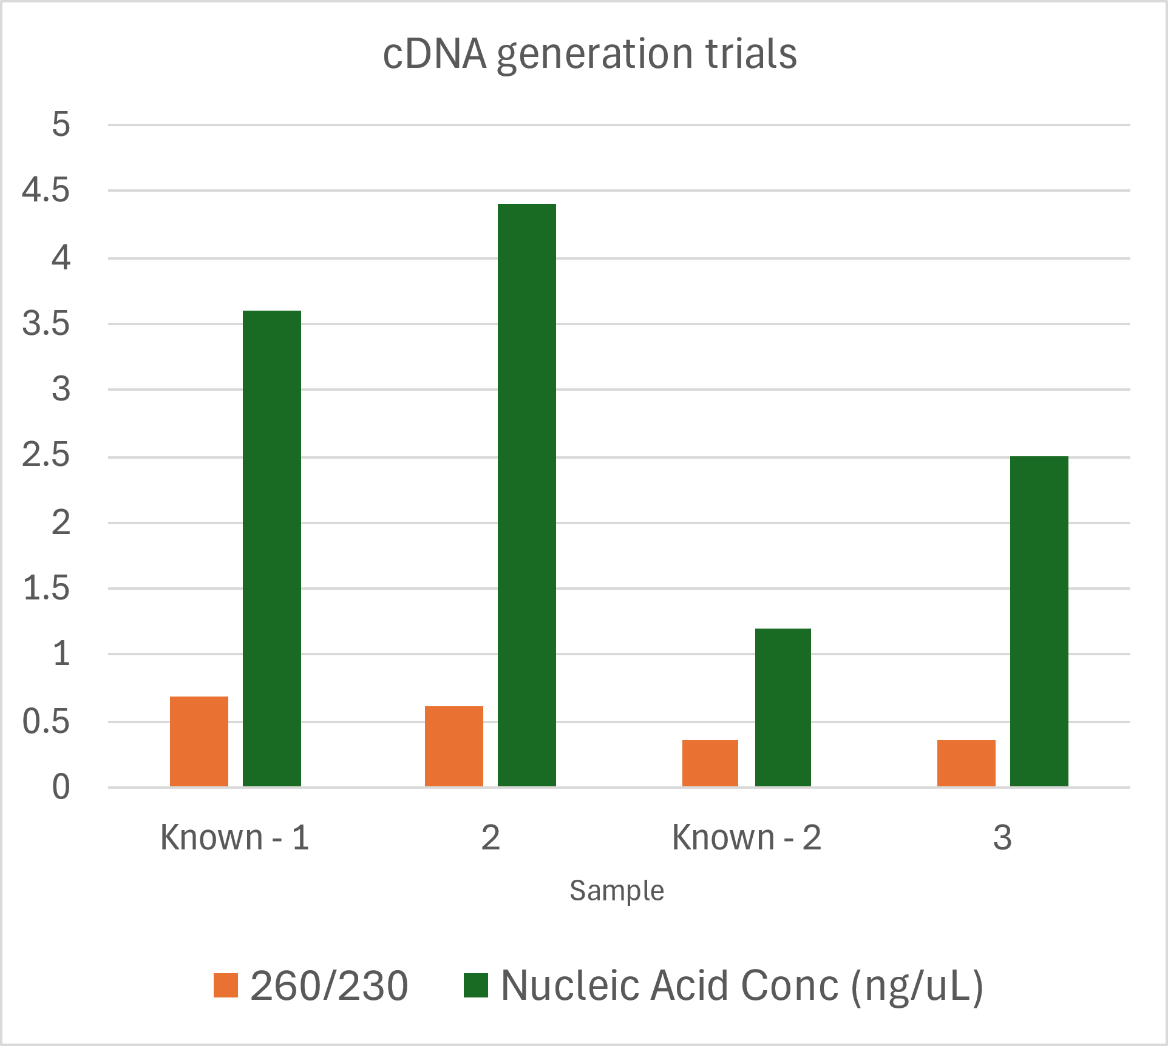
Lab Meeting 2.22.24
Question: What is happening with the cDNA generation?
Expectation: Not the procedure, probably a reagent.
Conclusion: It’s not the dNTPs, DTT, or buffer.
Introduced known sample
New Reagents
Goal 260/230 Value

Slide 11
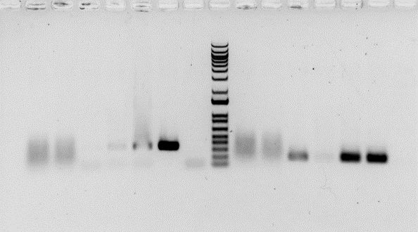
Lab Meeting 2.29.24
Question: Is there DNA that is getting carried over from RNA isolation? Is our enzyme in cDNA generation active?
Expectation: If working, no bands except in controls
Controls: Sierra’s cDNA in lane 5, LVS gDNA in lane 6, negative lane 7
Conclusion: Confusion
Known cDNA
cDNA 1B
gDNA
RNA 1B
cDNA 3
water
RNA 3
Known cDNA
RNA 1B
cDNA 1B
RNA 3
cDNA 3
gDNA
water
KROL 526/527
KROL 59/60

Slide 12
Lab Meeting 3.7.24
Question: can cDNA be generated in good quality?
Expectation: Yes.
Controls: RNA sample Δ1
Interpretation/conclusion: Finally got some ☺

Slide 13
Lab Meeting 3.18.24
Question: can I repeat the cDNA generation?
Expectation: Yes.
Interpretation: Time for the next step please

Slide 14
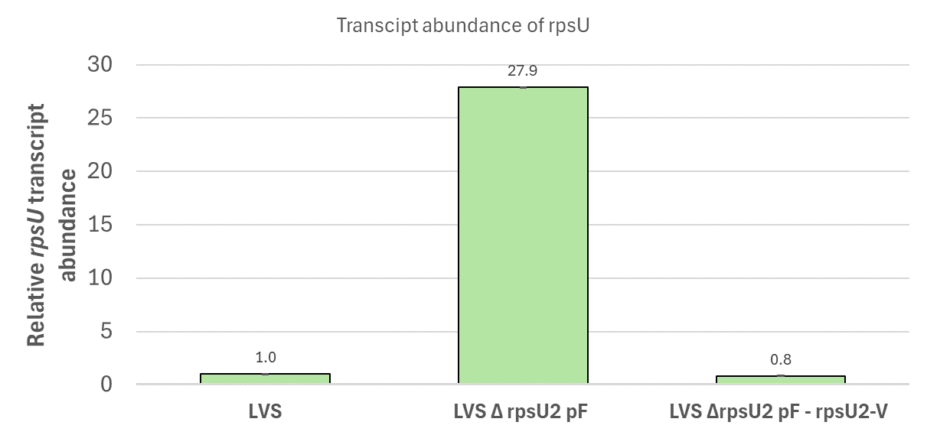
Lab Meeting 3.28.24
Question: Is there a change in transcript amount between LVS samples? Is this consistent with Sierra’s results?
Expectation: Yes, expecting LVSΔrpsU2 will have a different amount
Interpretation: LVSΔrpsU2 has more transcript

Slide 15
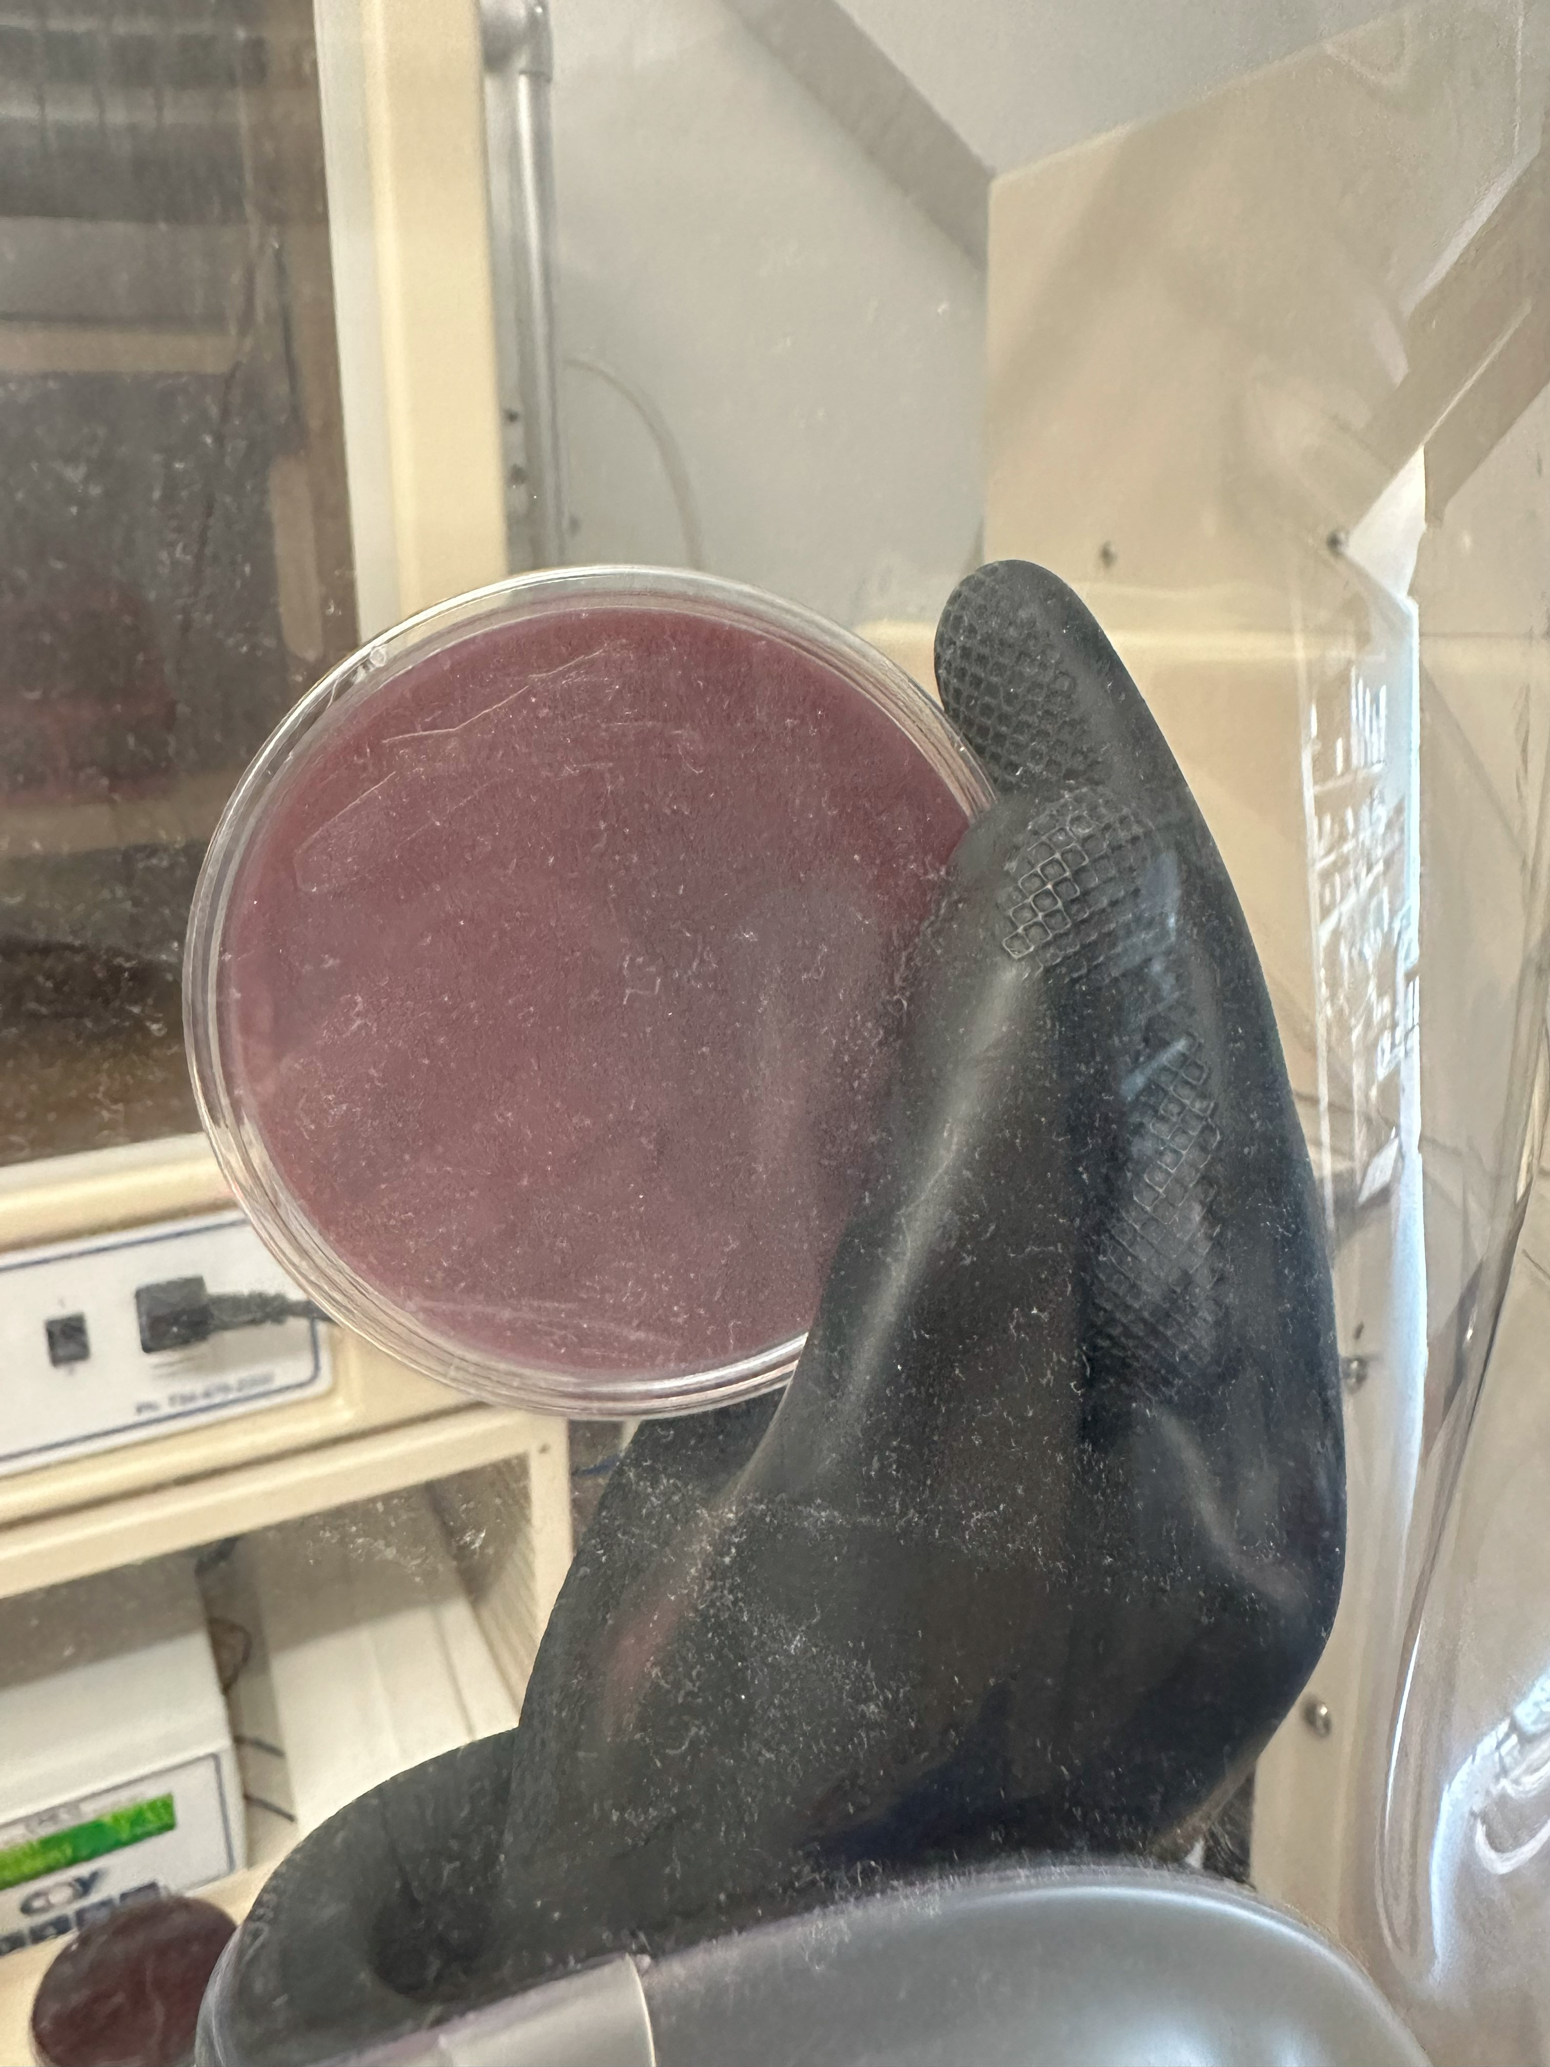
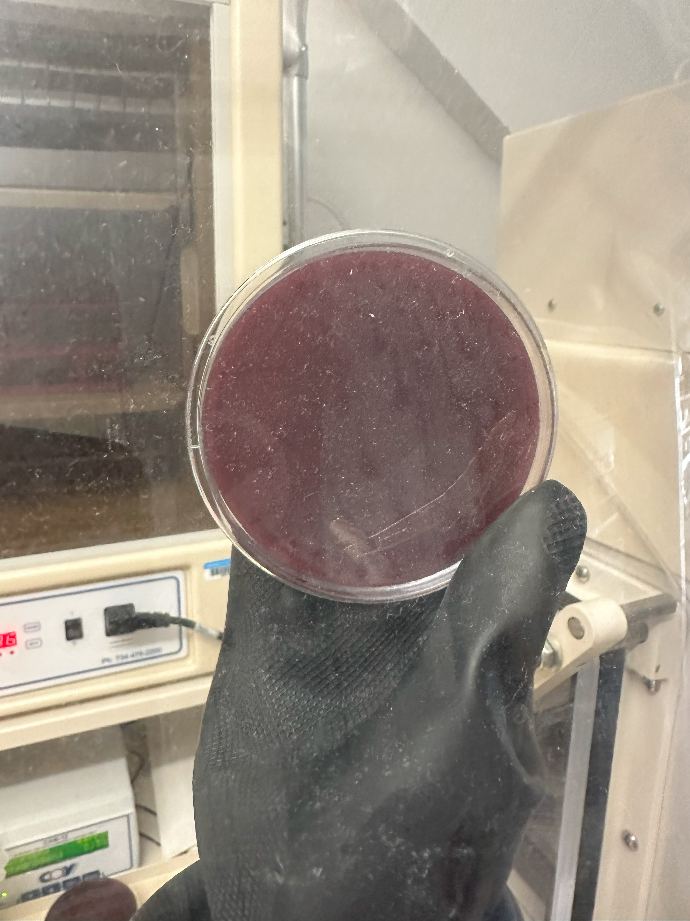
Lab Meeting 3.28.24
Question: Are the plates made on 2/20/24 still good to grow P. ging? Do the plates expire?
Expectation: No idea
Interpretation: P. ging is growing way slower, but it is growing

Slide 16
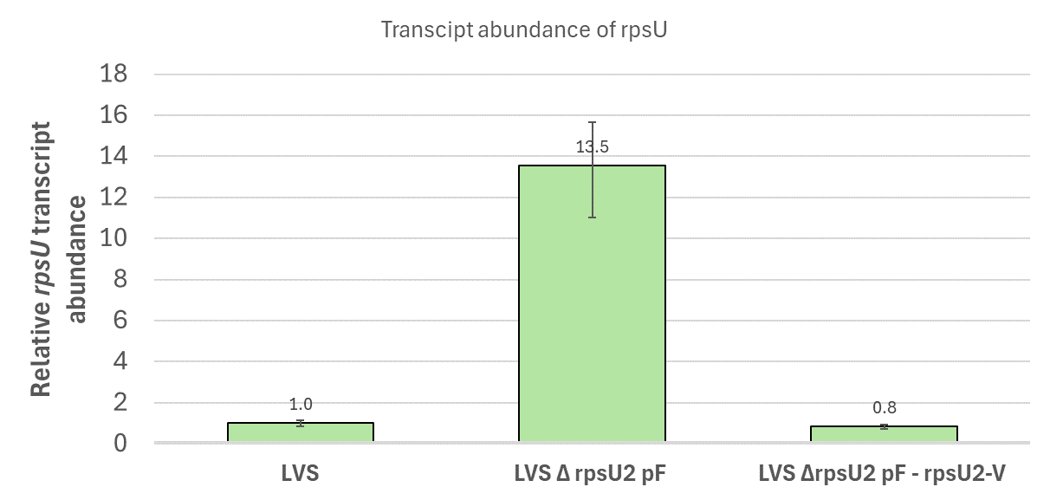
Lab Meeting 4.11.24
Question: Can I repeat the analysis from a few weeks ago with more samples and get consistent results?
Expectation: Yes, expecting LVSΔrpsU2 will have a different amount of transcript and analysis will be repeatable.
Interpretation: Yes, was repeatable, LVSΔrpsU2 has less transcript than last time.

Slide 17
Lab Meeting 4.18.24
Set up and growth week:
  KRLVS 148 and 149 for Stability Assay into RNA isolation, qRT-PCR
  Isolated P. ging colonies. In liquid cultures and pelleted rest in -80C for genomic DNA isolation

Slide 18
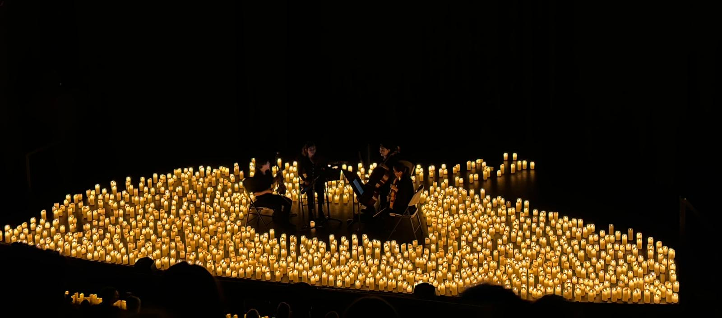
Lab Meeting 4.25.24
RNA Stability Assay (Shoutout to Christina)
Pelleted remaining P. ging colonies for gDNA extraction

Slide 19
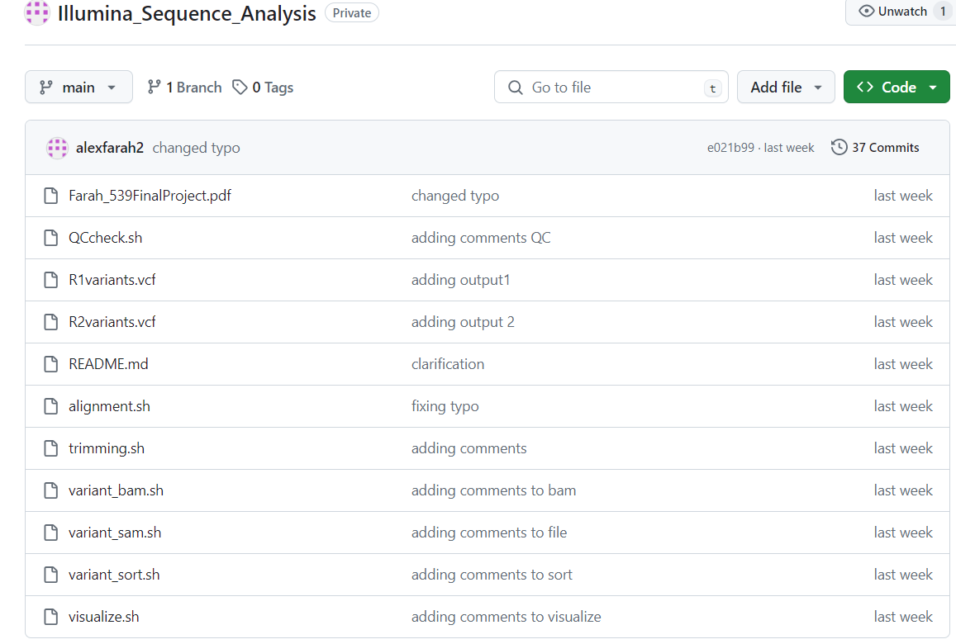
Lab Meeting 5.16.24
Question: Can I analyze the sequencing reads of a triple mutant to see if we have a triple deletion?
Expectation: Hopefully, with multiple tools
Results: From basic alignment I can’t see a triple deletion, but will look to make sure its not misaligning or if deletions won’t be shown
30/60 RNA Samples extracted
All gDNA samples extracted
15/60 cDNA samples made

