Slide 1
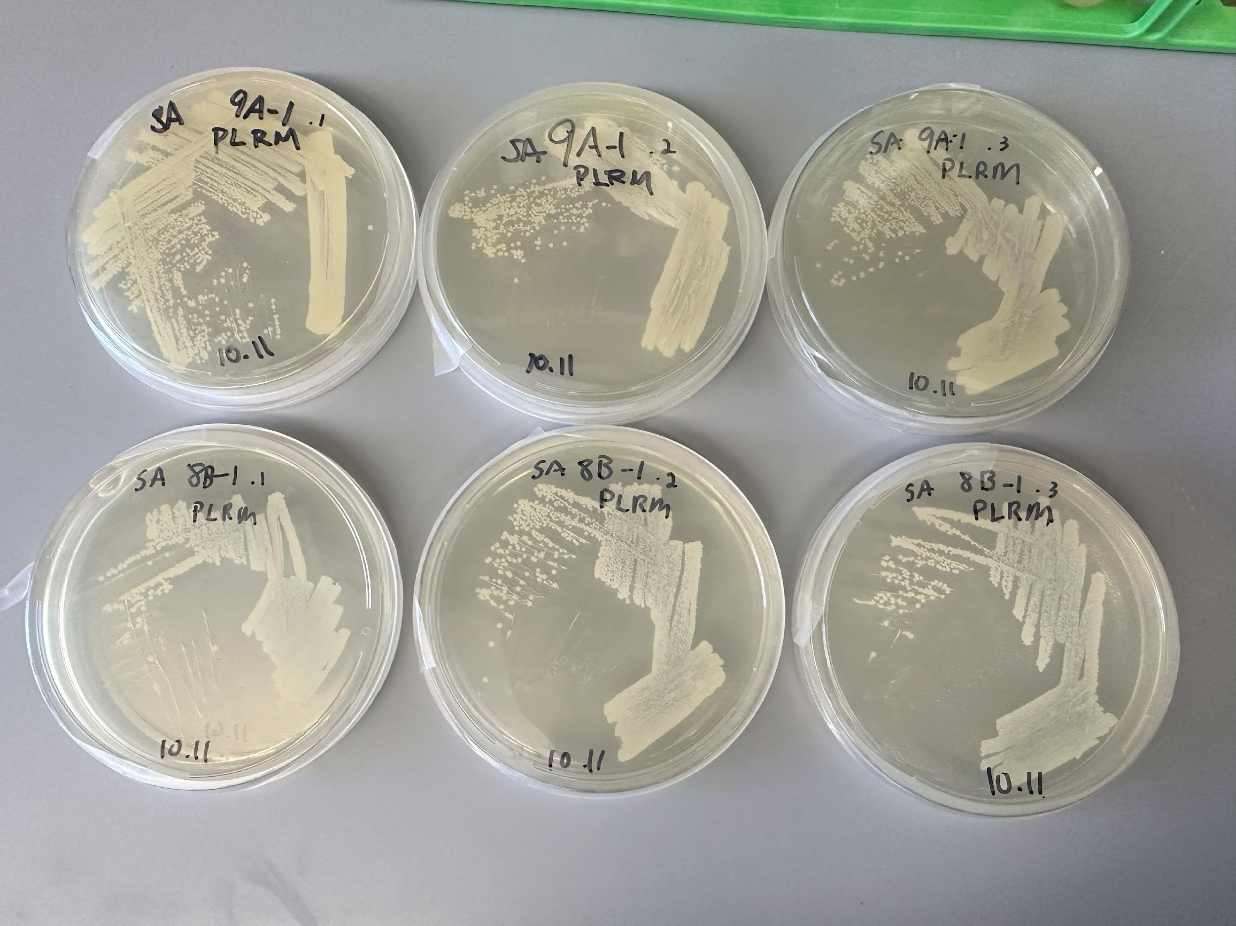
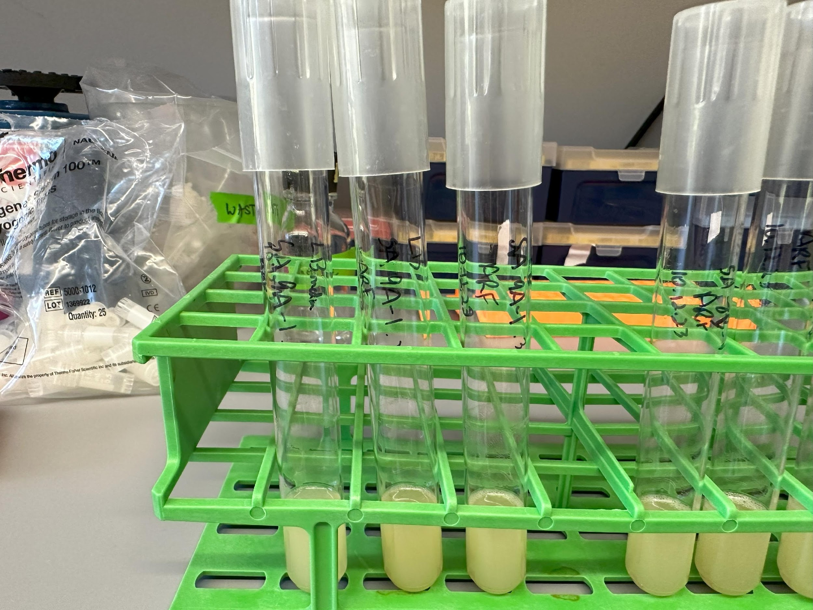
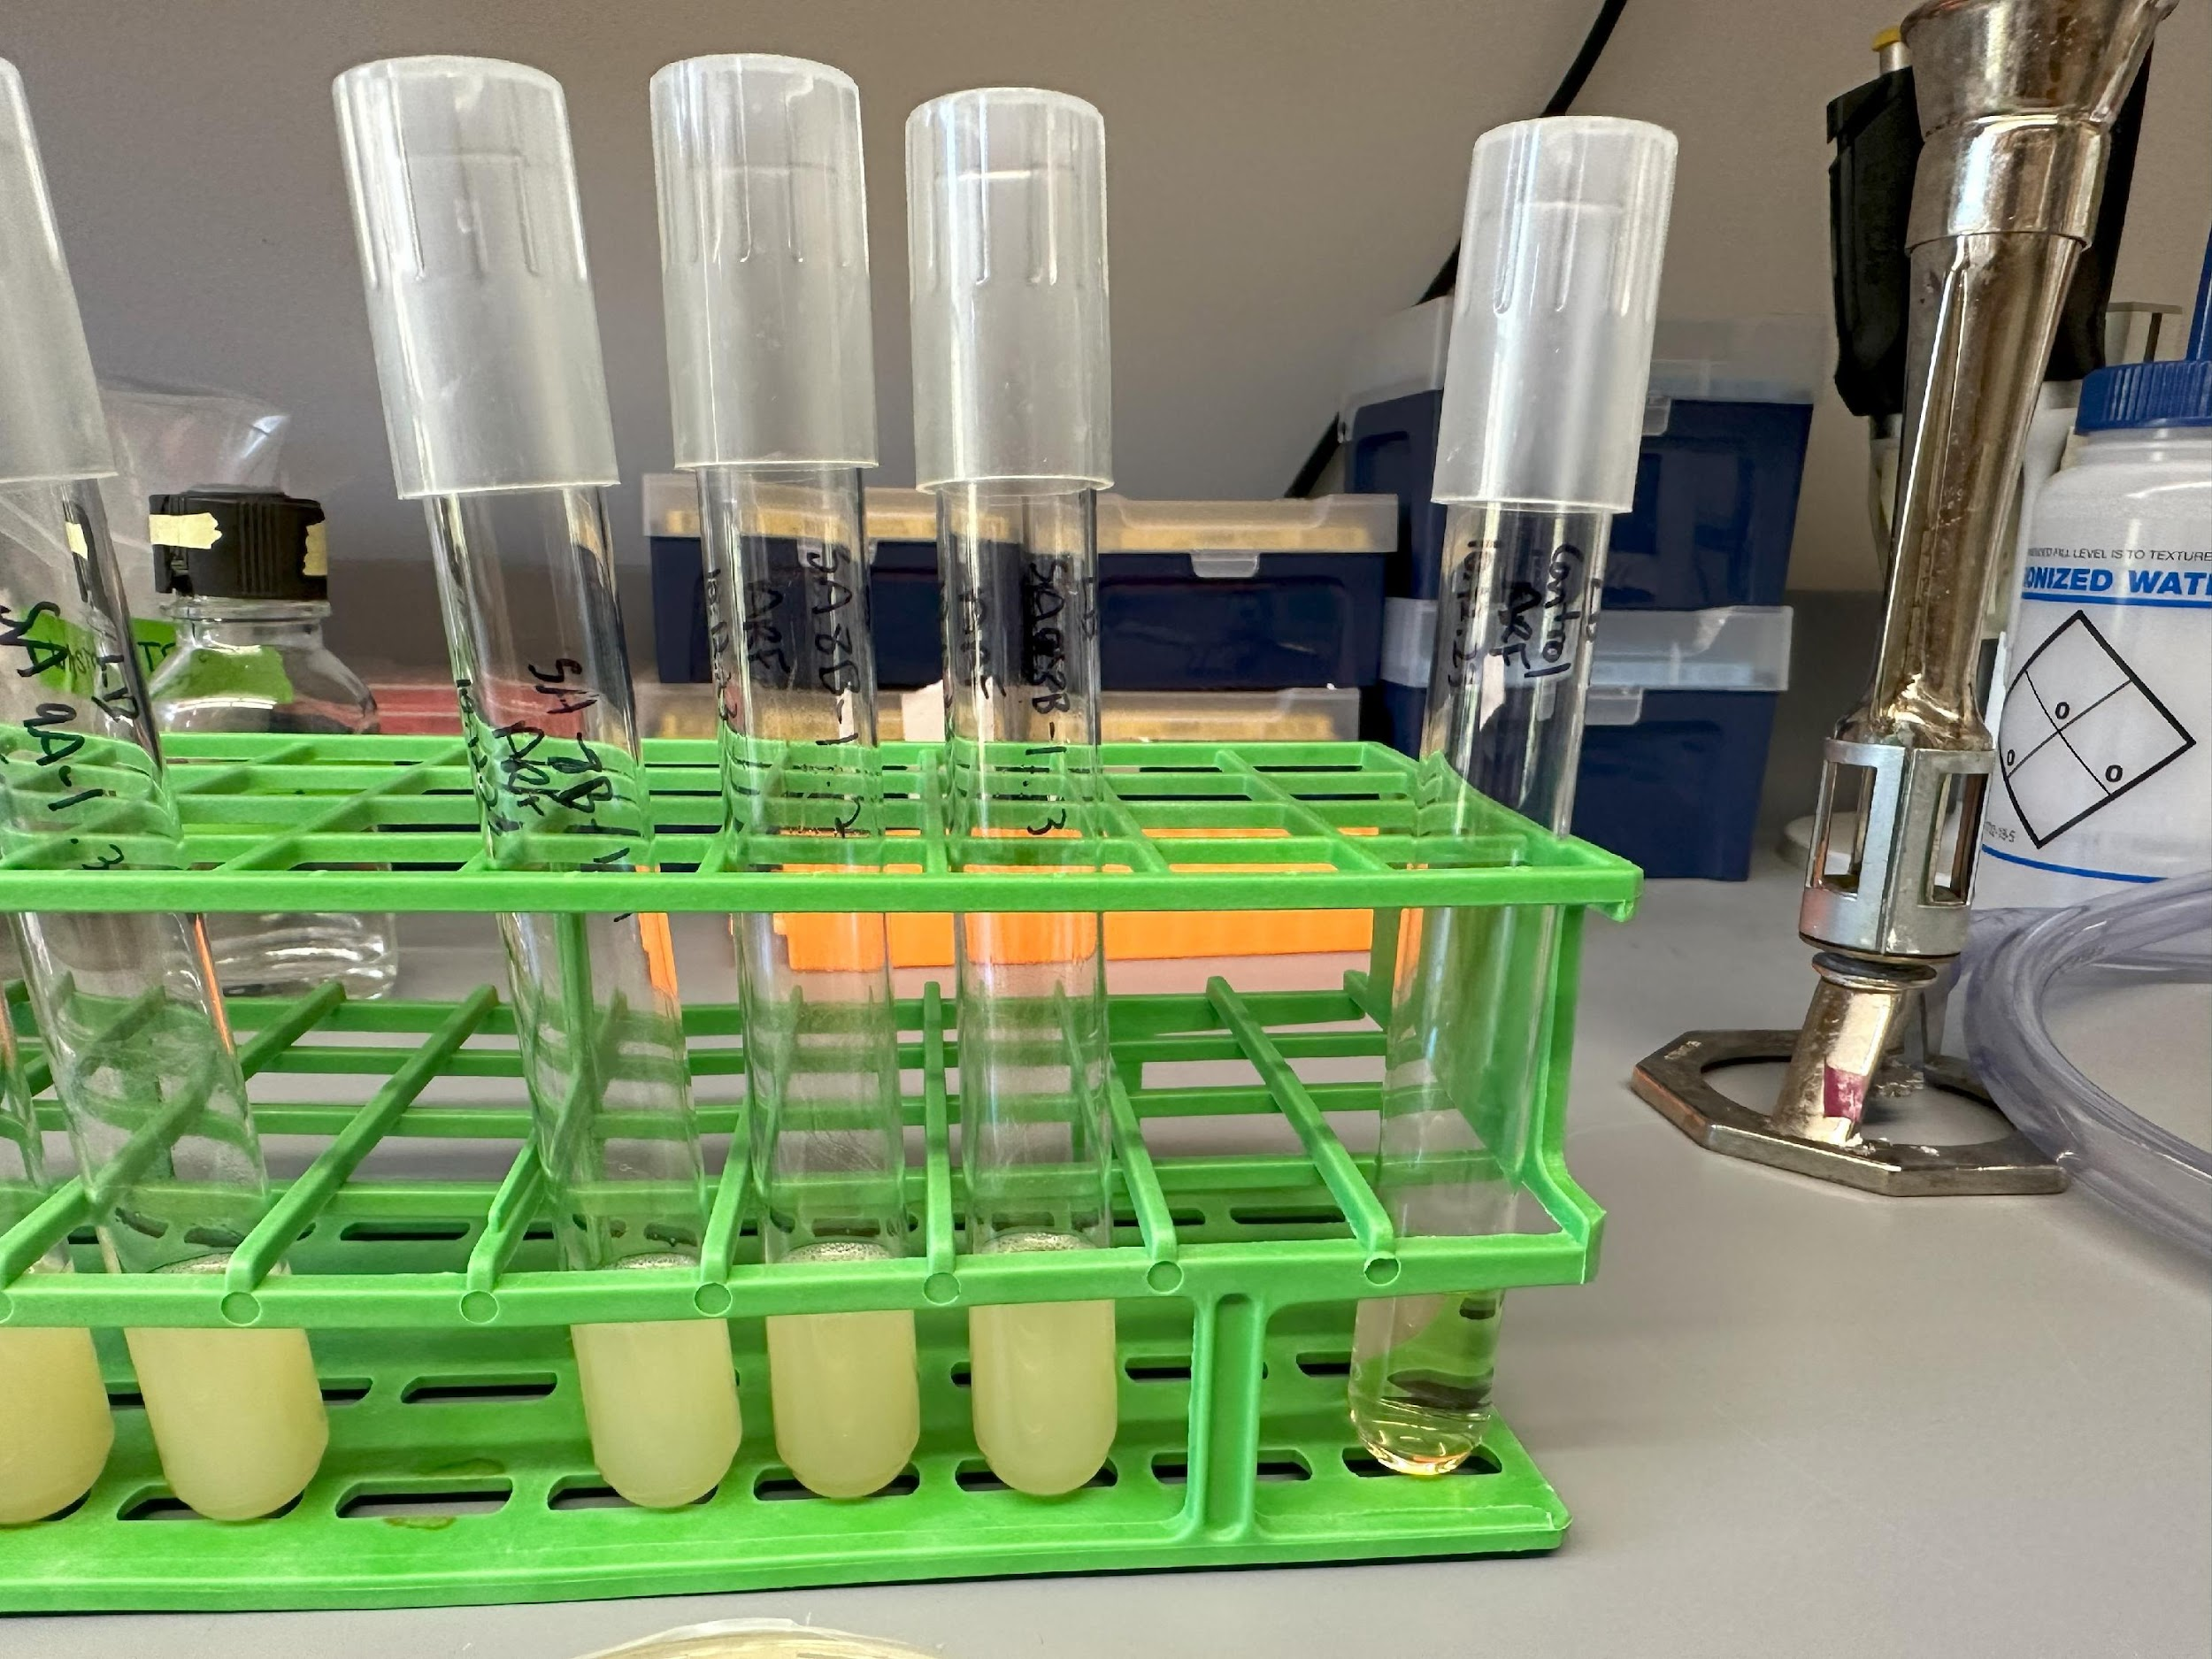
Lab Meeting 10.16.23
Streaked potentially resistant colonies for isolation
Picked individual colonies and inoculated LB cultures
Made glycerol stocks
This week: disk diffusion assay

