Slide 1

RNA World
Alex Farah
K Ramsey Lab Meeting
June 13, 2024

Slide 2
Outline
Background
Methods
Results
Future Directions

Slide 3
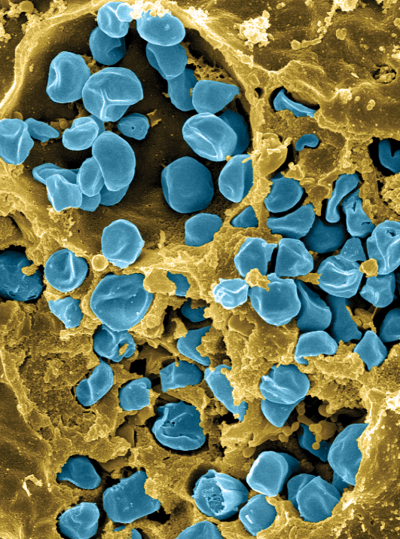
Francisella tularensis
Causes tularemia
Highly infectious
Potential bioweapon
F. tularensis subsp. holarctica LVS
Intracellular growth is essential to cause disease
Fischer, PNAS cover 2006

Slide 4
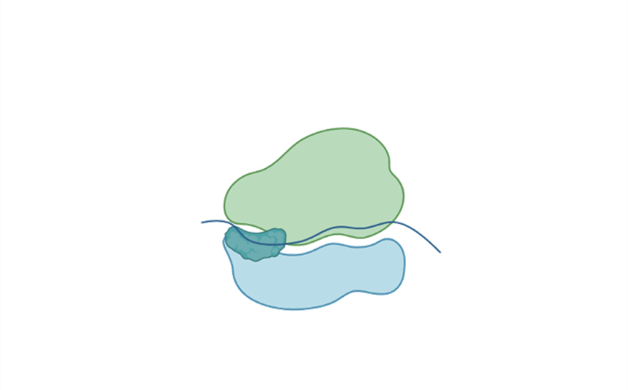
Ribosome
Site of protein translation
50S
bS21
30S

Slide 5
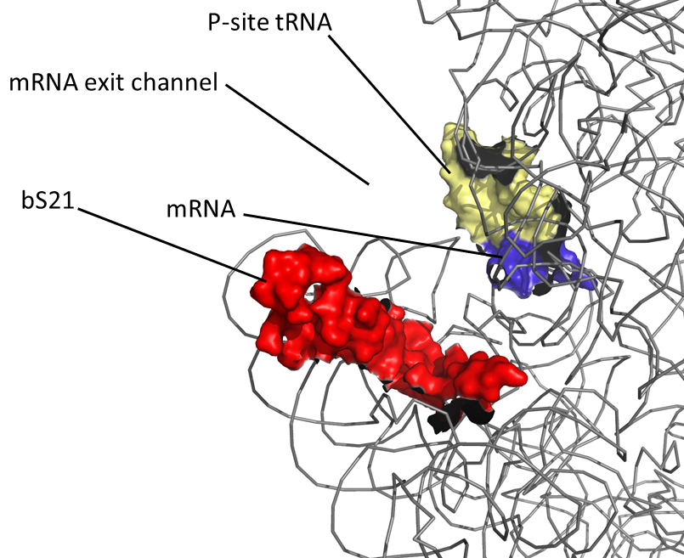
bS21
30S subunit
Last protein to join during ribosome assembly
Non-essential
Thought to be a regulator of translation
30S subunit, modeled from PDB entry: 4V50
Notes:
Pic from steve add PDB number

Slide 6
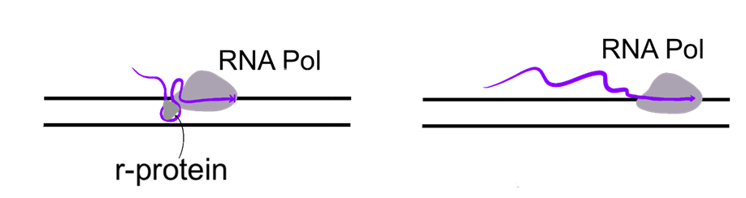
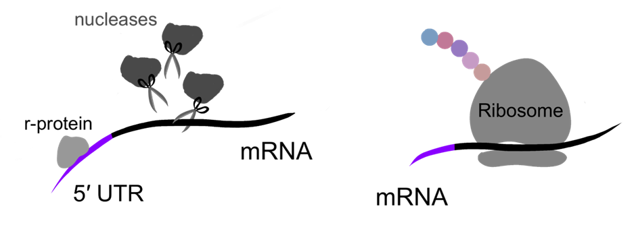
Some r-proteins Autoregulate
With r-protein
Without r-protein
Attenuation
Regulating r-protein will interact with secondary structures as transcription is occurring
Stalls the RNA polymerase
With r-protein
Without r-protein
Post-Transcriptional Control
Regulating r-protein may recruit nucleases and degrade transcript
Translation is unable to proceed
Notes:
Translation is very highly regulated because of how energetically costly it is to the cell. Therefore, if there is too much r-protein it can bind to itself to turn off translation.

Slide 7
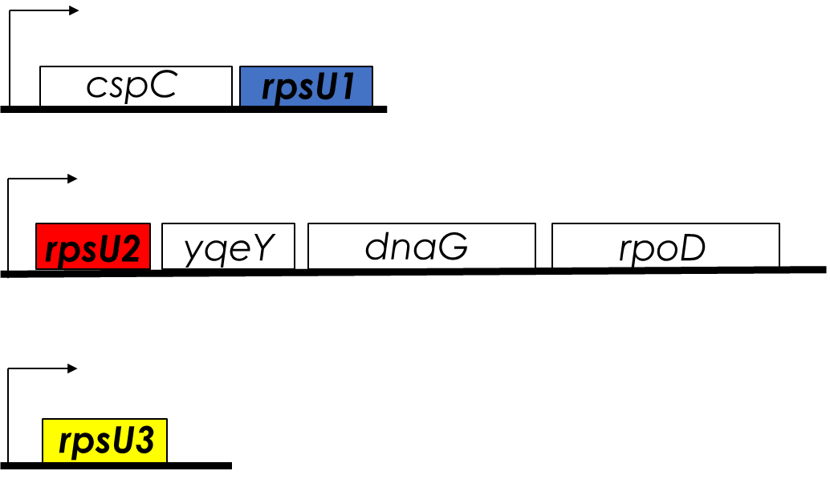
Three bS21 Homologs
Three homologs – bS21-1, bS21-2, bS21-3
Weird, because Francisella tularensis doesn’t have a large genome
Heterogenous ribosome

Slide 8
bS21 - 2
Evidence that its autogenously regulated

Slide 9
Leader sequence controls rpsU2 transcript abundance
bS21 homologs repress rpsU2 transcript abundance
  Mediated by rpsU2 5ʹ UTR
Translation of rpsU2 5ʹ UTR is influenced by unidentified factor(s)
If just UTR is sufficient, then this suggests stability is important
Notes:
After I reintroduce transcript, be like we can use b gals to look at protein and woo
after protein talk about stem loop structures, we didn’t know what it would affect if it would affect transcription or maybe translation so we looked into it and structure is bullshit

Slide 10
Questions
Can I replicate these results?
How does the cell know which homologs to make, how much of them to make, and how to balance it?
Does the increase in transcript abundance = an increase in translation?
Does bS21-2 alter mRNA stability?
What happens with three homologs? Are they all auto regulating? How to find out?

Slide 11
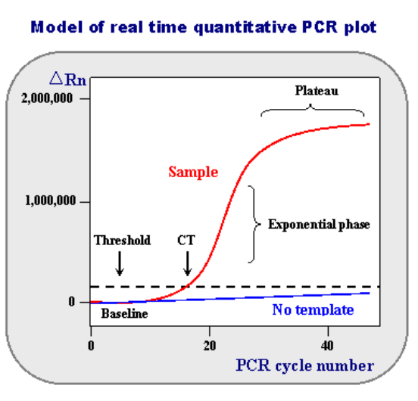
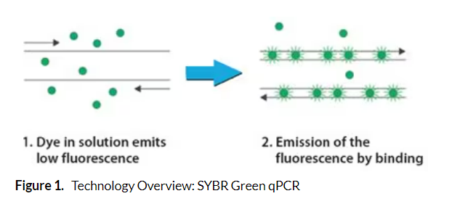
qRT-PCR
Quantitative Real Time Polymerase Chain Reaction
Shows the replication of strands in real time
Lets you quantify how much DNA is in a sample
https://www.sigmaaldrich.com/US/en/technical-documents/protocol/genomics/qpcr/sybr-green-qpcr
https://www.ncbi.nlm.nih.gov/probe/docs/techqpcr/#:~:text=(Real%2DTime%20Quantitative%20Reverse%20Transcription,each%20cycle%20of%20PCR%20process.

Slide 12
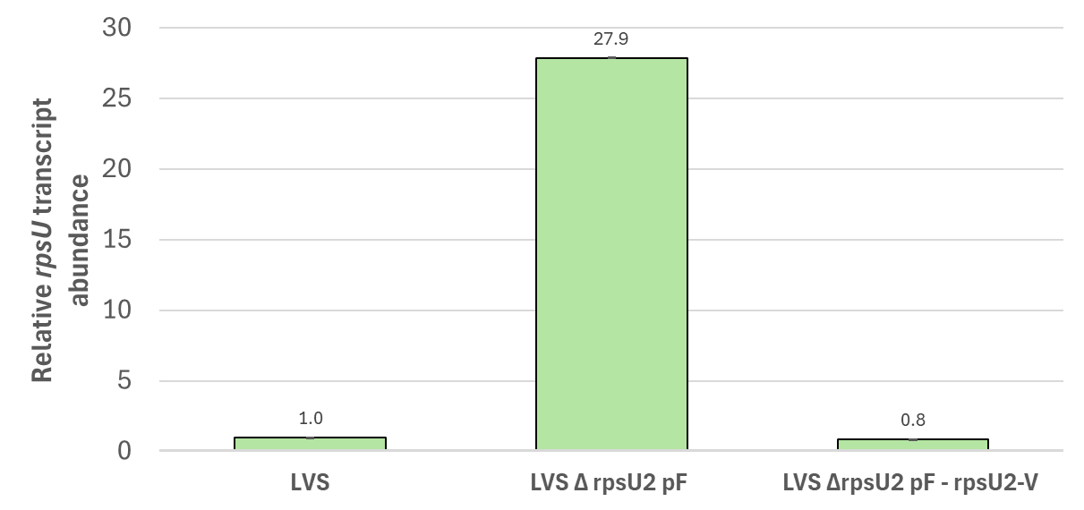
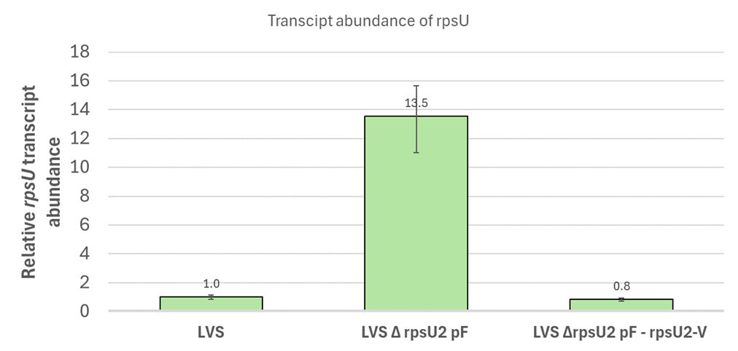
qRT-PCR
With the deletion of rpsU2, more transcript is made

Slide 13
Summary
More transcript with deletion of rpsU2!

Slide 14

New Question
What leads to more transcript abundance? More transcription? Or less degradation?

Slide 15
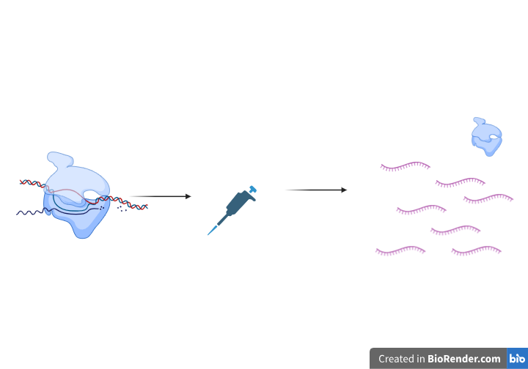
Stability Assay
Stop the transcription of mRNA by adding rifampin
Halts transcription at initiation
No more transcript made
See the stability of the mRNA transcript already made

Slide 16
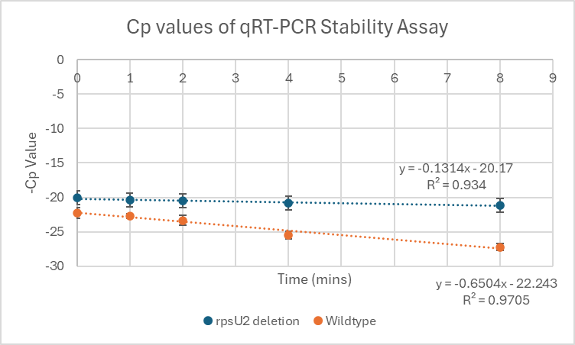

Slide 17
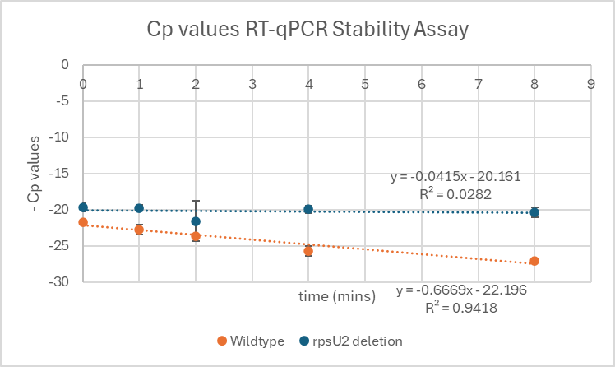

Slide 18
Summary
Deletion mutant mRNA is more stable over time

Slide 19
Future Directions
Is there anything else limiting translation initiation?
How is rpsU2 regulating its translation?
How does bS21-2 exert its regulation?

