Slide 1
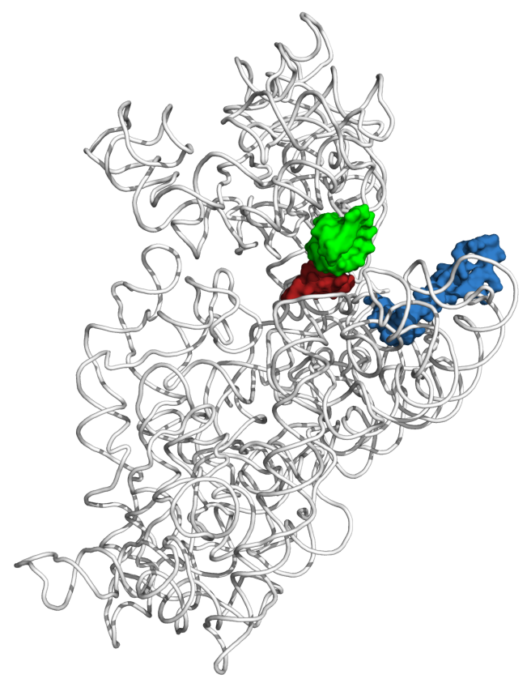
bS21 may act as a regulator of translation
  Involved in translation initiation
  Non-essential
  Implicated in control of specific processes
    biofilm
    motility
    acid stress resistance
    antibiotic resistance
    virulence
  Encoded by phage
mRNA channel
PDB 4V50
Berk et al., 2006
P-site tRNA ASL
mRNA (P-site codon)
bS21
Dr. Steven Gregory

Slide 2

Multiple bS21 homologs lead to heterogenous ribosomes in Francisella tularensis
70S containing:
cspC
rpsU1
bS21-1
dnaG
bS21-2
rpsU2
yqeY
rpoD
rpsU3
bS21-3
Trautmann and Ramsey, 2022
How is ribosome composition regulated?
Notes:
Even though francisella has a reduced genome, it encodes three copies of the rpsU genes, which encode bS21, a protein in the small ribosomal subunit. Most bacteria have 0 or 1 of this gene. We originally, hypothesized, and have since shown, that these three proteins are produced and incorporated into ribosomes. This is a western blot of purified ribosomes from our wild-type strain as well as strains ectopically expressing each of the bS21 proteins, with a VSVG tag. This, along with some mass spec data we have of purified ribosomes, indicates that multiple classes of ribosomes are possible and occurring
This protein is also interesting to us because it is located close to the mRNA exit channel in the ribosome, and early research has identified that it is involved in translation initiation, so it is in an ideal location to be regulating gene expression at the level of translation initiation.
So this heterogeneity of ribosomes may be a mechanism of regulation, but you may not know that ribosomes are heterogeneous so let me show you other ways that may occur.

Slide 3
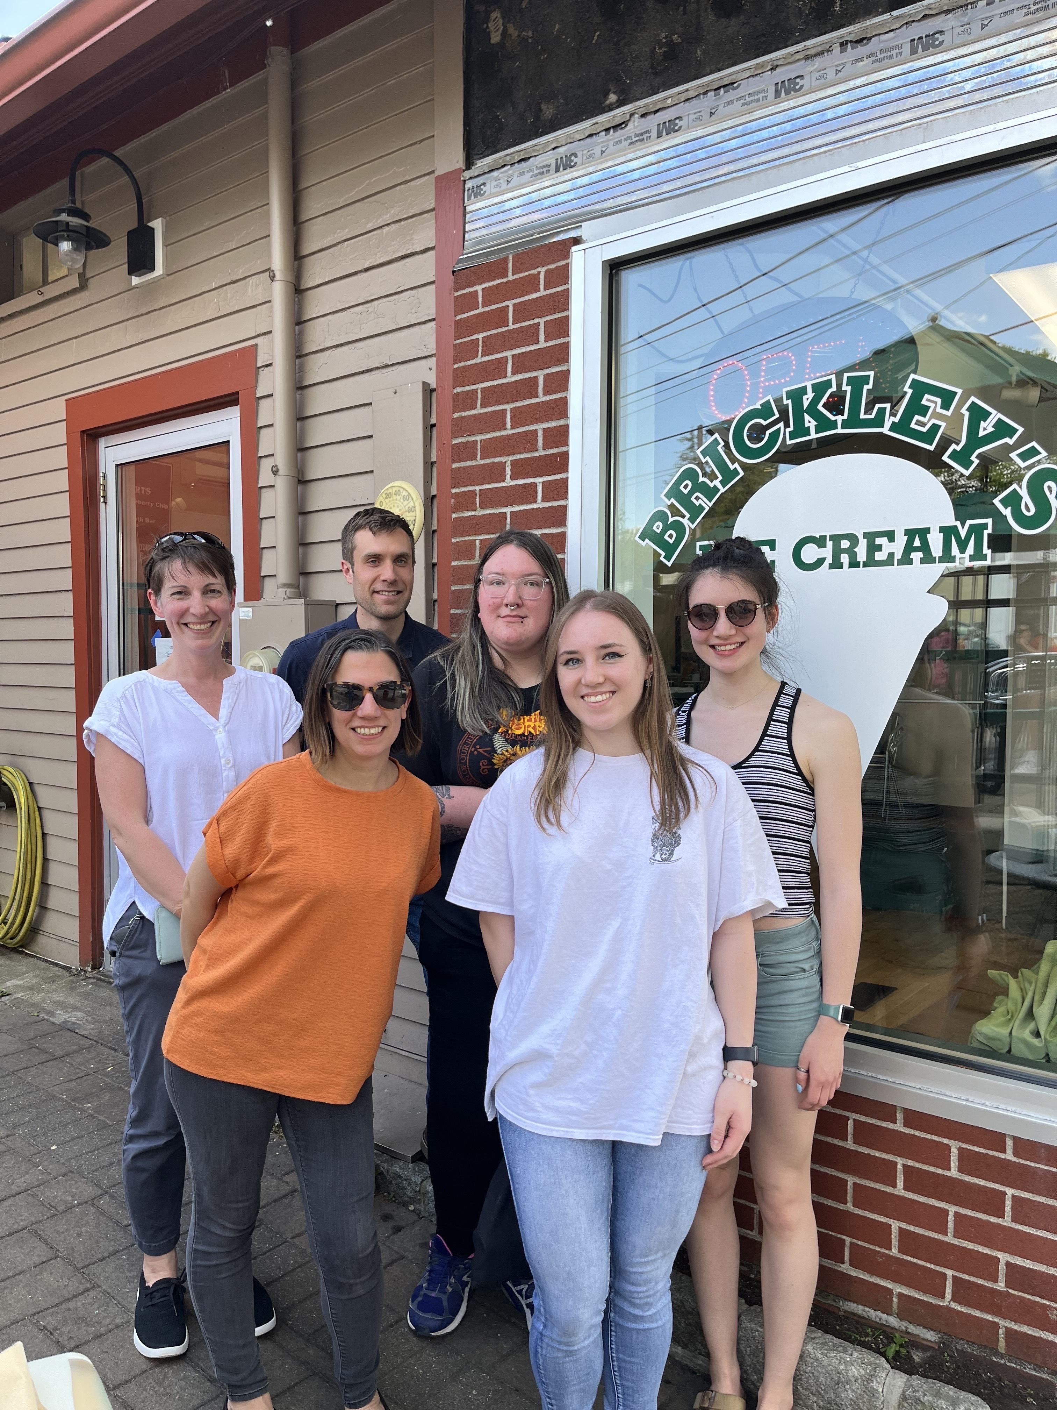
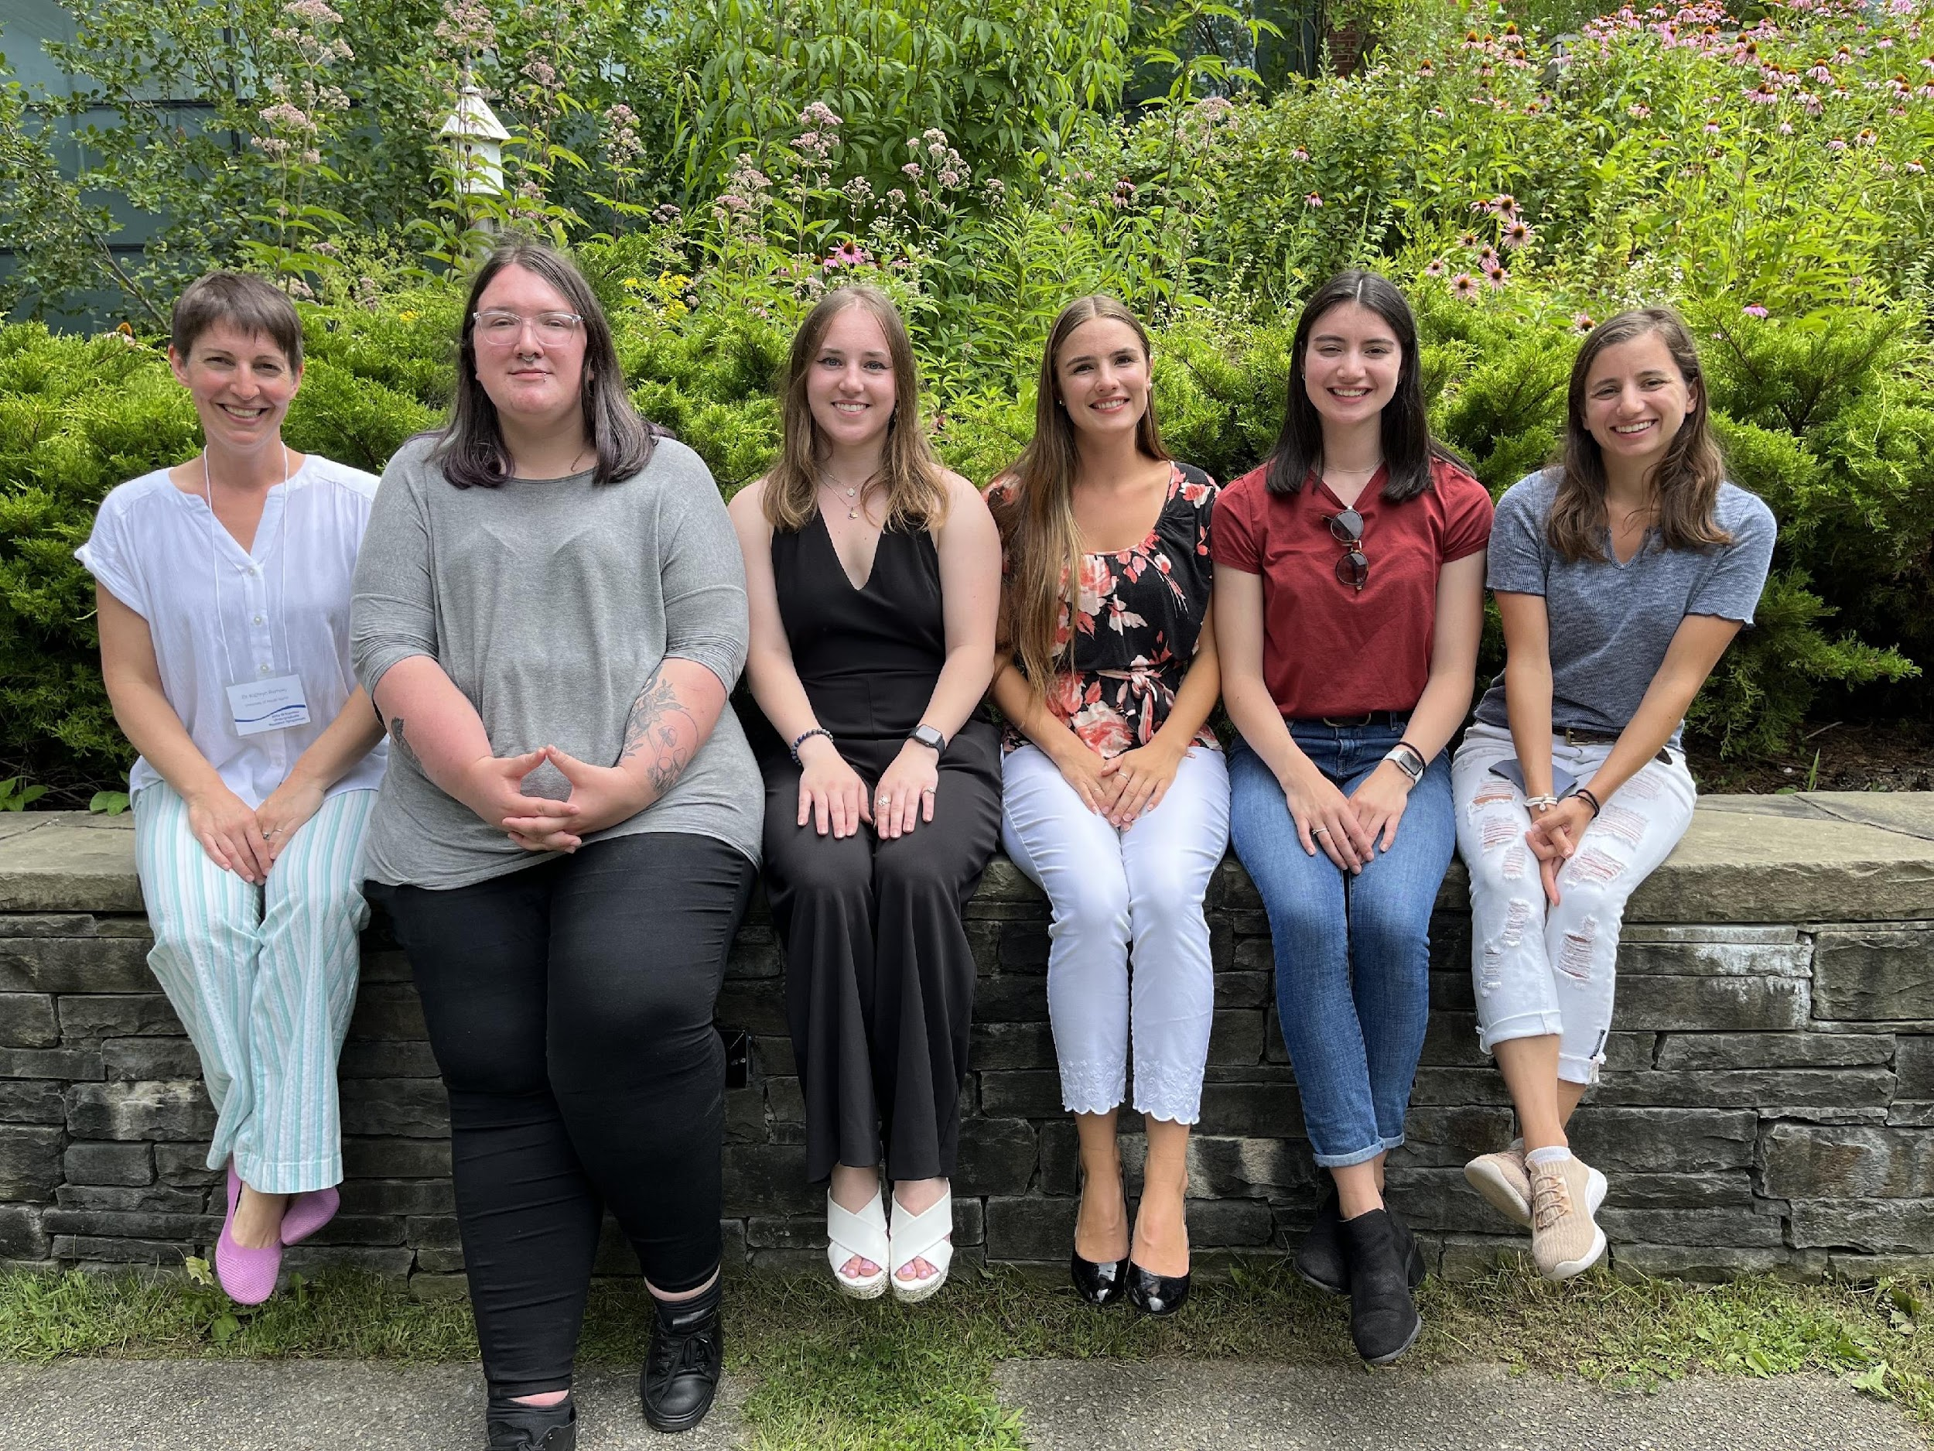





ACKNOWLEDGEMENTS
Dr. Kathryn Ramsey
  Hannah Trautmann
  Ben Moore
  Kira Bernabe
  Aisling Macaraeg
  Dan Floyd
  Dan Ruggerio
  Current and former lab members
Dr. Steven Gregory
Dr. David Rowley
Dr. Alison Roberts
URI INBRE core
Notes:
I want to thank everyone in the Ramsey lab for their support especially Kathryn. We have fantastic collaborators at URI and Duke whom I want to thank, and then our funding sources, and I will happily take any questions.
Notes:
Motility and biofilm – bacillus subtilis
Acid stress resistance – listeria monocytogenes
Antibiotic resistance – staph aureus
Virulence – burkholderia pseudomallei and francisella in this work
Phage paper – Mizuno et al. 2019, Chen 2022
Bacteriodetes – Jha et al 2020 – probably autoregulating its own expression because rpsU is one of the few genes with a strong SD

