Slide 1

Essential genome of Hp
Methods
Use a mariner transposon to build a mutant pool library in both Hp strains
Thais
Harder de Palma
Hp mutants – transposon disrupts genes in which it was inserted
Only cells with mutation
in non-essential
genes survive
Mutant pool – surviving mutants are collected

Slide 2
Essential genome of Hp
Methods
Grow mutant pool in rich medium (BHIYE-HP) to identify essential genes
TA
CCCC
Illumina adapter
Hp
genome
Illumina adapter
GGGG
Mutant pool
BHIYE-HP
16h growth
DNA extracted
Transposon fragment

Slide 3
Essential genome of Hp
Methods
Compare “expected” transposon insertions to observed insertions
# of reads per TA site
Expected assuming neutral fitness
Observed
Non-essential gene
Essential gene
Notes:
To identify the essential genes, I used a Monte Carlo Method approach creating an expected data set based on the places where we see transposon insertions. This expected dataset calculates where we should see transposon insertions assuming neutral fitness, meaning, considering that the gene was not essential.

Slide 4


Results
~ 195,115 (Hp 392) and 144,946 (EL1) unique transposon insertions, 1 insertion every 11 and 15 bp respectively
Hp 392
2,146,020 bp
Total genes = 2010
Essential = 395
Hp EL1
2,153,240 bp
Total genes = 2033
Essential = 384
Notes:
As we can see this figure.
Here, indicated by the purple ring, we can see all the transposon insertions and where they were inserted into Hp’s genome. All the ORF are showed in gray and the inner green circle shows all the essential genes.
So, if we look here for example, we observe a gap where we have none or very few transposon insertions indicating that those genes do not tolerate mutation thus, you see here higher number of essential genes as well. In summary, this figure shows that that the mutant pools were well saturated and randomly distributed and do not have any hotspots.

Slide 5
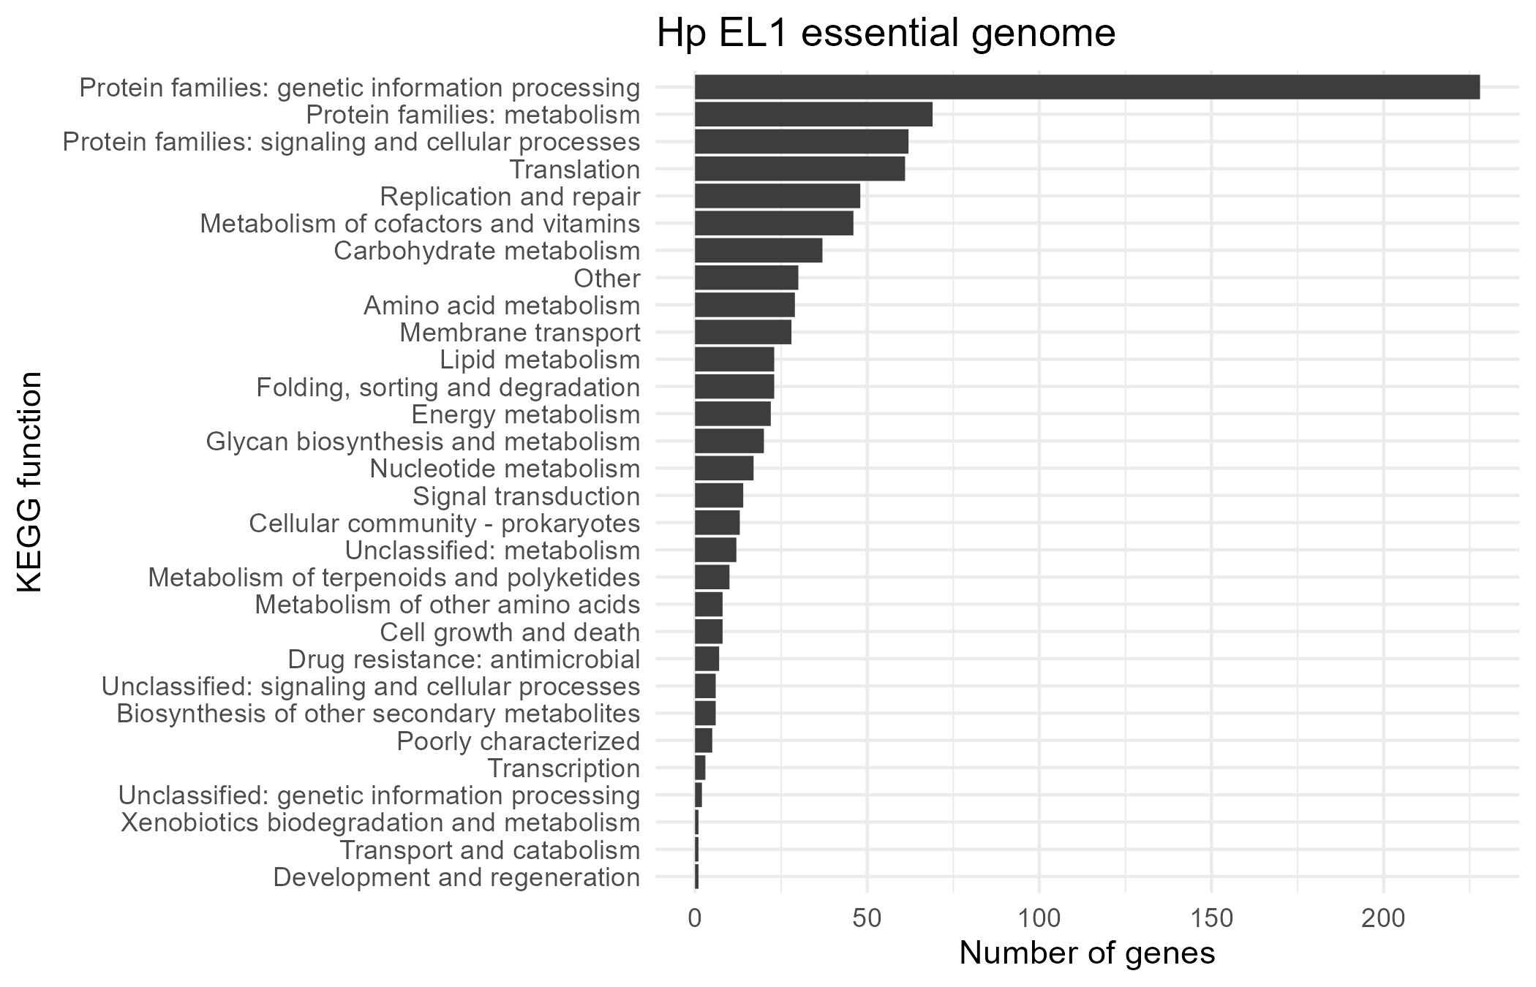
Results
Genes that compose the essential genome are involved in central cell functional “housekeeping” processes including genetic information processing and common energy metabolism pathways

Slide 6
Is the essential genome similar for both Hp strains?

Slide 7
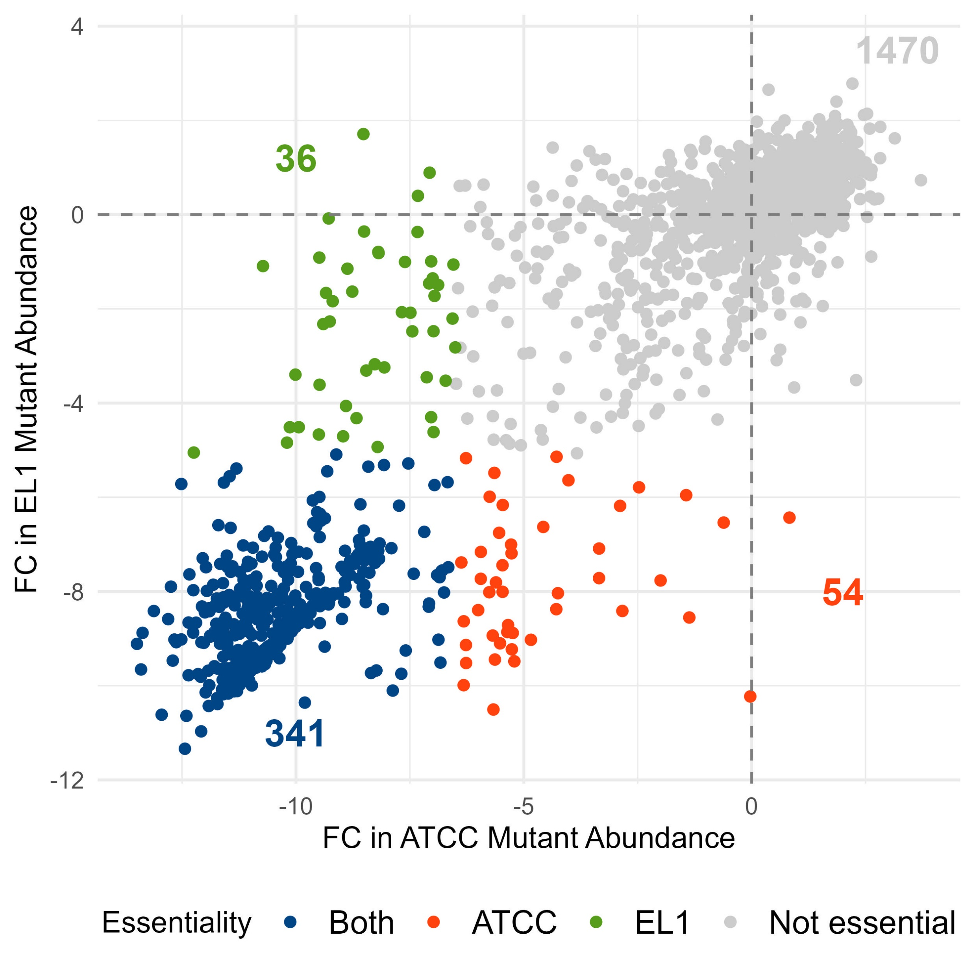
The majority of essential genes are essential in both Hp strains, and some are strain specific

