Slide 1

Commensal Corynebacterium quench Staphylococcus aureus quorum sensing
Matthew M. Ramsey PhD
Lemon Lab

Slide 2
What specific interactions occur between bacterial species in a polymicrobial community?
We use a reductionist approach starting with pairwise interactions

Slide 3
Polymicrobial Synergy
Many infections are caused by multiple organisms (ex: sepsis, abscesses)
Pathogen:Pathogen or Pathogen:Commensal
Intensify symptoms and prolong recovery time
Host effects are well characterized but the causes remain in question

Slide 4
Which microbes to study?
Likely interactions due to abundance and major metabolites
Macroscopic co-occurrence / co-isolation
Co-localization / proximity

Slide 5
Diabetes
Affects 25.8 million (8.3%) of the USA population
27% of Americans >65 y/o have diabetes
Major cause of kidney failure, blindness and lower limb amputation
Cost Americans $174 billion (2007)
CDC Diabetes Factsheet, 2011

Slide 6
Diabetic foot ulcer infections (DFIs)
Chronic polymicrobial infections
  Superficial wounds progress to non-healing, infected ulcerations
  Precedes amputation
S. aureus is a common pathogen
  Other antibiotic-resistant pathogens
Commensal Corynebacterium
  C. striatum, C. amycolatum
Need for new approaches to prevent and treat DFIs
Notes:
[]add references!

Slide 7
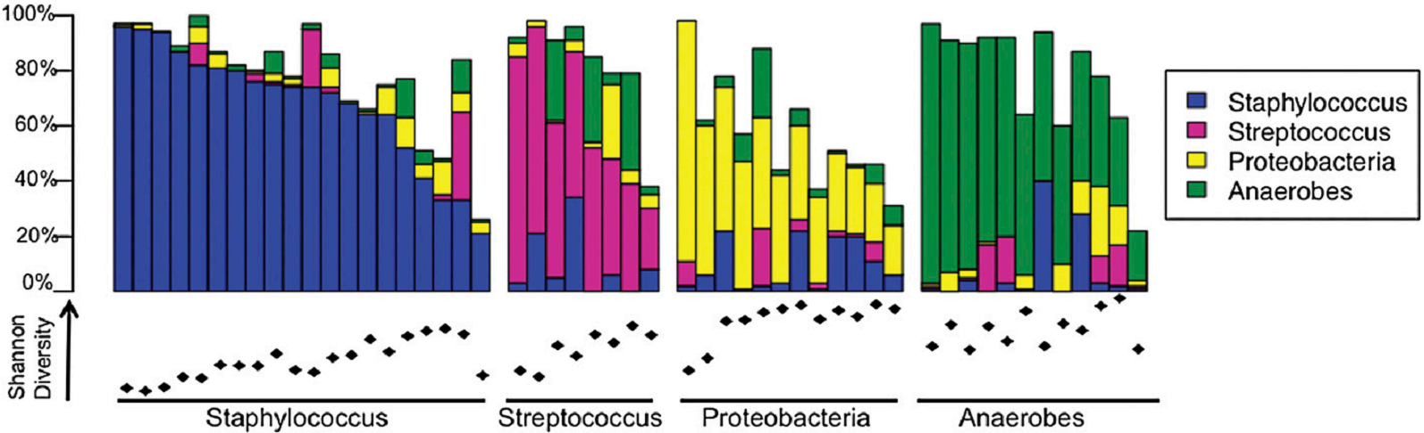
Culture independent DFI Data
52 patients
  All neuropathic, nonischemic DFUs
V1-V3 16S dataset 454 sequencing
Gardner S, Hillis S, Heilmann K, Segre J, Grice E. (2013) Diabetes

Slide 8
Which organisms to study?
Staphylococcus aureus
  Strong negative correlation with anaerobes
Corynebacterium OTU
  Spearman Rank coefficient (ρ) = 0.47, p = <0.001
We started with C. striatum as an initial model organism due to previous culture dependent data

Slide 9
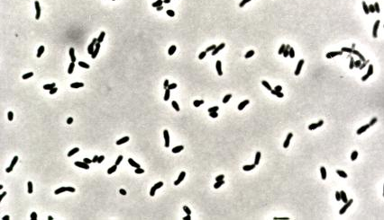
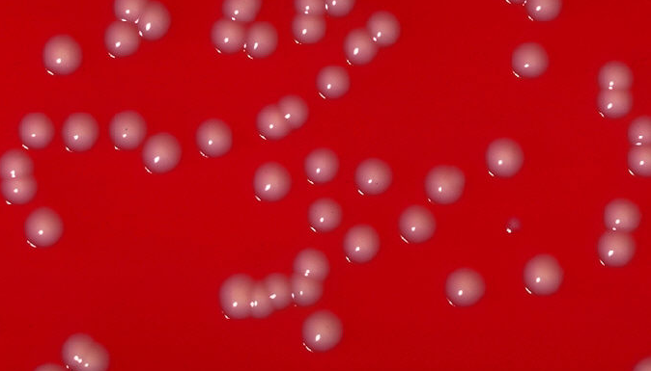
Skin Corynebacterium spp.
Non-diphtheriae
Detected in the nose and on various skin sites
Typically benign and very understudied
Functions in microbiome are largely unknown
Federal Agricultural Research Center
CDC Public Health Image Library
Notes:
SKIN: nasal vestibule (nostrils), face, chest, feet

Slide 10
Staphylococcus aureus
Gram positive
  Actinobacteria
Opportunistic pathogen
  Human associated
Colonizes nasal cavity (~25% population)
Methicillin Resistant variety (MRSA) a growing concern

Slide 11
S. aureus causes a range of infections
Skin & soft tissue
  DFIs
Bone
Joint
Blood stream
Heart valve
Pneumonia
Medical devices

Slide 12
S. aureus and Corynebacterium striatum
are co-isolated from DFIs
These species also overlap on colonized human skin
Hypothesis: C. striatum and S. aureus interact directly with each other

Slide 13
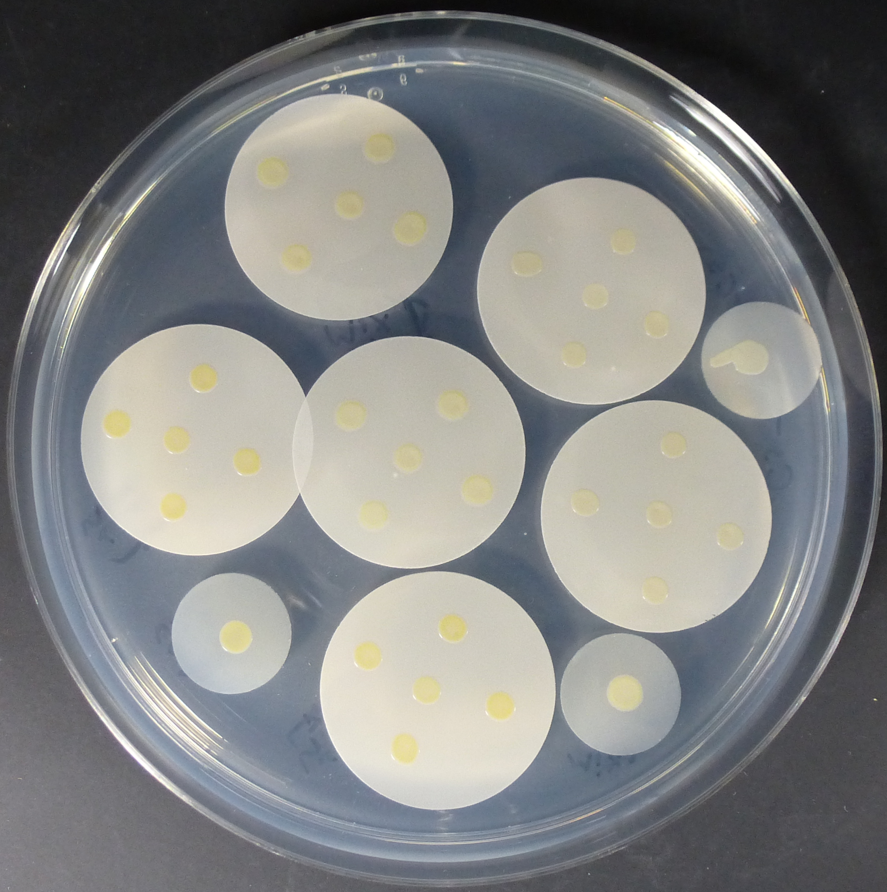
S. aureus-C. striatum coculture assay
Notes:
[]CUT edges off in photoshop and then can use on gray background
From MMR – file P1040059.jpg
pH 6, 0 or 2mM glucose, solid surface, complete defined medium (CDM)
Mono vs co-culture
Cultures grown overnight / moved to fresh medium, incubated 4h.

Slide 14
S. aureus-C. striatum coculture assay
S. aureus JE2
5 x 10⁵
C. striatum
5 x 10⁶
Mixed inoculum
Complete defined medium agar (CDM), 0 or 2mM glucose, pH 6
Inoculate bacteria onto 0.2 micron polycarbonate filters
No statistically significant change in growth for either species
Notes:
pH 6, 0 or 2mM glucose, solid surface, complete defined medium (CDM)
Mono vs co-culture
Cultures grown overnight / moved to fresh medium, incubated 4h.

Slide 15
RNASeq analysis of S. aureus in mono vs coculture

Slide 16
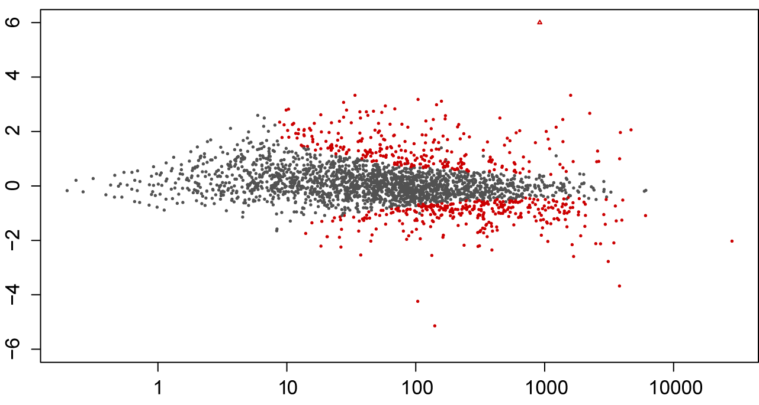
Cocultivation with C. striatum induces broad changes in S. aureus transcription
log² fold change
mean expression
Notes:
[]recheck #s from MMR email
3/17/15: total 817 S. aureus genes differentially expressed in coculture with C. striatum (290 differentially expressed >3-fold; 250 induced, 40 repressed,
-Statistical significance difference in mono vs co (passing q square)
[] Log fold change as standard output (log2)
**similar changes in transcripts with largest increase in coculture when compared to monoculture on other media
[]regraph w/ blue for static and orange from changed

Slide 17
S. aureus Protein A (spa)
Protein A
Induced >260-fold by C. striatum
Protein A (spa) is a 56kd surface protein
Binds the Fc region of IgG
Disrupts opsonization and phagocytosis
Y
Y
Y
Y
IgG

Slide 18
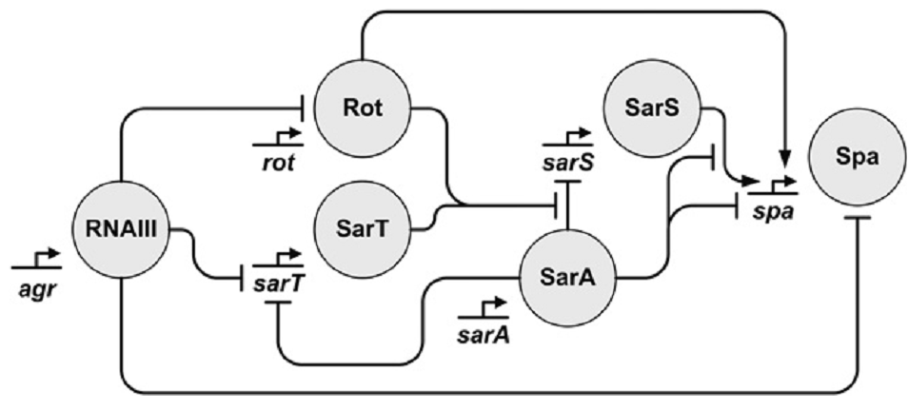
Multiple transcription factors impact spa transcription
Gustaffson, et al. (2009) IJJM.
Notes:
sarS only 2.8-fold induced, sarT 7-fold induced
spa (Protein A) transcription is indirectly repressed by agr quorum signaling

Slide 19
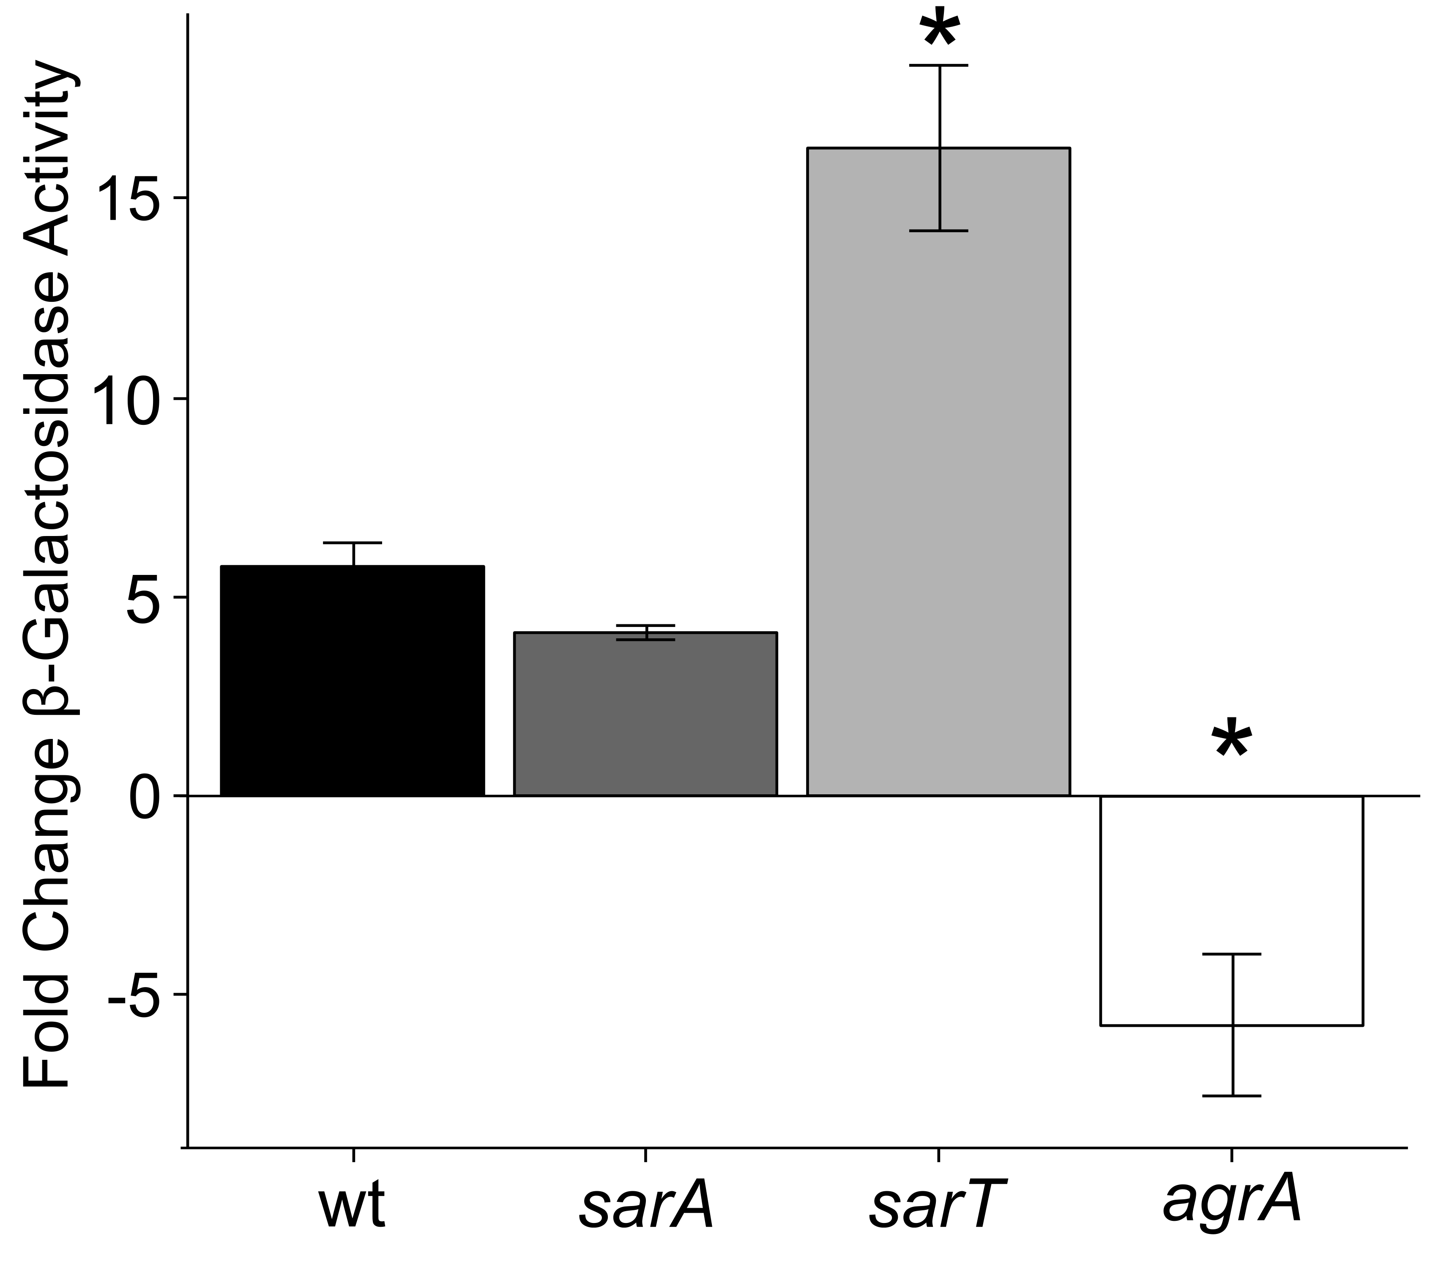
Coculture S. aureus spa promoter induction depends on agr
S. aureus transposon mutants
Notes:
sarS only 2.8-fold induced, sarT 7-fold inducedC/\Users\Matthew\Google Drive\Lemon Lab\Manuscripts\2015-aureus-coryne-paper1\Figure and Data Files\Figure 1\Ink_sSpa_Sau_Cst_cocx

Slide 20
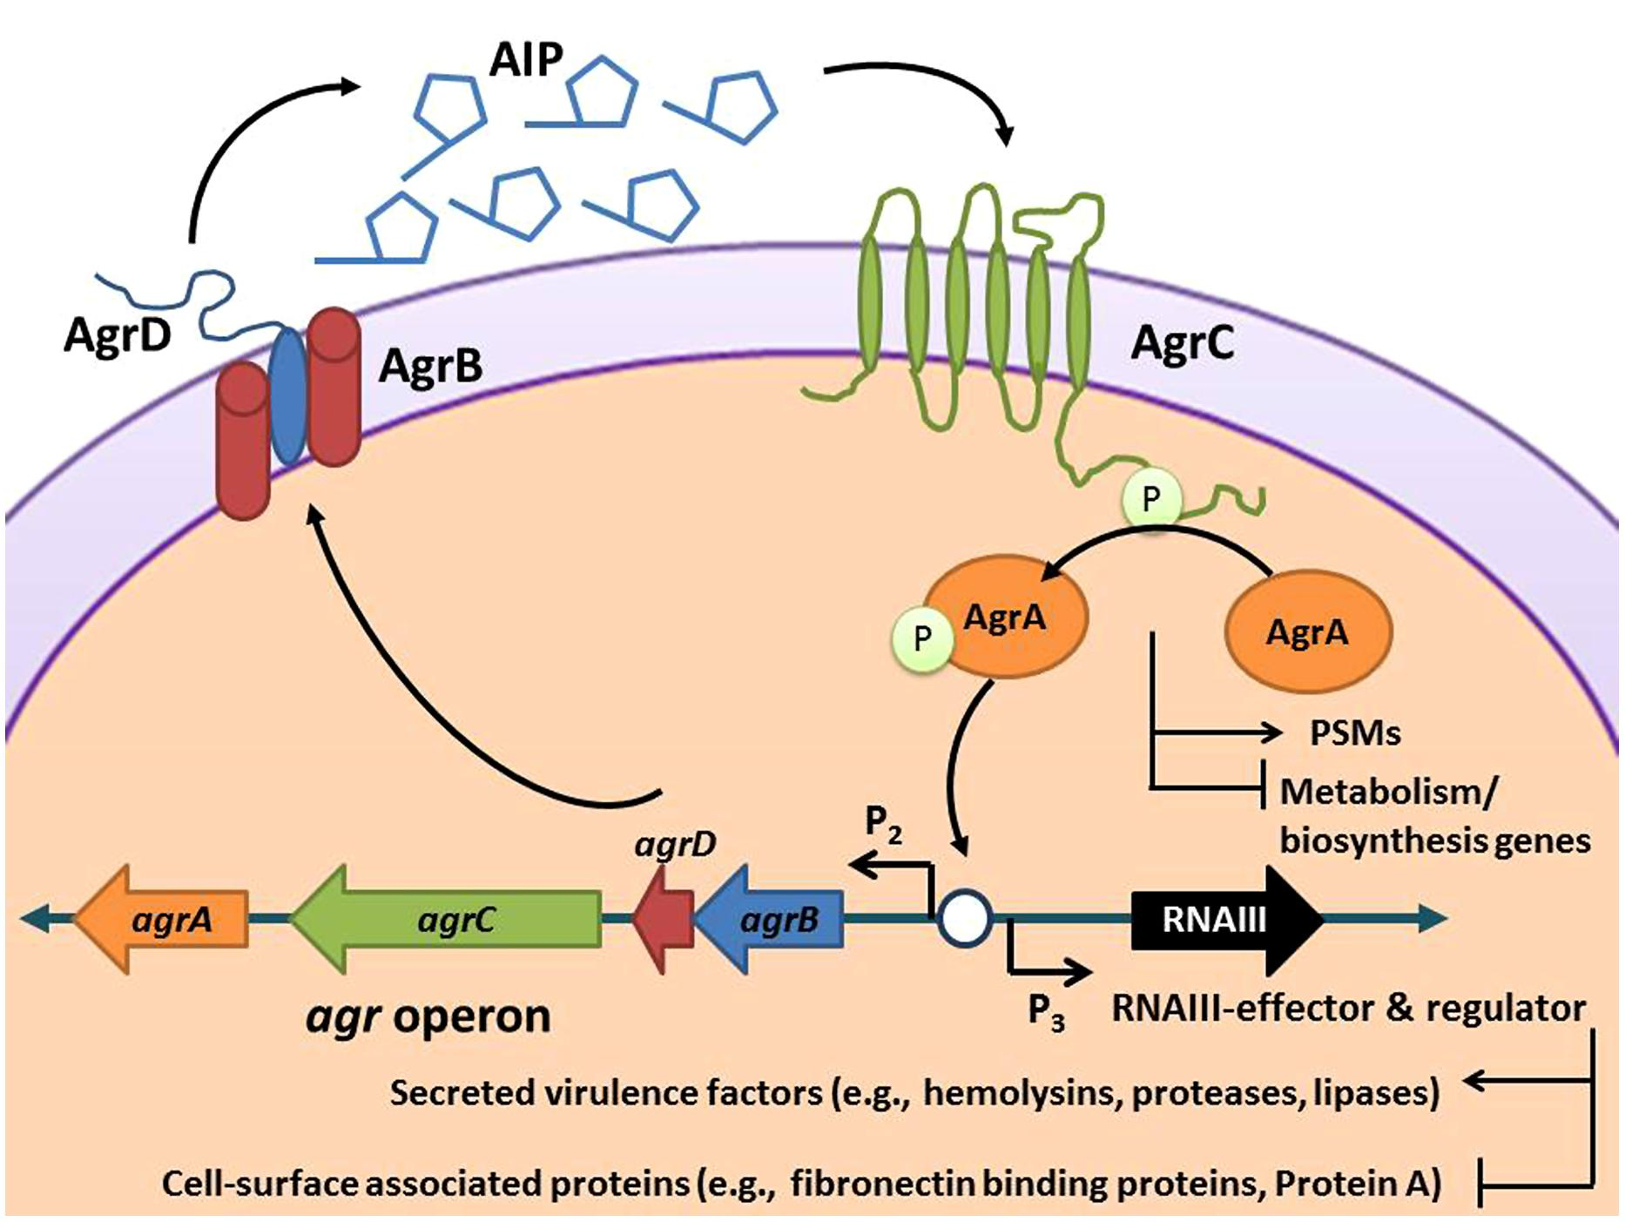
S. aureus agr quorum sensing is mediated by autoinducing peptides (AIP)
Quave & Horswill, Front Micro 2014
Notes:
Flipping the switch: tools for detecting small molecule inhibitors of staphylococcal virulence
Cassandra L. Quave1,2 * and Alexander R. Horswill 3

Slide 21
Quave & Horswill, Front Micro 2014
Notes:
Cassandra L. Quave1,2 * and Alexander R. Horswill 3
1 Department of Dermatology, Emory University School of Medicine, Atlanta, GA, USA
2 Center for the Study of Human Health, Emory University College of Arts and Sciences, Atlanta, GA, USA
3 Department of Microbiology, Roy J. and Lucille A. Carver College of Medicine, University of Iowa, Iowa City, IA, USA

Slide 22
Many S. aureus transcripts repressed in coculture are agr regulated
Fold Δ | Gene | SAUSA300_# | Product
-54.3 | - | 1067 | Phenol soluble modulin β1
-16.8 | - | 1068 | Phenol soluble modulin β2
-12.6 | lip | 2603 | triacylglycerol lipase
-8.3 | - | 1918 | Trunc. β hemolysin/ phospholipase C
-8.2 | - | * 1988 | δ hemolysin
-3.5 | - | 0320 | triacylglycerol lipase
-2.7 | agrB | * 1989 | accessory gene regulator B
-2.7 | agrA | * 1992 | accessory gene regulator A
-2.5 | agrD | * 1990 | accessory gene regulator D
-2.0 | agrC | * 1991 | accessory gene regulator C
Notes:
[]q value cut-off?
MMR: for 2mM glucose the "Antibacterial Proteins" or the Phenol soluble Modulin-Beta's are still the two most repressed genes but only at around 10 and 11-fold.

Slide 23
Hypothesis: C. striatum inhibits quorum signaling in S. aureus

Slide 24
S. aureus mutant unable to produce AIP-1
with lux reporter under AIP-1 dependent promoter
O
AIP-1
M
S
I
F
Y
S
T
C
D
luxCDABE
agrP3
Light Production
Light Production?
+ AIP-1
+ Corynebacterium
+ AIP-1
?
Thoendel & Horswill JBC 2009
Notes:
[] Add ref from ROJ.... From MMR’s strain table

Slide 25
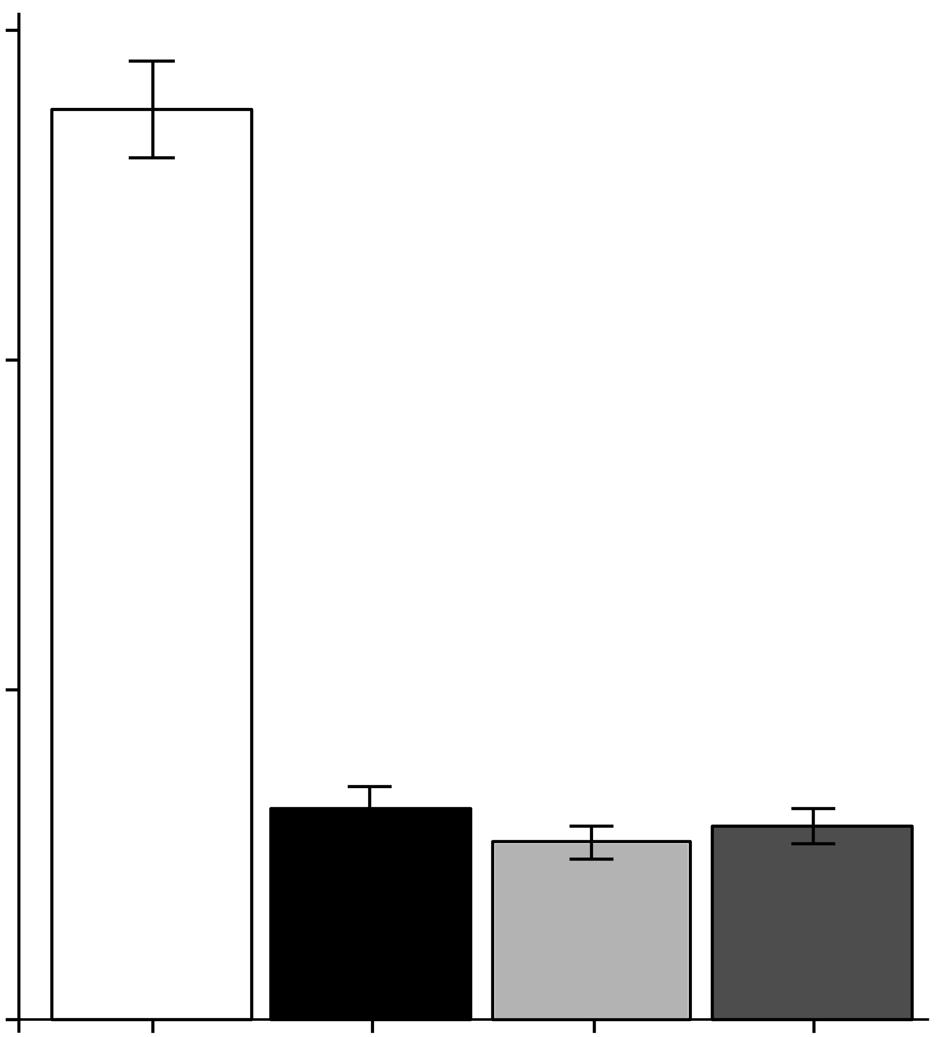
C. striatum (Cst) cell-free conditioned medium inhibits S. aureus AIP-1 signaling
30000
20000
Luminescence
10000
0
BHI
medium
CFCM
Cst
<3kDa
<3kDa
heat
AIP-1 +
n ≥ 3
Notes:
BHI

Slide 26
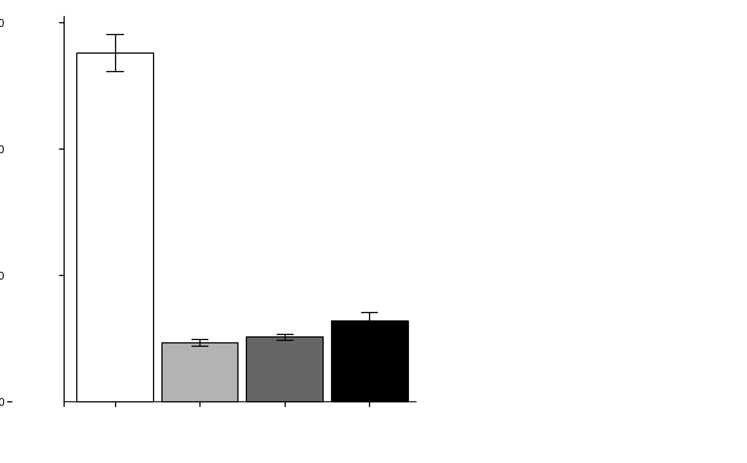
CFCM from other Corynebacterium spp. also interfere with AIP-1 signaling
30000
medium = BHI
Cam = C. amycolatum
Cgl = C. glutamicum
Cst = C. striatum
20000
Luminescence
10000
0
AIP-1 +
medium
Cam
Cgl
Cst
n ≥ 3
Notes:
AIP-1 produced in E. coli
Pre-mix w/ Coryne CFCM for 2 hours then add to S. aureus reporter strain
S. aureus RN4220 ∆agr::ermB P3agr_luxABDCE + pArC/agrA (cmR) / ROJ143
Ink_Cst_Cam_Cst_CFCM_AIP1inhibition.png

Slide 27
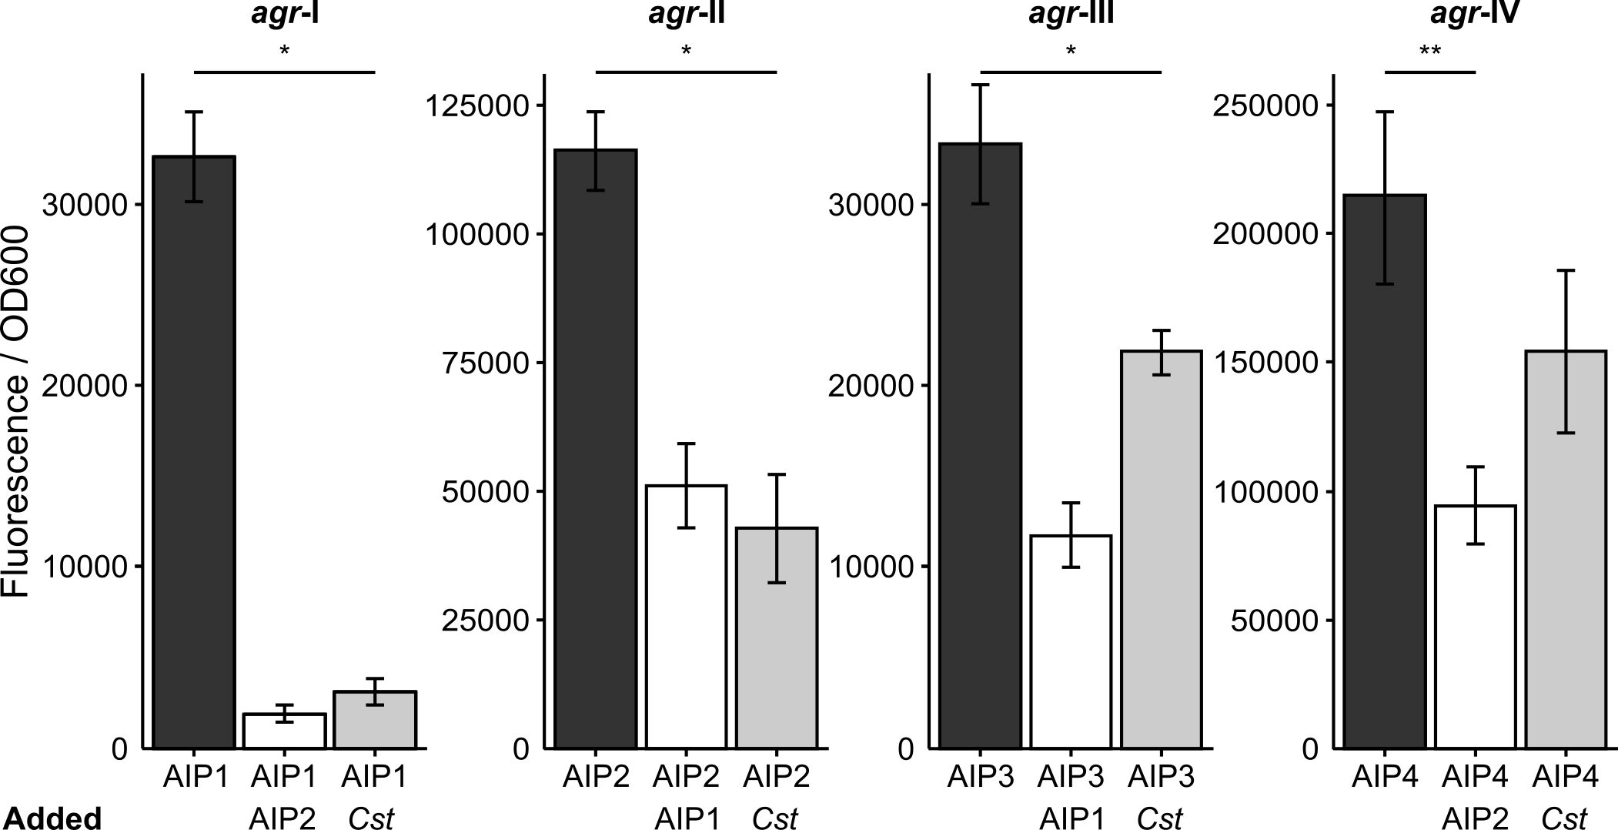
Cst inhibits agr types I, II and III

Slide 28
Possible mechanisms of AIP signaling inhibition
Degradation or modification
Sequestration
Production of competitive inhibitor
Other?

Slide 29
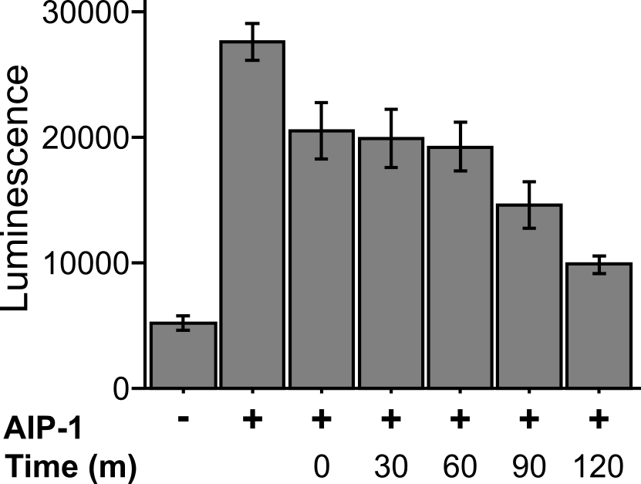
AIP-1 inhibition is time-dependent

Slide 30
Summary
All Corynebacterium spp. tested inhibit S. aureus AIP-1 function
C. striatum inhibits AIP 2 and 3 function
The inhibitor is <3kDa, heat stabile and is not due to pH

Slide 31
Hypothesis: C. striatum diminishes S. aureus virulence
S. aureus agr mutants can display decreased virulence

Slide 32
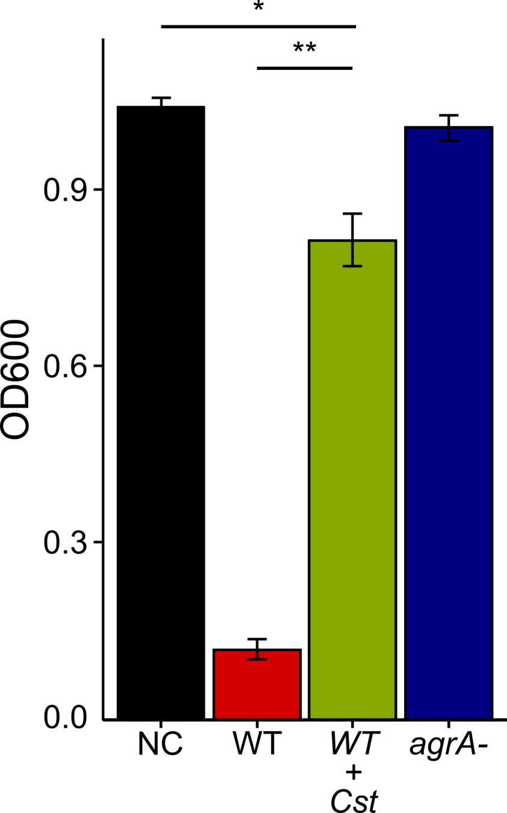
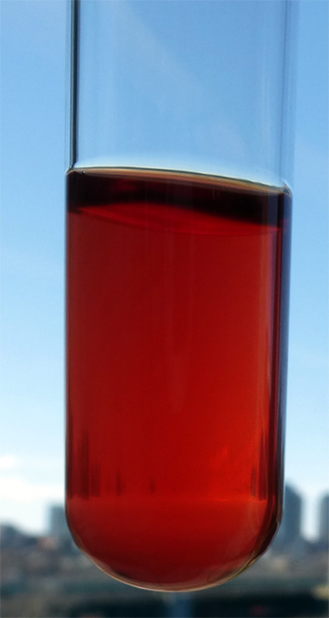
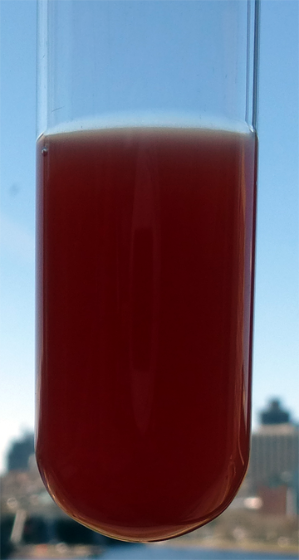
C. striatum inhibits S. aureus hemolysis
WT
WT+Cst
*p < 0.05, **p < 0.01 n = 8

Slide 33
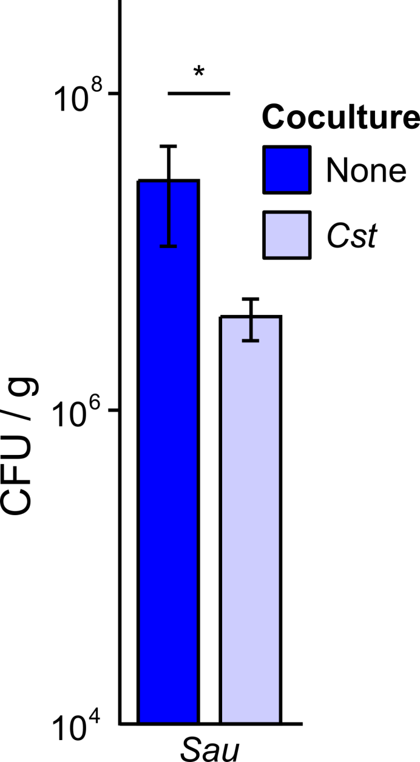
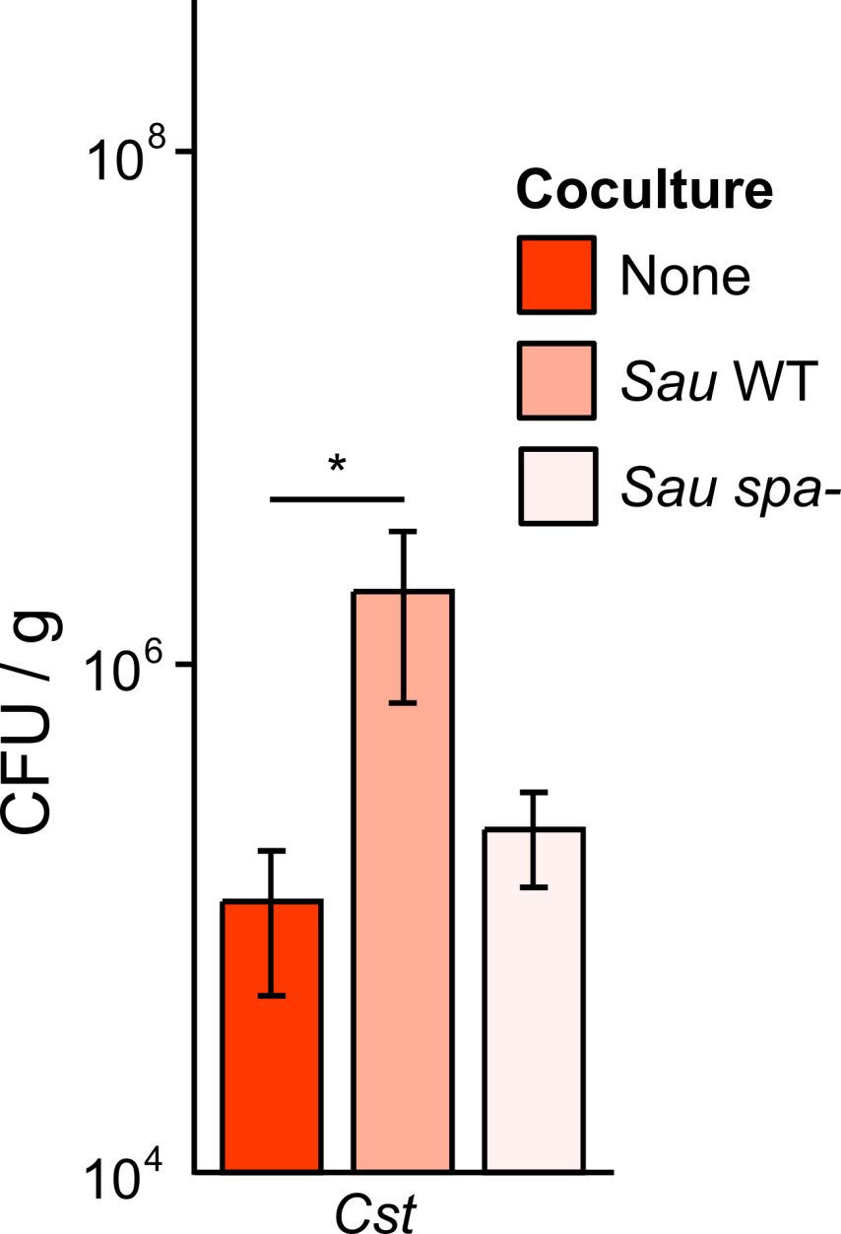
Survival of C. striatum increases in abscesses with wild-type S. aureus
Survival of wild-type S. aureus decreases in abscesses with C. striatum
C. striatum’s survival advantage in coculture depends upon S. aureus spa (Protein A)
Mouse subcutaneous abscess infection
Sau wt
C. striatum

Slide 34
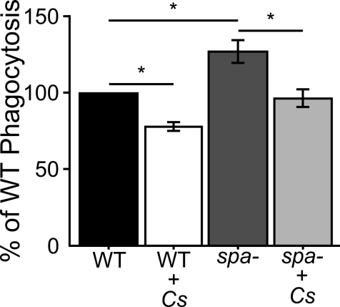
C. striatum inhibits S. aureus phagocytosis
*p < 0.05, n = 4

Slide 35
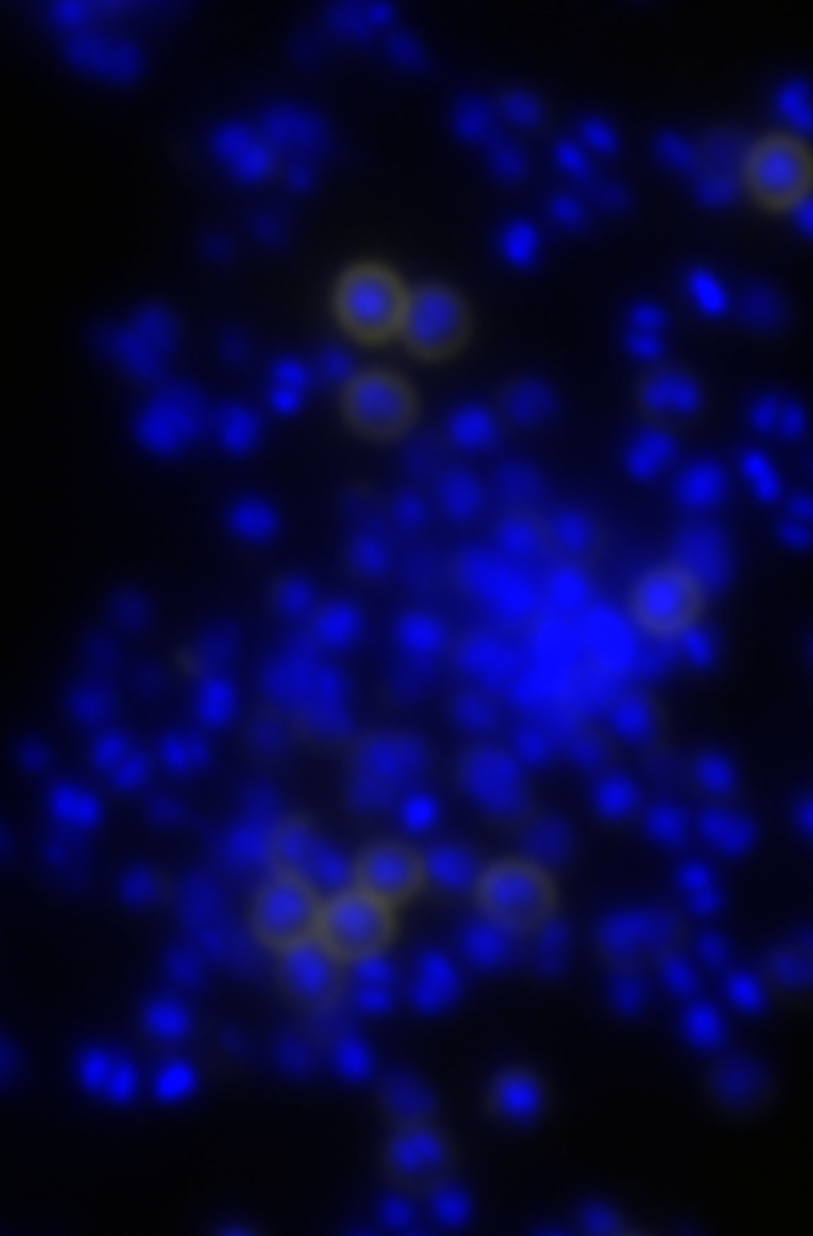
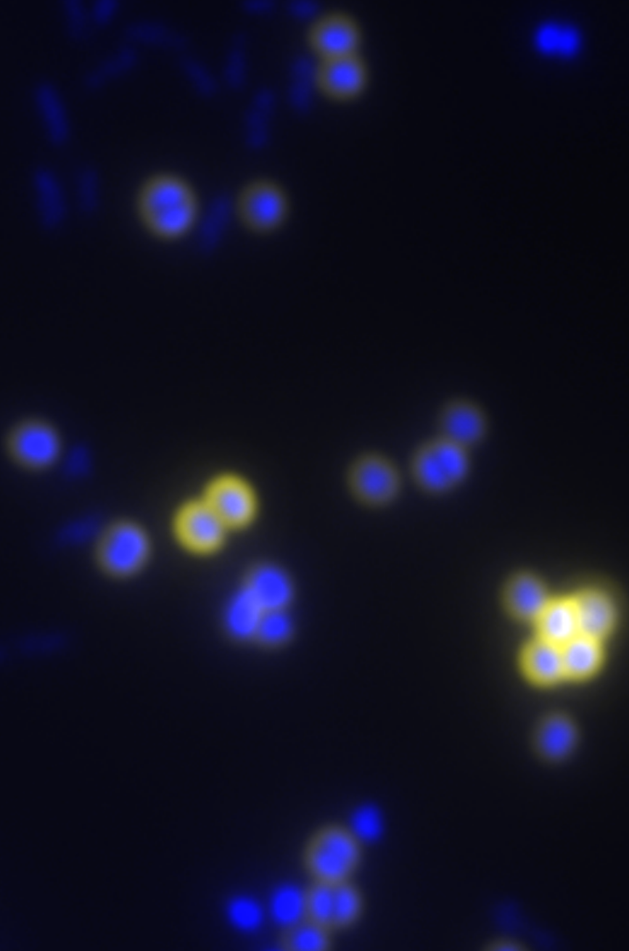
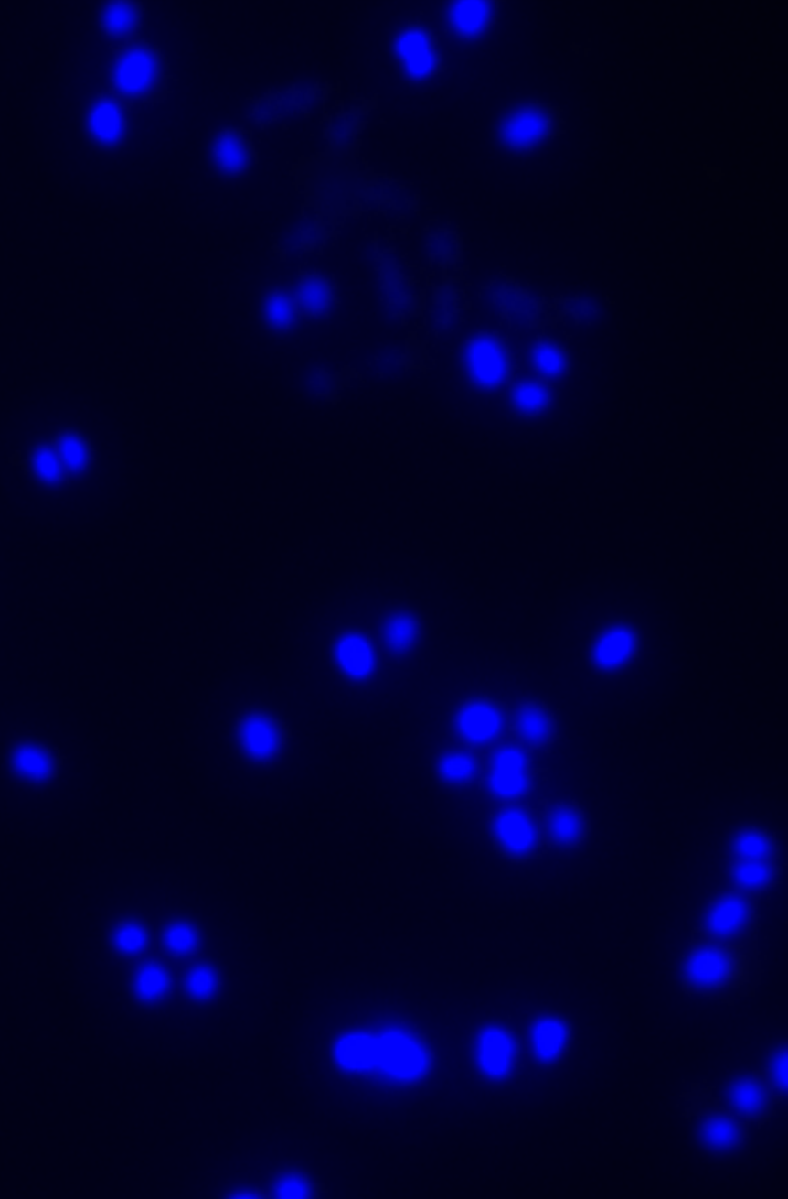
Protein A is increased on S. aureus cells grown in coculture with C. striatum
Cells stained with DAPI
Antibody-stained Protein A
Sau mono
Sau + Cst
Δspa + Cst
4%
59%
n.d.
n=3
Notes:
DAPI was the nuclear stain, FITC was the Spa stain. Images were taken at 1000x magnification under identical exposure settings. Image analysis and counts in each color channel were performed with ImageJ under identical settings for each image to generate the ‘E’ figure above.
P=<0.001 for the figure and these were from a biological n=2.
WT-monoA.png
WT-mixB.png
Spa-mixB.png
+++

Slide 36
Summary
S. aureus
alone
S. aureus +
Corynebacterium spp.
AIP-1
AIP-1
Virulence
Factors
?
Antibacterial proteins
Exotoxins
Hemolysin
Protein A (Spa)
Antibacterial proteins
Exotoxins
Hemolysin
Protein A (Spa)
Notes:
[]read diggle paper again re AIP as public good in Sau
[]Cst exploiting Sau public good – acting like a cheater
[]Could the mixed infection with Coryne actually promote chronicity while inhibiting invasion & bacteremia?

Slide 37
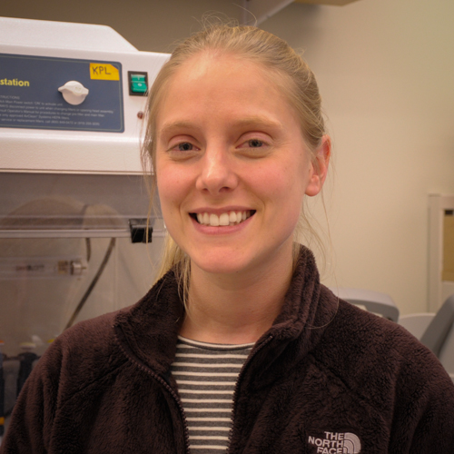


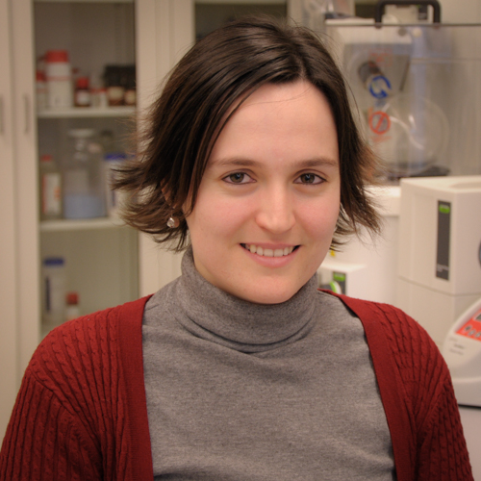
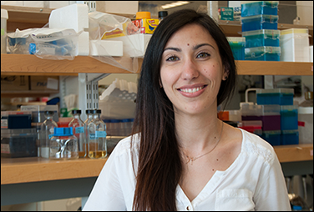





Acknowledgements
The Lemon Lab
Katherine Lemon
Lindsey Bomar
Isabel Fernandez Escapa
Jennifer Spagnolo
Silvio Brugger
Past members
Anne Mentzinger
Michael Wollenberg
Kelly Aldridge
Carla Cugini (w/ Davey Lab)
Beck Jacobson
Kelsey Goguen
Evan Pagano
Brian Yost
Collaborators
Kendra Rumbaugh (Texas Tech)
Marcelo Friere (Forsyth)
Boston
Children’s
Hospital
Notes:
[]ADD MMR and CC

Slide 38
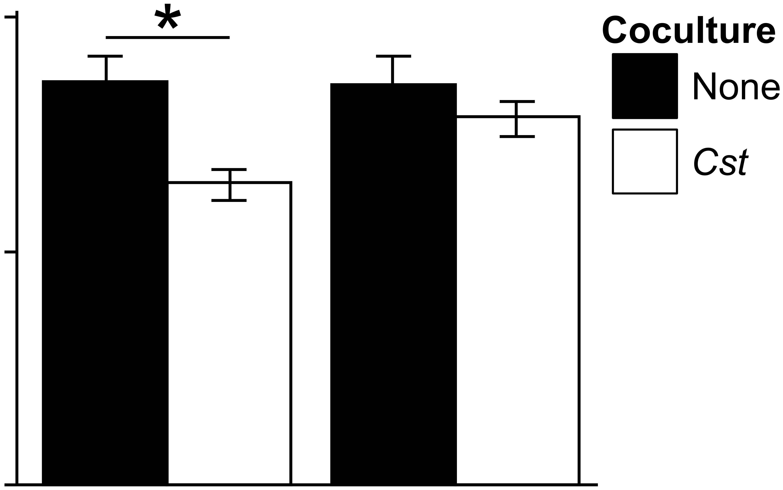
S. aureus numbers in abscesses do not depend on spa alone
10⁶
Co-infection
No
Cst
CFUs/gram of abscess
10⁵
10⁴
Sau wt
Sau Δspa
*p < 0.012, n = 9
Notes:
Ink_Mouse_Sau.png
Error bars represent 1 SEM, n >=9, Mann Whitney U-test values are: * p <0.012, ** p <0.05.

