Slide 1
Slides for COBRE talk

Slide 2
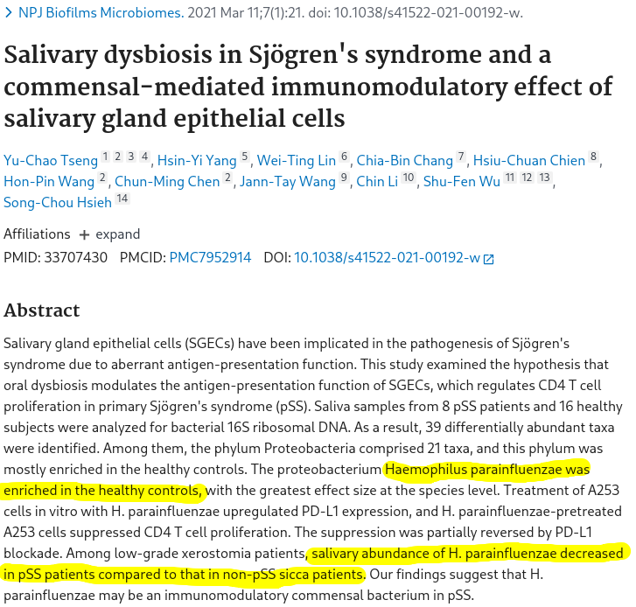

Slide 3
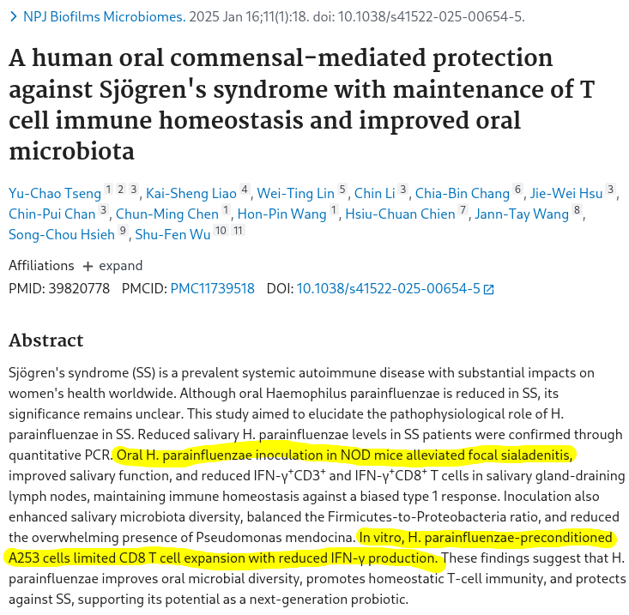

Slide 4
Initial experiments
H. parainfluenzae was exposed in transwell plate culture to A293 SG cells overnight.
As a comparison condition we also carried out an identical experiment with OKF6 epithelial cells.
RNASeq was performed on Hp in both conditions (mono vs coculture) and the same for A293

Slide 5
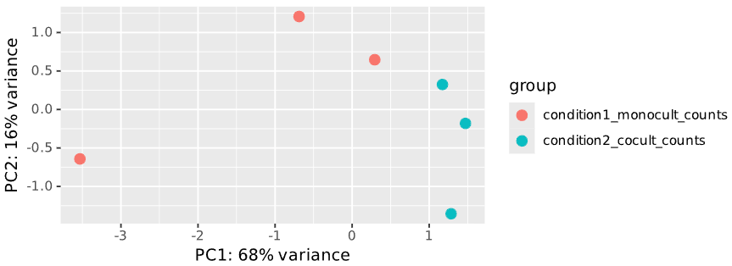
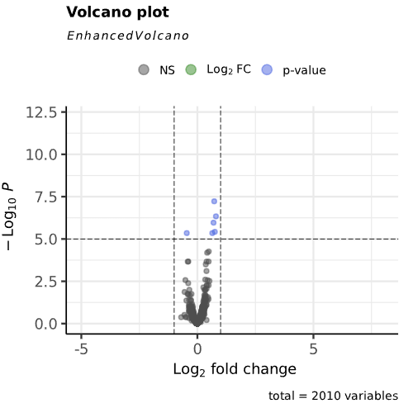
Hp mono vs Hp + OKF6 transcriptomes
Basically nothing happened here

Slide 6
Hp mono vs Hp + A293
1614 DEGs (800 up, 814 down)
This is a lot
  ~400 DEGs were the most we’ve ever observed with Hp in any other condition

Slide 7
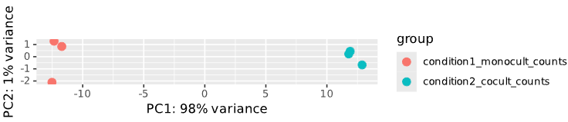
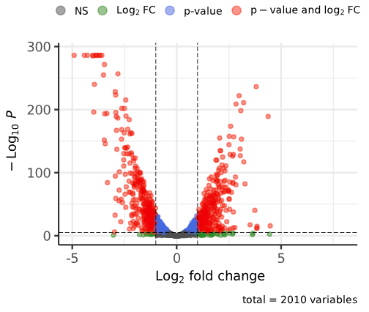
Hp mono vs Hp + A293 transcriptomes

Slide 8
Major transcriptome trends
UP
Envelope stress
DNA repair
Iron scavenging
Biofilm formation
Stringent response
DOWN
Translation
Energy metabolism
General transporters
CRISPR / T6SS (doubt)

Slide 9
Biofilm formation?
Type IV pili up
Pga (capsule) up
Type II secretion up
Efflux pumps up

Slide 10
Biofilm experiments (prelim data)
Use GFP-expressing H. parainfluenzae to directly assess attachment to A293 vs OKF6/ other cell types.
TEM/SEM of Hp exposed to A293 vs OKF6?
Crystal violet assay
  Incubate Hp in supernatant from A293, OKF6 and basal media separately in 96-well plates overnight and stain for biofilm formation.

