Slide 1
The role of oral bacteria in subgingival plaque and foot infections in diabetes
M. Ramsey
Former K99/R00 application, 2014 and 2015

Slide 2
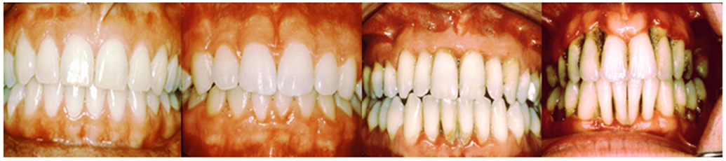
Periodontitis
Complex polymicrobial infection
Healthy plaque transitions to a Gram-negative anaerobe-rich variety
A risk factor for heart disease
www.oramd.com
Notes:
Add images of gingivitis then Perio

Slide 3
Aggregatibacter
actinomycetemcomitans
Streptococcus gordonii
Aa
Sg
Gram negative
Facultative anaerobe
Pathogen
Gram positive
Facultative anaerobe
Commensal

Slide 4
Necessary for in vivo coinfection
Lactate
X
Aa
Sg
OxyR
H₂O₂
KatA
ApiA
Contributes to immune resistance
Detoxifies mM concentrations in <10 um distances
Ramsey et al., PNAS 2009
Liu, Ramsey et al., PNAS 2010
Ramsey et al., PLoS Pathog 2011

Slide 5


🤔

Slide 6
Diabetic foot ulcer infections (DFIs)
Chronic polymicrobial infections
  Superficial wounds progress to non-healing, infected ulcerations
  Precedes amputation
Microbiota is variable
  Most attention given to major pathogens
  Many studies have identified potential oral taxa
  Diabetics (type-2) are 3x more likely to develop periodontal infections
Notes:
[]add references!

Slide 7
Isolated infection flora is diverse
Many genera that contain oral species are present in DFIs
These include: Prevotella, Porphyromonas, Fusobacterium, Streptococcus and many more
Bowler et al. (1999) Int. J. Derm.
Dowd et al. (2008) PLoS One
Gardner et al. (2013) Diabetes
Citron et al (2007) J. of Clin. Micro
Notes:
Fix this, minimize, add Dowd and Bowler Data

Slide 8
Many genera present in DFIs contain oral species
Are oral species present in DFIs in a meaningful context?

Slide 9
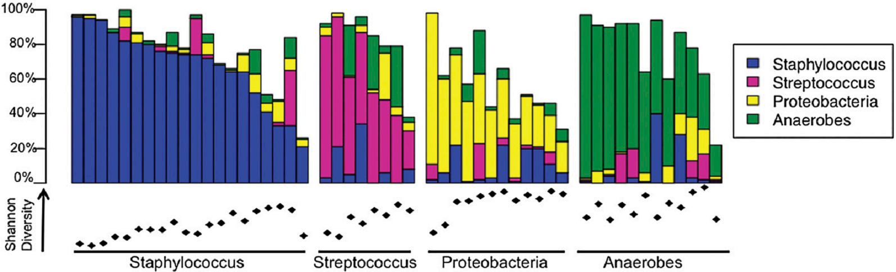
Culture independent DFI Data
52 patients
  All neuropathic, nonischemic DFUs
V1-V3 16S dataset 454 sequencing
Gardner S, Hillis S, Heilmann K, Segre J, Grice E. (2013) Diabetes

Slide 10
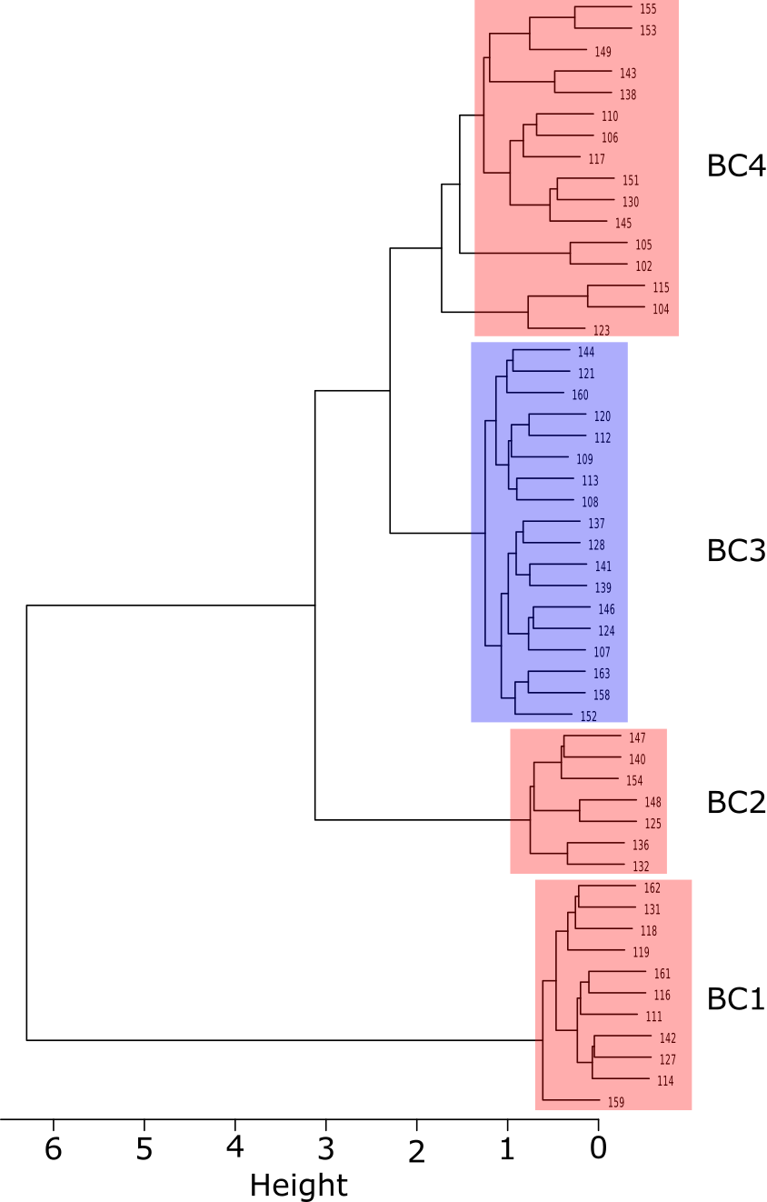
52 patients
~160 species, 83 genera
4 clusters determined by Bray-Curtis dissimilarity
Cluster 3 (18 patients) enriched in anaerobes / oral taxa

Slide 11
Composition of Cluster 3
We used Linear Discriminate Analysis Effect Size (LEfSe) for genus / species enrichment
156 of 176 nodes were present >0.1% relative abundance
Nodes matched to HOMD then RDP @ >98.5% similarity

Slide 12
Identity | LDA (log10)
Anaerococcus | 4.49
lactolyticus | 3.75
vaginalis | 4.06
Atopobium | 3.80
parvulum | 3.06
Bacteroides | 4.47
ureolyticus | 3.86
Dialister | 3.55
propionifaciens | 3.07
Fusobacterium | 4.25
periodonticum | 3.79
Haemophilus | 4.02
parainfluenzae | 3.24
Peptoniphilus | 4.14
asacchyrolyticus | 3.25
HOT836 | 3.28
indolicus | 3.94
Peptostreptococcus | 4.29
anaerobius | 4.26
Porphyromonas | 4.59
bennonis | 3.87
somerae | 4.31
Prevotella | 4.02
bergensis | 3.20
buccalis | 3.29
corporis | 3.28
loescheii | 3.22
nigrescens | 3.41
Solobacterium | 4.06
moorei | 3.40
Many oral taxa are seemingly present
Are they present in meaningful numbers?
These data compared to a diabetic periodontitis dataset
Culture isolation data also supports this
Species | % of patients
Bacteroides spp | 8.4
Clostridium spp | 4.9
Corynebacterium spp | 28.3
Finegoldia spp | 24.4
Fusobacterium spp | 2.5
Porphyromonas spp | 10.3
Prevotella spp | 12.3
Staphylococcus spp | 80.8
Streptococcus spp | 41.1
-(mitis group) | 9.4
Table 1. Bacterial isolates of Diabetic Foot Infections. Isolate data above is from a 433 patient culture-based study of bacterial diversity of DFIs (Citron, 2007). Common skin inhabitants (Corynebacterium, Staphylococcus) are numerically abundant in addition to Streptococcus however most were S. agalactiae (20%) with the oral “mitis” group (S. australis, S. cristatus, S. gordonii, S. infantis, S. mitis, S. oligofermentans, S. oralis, S. parasanguinis, S. peroris, S. pneumoniae, S. pseudopneumoniae, S. sanguinis S. sinensis) represented poorly compared to other species in the genus.

Slide 13
Relative Abundance Comparison
Identity |  | DFI BC3 | DB Perio | Perio | DFI | Identity | DFI BC3 | DB Perio | Perio | DFI
Actinomyces |  | 0.91 | 1.10 | 0.06 | 0.13 | Parvimonas | 1.56 | 0.33 | 0.04 | 0.38
Bacteroides |  | 4.76 | 0.04 | 0.24 | 0.08 | micra | 1.56 | 0.29 | 0.04 | 0.38
Capnocytophaga |  | 0.33 | *2.58 | 0.95 | *0.00 | Peptococcus | 0.04 | 0.24 | *0.00 | *0.00
Corynebacterium |  | 11.73 | *1.63 | *0.00 | 5.24 | Porphyromonas | 7.01 | 14.82 | 21.55 | *0.32
Delftia |  | 0.13 | 0.07 | 0.03 | 0.34 | Prevotella | 1.91 | *24.17 | *29.32 | 0.38
acidovorans |  | 0.13 | 0.07 | 0.03 | 0.34 | loescheii | 0.07 | 0.28 | *0.00 | *0.00
Dialister |  | 0.36 | 0.19 | 0.14 | *0.00 | melaninogenica | 0.80 | 0.51 | 0.71 | 0.02
Eikenella |  | 0.03 | 0.17 | 0.17 | 0.23 | nigrescens | 0.46 | 4.00 | 3.39 | *0.00
corrodens |  | 0.03 | 0.17 | 0.17 | 0.23 | Propionibacterium | 1.06 | 1.39 | 0.20 | 2.67
Fusobacterium |  | 3.19 | 6.80 | 3.04 | 0.05 | Pseudomonas | 1.37 | 0.23 | *0.00 | 0.72
nucleatum.ss.polymorphum |  | 0.28 | 1.76 | 0.77 | 0.02 | Rothia | 0.94 | 0.16 | 0.39 | 0.21
nucleatum.ss.vincentii |  | 0.10 | 0.94 | 2.39 | 0.02 | Streptococcus | 8.51 | *0.55 | *0.47 | 11.92
periodonticum |  | 1.30 | 0.71 | 0.24 | *0.00 | mitis | 1.38 | 0.55 | 0.11 | 0.79
Haemophilus |  | 0.26 | 0.49 | *0.00 | *0.01 | Veillonella | 0.10 | 0.31 | 0.12 | 0.29
Lachnospiraceae |  | 0.33 | 0.46 | 0.10 | 0.07 | parvula | 0.10 | 0.31 | 0.12 | 0.29
Neisseria |  | 0.33 | *1.15 | 0.76 | 0.32
elongata |  | 0.22 | 0.37 | 0.24 | 0.04
Values in red are significantly different from BC3, p <0.05

Slide 14
Oral Species in DFIs
Many observed at similar relative abundances
Some prominent species are not represented
Could non-oral species act as analogues for oral species in maintaining required interactions?

Slide 15

Two Hypotheses
Oral bacteria autoinfect DFIs within individuals
Oral
?
“Hybrid Community”
Oral bacteria maintain molecular mechanistic relationships with non-oral microbes in DFIs
?
Oral

Slide 16
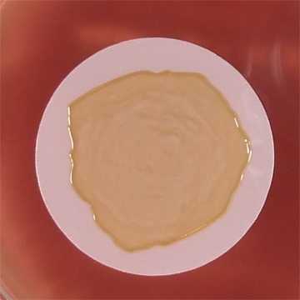
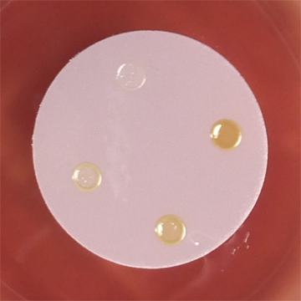
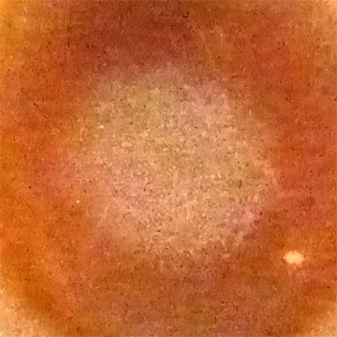
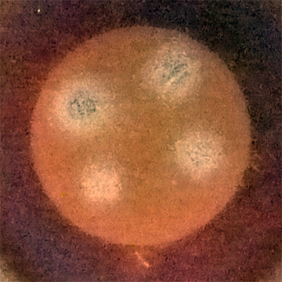
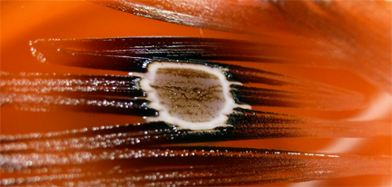
Complementary Functions / Auxotrophies to be Satisfied
Pg Spots
A
B
Oral Bacteria
Non-Oral Bacteria
Fusobacterium nucleatum,
others
Staphylococcus aureus
Sa overlay
Porphyromonas
gingivalis
C
D
Vitamin K
Cell-cell adhesion
Vitamin K
Growth stimulatory Factor
(Fig. 4)
Treponema denticola
Succinic acid
Isobutyric acid
E
Streptococcus gordonii
???
?
Contact dependent signaling
AI-2
Figure 3 Metabolite, signaling and co-adhesion interactions with the oral pathogen P. gingivalis. This figure summarizes numerous studies demonstrating the ability of P. gingivalis to obtain nutrients such as Vitamin K (menaquinone) from oral and non-oral sources. Succinic acid uptake and mutual synergistic growth of T. denticola by P. gingivalis isobutyric acid production as well as cell-cell adhesion, contact dependent signaling and quorum signaling that aid in mature periodontal biofilm development are thought to be important in disease.
Figure 4. Synergism between oral and non-oral bacteria. This figure shows (A-B) 5 day old cultures of P. gingivalis grown on 0.2um polycarbonate membranes on blood agar. (B) Cultures were inoculated at 4 different orders of magnitude. (C) S. aureus overlay grown for 16h after removal of P. gingivalis containing membrane indicates growth stimulatory activity remaining in the agar medium. (D). Growth stimulation of identical S. aureus overlay on different densities of P. gingivalis. (E) Enhancement of P. gingivalis growth (black streaks) around a central colony of S. aureus.

Slide 17
Global Hypothesis: Oral anaerobes participate in conserved molecular interactions that are critical for their survival in DFIs and periodontitis
Aim. Identify species of oral bacteria in DFIs and compare their spatial relationships to other bacterial species in DFIs and subgingival plaque.
Aim. Determine if oral species in DFI are clonal matches to ones in the mouth.
Aim. Investigate polymicrobial interx between species and determine if mechanisms of interx are identical in both DFI and oral environments.

Slide 18
Why do this?
Proving autoinfection might allow for better containment / hygeine practices
Identification of conserved mechanistic relationships in oral bacteria highlight necessary pathways for in vivo survival that can be exploited in two separate infection contexts

Slide 19
Summary
Oral species are enriched in a subset of DFIs
Oral species appear to form “hybrid communities” with non-oral DFI residents
Caveat – we don’t know if these interactions are meaningful or even necessary as there are too many gaps in the data

