Slide 1
One (or two) ways in which bacterial commensals may prevent disease
Matthew Ramsey, Ph.D.
Department of Oral Immunology and Infectious Diseases
University of Louisville School of Dentistry

Slide 2
A top down view of a complex community
Metabolites
or Signals
Synergy
Antagonism

Slide 3
A reductionist approach to reveal interactions
in vitro
“omics” approaches
molecular mechanisms
extrapolate to in vivo

Slide 4
Mechanistic interaction revealed
Synergy
Antagonism

Slide 5

Nasopharynx Microbiome
Changes in puberty and again in old age
Cutibacterium (Propionibacterium), Staphylococcus, Corynebacterium and others are the more dominant members
Opportunistic pathogens can often be found colonizing here asymptomatically

Slide 6
Corynebacterium
striatum
Staphylococcus
aureus
Cst
Sau
Gram positive
Benign commensal
Understudied
Gram positive
Invasive pathogen
Commensal as well
agr Quorum Sensing

Slide 7
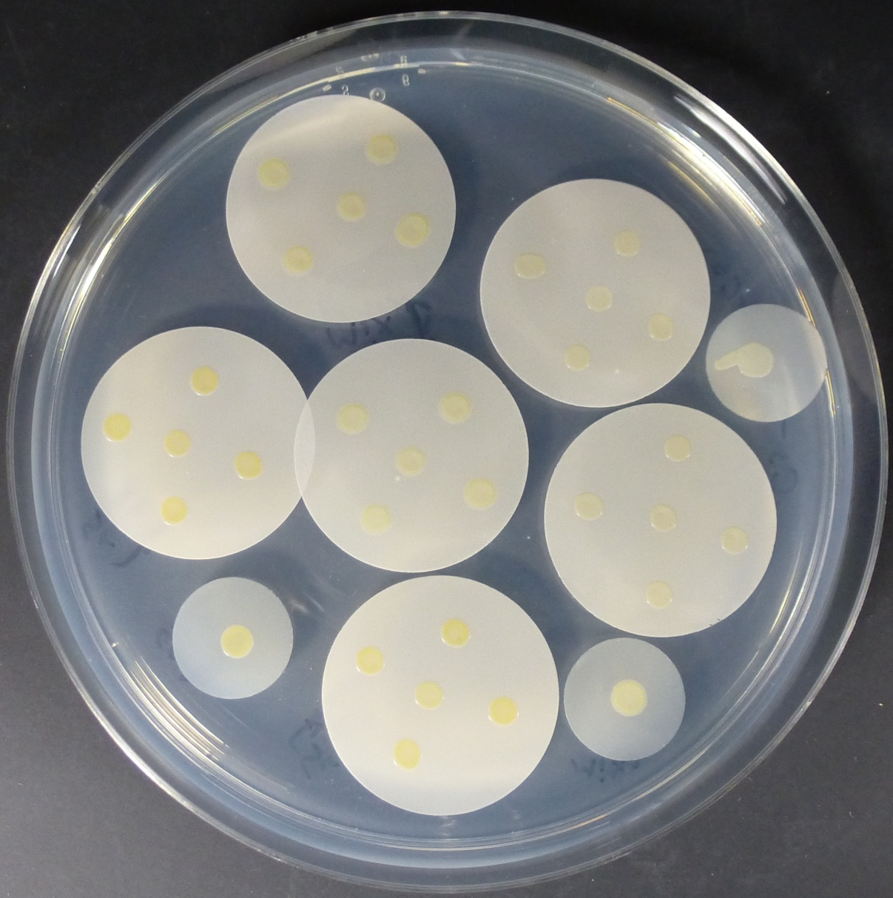
S. aureus-C. striatum coculture assay
C. striatum
5 x 10⁶
S. aureus JE2
5 x 10⁵
Mixed inoculum
Notes:
Color coded and animated labels for mono / cocultures here

Slide 8
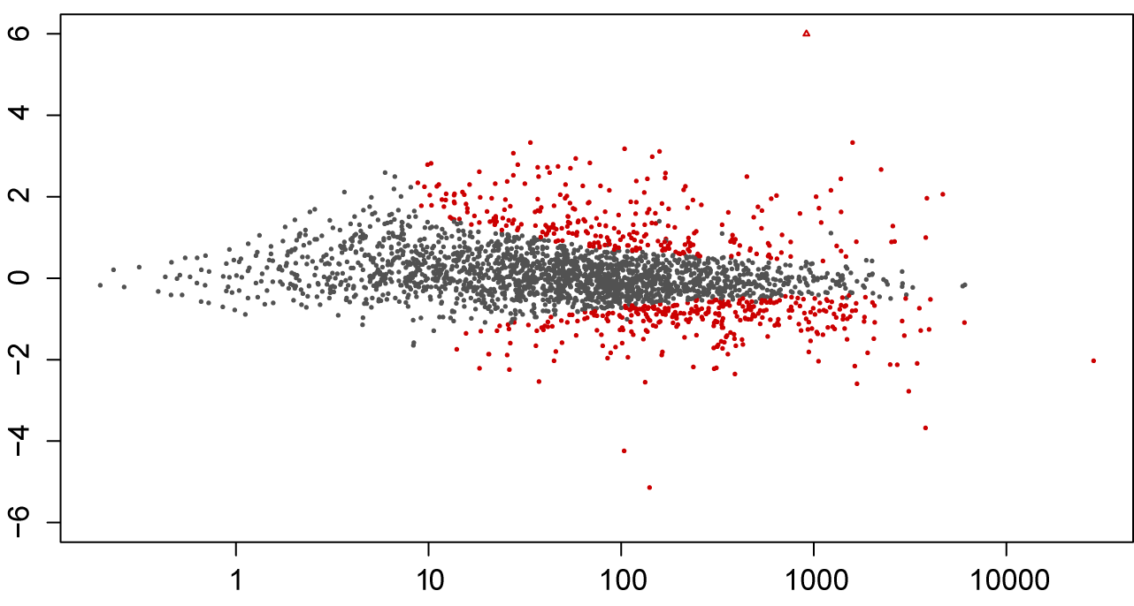
Cocultivation with C. striatum induces broad changes in S. aureus transcription
log₂ fold change
mean expression

Slide 9
S. aureus agr regulon is repressed in coculture with C. striatum
~50% of the genes differentially expressed belonged to the agr regulon
Most genes involved in virulence were repressed
Many cell surface proteins and genes involved in adherence were induced

Slide 10
agr and Virulence
O
AIP-1
M
S
I
F
Y
S
T
C
D
Exotoxins
Hemolysin
Degradation enzymes
Adhesion factors

Slide 11
The S. aureus agr system plays a critical role in pathogenesis
Commensal
Pathogen
agr OFF
Adhesion / evasion
agr ON
Virulence factor production

Slide 12
S. aureus modulates extracellular virulence factor production
Commensal
Pathogen
agr OFF
Adhesion / evasion
agr ON
Virulence factor production

Slide 13
S. aureus agr activity is inhibited by C. striatum
Commensal
Pathogen
agr OFF
agr ON

Slide 14
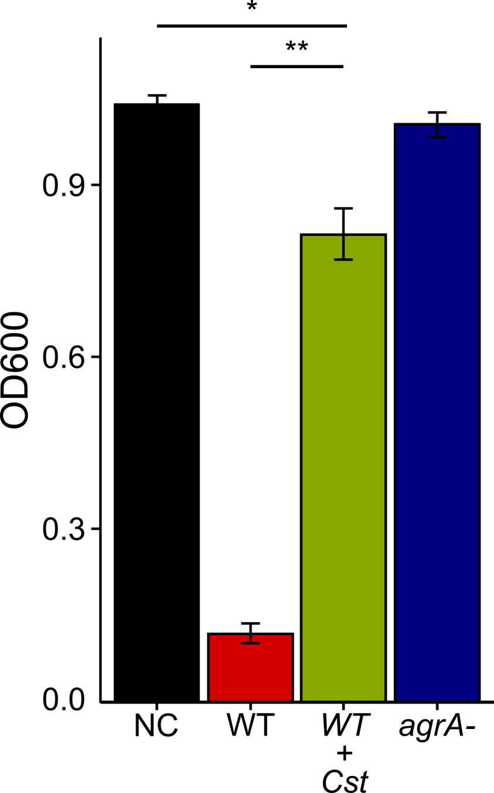
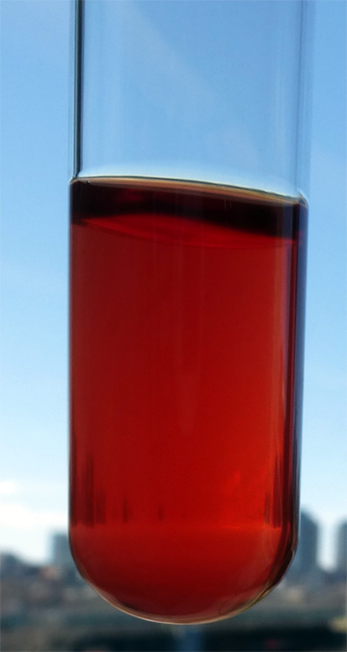
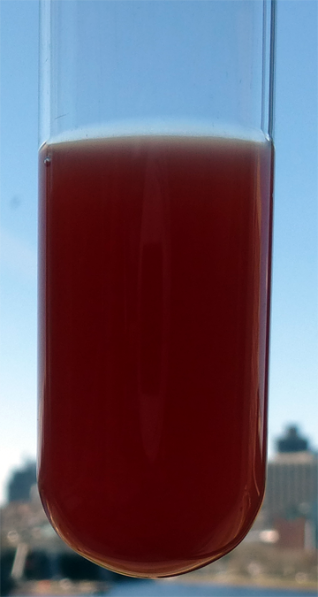
S. aureus hemolysis is inhibited by C. striatum
WT
WT+Cst
*p < 0.05, **p < 0.01 n = 8

Slide 15
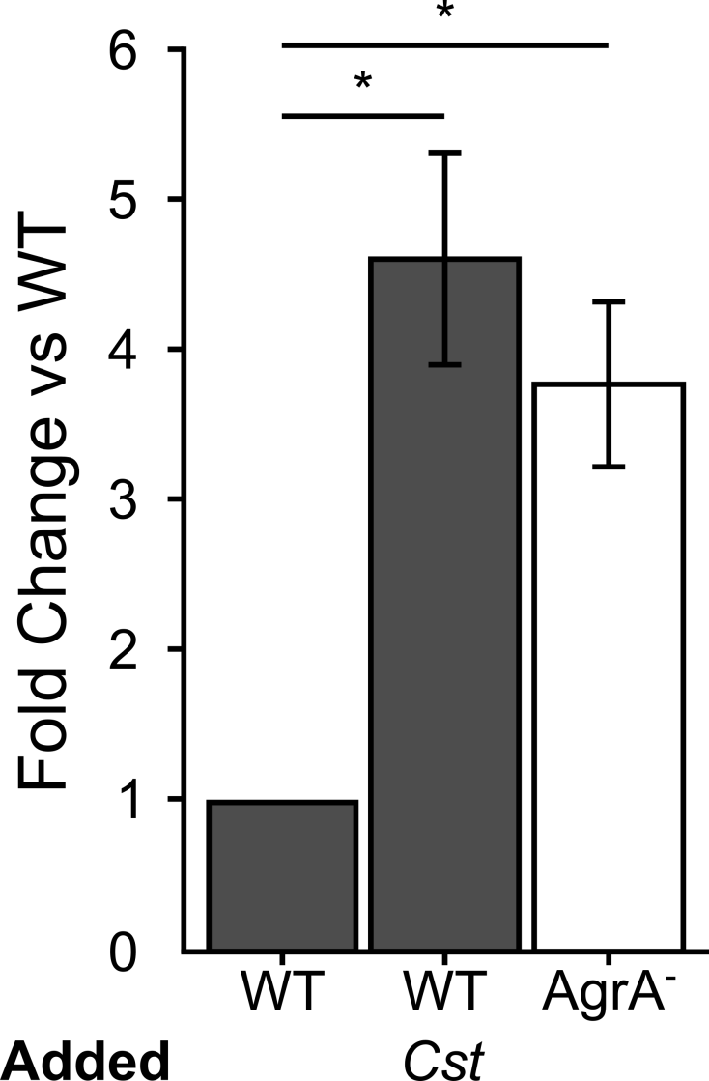
S. aureus epithelial cell attachment

Slide 16
Summary
All Corynebacterium spp. tested inhibit S. aureus agr QS activity
Other S. aureus agr types are inhibited
To date the inhibitor compound has not been purified
Ramsey, Freire et al, Frontiers Micro. 2016

Slide 17
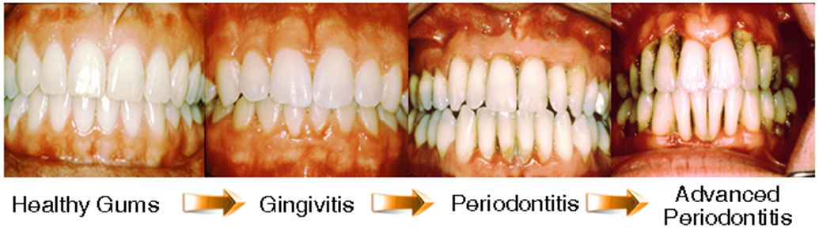
Periodontitis
Complex polymicrobial infection / inflammatory disease
Healthy plaque transitions to a Gram-negative anaerobe-rich variety
  Complex polymicrobial disease
A risk factor for heart disease

Slide 18
We must understand mechanisms of interaction between commensals to exploit them for our benefit.
My laboratory studies interactions within the oral cavity
How do we choose the right species for study?

Slide 19
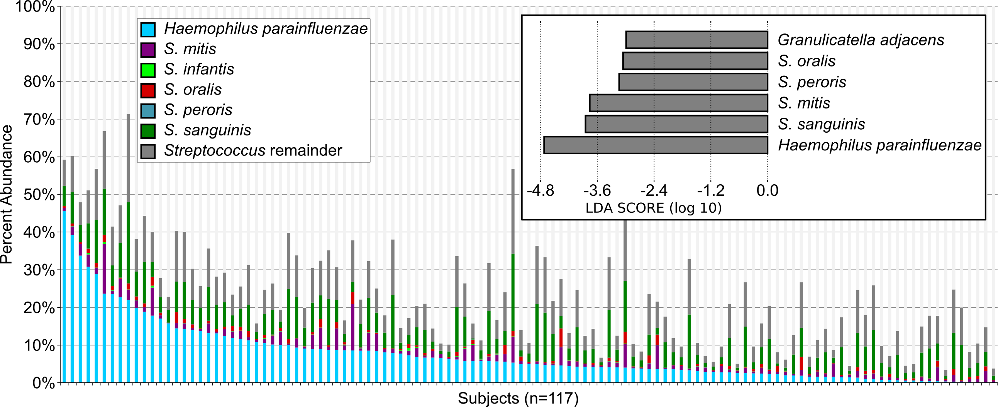
Choosing commensal pairs
Microbiome correlations are validated by microscopy for species probes on ex vivo samples

Slide 20

Haemophilus parainfluenzae
Gram negative
Facultative anaerobe
Abundant in several oral sites / extraoral
Opportunist, generalist
Strongly correlates with healthy oral conditions
Dasith Perera - PhD

Slide 21
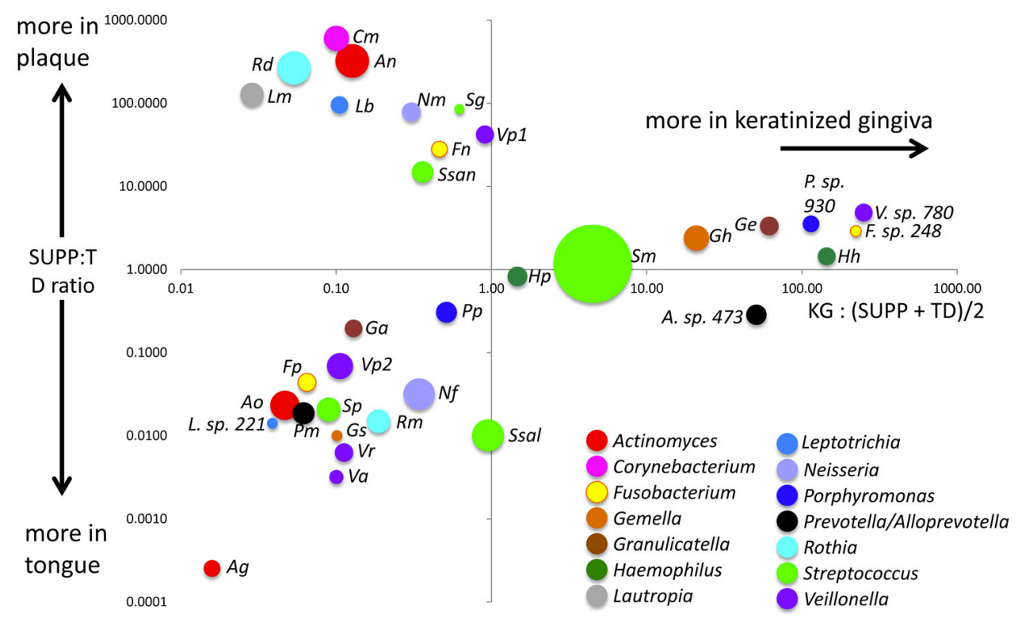
Haemophilus parainfluenzae and Streptococcus mitis
Mark Welch et al., 2019

Slide 22
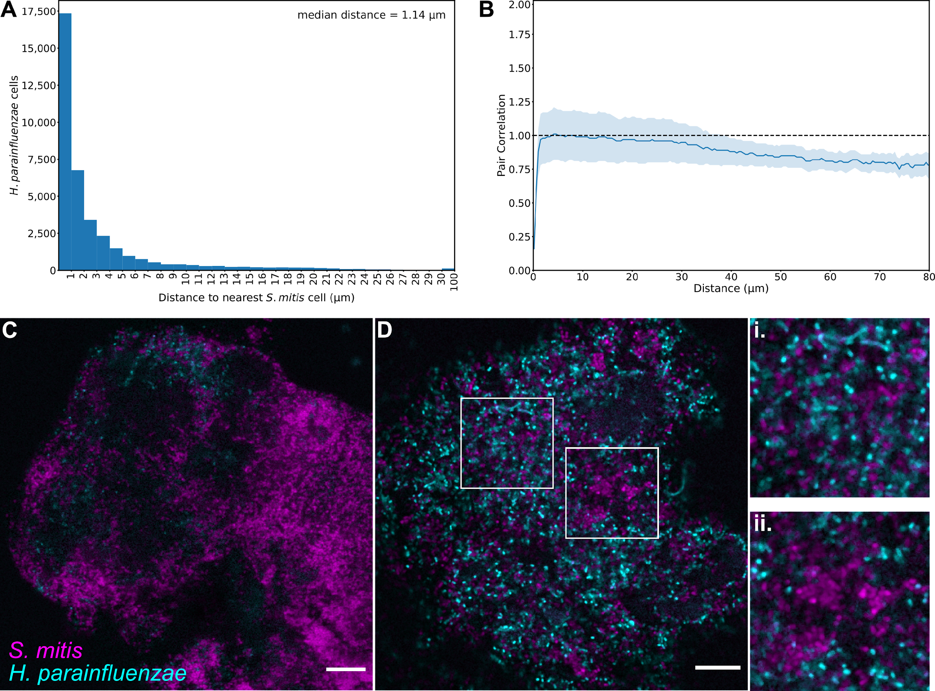
Hp – Sm in vivo proximity
“mitis-group”
Perera D., McLean, A., Mark Welch, J, Ramsey, M. (2021), ISME

Slide 23
Hp – Sm in vivo proximity
Perera D., McLean, A., Mark Welch, J, Ramsey, M. (2021), ISME

Slide 24
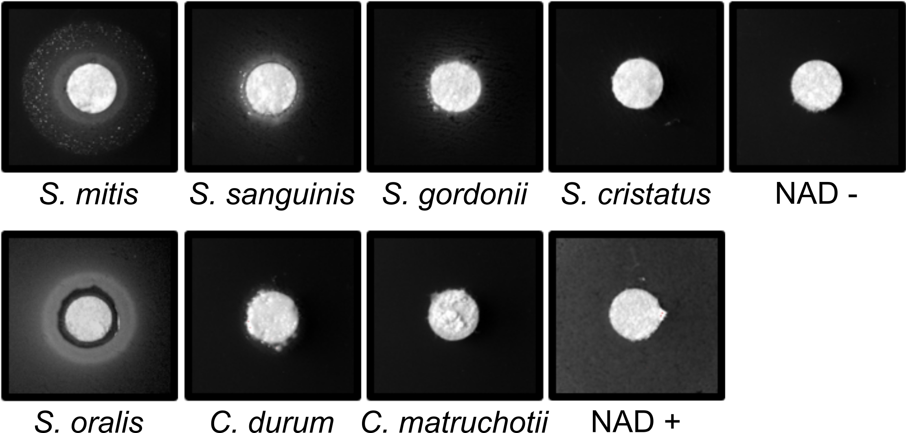
Why is Hp found near Sm in vivo?
Hp lawns
Medium:
BHI +YE +Hemin + Catalase
Perera D., McLean, A., Mark Welch, J, Ramsey, M. (2021), ISME

Slide 25
Streptococcal NAD release
Is NAD excreted or released from streptococci via lysis?
Some of the most potent NAD producers we tested possess lytA
Hypothesis: LytA is the primary method for NAD release

Slide 26
How is this important for health?
Hp is highly abundant in oral health
Hp abundance negatively correlates with:
  Periodontitis, Sjögren’s disease, mucositis, oral cancer and other disease states
Does Hp contribute to host health?
Is Sm presence required?

Slide 27
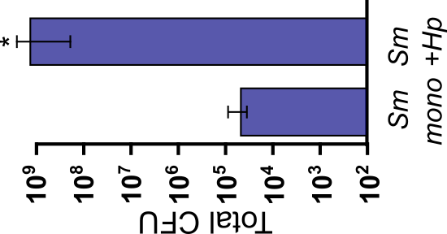
Hp – Sm phagocyte killing
Survival post-exposure to HL60 neutrophil-like cells for 1 – 8hrs
Hp was not killed by HL60 cells (or serum complement)
Sm survival was enhanced only if Sm-Hp coculture was >1h
Sm transcriptomes showed elevated expression of several “pspA / pspC” like surface proteins in Hp coculture

Slide 28
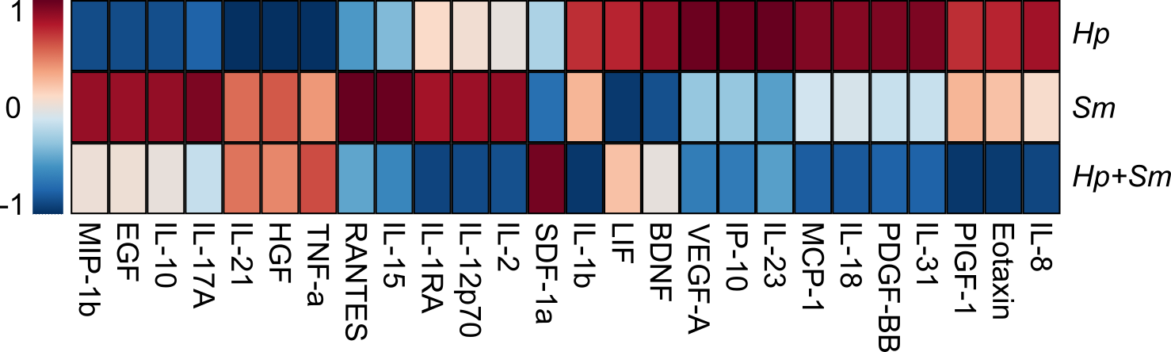
Hp – Sm cytokine profiles

Slide 29
Summary
Hp exists in direct proximity to Sm in vivo
Hp induces Sm phagocyte resistance
Hp-Sm coculture alleviates inflammatory signaling from exposed neutrophils
Sm gene expression in Hp coculture suggests a mechanism for phagocyte survival

Slide 30
Future / Current Work
Repeat all Hp-Sm experiments with blood-derived neutrophils
  If promising, test Sm psp-like gene involvement in coculture neutrophil resistance
Assess mechanisms for Hp complement resistance
Determine NAD export route for Sm
Can we use these commensal interactions to prevent or reverse inflammation?

Slide 31
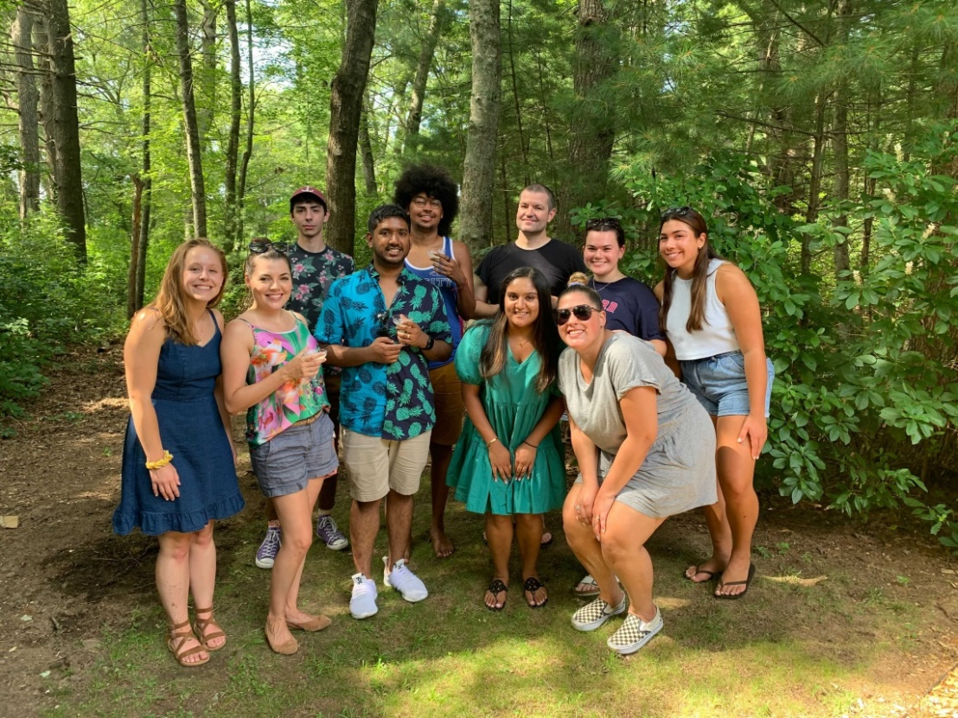




Acknowledgements
Former Graduate Students:
Dr. Alex Labossiere
Dr. Dasith Perera
Dr. Thais Harder DePalma
Dr. Eric Almeida
MS Morgan McPartland
Funding:
RI Foundation Medical Research Fund
RI COBRE - #P20GM104317
RI INBRE Early Career Award – #P20GM103430
NIH – NIDCR #R01DE027958
Collaborators:
Marcelo Freire (JCVI) / Jiyeon Kim (URI)
Jessica Mark Welch (Forsyth)
Samantha King (NWCH)

