Slide 1
Mechanisms underlying spatial interaction in the oral microbiota
Matthew Ramsey, Ph.D.
Department of Oral Immunology and Infectious Diseases
University of Louisville School of Dentistry

Slide 2
We must understand mechanisms of interaction between commensals to exploit them for our benefit.

Slide 3
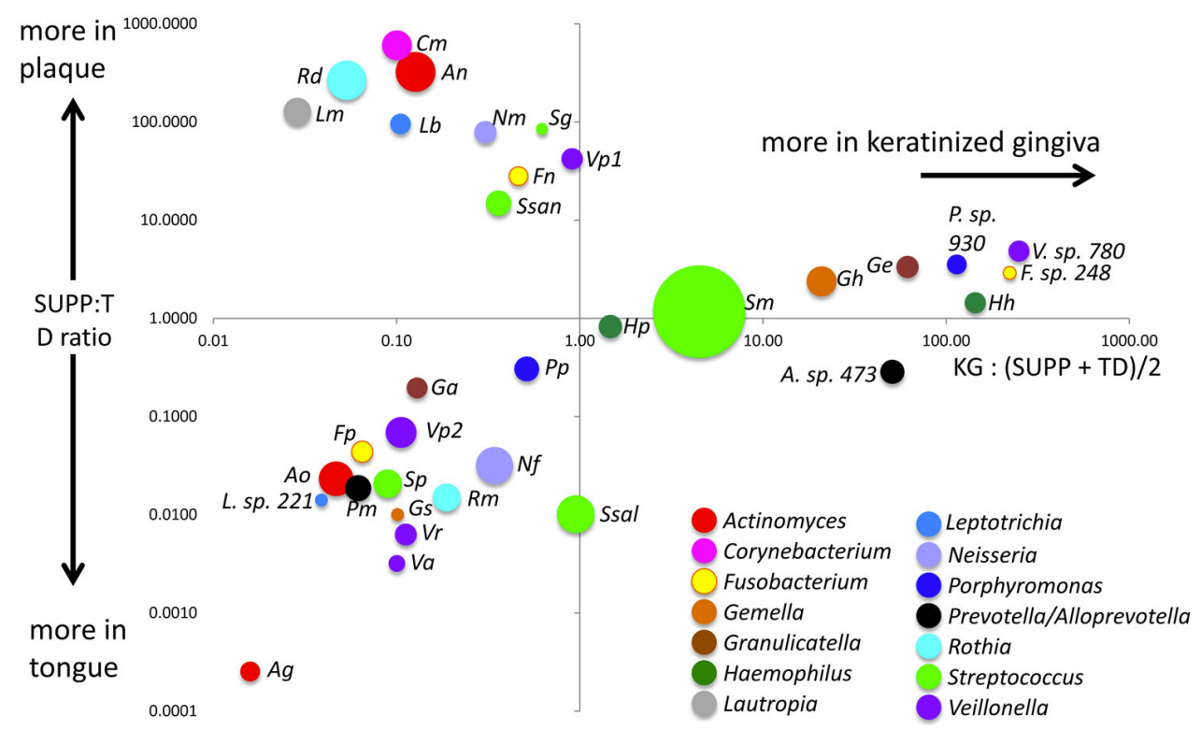
Haemophilus parainfluenzae and Streptococcus mitis
Mark Welch et al., 2019

Slide 4
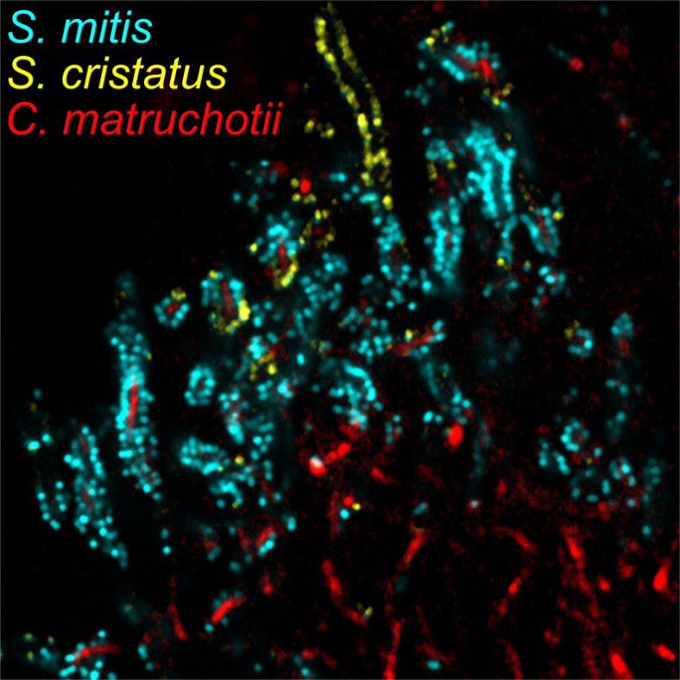
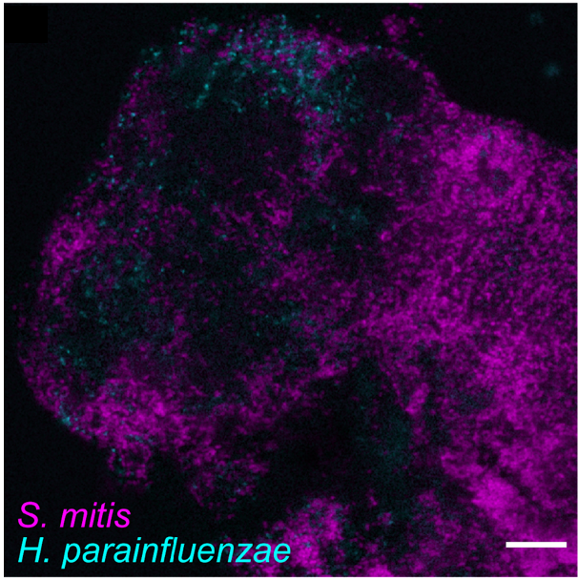
Initial Mechanisms
H₂O₂ detox
H. parainfluenzae
H₂O₂ detox
C. matruchotii
S. mitis
NAD+
lactate
Almeida E, et al (2023) mSystems
Puri S, et al (2023) Analytical Chemistry
Perera D., McLean, A., Mark Welch, J, Ramsey, M. (2021), ISME

Slide 5
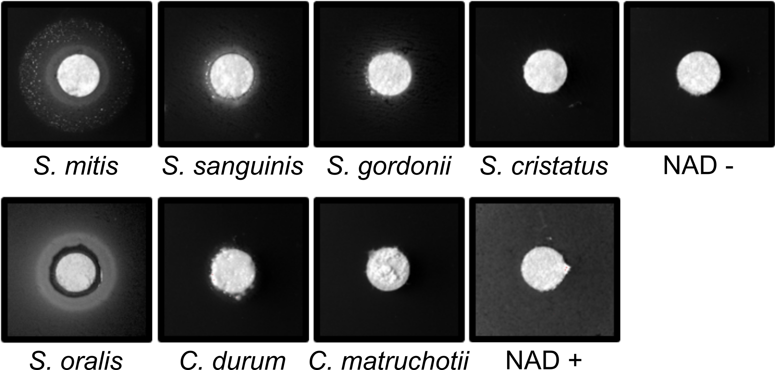
Streptococcal NAD release
Is NAD excreted or released from streptococci via lysis?
Some of the most potent NAD producers we tested are lytA positive
Hypothesis: LytA is the primary method for NAD release
Perera D., McLean, A., Mark Welch, J, Ramsey, M. (2021), ISME

Slide 6
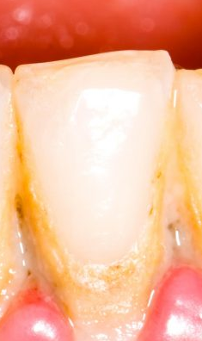
Conversations in a crowd
Metatranscriptomes tell us all the genes expressed per species
They do not tell us who/what these may be in response to
Reductionist experiments can start to address this
Further in vivo/vitro testing is required to validate
in vitro
in vivo
Differentially expressed genes (DEG)
+
CocultureDEG
Hypothesis: in vitro DEG conserved in vivo are due to interactions between the two selected species.

Slide 7
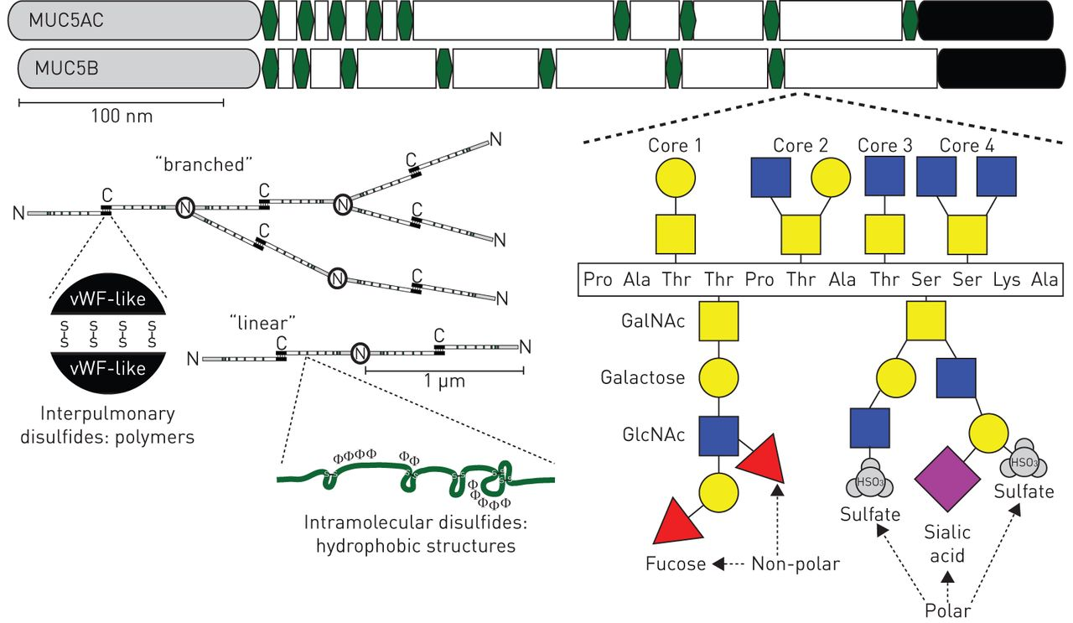
Hypothesis: Cooperative degradation of Muc carbohydrates feeds Sm and Hp
Sialic acid catabolism genes are upgregulated in Hp in coculture with Sm
Numerous carbohydrate catabolism genes upregulated in both species in coculture in vitro and expressed in vivo
Janssen, W., et al. 2016, Euro Respiratory Journal

Slide 8
Let’s grow them on saliva and
Neither Hp or Sm grow on saliva
Let’s use an in vitro model with other species
These have their own issues
  Not SUPP specific
  Most are anaerobic
  Most overgrow plaque pathogenic species

Slide 9
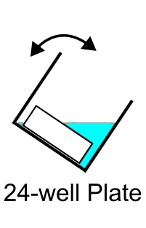
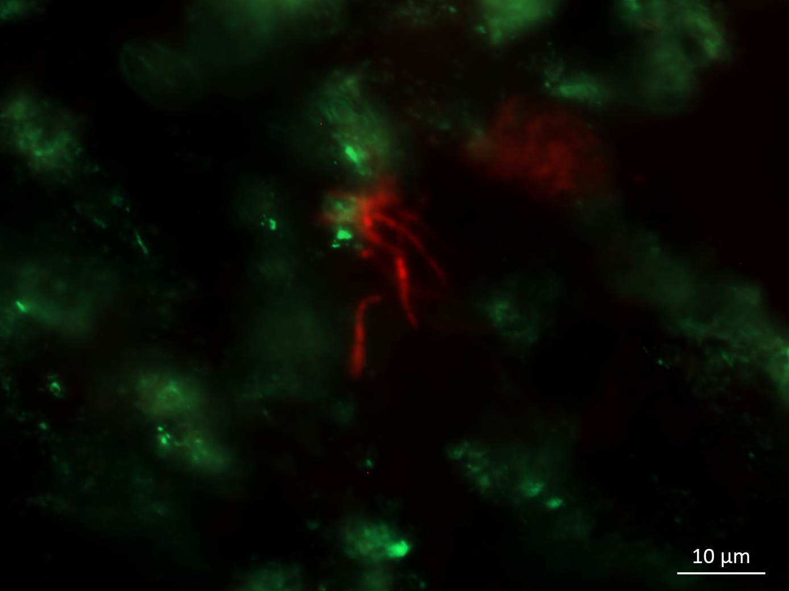
SUPP model with a healthy focus
Aerobic, saliva-coated hydroxyapatite biofilms
Medium conditions iteratively tested based on 16S results vs T0 SUPP inoculum
Shi medium (good)
Saliva-based Neidhardt (better)
Testing saliva preparation, medium replacement intervals, aeration amounts
C. matruchotii
H. parainfluenzae

Slide 10
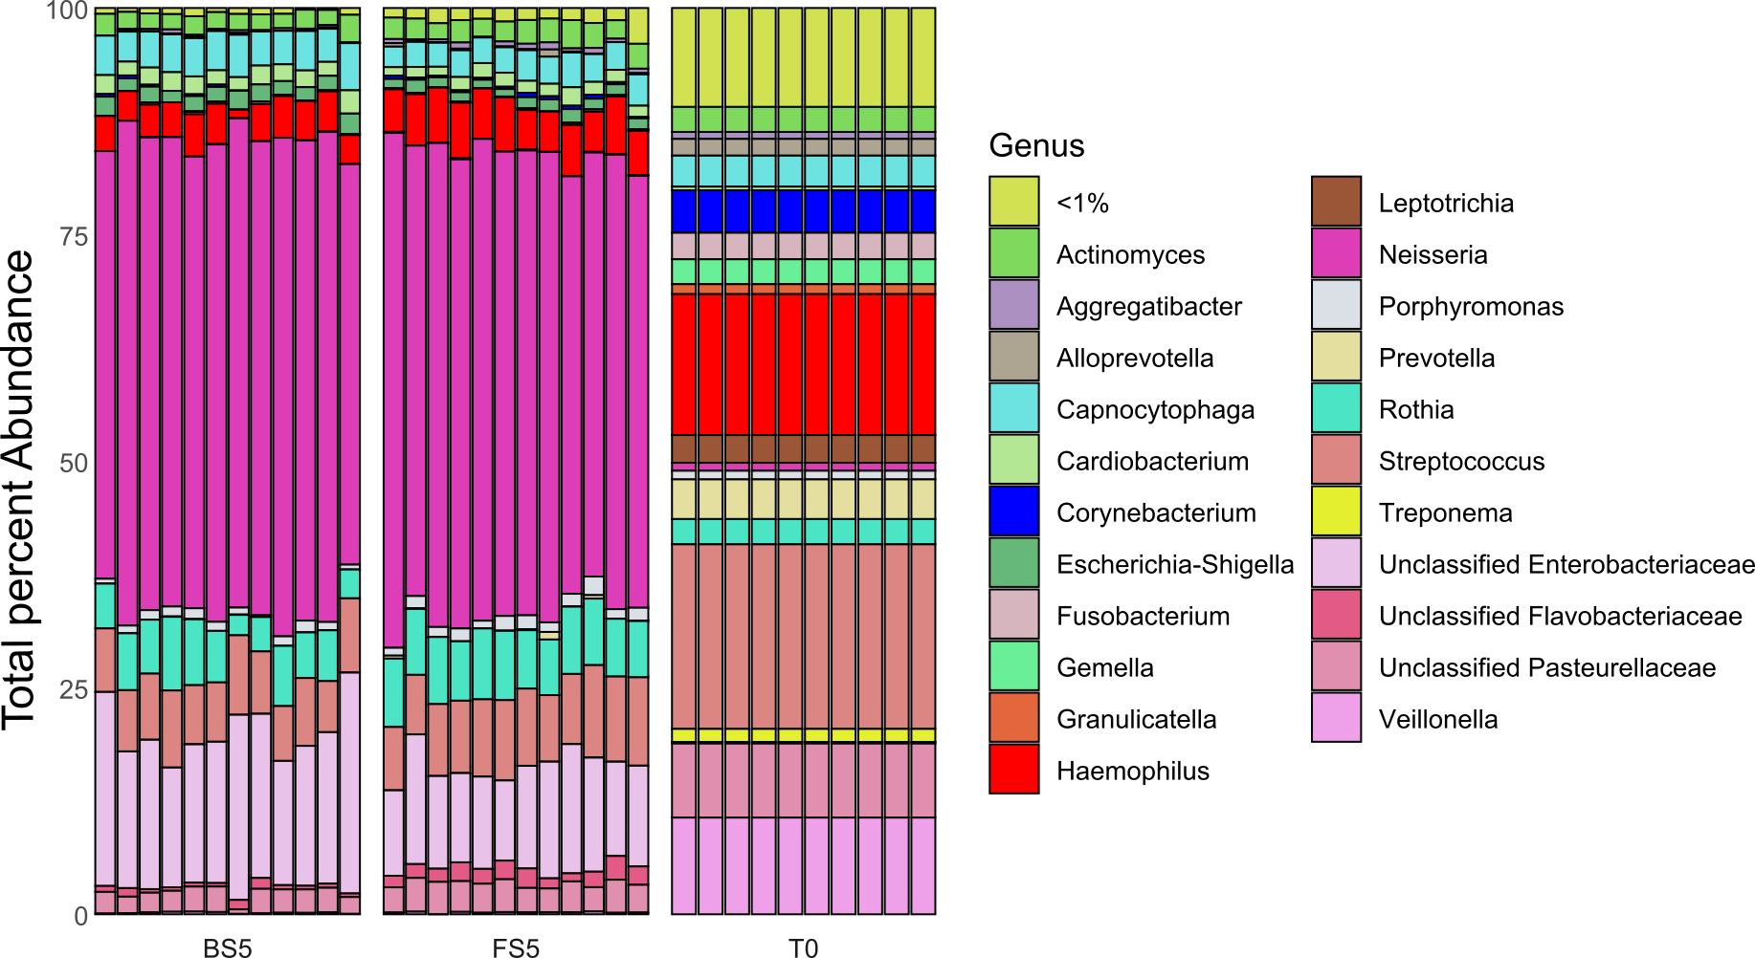
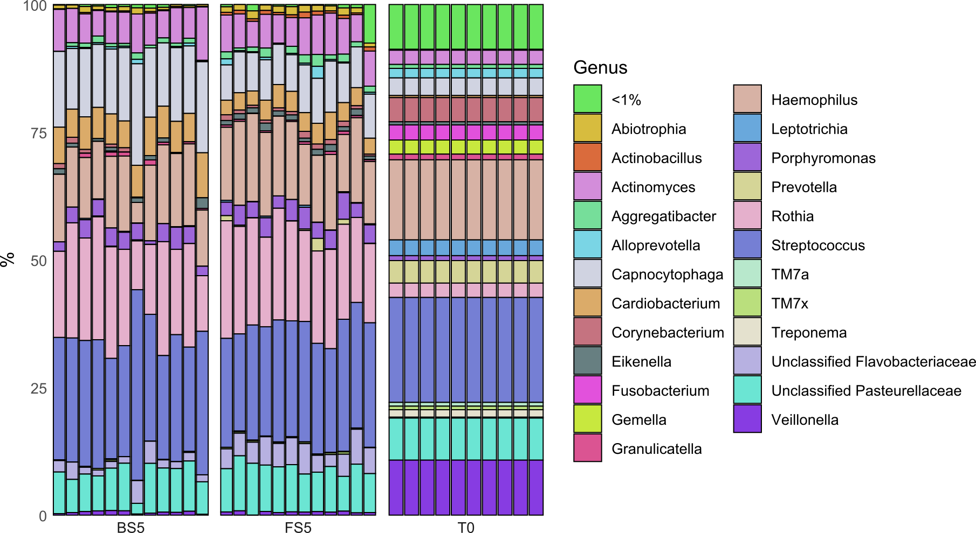
Boiled vs Filtered saliva preparation yields few differences
Only 3 species significantly differed

Slide 11
Sm – Hp coculture future
Collaborative mucin degradation?
We plan to use SECM to monitor NAD/NADH release by Sm
We hypothesize that the lyt system is involved in NAD release
NAD
H. para
S. mitis

Slide 12
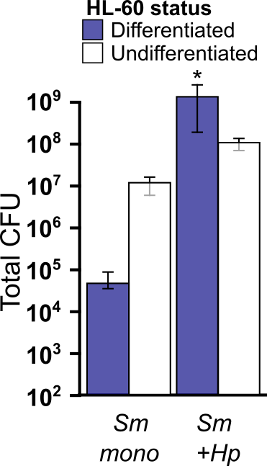
Sm – Hp coculture future
Hp induces Sm to be phagocyte resistant
Hp-Sm interaction causes broad changes in cytokine responses from neutrophils

Slide 13
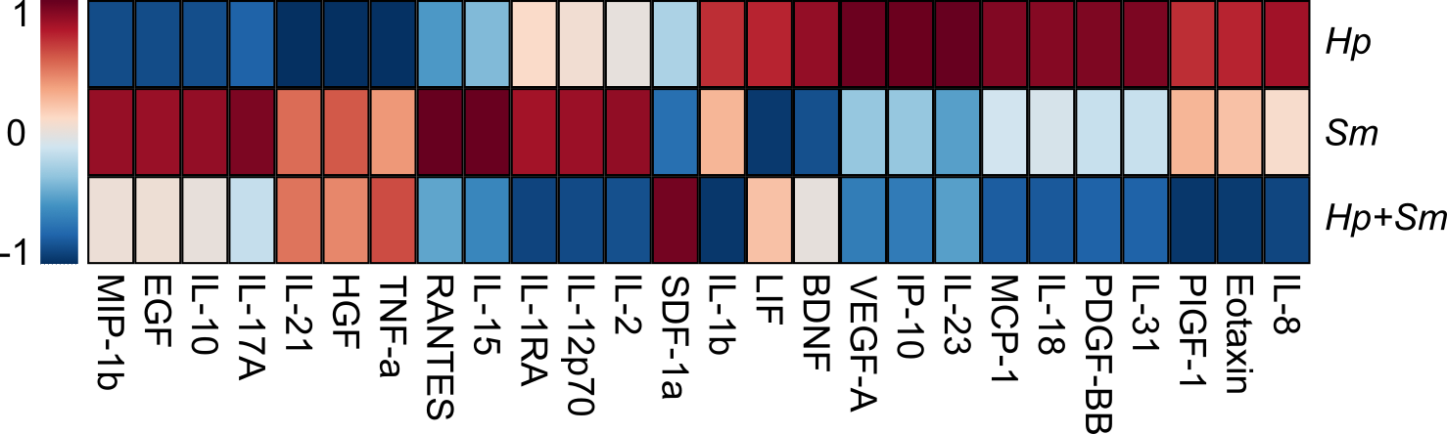
Sm – Hp cytokine changes

Slide 14
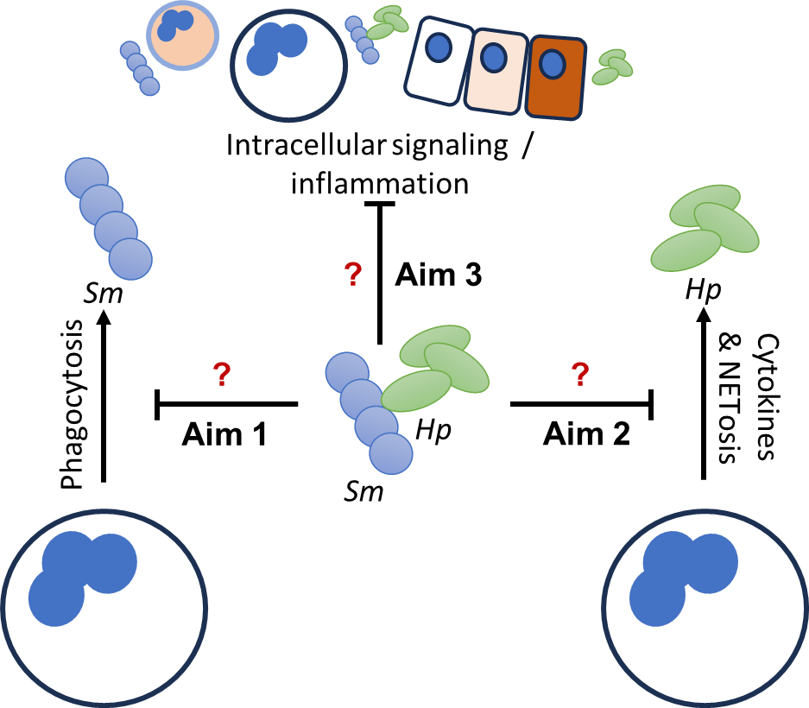
Sm – Hp impact on host immune responses

Slide 15
Future Work
In last iteration of model testing
Fitness testing of mucin-catabolism mutants is next
Many other mechanisms to test here
Expanding mechanistic detection via transcriptomics
Biogeography associations being continued (w/ J Mark Welch lab)
Mechanisms of Streptococcus – Corynebacterium in progress (w/ S King lab)

Slide 16
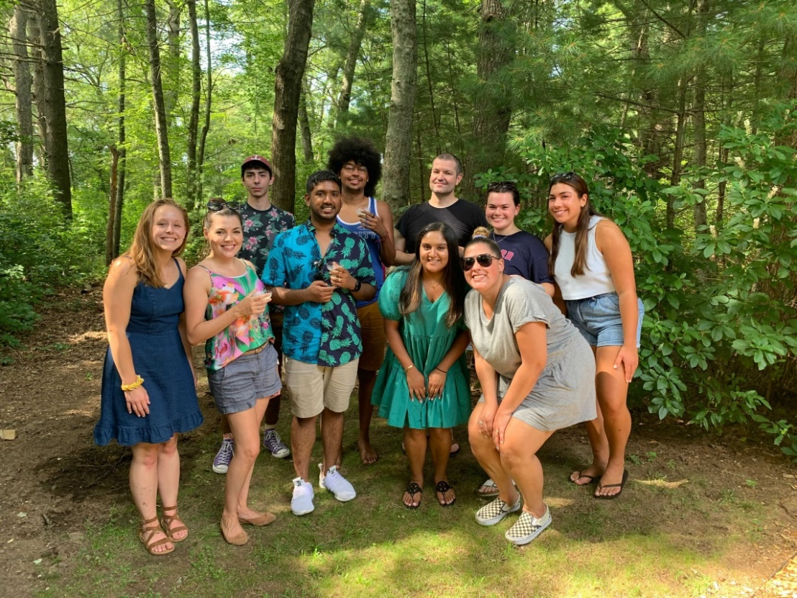




Acknowledgements
Graduate Students:
Alex Labossiere
Funding:
RI Foundation Medical Research Fund
RI COBRE - #P20GM104317
RI INBRE Early Career Award – #P20GM103430
NIH – NIDCR #R01DE027958
Collaborators:
Marcelo Freire (JCVI) / Jiyeon Kim (URI)
Jessica Mark Welch (Forsyth)
Samantha King (NWCH)

