Slide 1

Mechanisms underlying spatial interaction in the oral microbiota
Matthew M. Ramsey, PhD

Slide 2
We must understand mechanisms of interaction between commensals to exploit them for our benefit.
My laboratory studies interactions within supragingival plaque

Slide 3
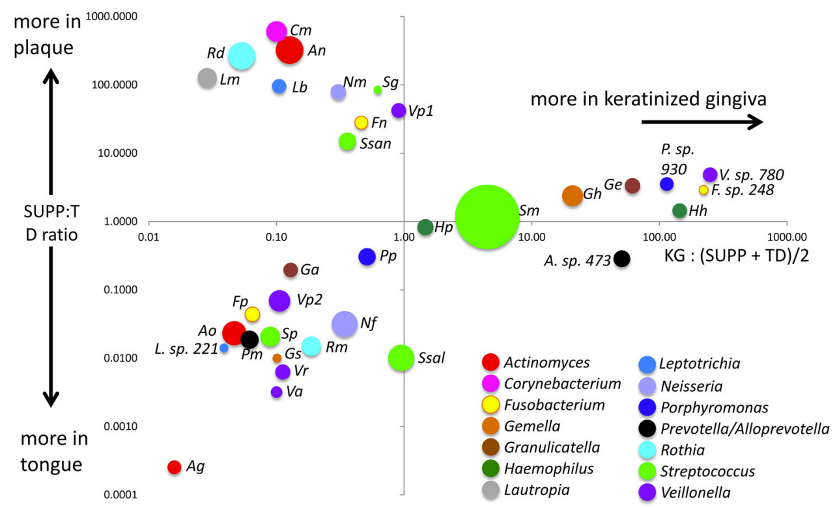
H. parainfluenzae and S. mitis
Mark Welch et al., 2019

Slide 4
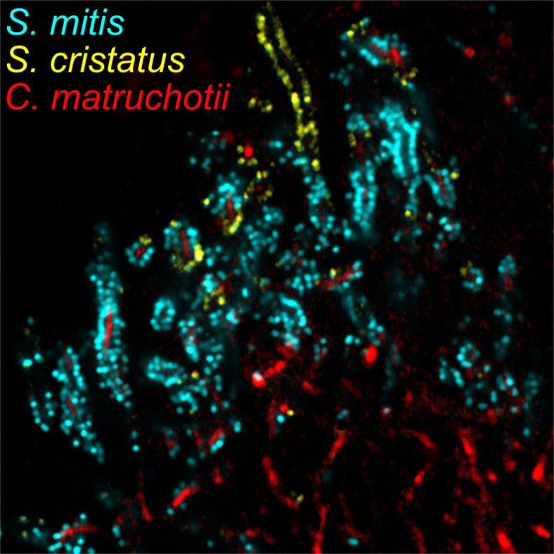
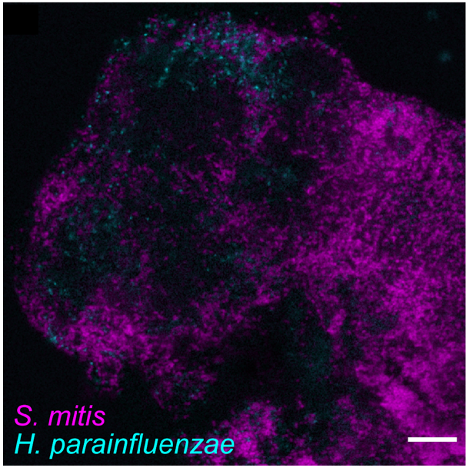
Initial mechanisms
H₂O₂ detox
H. parainfluenzae
H₂O₂ detox
C. matruchotii
S. mitis
NAD+
lactate
Almeida E, et al (2023) mSystems
Puri S, et al (2023) Analytical Chemistry
Perera D., McLean, A., Mark Welch, J, Ramsey, M. (2021), ISME

Slide 5
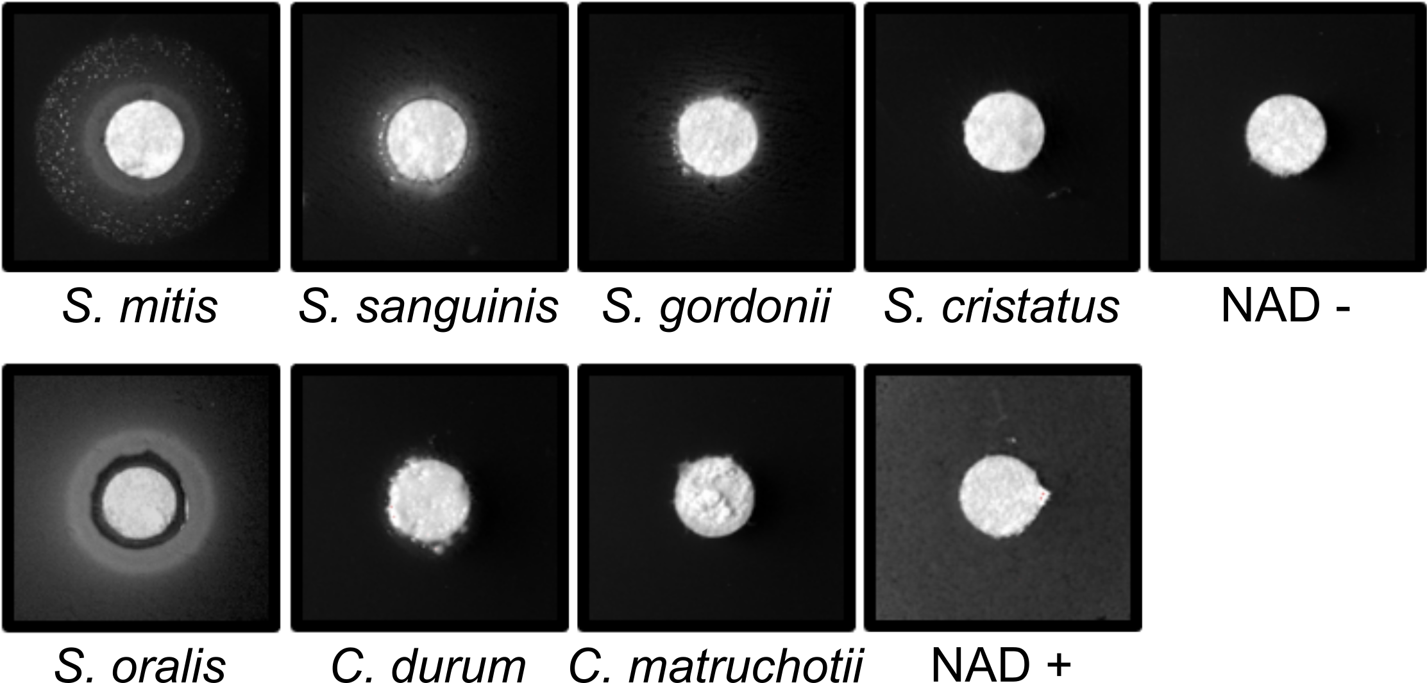
Sm NAD production
Is NAD excreted or released via lysis?
Some of the most potent NAD producers we tested are lytA positive
Hypothesis: LytA is the primary method for NAD release

Slide 6
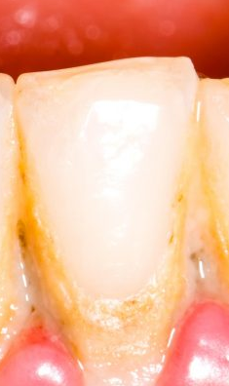
Conversations
in vitro
in vivo
Differentially expressed genes (DEG)
Metatranscriptomes tell us all the genes expressed per species
They do not tell us who/what these may be in response to
Reductionist experiments can start to address this
Further in vivo/vitro testing is required to validate
+
CocultureDEG
Hypothesis: in vitro DEG conserved in vivo are due to interactions between the two selected species.

Slide 7
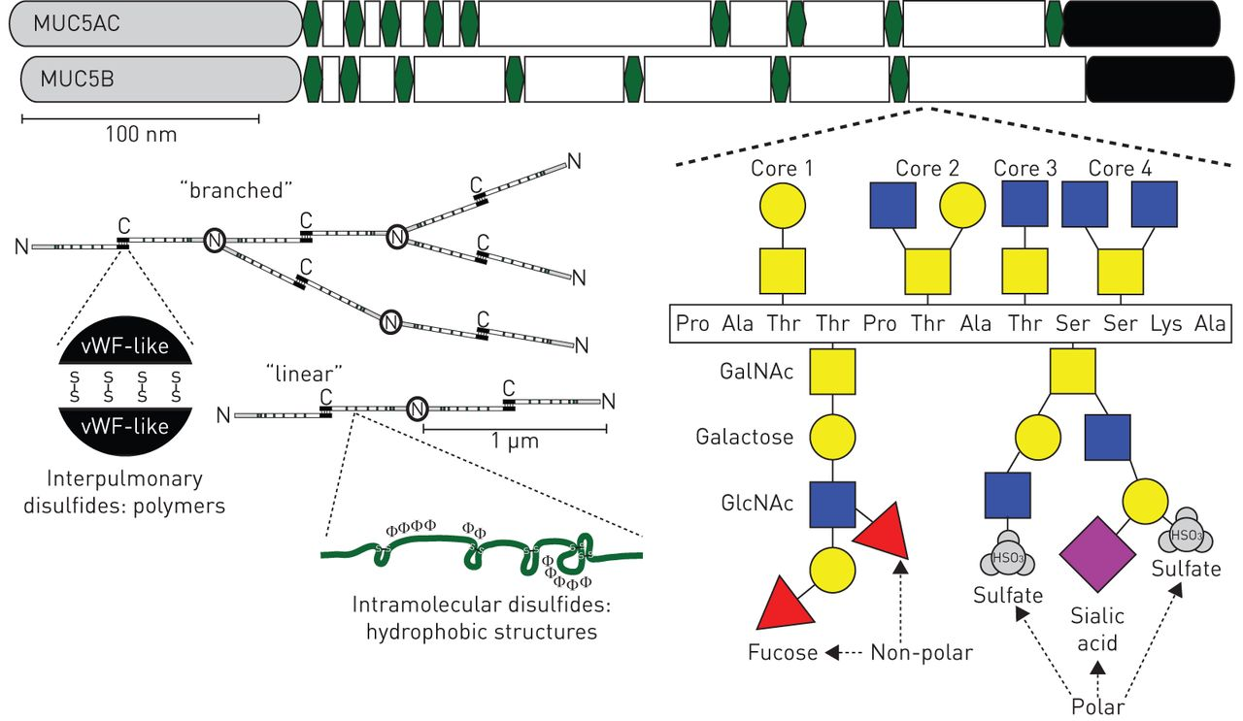
Hypothesis: Cooperative degradation of Muc carbohydrates feeds Sm and Hp
Sialic acid catabolism genes are upgregulated in Hp in coculture with Sm
Numerous carbohydrate catabolism genes upregulated in both species in coculture in vitro and expressed in vivo
Janssen, W., et al. 2016, Euro Respiratory Journal

Slide 8
Let’s grow them on saliva and
Neither Hp or Sm grow on saliva
Let’s use an in vitro model with other species
These have their own issues
  Not SUPP specific
  Most are anaerobic
  Most overgrow plaque pathogenic species

Slide 9
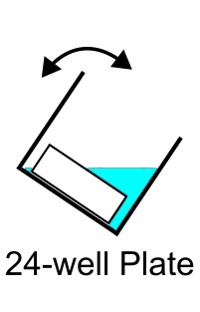
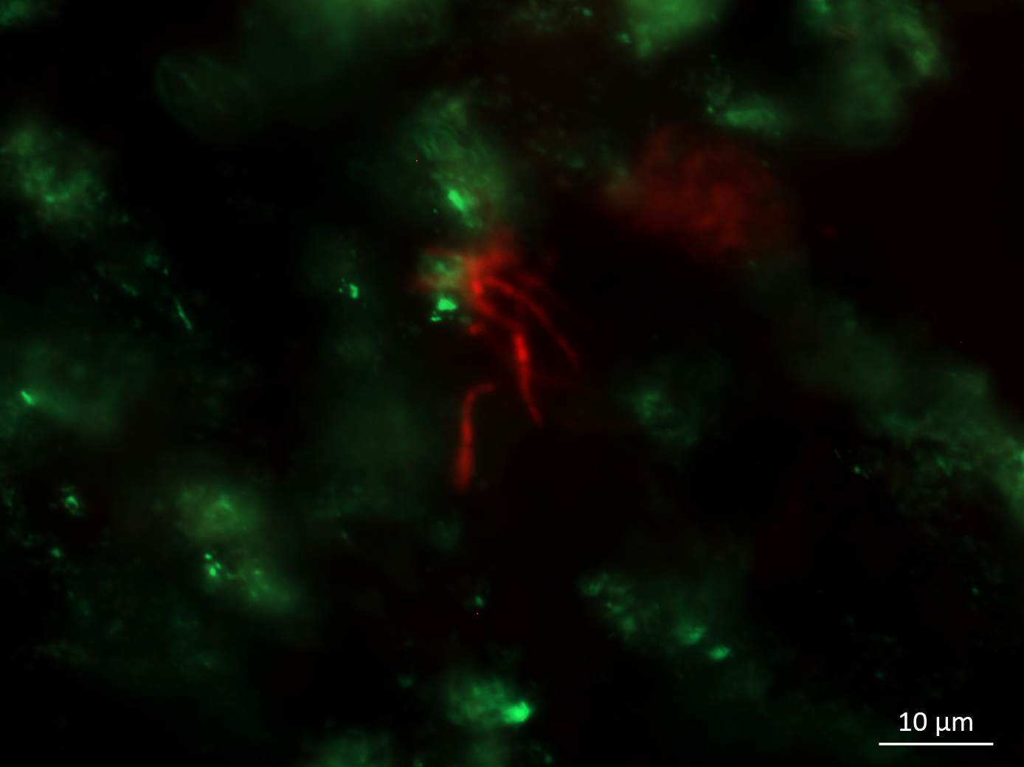
SUPP model
Aerobic, saliva-coated hydroxyapatite biofilms
Medium conditions iteratively tested based on 16S results vs T0 SUPP inoculum
Shi medium (good)
Saliva-based Neidhardt (better)
Testing saliva preparation, medium replacement intervals, aeration amounts
C. matruchotii
H. parainfluenzae

Slide 10
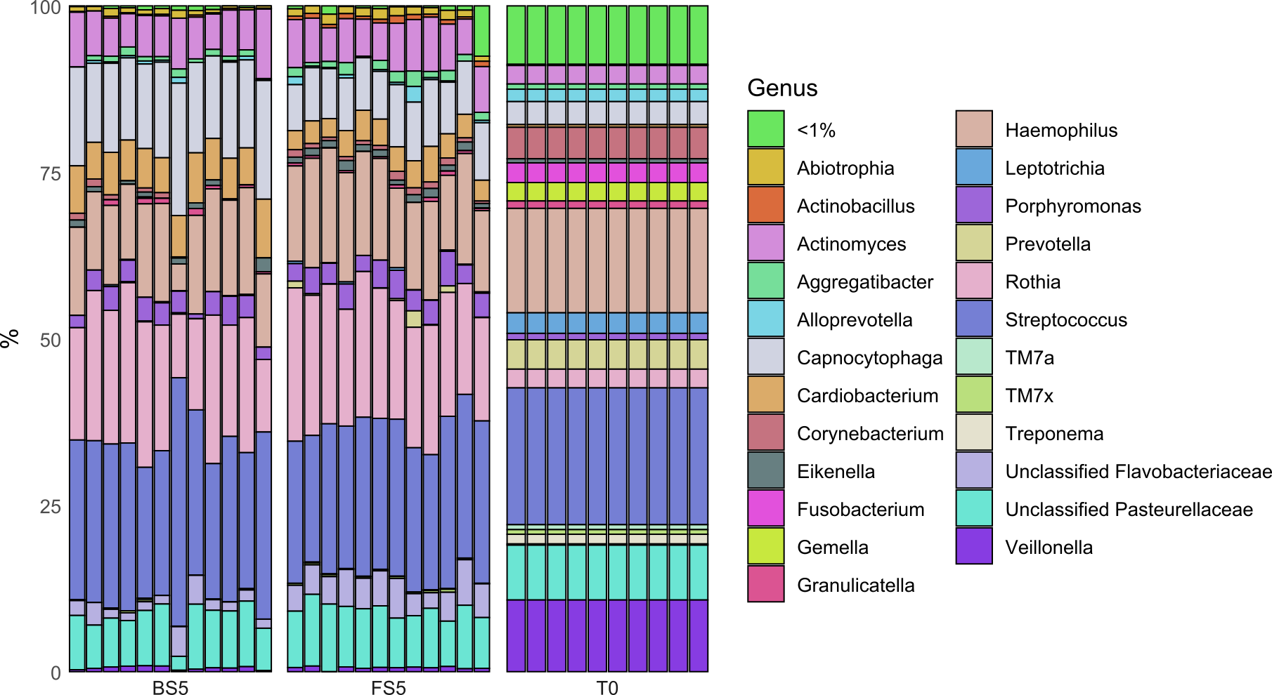
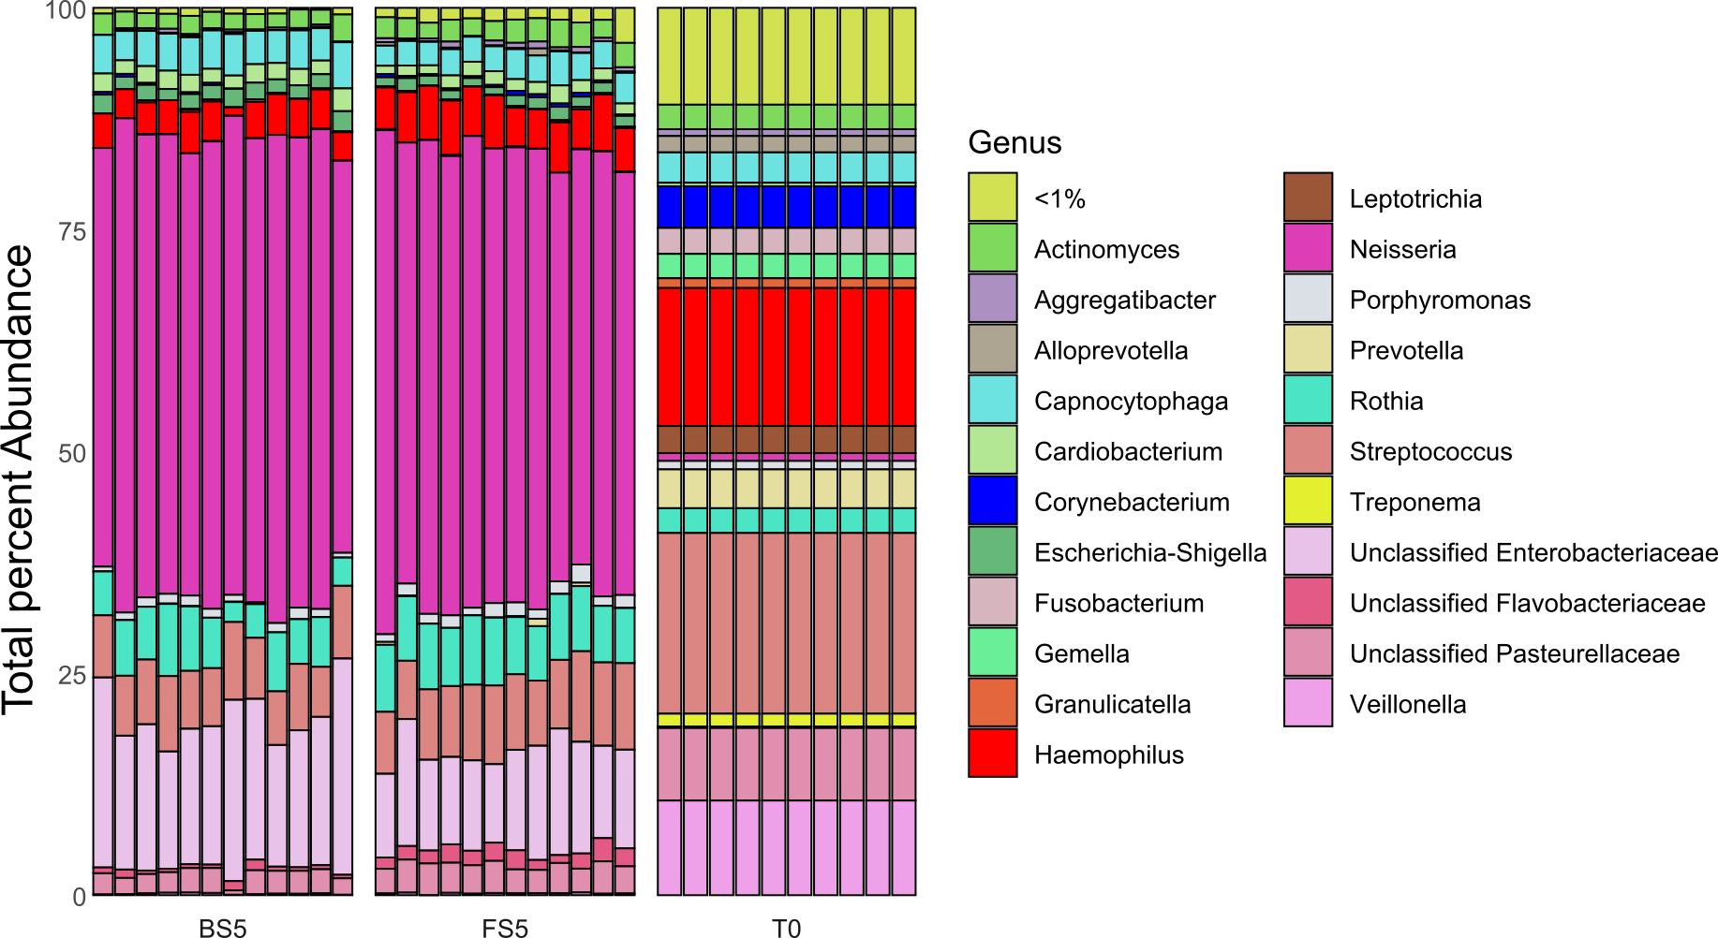
Boiled vs filtered
Only 3 species significantly differed

Slide 11
Future work
In last iteration of model testing
Fitness testing of mucin-catabolism mutants is next
Many other mechanisms to test here
Expanding mechanistic detection via transcriptomics
Biogeography associations being continued (w/ J Mark Welch lab)
Mechanisms of Streptococcus – Corynebacterium in progress (w/ S King lab)

Slide 12
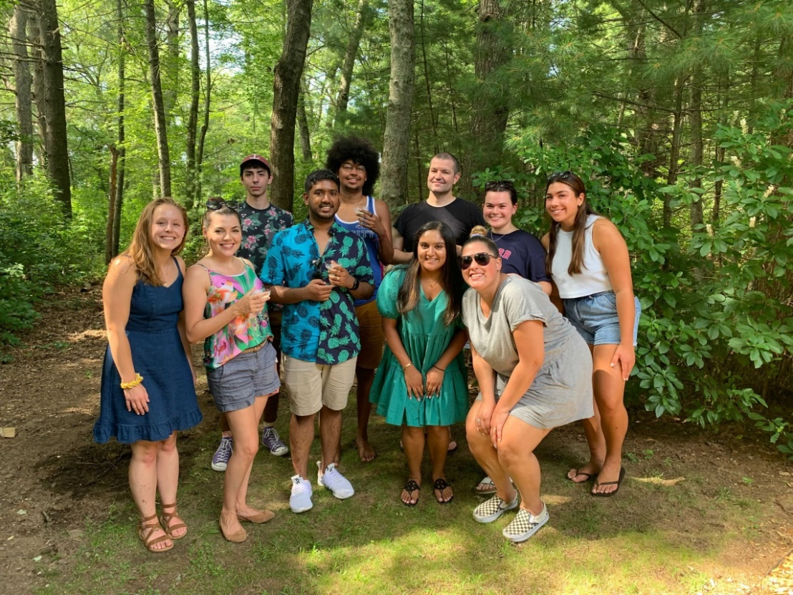



Acknowledgements
Graduate Students:
Alex Labossiere
Funding:
RI Foundation Medical Research Fund
RI COBRE - #P20GM104317
RI INBRE Early Career Award – #P20GM103430
NIH – NIDCR #R01DE027958
Collaborators:
Marcelo Freire (JCVI) / Hatice Hasturk (Forsyth)
Jessica Mark Welch (Forsyth)
Jiyeon Kim (URI)

