Slide 1
Polymicrobial interactions of oral bacteria in subgingival plaque and diabetic foot infections
Matthew M. Ramsey PhD
2024

Slide 2
This is an old project…
I submitted two versions of this, both scored but not funded for a K99/R00
At URI we did not have reliable access to any hospital cohorts needed to make this work.
U of L should be much more feasible for this project.
This is all a bit out of date now and needs a refresh.
I am hoping that this can be ready for an R01 or similar submission around 1 year from now.

Slide 3
Help needed.
I wanted to share this to all to start finding clinical resources (dental and non-dental) and collaborators.
The field has moved forward a bit since 2015 when this was current, but the core of it has not changed or been proven that I have seen.
I’d love to hear suggestions on how to update this across the board.

Slide 4
Diabetic foot ulcer infections (DFIs)
Chronic polymicrobial infections
Microbiota is variable
  Most attention given to major pathogens
  Many studies have identified potential oral taxa
Diabetics are ~3x more likely to develop periodontal infections
Gardner S et al. (2013) Diabetes
Citron DM et al. (2007) J. of Clin. Micro
Notes:
[]add references!

Slide 5
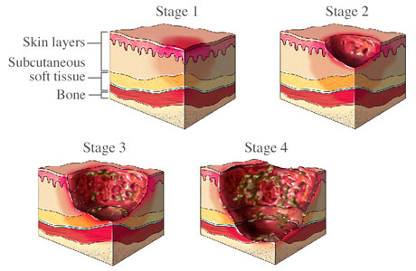
www.gluxus.com

Slide 6
Isolated infection flora is diverse
Many genera that contain oral species are present in DFIs
These include: Prevotella, Porphyromonas, Fusobacterium, Streptococcus and many more
Bowler et al. (1999) Int. J. Derm.
Dowd et al. (2008) PLoS One
Gardner et al. (2013) Diabetes
Citron et al (2007) J. of Clin. Micro
Notes:
Fix this, minimize, add Dowd and Bowler Data

Slide 7
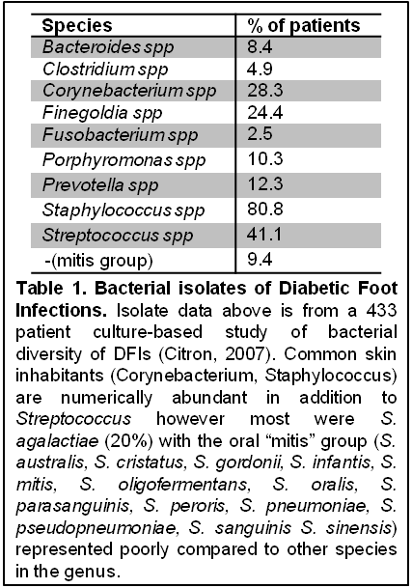
Are oral species present in DFIs in a meaningful context?

Slide 8
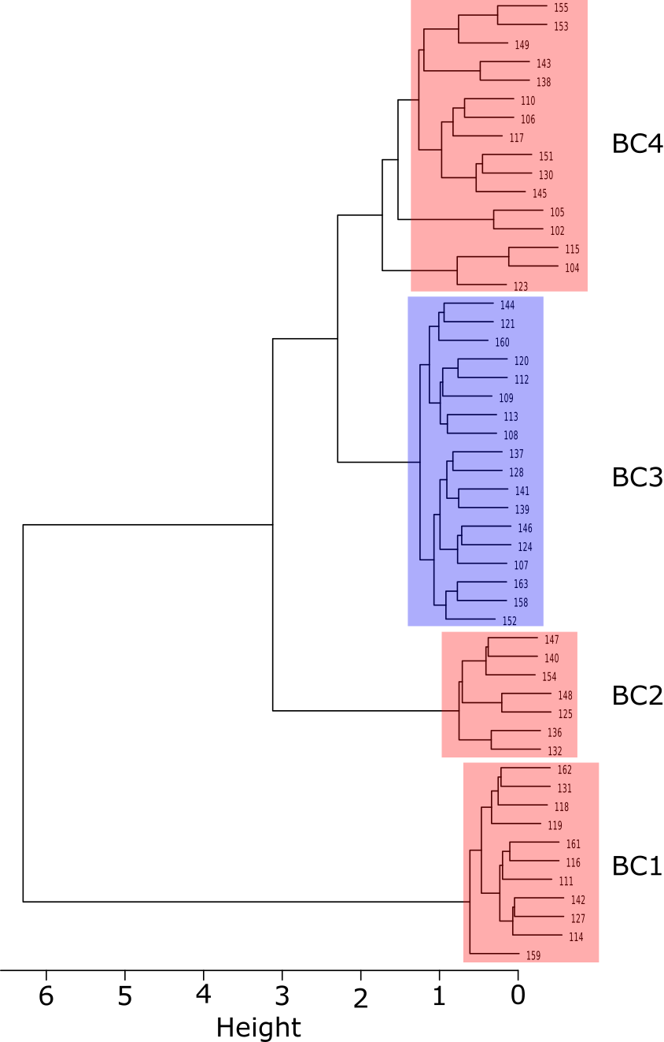
Re-analysis of Gardner et al. (2013) Diabetes
52 patients
~160 species, 83 genera
4 clusters determined by Bray-Curtis dissimilarity
Cluster 3 (18 patients) enriched in anaerobes / oral taxa

Slide 9

BC3 Enriched taxa | LDA (log10)
Anaerococcus | 4.49
lactolyticus | 3.75
vaginalis | 4.06
Atopobium | 3.80
parvulum | 3.06
Bacteroides | 4.47
ureolyticus | 3.86
Dialister | 3.55
propionifaciens | 3.07
Fusobacterium | 4.25
periodonticum | 3.79
Haemophilus | 4.02
parainfluenzae | 3.24
Peptoniphilus | 4.14
asacchyrolyticus | 3.25
HOT836 | 3.28
indolicus | 3.94
Peptostreptococcus | 4.29
anaerobius | 4.26
Porphyromonas | 4.59
bennonis | 3.87
somerae | 4.31
Prevotella | 4.02
bergensis | 3.20
buccalis | 3.29
corporis | 3.28
loescheii | 3.22
nigrescens | 3.41
Solobacterium | 4.06
moorei | 3.40
Figure 1. Minimal entropy decomposition of a 16S rRNA tag dataset from 52 DFIs¹⁵ revealed a Bray-Curtis cluster (BC3) enriched for oral taxa as demonstrated by LEfSe analysis. (A) BC3 (blue) was enriched for vaginal and oral taxa. (B) Linear Discriminate Analysis Effect Size (LDA) scores above a cut-off of 3 for BC3 are listed separately for genera and species and indicate significant differences between BC3 and Bray-Curtis clusters 1,2 and 4. Each species had >1% sequence abundance in at least 1 patient. Each sample had >1000 sequences.

Slide 10
Identity |  | DFI BC3 | DB Perio | DFI | Identity | DFI BC3 | DB Perio | DFI
Actinomyces |  | 0.91 | 1.10 | 0.13 | Parvimonas | 1.56 | 0.33 | 0.38
Bacteroides |  | 4.76 | 0.04 | 0.08 | micra | 1.56 | 0.29 | 0.38
Capnocytophaga |  | 0.33 | *2.58 | *0.00 | Peptococcus | 0.04 | 0.24 | *0.00
Corynebacterium |  | 11.73 | *1.63 | 5.24 | Porphyromonas | 7.01 | 14.82 | *0.32
Delftia |  | 0.13 | 0.07 | 0.34 | Prevotella | 1.91 | *24.17 | 0.38
acidovorans |  | 0.13 | 0.07 | 0.34 | loescheii | 0.07 | 0.28 | *0.00
Dialister |  | 0.36 | 0.19 | *0.00 | melaninogenica | 0.80 | 0.51 | 0.02
Eikenella |  | 0.03 | 0.17 | 0.23 | nigrescens | 0.46 | 4.00 | *0.00
corrodens |  | 0.03 | 0.17 | 0.23 | Propionibacterium | 1.06 | 1.39 | 2.67
Fusobacterium |  | 3.19 | 6.80 | 0.05 | Pseudomonas | 1.37 | 0.23 | 0.72
nucleatum.ss.polymorphum |  | 0.28 | 1.76 | 0.02 | Rothia | 0.94 | 0.16 | 0.21
nucleatum.ss.vincentii |  | 0.10 | 0.94 | 0.02 | Streptococcus | 8.51 | *0.55 | 11.92
periodonticum |  | 1.30 | 0.71 | *0.00 | mitis | 1.38 | 0.55 | 0.79
Haemophilus |  | 0.26 | 0.49 | *0.01 | Veillonella | 0.10 | 0.31 | 0.29
Lachnospiraceae |  | 0.33 | 0.46 | 0.07 | parvula | 0.10 | 0.31 | 0.29
Neisseria |  | 0.33 | *1.15 | 0.32
elongata |  | 0.22 | 0.37 | 0.04
Table 1. A majority of oral taxa have similar relative abundances, as highlighted in blue, in DFIs and in diabetic periodontitis. Values represent average percentage of sequences for each of the genera and species present in both DFI and periodontitis datasets as identified by oligotypes using MED analysis. DFI-BC3¹⁵ = Diabetic foot infection Bray-Curtis cluster 3 (see Fig. 1A), n = 18; DB-Perio³⁴ = type II diabetes periodontitis patients, n = 12; DFI¹⁵ = DFI Bray-Curtis clusters 1,2 and 4, n = 34. Values in blue indicate no significant difference from DFI-BC3. Values in red are significantly different from DFI-BC3. Only 5 out of 32 taxa were significantly different between DFI-BC3 and DB-Perio. All samples used had >1000 sequences per patient. *p = <0.05 Bonferroni corrected Student’s t-test value for each site vs. DFI-BC3.

Slide 11
Many oral species were present at relative abundances similar to those observed in oral studies
Non-oral species in the same genera were also often present

Slide 12

Two Hypotheses
A1. Oral bacteria autoinfect DFIs within individuals
Oral
?
A2. “Hybrid Community”
Oral bacteria maintain molecular mechanistic relationships with non-oral microbes in DFIs
?
Oral

Slide 13
Why do this?
Proving autoinfection might allow for better containment / hygeine practices
Identification of conserved mechanistic relationships in oral bacteria highlight necessary pathways for in vivo survival that can be exploited

Slide 14
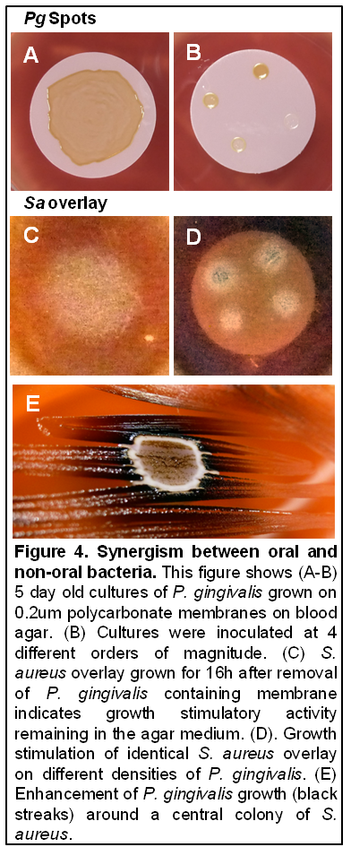
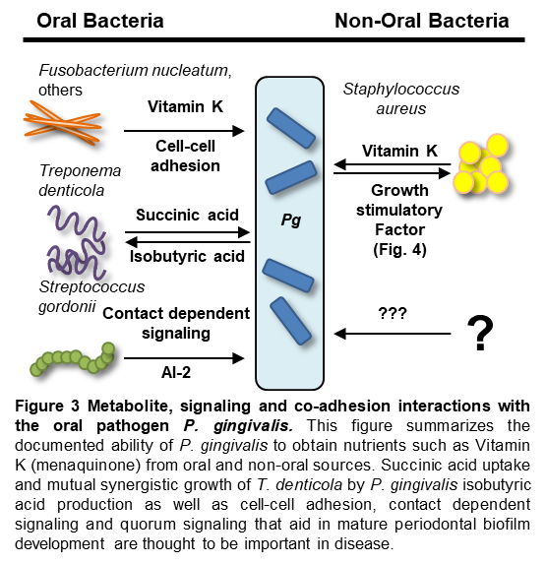

Slide 15
Aim 1 methodology
We need a cohort of DFI individuals.
Sampling = DFI debridement and/or punch biopsy samples.
  Need to consult with clinician for most appropriate
Sampling = Matched oral sampling (dependent on perio status?)
  Need to consult with dentist for most appropriate
  Nasal / rectal swabs useful as well
Samples will be preserved for DNA sequencing (metagenome) and RNA sequencing (metatranscriptome)

Slide 16
A1. Oral bacteria autoinfect DFIs within individuals
If true, we will see clonal matches between DFI and oral samples for some species (ANI, whole genome alignment).
If false, we still would verify oral species of note in DFI for a subset of patients. Further study of their interactions (A2) could be of use.
Sequencing of nasal / rectal swabs may show autoinfection of these sites, less relevant to NIDCR but could be a postdoc project to walk out with.

Slide 17
A2. Hybrid community interactions are conserved
If true this would reveal very important community interactions for human infection orally and extraorally
If false we still would have data useful to treat a sizable portion of DFI patients (~25% have mixed anaerobic infection)

Slide 18
Where to go?
This might be a 2-aim R21 to build the cohort, or expand this with something further.
If an R21 the follow on R01 would likely feature around interaction data we find.
  Immune responses to these interactions would also be an area of study

