Slide 1
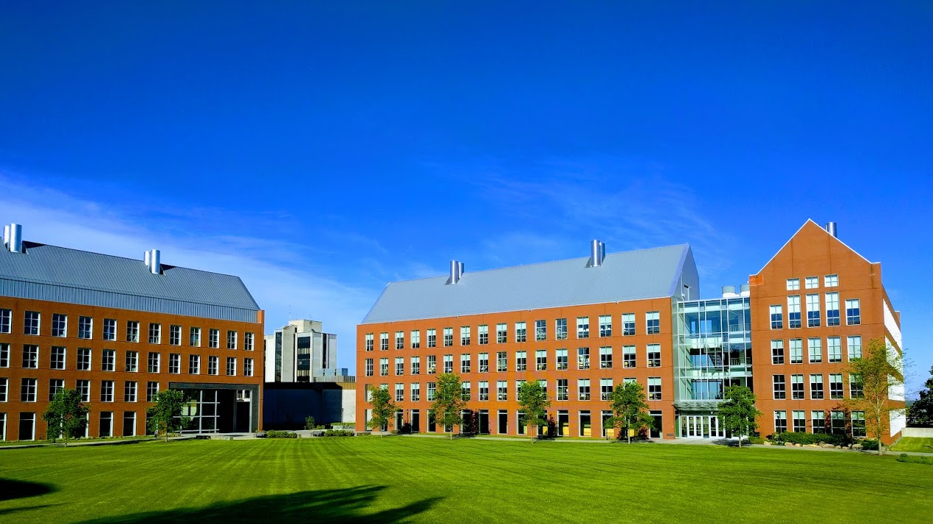

Mechanisms underlying spatial interaction in the oral microbiota
Matthew M. Ramsey, PhD
University of Rhode Island

Slide 2
We must understand mechanisms of interaction between commensals to exploit them for our benefit.
My laboratory studies interactions within supragingival plaque (for now)
How do we choose the right ones?

Slide 3
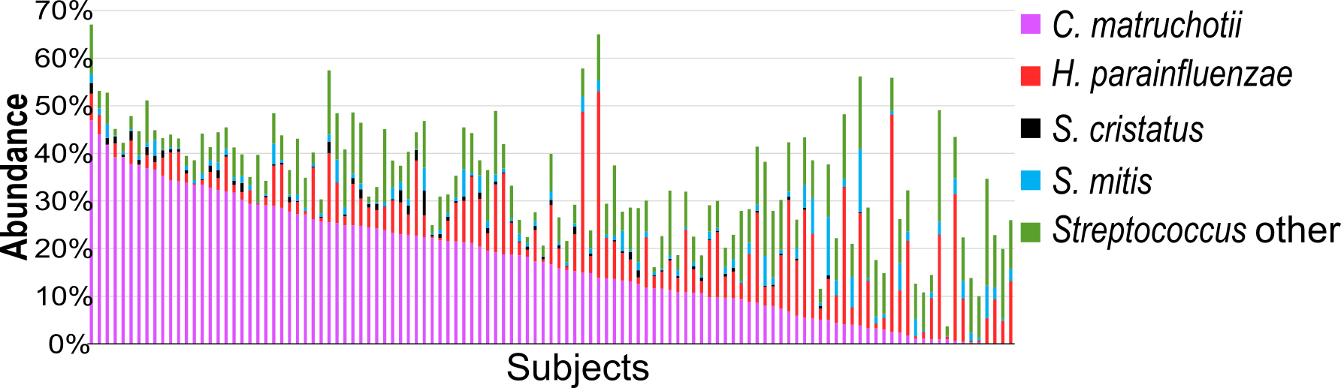
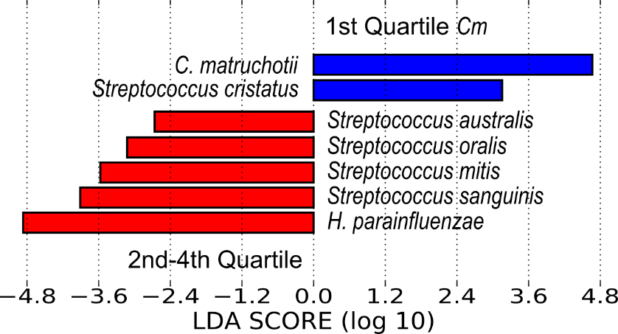
Choosing Pairs

Slide 4
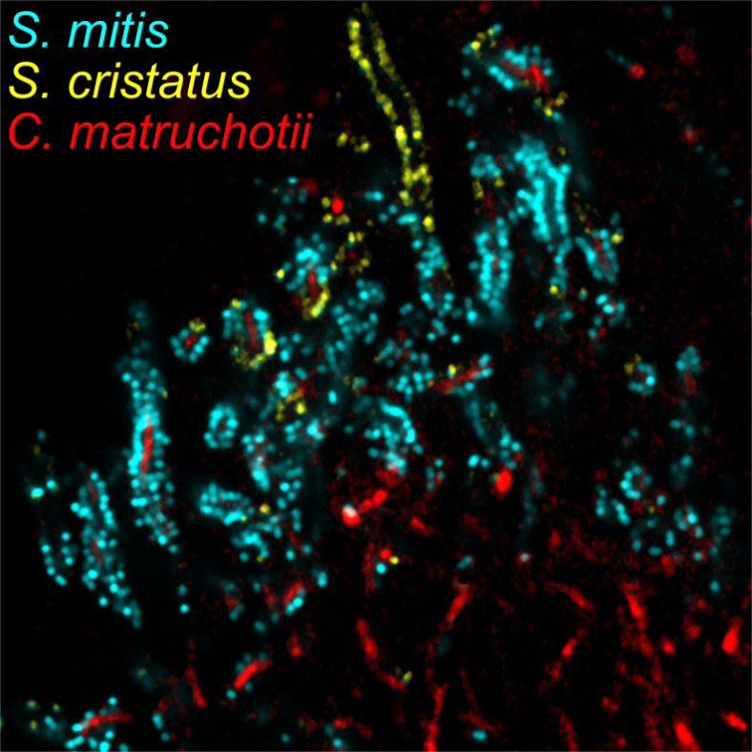
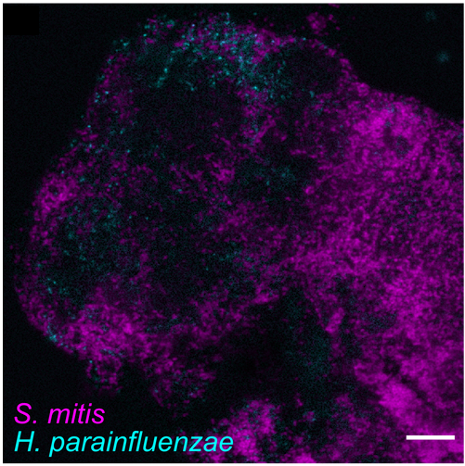
Choosing Pairs

Slide 5
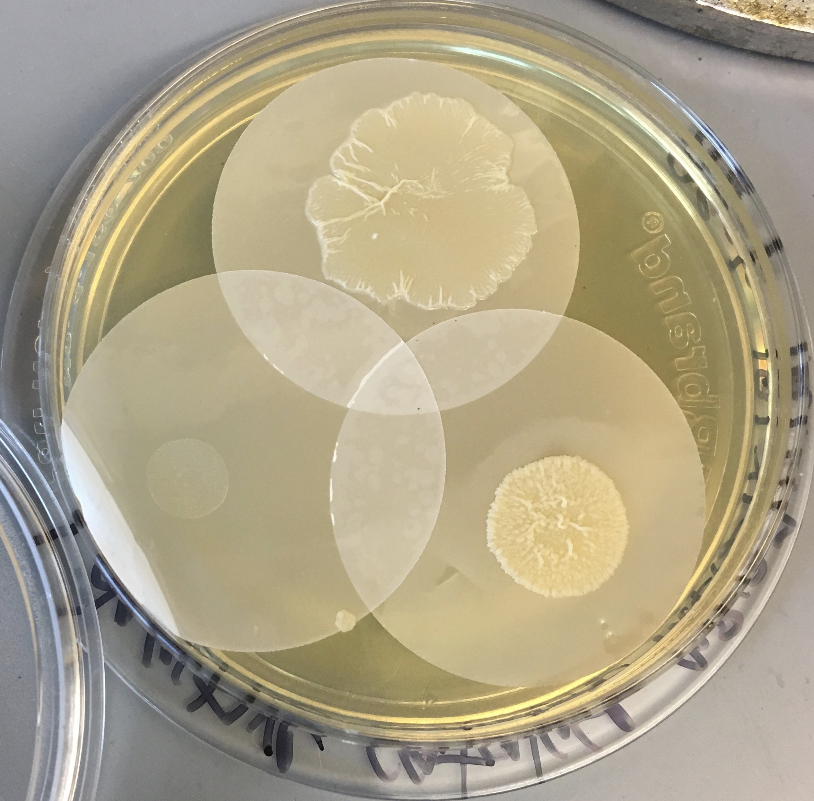
In vitro testing

Slide 6
Aerobic mono vs coculture
H. parainfluenzae
C. matruchotii
S. mitis
Anaerobic mono vs coculture
H. parainfluenzae
C. matruchotii
S. mitis
Perera D., McLean, A., Mark Welch, J, Ramsey, M. (2021), ISME
Almeida, A., et al (2022), bioRxiv

Slide 7
Interactions With Oral Streptococci
?
Lactate
Streptococcus sp.
O₂
Adjacent species
?
H₂O₂
Sugars

Slide 8
Interactions with Streptococcus
H. parainfluenzae
C. matruchotii
Needs NAD+ from adjacent mitis-group Streptococcus
Upregulates potential genes for mucin catabolism
Highly redundant H2O2 defense system
Must consume lactate to help Streptococcus grow
Catalase only H2O2 defense
Potential source of biotin to some Streptococcus

Slide 9
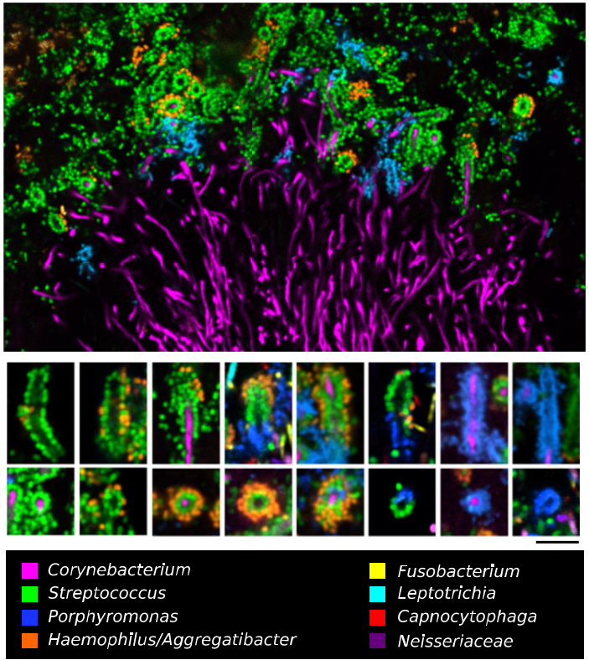

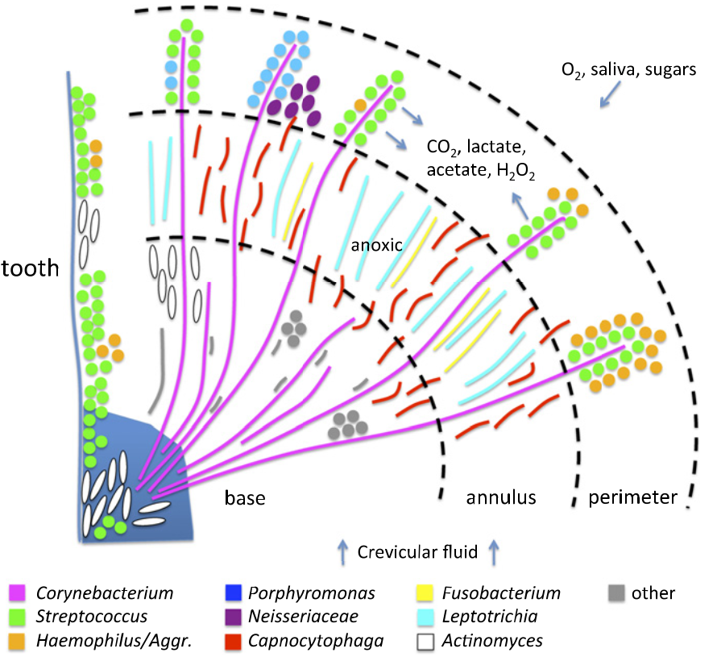
Jessica Mark Welch PhD
Associate Scientist
Marine Biology Lab / University of Chicago. Woods Hole, MA
2011. Valm, Borisy, PNAS.
2016. Mark Welch, Borisy, PNAS.

Slide 10
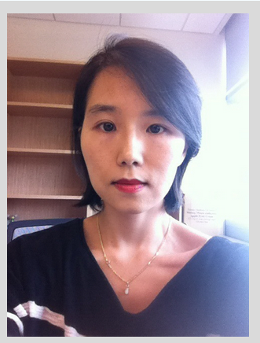
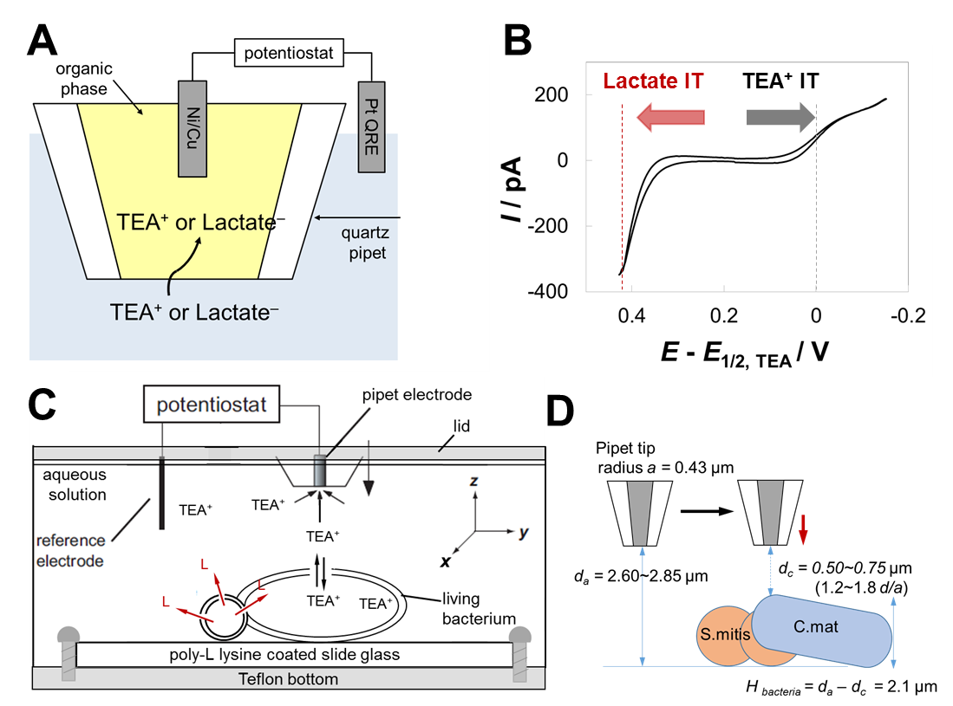
Scanning Electrochemical Microscopy
SECM
Uses current measurement at set redox potential to quantify specific molecules in real-time in 3-dimensions in sub-micron scales
Dr. Jiyeon Kim
URI Dept. of Chemistry

Slide 11
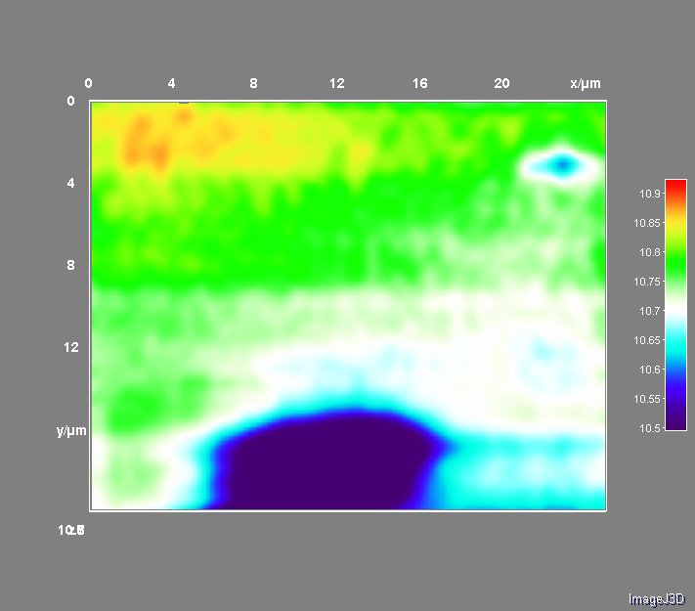
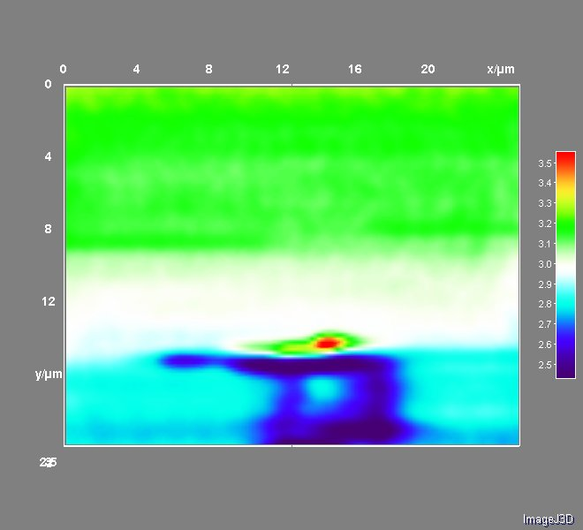
SECM Image with TEA
SECM Image for
Lactate Detection
At d_{a} = 2.85 μm, d_{c} = 0.75 μm (1.8 d/a)
At d_{a} = 2.6 μm, d_{c} = 0.5 μm (1.2 d/a)
I x10
/ pA
I x10
/ pA
S.mitis
C.mat
Demonstrates object presence by lack of permeability to TEA

Slide 12
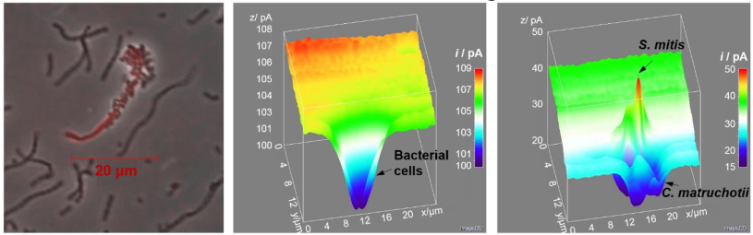
SECM Image for
Lactate Detection
SECM Image with TEA
Almeida et al https://doi.org/10.1101/2022.05.09.491233
Puri et al (in submission @ JACS)

Slide 13
What’s next?
Mucin catabolism
H. parainfluenzae
C. matruchotii
S. mitis
NAD+
biotin
?
Host immune responses

Slide 14




Acknowledgements
Graduate Students:
Eric Almeida
Thais Harder De Palma
Dasith Perera
Alex Labossiere
Funding:
RI Foundation Medical Research Fund
RI COBRE - #P20GM104317
RI INBRE Early Career Award – #P20GM103430
NIH – NIDCR #R01DE027958
Collaborators:
Marcelo Freire (JCVI) / Hatice Hasturk (Forsyth)
Jessica Mark Welch (U Chicago / MBL)
Jiyeon Kim (URI)

Slide 15

C. matruchotii
Gram positive
Facultative anaerobe
Plaque ‘specialist’
Commensal
Eric Almeida

Slide 16

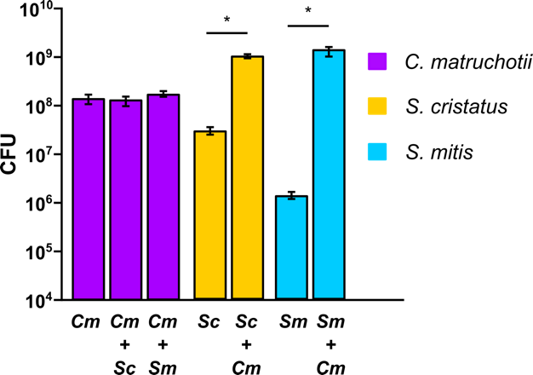
Aerobic cocultures

Slide 17
Why is streptococcal growth increased in the presence of
C. matruchotii?
Hypotheses:
C. matruchotii mitigates streptococcal-produced H₂O₂
  Removal of ROS
C. matruchotii catabolizes streptococcal metabolic end products
  Removal of acid stress

Slide 18
What about lactate?
Cm upregulates the lutABC operon in coculture with either streptococci
ΔlutA deletion strains are deficient in lactate catabolism
Cm ΔlutA and Sm yields decrease in coculture
  Additional pH buffering does not help…

Slide 19
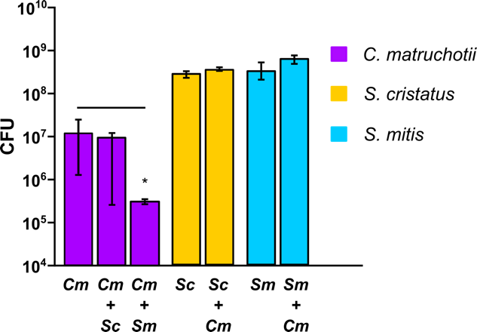
Anaerobic Coculture

Slide 20
Cm interaction summary
H₂O₂ removal enhances S. mitis growth and Cm survival is required for full Sm yields
Lactate utilization by Cm also enhances S. mitis yield and is NOT dependent on pH modulation (not shown)

Slide 21
Why is streptococcal growth increased in the presence of
C. matruchotii?
Hypotheses:
C. matruchotii mitigates streptococcal-produced H₂O₂
  Removal of ROS (TRUE)
C. matruchotii catabolizes streptococcal metabolic end products
  Removal of acid stress (FALSE)

